Slide 1
GDPR, Consent, and Semantic Web
Harshvardhan J. Pandit
Theme-E :: Trinity College Dublin
@coolharsh55 :: harshvardhan.pandit@adaptcentre.ie

Slide 2

PhD Researcher
Research Goal
Use of semantic web technologies to assist with GDPR compliance
https://openscience.adaptcentre.ie/ ← OA publishing of resources
Linking information with clauses of GDPR
Representing information
Activities associated with personal data and consent
Consent metadata
Validating information
Querying information
Build a compliance ‘knowledge-graph’

Slide 3
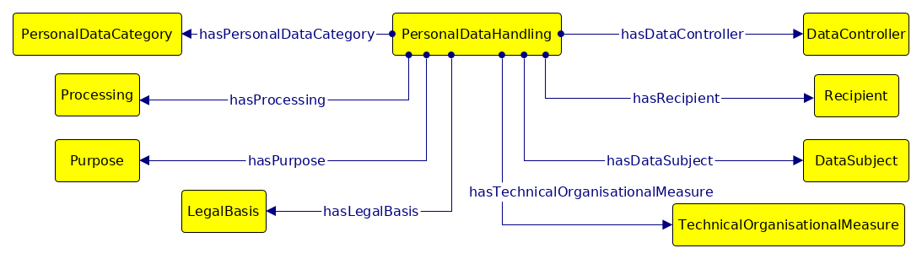
Contributor to DPVCG
Data Privacy Vocabularies and Controls W3C Community Group (DPVCG) https://www.w3.org/community/dpvcg/
A collaboration of academic researchers, legal experts, data protection officials, and industry stakeholders
Goal: standardize vocabulary for “data processing” based on GDPR
Published: Data Privacy Vocabulary (DPV) https://www.w3.org/ns/dpv
Editor of DPV; Acting as co-chair since Jan 2020

Slide 4
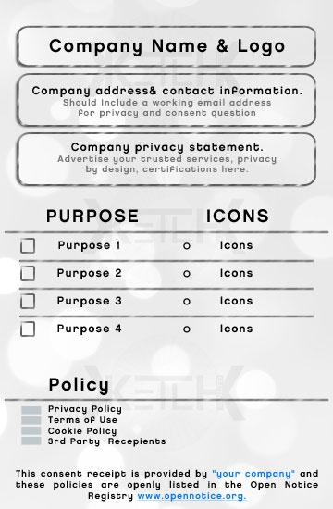
Contributor to Kantara Initiative
Kantara is a non-profit initiative that has developed
Consent Receipt utilised in ISO/IEC DIS 29184 Information technology — Online privacy notices and consent
AdvCIS is a WG within Notice & Consent project
Goal: ‘Global’ specification for consent receipt
Contributor to AdvCIS and DPVCG liason
Editor of Consent Receipt v2

Slide 5

That sums up 2016 - 2020
Harsh
@coolharsh55
harshvardhan.pandit@adaptcentre.ie

