Slide 1
A Common Semantic Model of the GDPR Register of Processing Activities
Paul Ryan¹²³ , Harshvardhan J.Pandit¹⁴ , Rob Brennan¹²
ADAPT Centre,
School of Computing, Dublin City University
Uniphar Plc, Ireland
Trinity College Dublin
Contact : Paul.Ryan76@mail.dcu.ie
1
The ADAPT Centre is funded under the SFI Research Centres Programme (Grant 13/RC/2106) and is co-funded under the European Regional Development Fund.

Slide 2
What is a Register of Processing Activities (ROPA)?
A legal requirement (Article 30 GDPR)
A record of the personal data processing activities being carried out by the organisation
A prescribed minimum content
A critical element for the demonstration of compliance (CNIL France)
2
Notes:
“A Common Semantic Model of the GDPR Register of Processing Activities” looks in detail into a specific area of GDPR and seeks to enable a technical approach to GDPR compliance.
A core requirement for GDPR compliance is the maintenance of a register of processing activities (ROPA). Every organisation must maintain a Register of Processing Activities (ROPA) under Article 30 of the GDPR . This document is a rich repository of the personal data handling carried out by the organisation and is an integral element to the demonstration of GDPR compliance.
In practice most ROPA’s held on excel spreadsheets using regulator provided templates in many organisations
We evaluated these templates

Slide 3
Motivation
Data Protection regulators provide manual templates
Almost half of organisations are using such manual approaches to completion of ROPA (45%) ( IAPP, Trust Arc 2019)
A Semantic Model of ROPA would enable privacy tool-chains & interoperability with external bodies to support accountability
Only 28% of organisations compliant with the GDPR (Cap Gemini,2020)
3
Notes:
“A Common Semantic Model of the GDPR Register of Processing Activities” looks in detail into a specific area of GDPR and seeks to enable a technical approach to GDPR compliance.
A core requirement for GDPR compliance is the maintenance of a register of processing activities (ROPA). Every organisation must maintain a Register of Processing Activities (ROPA) under Article 30 of the GDPR . This document is a rich repository of the personal data handling carried out by the organisation and is an integral element to the demonstration of GDPR compliance.
In practice most ROPA’s held on excel spreadsheets using regulator provided templates in many organisations
We evaluated these templates

Slide 4
An Example of a ROPA Template from an EU Data Protection Regulator (Finland)
Name and contact details
Data Protection Officer (if designated)
Representative (if required)
Purposes of processing
Name and contact details of the joint controller (if required)
Description of the categories of data subjects
Description of the categories of personal data
Categories of recipients
Reference to the personal data processing agreement signed with the processor
Third countries and international organisations to which data is transferred,
Documentation on suitable safeguards for International transfer
Data storage times or the criteria for defining such storage times
A description of the technical and organisational security measures provided for in Article 32, section 1 of the GDPR
how to make this information machine readable?
4
Notes:
A ROPA document is a rich source of the personal data processing activities carried out by an organisation. We identified a set of six English language ROPA templates published by EU data protection regulators which contained a wide variation, scope and granularity for representing similar information. We identified the 43 unique GDPR concept fields across the six templates. This enabled the construction of the most comprehensive domain model of a ROPA to date that included both common and unique ROPA terms

Slide 5
Methodology
We identified 14 ROPA templates from regulator websites
We focused on 6 English language ROPA’s
We identified that they differed greatly
Some contained 12 input fields where as other templates have up to 34 fields
We identified 43 unique fields
Regulator | No. of Fields on Template
Belgium | 34
Cyprus | 12
Denmark | 12
Finland | 13
Luxembourg | 14
United Kingdom | 33
Analysis of templates to identify unique concepts
43 Unique Concepts
5
Notes:
A ROPA document is a rich source of the personal data processing activities carried out by an organisation. We identified a set of six English language ROPA templates published by EU data protection regulators which contained a wide variation, scope and granularity for representing similar information. We identified the 43 unique GDPR concept fields across the six templates. This enabled the construction of the most comprehensive domain model of a ROPA to date that included both common and unique ROPA terms

Slide 6
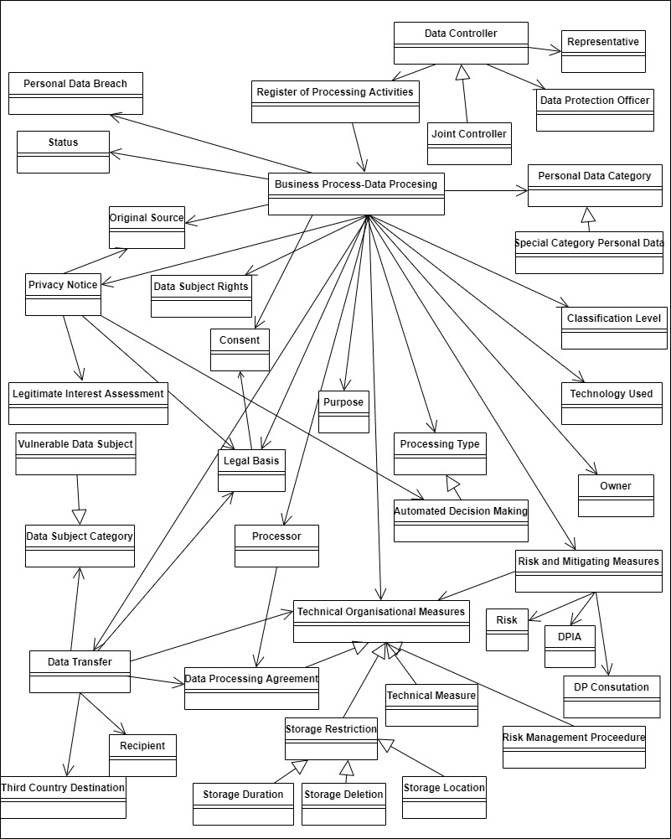
A Semantic Model of ROPA ( Containing the 43 Concepts)
6
Notes:
This enabled the construction of the most comprehensive domain model of a ROPA to date that included both common and unique ROPA terms

Slide 7
What is the Data Privacy Vocabulary ?
The DPV is a vocabulary (terms) and an ontology (relationships) serialised using semantic-web standards to represent concepts associated with privacy and data protection, primarily derived from GDPR
A community specification through the W3C Data Privacy Vocabulary and Controls Community Group (DPVCG).
A machine-readable representation of personal data processing and can be adopted in relevant use-cases such as legal compliance documentation and evaluation, policy specification, consent representation and requests, taxonomy of legal terms, and annotation of text and data.
Links to DPV and community group
https://w3.org/ns/dpv
https://www.w3.org/community/dpvcg/
7

Slide 8
Mapping ROPA Using the Data Privacy Vocabulary (DPV)
Sample of mapping of GDPR Concepts to DPV
GDPR Regulation | Regulator Template GDPR Concept | Mandatory Art. 30 GDPR | Related DPV Concept | DPV mapping outcome | Belgium (34) | Cyprus (12) | Denmark (12) | Finland (13) | Luxembourg (14) | UK (33)
30 | Register of Processing Activities | Y | No DPV Concept | None | Y | Y | Y | Y | Y | Y
30 | DataController | Y | dpv:DataController | Exact | Y | Y | Y | Y | Y | Y
28/30 | Data Categories subject to transfer | N | dpv:PersonalDataHandling, dpv:Transfer, dpv:PersonalDataCategory | Complex, Partial | Y
Summary of mapping success GDPR Concepts to DPV
Match Status | Number of GDPR Concepts
Exact | 14
Partial | 15
Complex/Partial | 3
None | 11
8
Notes:
We mapped the 43 GDPR concepts identified using the Data Privacy Vocabulary (DPV) . We identified that 14 input fields can be fully mapped, 15 can be partially mapped, 3 can be mapped using a complex corresponding match, whilst 11 GDPR concepts cannot be matched as the DPV does not have sufficient expressive power

Slide 9
11 New Concepts Submitted for Inclusion in DPV
Combined ROPA Model Field | Related DPV Concept | Current Status with DPV
Register of Processing Activities | No DPV Concept | Proposed
Controller name and contact details | Many suitable vocabularies | Accepted
Data Protection Officer | No DPV Concept | Accepted
Representative | No DPV Concept | Accepted
The original source of data | No DPV Concept | Accepted
Risk - Information about the risk | No DPV Concept | Accepted
Data Protection Impact Assessment | No DPV Concept | Accepted
Data Subject Rights | No DPV Concept | Accepted
Privacy Notice | No DPV Concept | Proposed
Personal Data Breach | No DPV Concept | Proposed
Prior Consultation with DPA | No DPV Concept | Accepted
9

Slide 10
Conclusions
A first step to developing a comprehensive ontology of ROPAs and information processing that will serve as the basis for intelligent GDPR compliance tools that support machine inference, data federation and integration
We have engaged with the W3C DPVCG to incorporate our analysis towards representing ROPAs using the DPV.
Our analysis and mapping to DPV concepts provides a clear indication of further work in developing the DPV towards representing ROPA’s and its utilisation in the GDPR compliance process
10
Notes:
Our semantic analysis of the ROPA domain is the first step to developing a comprehensive ontology of ROPAs and information processing that will serve as the basis for intelligent GDPR compliance tools that support machine inference, data federation and integration. We have engaged with the DPVCG to incorporate our analysis towards representing ROPAs using the DPV. Our semantic model is a crucial component in this process by providing an indication of necessary fields to map ROPA templates published by EU data protection regulators. In addition, our analysis and mapping with DPV concepts provides a clear indication of further work in developing the DPV towards representing ROPA’s and its utilization in the GDPR compliance process. A completed ROPA map would be a very useful resource that could be used by organisations to link with privacy tools. These tools can be built to query the ROPA and identify areas of non-compliance, and remedy or mitigate accordingly, as part of the accountability framework for an organisation.

Slide 11
Future Work and Directions
Evaluating CSM-ROPA contribution to demonstrating ROPA compliance
Development of Compliance Tools based on CSM-ROPA
Contact: Paul.Ryan76@mail.dcu.ie
11

