Slide 1
An Investigation of Consent Dialogues on Websites
Harshvardhan J. Pandit
School of Computer Science & Statistics
ADAPT Research Centre
Trinity College Dublin
KDEG Seminar Series
2020-JUN-24
CC-by-NC 4.0

Slide 2
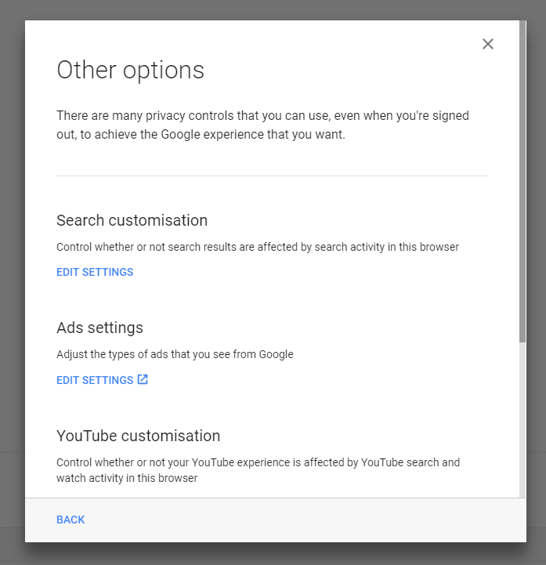
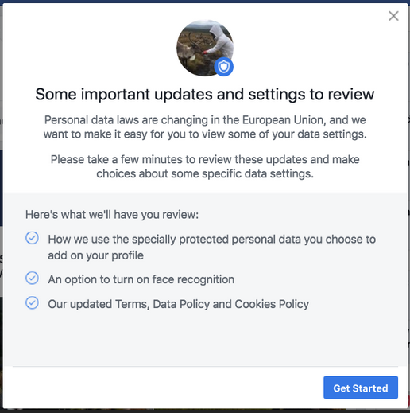
An offer you cannot refuse...

Slide 3
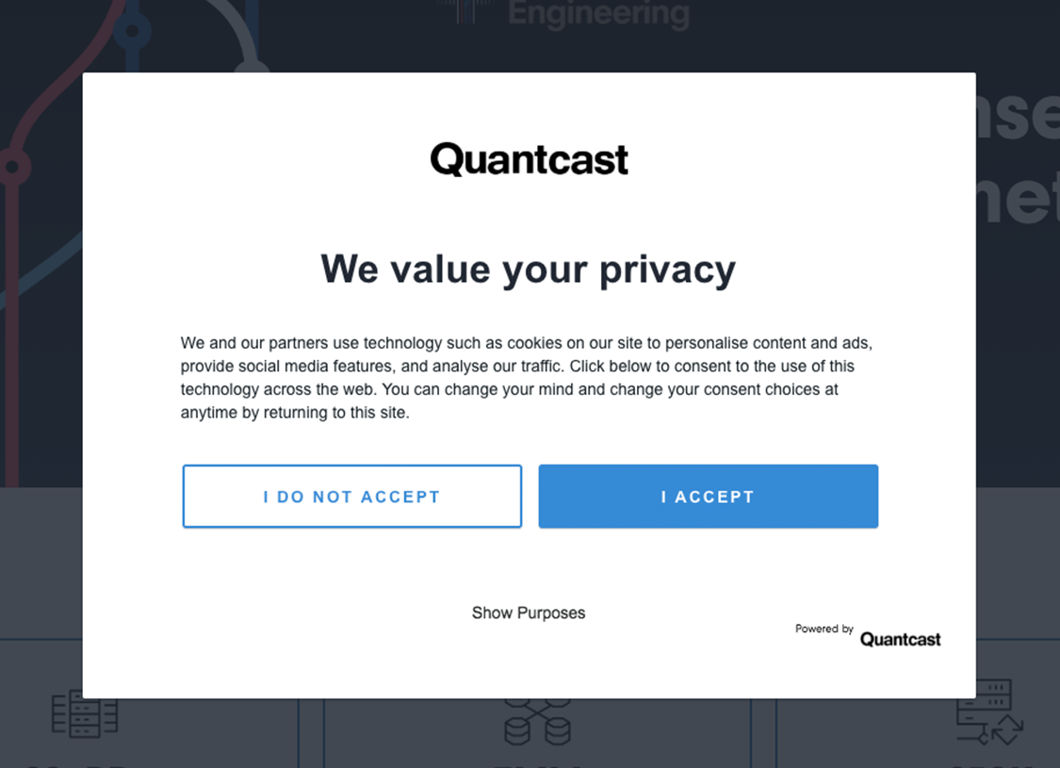
An offer you’re compelled to accept?

Slide 4
Consent Requirements
Freely given
Specific
Informed
Un-ambigious
Revocable / Can be Withdrawn
- GDPR Art. 4-11 (2016)

Slide 5
So what’s happening?
identity
purpose
revocation
Indication of consent

Slide 6
Hello, there... Dark Patterns!
Dark Patterns (https://www.darkpatterns.org/)
Dark Patterns are tricks used in websites and apps that make you do things that you didn't mean to, like buying or signing up for something.
“When applied to consent – does it count as psychological manipulation and make consent invalid?

Slide 7
Some notable observations
Nouwens et al. (2020) scraped five most popular consent dialogue providers on top 10,000 UK websites and found that dark patterns and implied consent are the norm – while only 11.8% were GDPR compliant.
Human and Cech (2020) investigated sociological dimensions of consent and found GAFAM policies contained several variations of dark patterns in interaction design, visual design and textual descriptions
Matte et al. (2020) list dark patterns within the IAB framework – largest ad networks on the internet – and showed that websites do not respect consent choices and collect data anyway
Santos et al. (2020) expand on the above work and show (opine) “it’s not possible to fully assess compliance with the law for the majority of requirements because of the current architecture of the Web”

Slide 8
Why should I / YOU / WE care?
Lets assume all data collected is used to provide better ads / personalisation / benefits
This involves creating user profiles that identify attributes about age, sex/gender, interests
Raw data: collecting everything – location, call records, apps installed, purchase history
Inferred data: correlate raw data using algorithms to identify required attributes e.g. demographics
So far, so good...

Slide 9
Why should I / YOU / WE care?
You don’t want to be surveiled, you don’t want the benefits – is that a right we have?
Is this data accurate? Am I really a – female, housewife, 45-50 age, mother of 2? (as you can see/tell – no.)
Who else is accessing this data? For what purposes? (Cambridge Analytica is the tip of the iceberg)

Slide 10
So why consent on websites?
Is the most closest to end-users / individuals
Can also be applied to smartphone apps
Legal requirements are (relatively) clear / known
Information is (relatively) transparent and accessible making research easier
Smaller case laws have larger implications (snowball effect: if you cannot touch anyone without permission, you cannot slap anyone without permission)

Slide 11
Okay … I’m in. Let’s do this!
Legal requirements talk about abstract dimensions of consent e.g. freely given
Real-world delves with UI/UX paradigms
We need to close the gap between the two
Legal Scholars – legal interpretations
Sociologists – social expectations
Psychologists – behaviour analysis
Computer Scientists – let’s automate that! (that’s a joke – the real reason is to analyse the underlying technological implementations)

Slide 12
Machine-readable metadata?
Indicate the contents of consent for inspection
Clear, precise (in terms of being present)
Standardisation
Legal Impetus??? ← lacking currently
ISO/IEC 29184 provides some direction

Slide 13
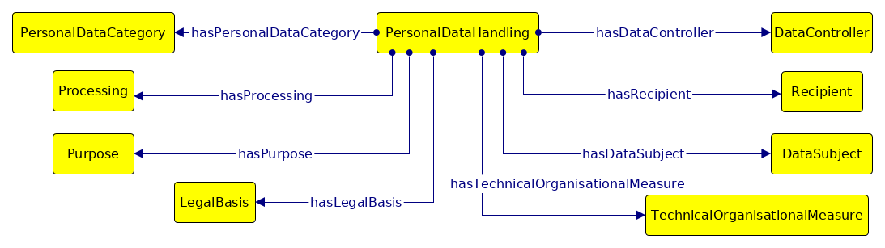
Data Privacy Vocabulary
https://www.w3.org/ns/dpv

Slide 14
Consent Receipt
Record of consent interactions – given, offered, withdrawn, refused – whatever, just log it
Proof !!! Websites cannot claim consent if you have a consent receipt that says otherwise
Specification (outdated)
ISO/IEC published 29184 (2020-06) listing requirements for consent dialogues and mentioning possibility of machine-readable metadata
ISO/IEC announced 27560 as an upcoming standardisation effort for consent receipts

Slide 15
that’s all, folks!
An Investigation of Consent Dialogues on Websites
Harshvardhan J. Pandit
School of Computer Science & Statistics
ADAPT Research Centre
Trinity College Dublin
KDEG Seminar Series
2020-JUN-24
CC-by-NC 4.0

