Slide 1
Data Privacy Vocabulary (DPV)
Harshvardhan J. Pandit
IRC Postdoctoral Research Fellow

Slide 2
Introduction: Expertise in GDPR and Semantics
PhD: GDPR x Semantic Web x Provenance → ADAPT Theme-E / EPWG
2016 - 2020 :: Data Governance, Legal Compliance, GDPR
Vocabularies, Ontologies → Representation, Querying, Validation^{d}
Open Sourced all work and resources http://openscience.adaptcentre.ie/
Focus:
Machine-readability - automation, interpretation, checking, verification
Interoperability - use it across systems, platforms, services, vendors, organisations
Standards - stability, agreement, commonality, interoperability
Outcomes:
GDPRtEXTª: taxonomy of GDPR, expose legislation as linked data
GDPRov^{b}: provenance of activities related to personal data and consent
GConsent^{c}: ontology for information related to consent based on GDPR
a GDPRtEXT https://w3id.org/GDPRtEXT/ “GDPRtEXT - GDPR as a Linked Data Resource” Pandit et al. (2018) https://doi.org/10.1007/978-3-319-93417-4_31
b GDPRov https://w3id.org/GDPRov “Queryable Provenance Metadata For GDPR Compliance” Pandit et al. (2018) https://doi.org/10.1016/j.procs.2018.09.026
c GConsent https://w3id.org/GConsent “GConsent - A Consent Ontology based on the GDPR” Pandit et al. (2019) https://doi.org/10.1007/978-3-030-21348-0_18
d “Test-driven Approach Towards GDPR Compliance” Pandit et al. (2019) https://doi.org/10.1007/978-3-030-33220-4_2

Slide 3
Data Protection Vocabularies and Controls Community Group (DPVCG) https://www.w3.org/community/dpvcg/
DPVCG is: a community of practitioners from various domains: legal, research, industry, privacy, academic, authorities
Started in 2018 under the EU H2020 SPECIAL Project (2017 - 2019)
Joined as a Member in Sep 2018 with support from ADAPT as part of PhD research undertaken regarding GDPR compliance
DPVCG creates a common vocabulary for specifying information about how personal data is processed and used based on GDPR
Current responsibilities:
Co-Chair (since Jan 2020)
Author / Maintainer of deliverables

Slide 4
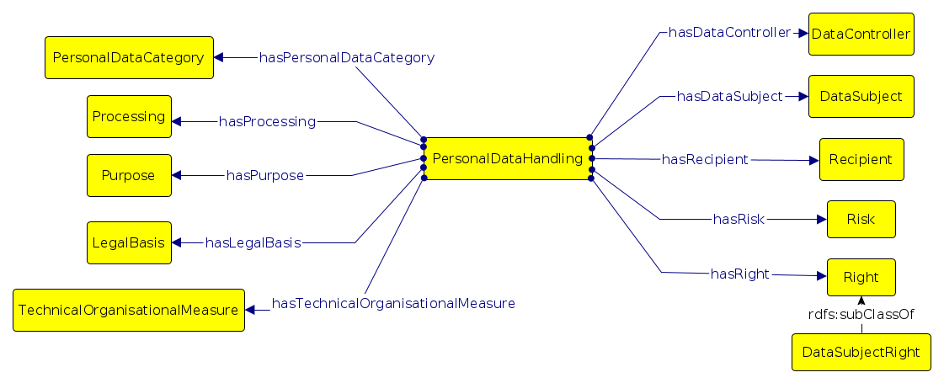
Data Privacy Vocabulary (DPV)ª https://w3.org/ns/dpv
v0.1 consisted of:
Personal data categories
Purposes
Processing categories
Technical and organizational measures
Legal Basis, including consent
Recipients, data controllers
v0.2 (Jan 2021) extends with: Rights, Risks
Ongoing Work
Technologies - databases, encryption, etc.
Risk Management ← IRC fellowship^{b}
2021-22 individual award
Express risk using DPV
Enable exploration of risks
Automate PIA / DPIA
Guidelines / Standards - ISO, etc.
Legal bases
Consent Records ← NGI TRUST funding^{c}
Create specification for consent
Verifiable, transparent, accountable
Implementations and Protocols
a “Creating A Vocabulary for Data Privacy”. Pandit and Polleres et al. https://doi.org/10.1007/978-3-030-33246-4_44
b RISKY: Exploring privacy risks of technologies using knowledge graphs https://harshp.com/research/projects/risky
c Privacy as Expected: Consent Gateway project https://privacy-as-expected.org/

Slide 5
Conclusions and Impact
Academic: DPV is the most comprehensive vocabulary within the SotA
Industry:
Thomson Reuters
Deutsche Telekom AG
PROXIMUS
Signatu AG
Personal Involvement:
Feedback to ISO/IEC WG in Privacy Engineering e.g. 27560 Consent Record
Kantara Initiative: Consent and Personal Data Receipts
Career-defining work as author of DPV and chair of DPVCG
Future Efforts:
Increase industry adoption through tools and documentation
Encourage research & development of interoperable solutions
Propose standard adoption to EU ISA² Programme

Slide 6
Career under ADAPT
PhD Mar 2016 -- May 2021
Funding awards
IRC Research Fellowship (2 years): Oct 2020 -- Sep 2022
NGI TRUST (H2020) Project (6 months): Oct 2020 -- Jun 2021
Freedom for exploring networks and opportunities
Legal data → EU Datathon (1st place) → EU Publications Office
Join DPVCG → Author/Editor of DPV → Co-Chair
Join NSAI & ISO WG → Contribute to 27560 standard on Consent
Research Supervision & Teaching
Taught Concurrent System to Third Year Undergraduate (CompSci)
Supervising Undergraduate & MSc Projects ; Mentor PhD Students
Organisation and Activities:
Chair for LegalTech track at SEMANTiCS conference (Sep’20, Oct’21)
Chair for COnSeNT workshop at Euro Security & Privacy (Oct’21)
Chair of W3C Consent Community Group (formed 2021)

Slide 7
Data Privacy Vocabulary (DPV)
Harshvardhan J. Pandit
harshvardhan.pandit@adaptcentre.ie
@coolharsh55

