Slide 1





[How] Do Users Benefit From Giving Consent?
https://doi.org/10.5281/zenodo.4601141
Harshvardhan J.Pandit | pandith@tcd.ie | @coolharsh55
ADAPT Centre, Trinity College Dublin, Ireland
Soheil Human
Mandan Kazzazi
Vienna University of Economics and Business, Austria
This work is partially supported by the Internet Foundation Austria (IPA) within the NetIdee call (RESPECTeD Project; Grant#prj4625). Harshvardhan J. Pandit is funded by the Irish Research Council Government of Ireland Postdoctoral Fellowship under Grant#GOIPD/2020/790; European Union’s Horizon 2020 research and innovation programme under NGI TRUST Grant#825618 for Project#3.40 Privacy-as-Expected: Consent Gateway; and as part of the ADAPT SFI Centre for Digital Media Technology which is funded by Science Foundation Ireland through the SFI Research Centres Programme and is co-funded under the European Regional Development Fund (ERDF) through Grant#13/RC/2106 P2.
The ADAPT Centre is funded under the SFI Research Centres Programme (Grant 13/RC/2106) and is co-funded under the European Regional Development Fund.

Slide 2
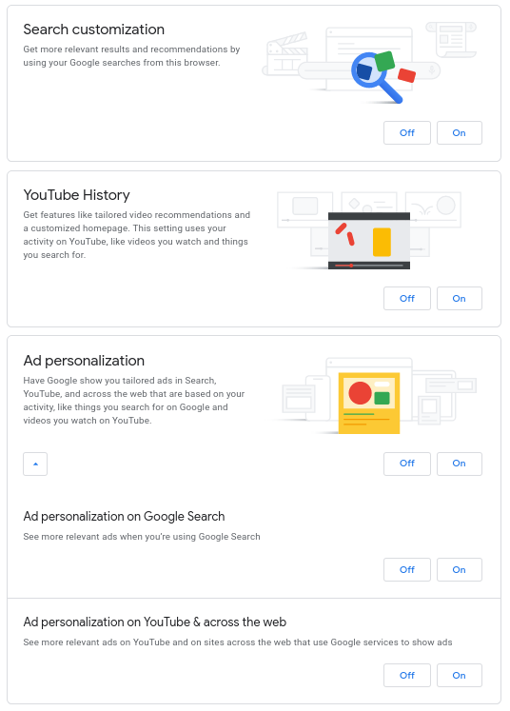
Consent as a Permission and as a Contract
Benefit to Service Provider
Analytics
Service Optimisation
Service R&D
Benefit to Service Consumer
Personalisation
Recommendations
Additional Features
Service Optimisation
google.com (and .others)

Slide 3
Malpractices regarding Consent and Consenting (acknowledge and keep aside)
Benefits and Values [1],[2]
Legal Compliance [2],[3]
Dark Patterns [3],[4]-[8]
Ambiguity in Purposes and descriptions [3],[9]-[11]
[1] D. W. Woods and R. Bohme, “The Commodification of Consent,” in 20th Annual Workshop on the Economics of Information Security, WEIS, p. 25, 2020.
[2] G. Malgieri and B. Custers, “Pricing privacy – the right to know the value of your personal data,” Computer Law & Security Review, vol. 34, pp. 289–303, Apr. 2018.
[3] C. Matte, C. Santos, and N. Bielova, “Purposes in IAB Europe’s TCF: Which legal basis and how are they used by advertisers?,” in Annual Privacy Forum (APF 2020), Oct. 2020.
[4] C. M. Gray, C. Santos, N. Bielova, M. Toth, and D. Clifford, “Dark Patterns and the Legal Requirements of Consent Banners: An Interaction Criticism Perspective,” arXiv:2009.10194
[cs], Sept. 2020.
[5] S. Human and F. Cech, “A Human-centric Perspective on Digital Con- senting: The Case of GAFAM,” in Human Centred Intelligent Systems 2020, (Split, Croatia), 2020.
[6] D. Machuletz and R. Böhme, “Multiple Purposes, Multiple Problems: A User Study of Consent Dialogs after GDPR,” Proceedings on Privacy Enhancing Technologies, vol. 2020, pp. 481–498, Apr. 2020.
[7] C. Matte, N. Bielova, and C. Santos, “Do Cookie Banners Respect my Choice?,” in 41st IEEE Symposium on Security and Privacy, p. 19, 2020.
[8] T. H. Soe, O. E. Nordberg, F. Guribye, and M. Slavkovik, “Circum- vention by design – dark patterns in cookie consents for online news outlets,” arXiv:2006.13985
[cs], June 2020.
[9] C. Utz, M. Degeling, S. Fahl, F. Schaub, and T. Holz, “(Un)informed Consent: Studying GDPR Consent Notices in the Field,” in ACM SIGSAC Conference on Computer and Communications Security (CCS’19), (London, United Kingdom), p. 18, Nov. 2019.
[10] C. Santos, N. Bielova, and C. Matte, “Are cookie banners indeed com- pliant with the law? Deciphering EU legal requirements on consent and technical means to verify compliance of cookie banners,” Technology and Regulation, pp. 91–135, Dec. 2020.
[11] I. Fouad, C. Santos, F. A. Kassar, N. Bielova, and S. Calzavara, “On Compliance of Cookie Purposes with the Purpose Specification Principle,” in IWPE, p. 9, 2020.

Slide 4
Existing avenues of Consumer Protection
Unfair practices → fairness
Fraud → accountability
Gaining advantage over competitors → competition
Mislead consumers → accuracy
Disclosure of information → transparency
GDPR’s Principles relating to processing of personal data (Art. 5)
lawfulness, fairness, transparency
purpose limitation
data minimisation
accuracy
storage limitation
integrity and confidentiality
accountability

Slide 5
Call for Investigation
Do Users receive the [PROMISED] Benefits from their Consent
To investigate this, we propose a set of interdisciplinary methodological study in which researchers carefully study:
(a) whether benefits exist in return for consenting;
(b) how they are formulated or justified by data-controllers
(c) whether they are clear and comprehensible;
(d) whether they are legally justifiable;
(e) can they be seen or demonstrated; and
(f) what ‘value’ does it provide to the user;
(g) do users perceive the benefit.

Slide 6
Methods of Investigation (non-exhaustive)
Sources of Information: notices, privacy policies, publications
Methodologies: surveys, interviews, experiments, data collection, data analysis
Technological aspects: technical/algorithmic evaluation of benefit and provision
Legal compliance: conformance with legal requirements
Legal rights: exercising rights e.g. Right to Access (GDPR)
Information transparency: accessibility, availability, comprehensibility
Benefits within/across domains: domain-specific context e.g. personalisation
Linguistic aspects: quale, formulation, sentiment, readability, vocabulary
Users’ perspective towards benefits: knowledge, attitude, preferences
Users’ perception after consenting: comprehension, interactions
Service Provider perspective: knowledge, attitude, perception, framing
Actors involved: parties and roles and relationships
Representation: HCI, UI/UX, nudging, dark patterns
Other human-centric aspects: heterogeneity, cognition, collective

