Slide 1







Role of Identity, Identification, and Receipts for Consent
Harshvardhan J.Pandit | pandith@tcd.ie | @coolharsh55
ADAPT Centre, Trinity College Dublin, Ireland
Vitor Jesus, Shankar Ammai
PrivDash Ltd., United Kingdom | (former: Birmingham City University, UK)
Mark Lizar, Salvatore D’Agostino
OpenConsent, London, United Kingdom
Privacy as Expected: Consent Gateway (PAECG) Project funded by
This work has been funded under the European Union’s Horizon 2020 research and innovation programme NGI TRUST Grant#825618 for Project#3.40 Privacy-as-Expected: Consent Gateway. Harshvardhan J. Pandit is also funded by Irish Research Council Government of Ireland Postdoctoral Fellowship Grant#GOIPD/2020/790; and ADAPT SFI Centre for Digital Media Technology funded by Science Foundation Ireland through SFI Research Centres Programme and co-funded under European Regional Development Fund (ERDF) through Grant#13/RC/2106_P2.
The ADAPT Centre is funded under the SFI Research Centres Programme (Grant 13/RC/2106) and is co-funded under the European Regional Development Fund.

Slide 2
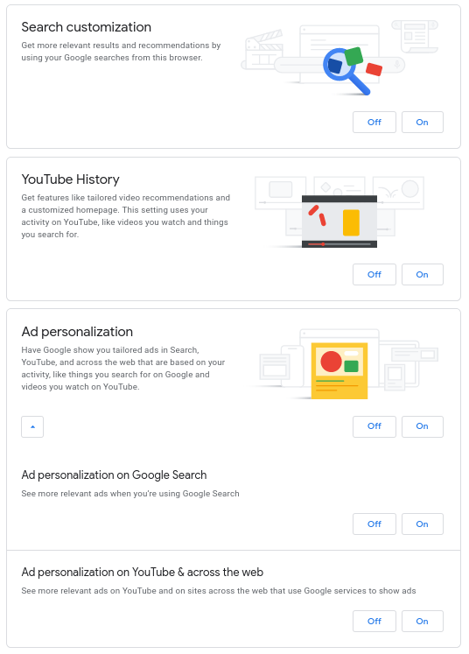
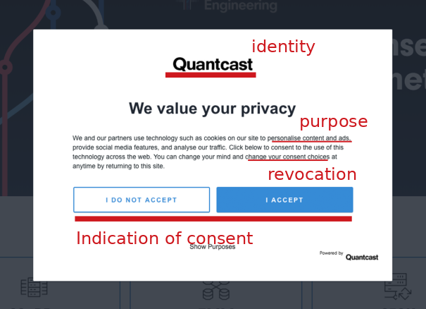
Consent on the Web: An Interactive Contract
quantcast.com
Consent should be:
Freely given → without coercion, no obligation
Specific → exact and limited in scope
Informed → prior knowledge
Un-ambigious → clear indication of consenting
Revocable → once given, can be withdrawn
- GDPR Art. 4-11 (2016)
google.com (and .others)

Slide 3

Identity and Consent
GDPR says:
Collect valid consent (legal requirements)
Provide ability to withdraw given consent
Provide rights (applicable to certain contexts)
Don’t collect additional information e.g. to validate identity merely for the purposes of identification for consent (data minimisation)
Resulting scenario:
If user has an account, consent is tied to the account
If user does not have an account, how to handle consent?
If temporary identifiers are utilised, how to do data minimisation?

Slide 4

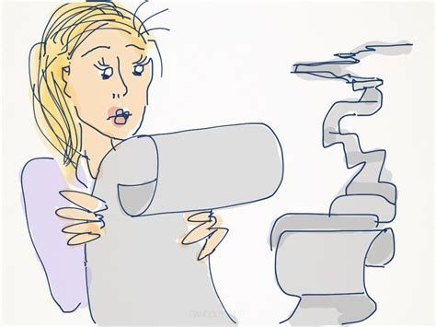
Two biggest challenges
Cookies (default choice for local data management for the web)
Ephemeral storage → collect universal consent with local control
Non-transparent → opening the cookie jar requires expertise
Non-transferable → cookies are per device, per app, per profile
Conditional → if no cookie, no control of preference
Lack of control → no user-utilisation of cookie or cookie-data
Non-challengeable → no user-ability to verify or challenge
Un-manageable → browsers only give ability to delete cookies
Notices:
(privacy is the) “biggest lie on the internet” -- [OO20]
the web is full of dark patterns and malpractices -- [SBM20, Ur20]

Slide 5
Technical approaches deployed (optional slide)
Do Not Track (DNT) → boolean (set on / off) browser signal to indicate user does not want to be ‘tracked’ across the websites. Last standardisation via W3C in 2019. All browsers implement it. No websites it. Spectacular failure. https://www.w3.org/TR/tracking-dnt/
Global Privacy Control (GPC) → boolean (set on / off) browser signal to indicate user does not want their data to be ‘shared’ beyond the website/controller. Last specification Jan 2021. Only 1 browser currently implements it - Brave. Some websites support it. Legally enforceable under CCPA. Uncertain regarding GDPR¹. https://globalprivacycontrol.github.io/gpc-spec/
Privacy Labels → Apple introduced notices for its App Store which requires developers to post information about data collected and used for tracking of individuals, in addition to requiring them to ask consent for tracking - and provides a global setting to prohibit such requests. The company dogfoods: https://www.apple.com/privacy/labels/
1 GPC + GDPR: will it work?. Harshvardhan J. Pandit. 2021. https://harshp.com/research/blog/gpc-gdpr-can-it-work

Slide 6
Consent Receipt
A consent receipt is similar in principle to a record of transaction issued as a receipt, whether in grocery stores, or shopping websites.
Kantara published Consent Receipt (2018) specification outlining a schema for issuing ‘receipts’ for given consent.
How to deploy? Does it meet legal requirements?
ANCR working group (2021) initiated to upgrade spec.
ISO/IEC 29184 (2020) standard for online privacy notices for consent
mentions possibility of machine-readable metadata.
ISO/IEC announced 27560 (likely publication >2023) as an upcoming standardisation effort for consent receipts.
“Web of Receipts”: using receipts as proof and record of transactions, and establishing trust through transparency and accountability [Je20]

Slide 7
Identity, Identification, and Receipts
Two problems with the way consent works today:
Consent records do not concern authentication or verification of entities and information → they are only data records
Creating receipts requires proactive participation by Controllers
Three challenges that need to be addressed to solve this:
Any entity must be able to create its own records
Receipts must be capable of specifying and verifying identity
Avoiding ‘my word against yours’ type of situations

Slide 8
The PAECG solution
PaE:CG is a project funded under NGI TRUST (OCT-2020 to JUN-2021) that provides an end-to-end, user-centric, comprehensive, open source solution to managing Consent for Personal Data.
The driving principle for PaE:CG is utilising receipts for an accountable
mechanism while ensuring the Internet as it currently is and should remain for the most part a pseudo-anonymous space, while still empowering individuals with choice and control through consent.
Consent interaction → Consent Receipt
All parties must benefit from receipts regardless of participation
Receipts are cryptographically signed for assurance & verification
Novel concept of ‘Consent Gateway’ as a Notary or Witness

Slide 9
Receipt → Identity → Identification
PAECG protocol :: implementation of developed solution
Receipt uses bearer tokens to provide cryptographic guarantees regarding identity when receipts are generated and signed
Receipts can be a form of De-centralized Identifier (DID)
Therefore, receipts can be utilised to provide an identifer for identification in interactions, e.g. consent withdrawal
Receipts, by acting as an identification mechanism, can also be used wherever identity is required, e.g. rights exercising
Controller benefits by having verifiable records, non-invasive identifiers for consent and rights management
Users benefits by having proof of consent, and accountable record of their consent interaction

Slide 10
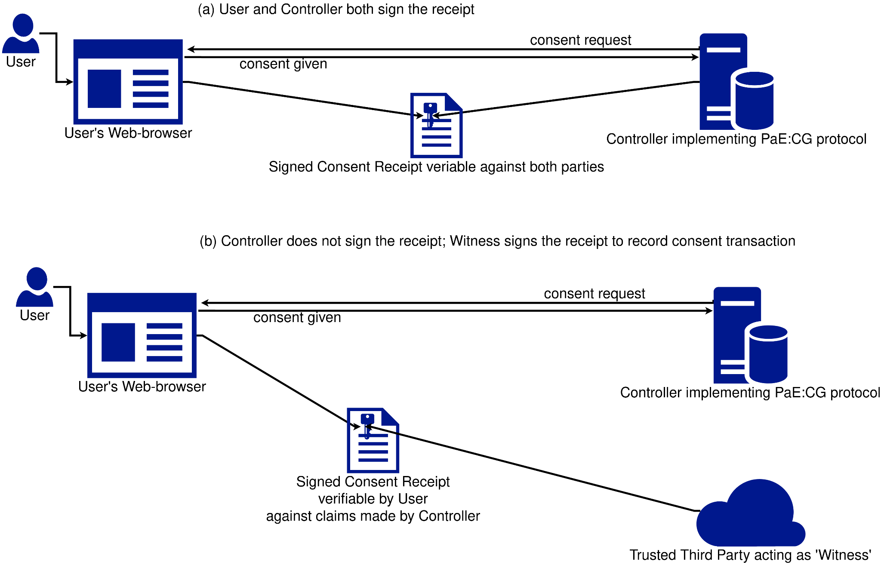
Scenario #1: All Parties utilise PAECG protocols
User has a browser plugin as User Agent
Controller implements PAECG protocol on server
Both generate Consent Receipt
Both sign Consent Receipt
Both hold copies of signed Consent Receipt

Slide 11
Scenario #2: CG as Trusted Witness
User has a browser plugin as User Agent
Controller implements PAECG protocol on server
Both generate Consent Receipt
Both + CG sign Consent Receipt
Both hold copies of signed Consent Receipt

Slide 12
Scenario #2: CG as Trusted Witness
User has a browser plugin as User Agent
Controller does not implement PAECG protocol on server
Both generate Consent Receipt
User + CG (on behalf of Controller) sign Consent Receipt
Both hold copies of signed Consent Receipt

Slide 13
Scenario #3: Controller does not sign
User has a browser plugin as User Agent
Controller implements PAECG protocol on server
User generates Consent Receipt
User + CG (as Witness) sign Consent Receipt
User has signed Consent Receipt

Slide 14
Information required for Record+Receipt
Credentials / Signing
Explicit keys provided by each party
Utilise certificates used for websites (e.g. HTTPS/TLS)
Information within Receipt
Self-declaration, e.g. website explicitly lists it in web-page
Annotated semantics, e.g. website implicitly lists elements which can be extracted from web-page
Derived, e.g. take information from consent notices using NLP
Provided, e.g. third party public registry of information

Slide 15
In Conclusion...
The issue of ‘accountable consent’ is a web-scale problem
PAECG provides a solution for practical accountability and implementation using cryptographic protocols
Introduces the novel concept of a ‘Consent Gateway’
Receipts can be utilised as records of consent, for accountability, legal enforcement, further interactions, identification and authentication, and clarification in disputes.
Contributions to ongoing standardisation efforts in ISO/IEC, Schema.org, Kantara ANCR, W3C DPVCG, and more.

