Slide 1


Technical Challenges of EU’s Digital Sovereignty Aspirations
Harshvardhan J. Pandit ADAPT Centre
School of Computing
Dublin City University
harshvardhan.pandit@adaptcentre.ie
Harshvardhan J. Pandit | EMILDAI Summer School | 09-MAY-2023 | https://harshp.com/research/presentations | CC-by-NC 4.0

Slide 2
“Digital” Jurisprudence
(selected regulations)
Law | Enforcement | Area | Rights & Freedoms
GDPR | MAY-2018 | personal data | transparency, autonomy, fiduciary
DSA | NOV-2022 | service | transparency, autonomy, fiduciary
DMA | MAY-2023 | market | autonomy
DGA | SEP-2023 | market | fiduciary
AI Act | voting | technology | fiduciary
ePrivacy Reg | draft | communication | transparency, autonomy, fiduciary
Data Act | proposed | data | autonomy
Health Data Space | proposed | health data | autonomy, fiduciary
Interoperability Act | proposed | data | autonomy
Harshvardhan J. Pandit | EMILDAI Summer School | 09-MAY-2023 | https://harshp.com/research/presentations | CC-by-NC 4.0

Slide 3


EU is building a repertoire of ‘Data’ Laws
Current: GDPR, DSA, DMA, DGA
Proposed: AI Act, ePrivacy, Data Act, (Health) Data Space, Interoperability Act
vs
“Jigsaw” Laws
one (correct) solution where everything fits, discovered progressively
“Lego” Laws
Many (correct) solutions can work, needs agreement on which one to choose
Harshvardhan J. Pandit | EMILDAI Summer School | 09-MAY-2023 | https://harshp.com/research/presentations | CC-by-NC 4.0

Slide 4
Known Challenges for GDPR Enforcement^{[1]}
[1] Four Years under the EU GDPR: How to fix its Enforcement https://www.accessnow.org/cms/assets/uploads/2022/07/GDPR-4-year-report-2022.pdf
Time investigations, decisions, appeals, final decisions
Space jurisdiction, establishment, transfers, adequacy
Money under-funded authorities, effective fines
Knowledge new technologies, new use-cases
Gaps new technologies, loopholes, interpretations
Consistency need for EDPB, under-investigated areas
Scope web-scale enforcement, pan-EU actions
(Side-)Effects malicious compliance: e.g. pesky dialogues
Harshvardhan J. Pandit | EMILDAI Summer School | 09-MAY-2023 | https://harshp.com/research/presentations | CC-by-NC 4.0

Slide 5
Foreseeing Legal Enforcement Challenges
Time technology change ~5 years, case law ~5 years
Space
global internet + multi-nationals = chaotic rules
Money under-funded authorities, effective fines
Knowledge new technologies, new use-cases
Gaps new technologies, loopholes, interpretations
Consistency need for EDPB, under-investigated areas
Scope web-scale enforcement, pan-EU actions
(Side-)Effects malicious compliance: e.g. pesky dialogues
Harshvardhan J. Pandit | EMILDAI Summer School | 09-MAY-2023 | https://harshp.com/research/presentations | CC-by-NC 4.0

Slide 6
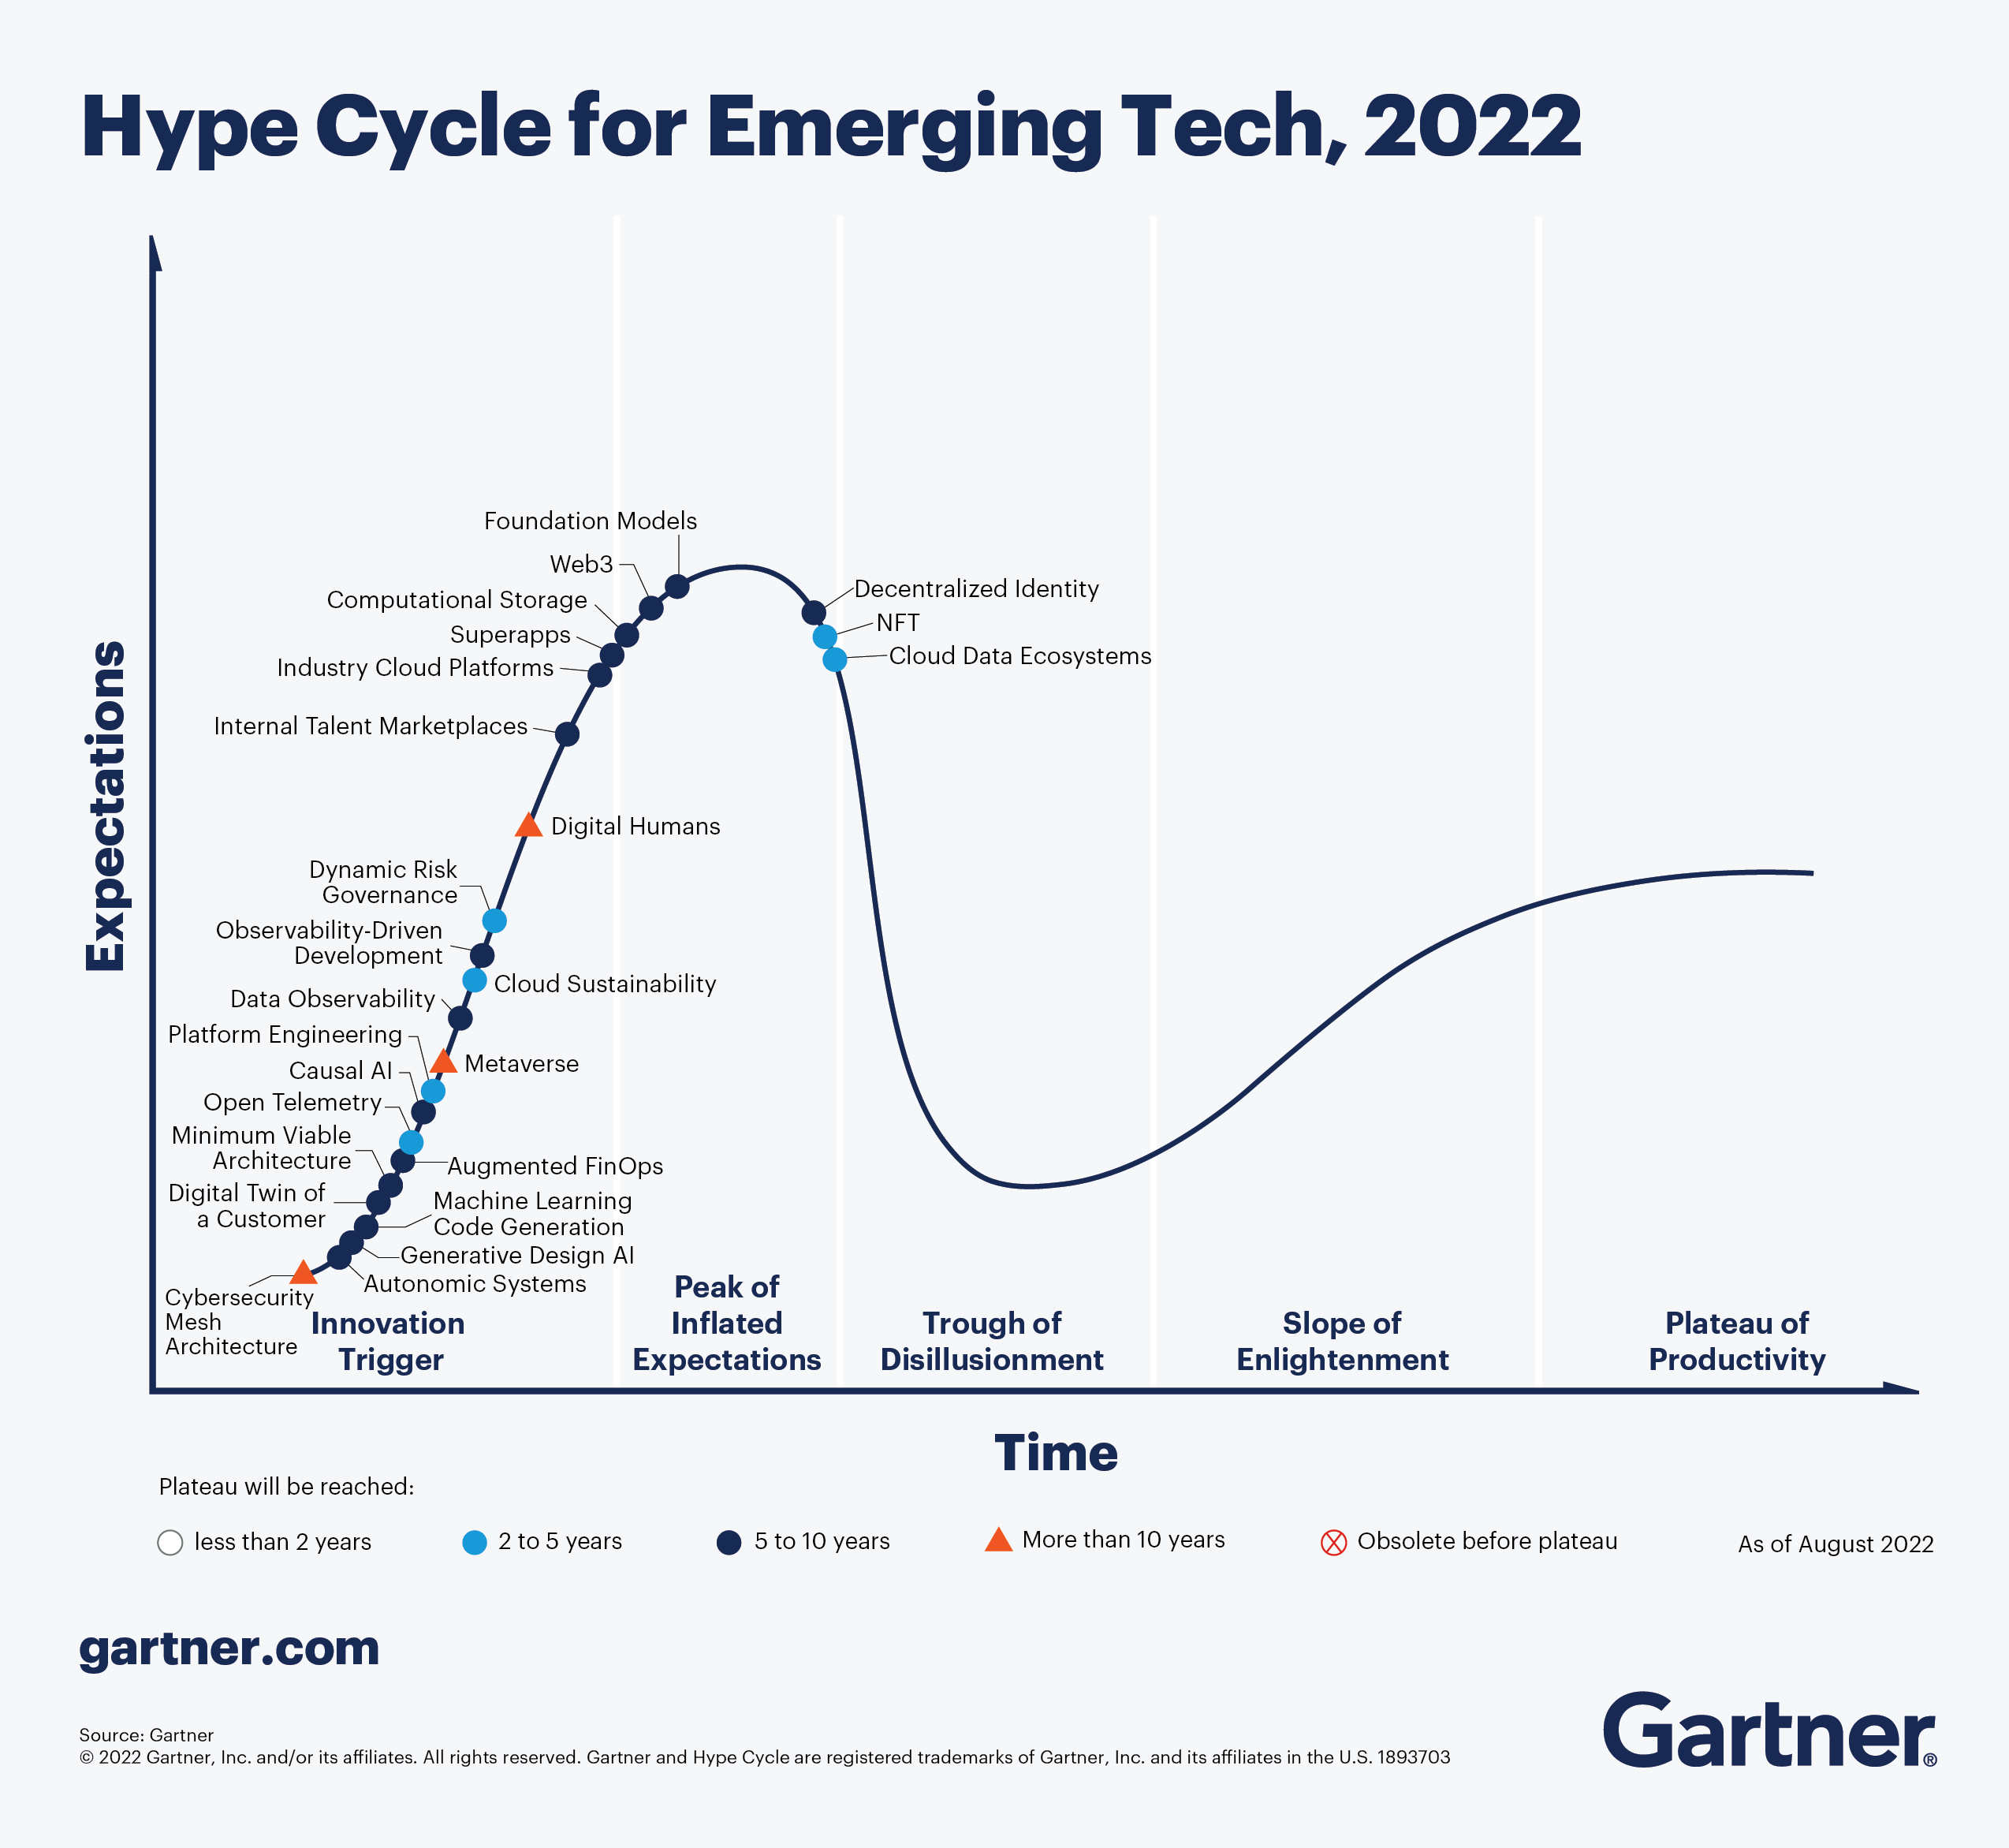
Laws planned vs Technological Advances
Harshvardhan J. Pandit | EMILDAI Summer School | 09-MAY-2023 | https://harshp.com/research/presentations | CC-by-NC 4.0

Slide 7
Foreseeing Legal Enforcement Challenges
Time technology change ~5 years, case law ~5 years
Space
global internet + multi-nationals = chaotic rules
Money MORE under-funded authorities + SLOW fines
Knowledge disconnected laws and reactive interpretation
Gaps new technologies, loopholes, interpretations
Consistency need for EDPB, under-investigated areas
Scope web-scale enforcement, pan-EU actions
(Side-)Effects malicious compliance: e.g. pesky dialogues
Harshvardhan J. Pandit | EMILDAI Summer School | 09-MAY-2023 | https://harshp.com/research/presentations | CC-by-NC 4.0

Slide 8
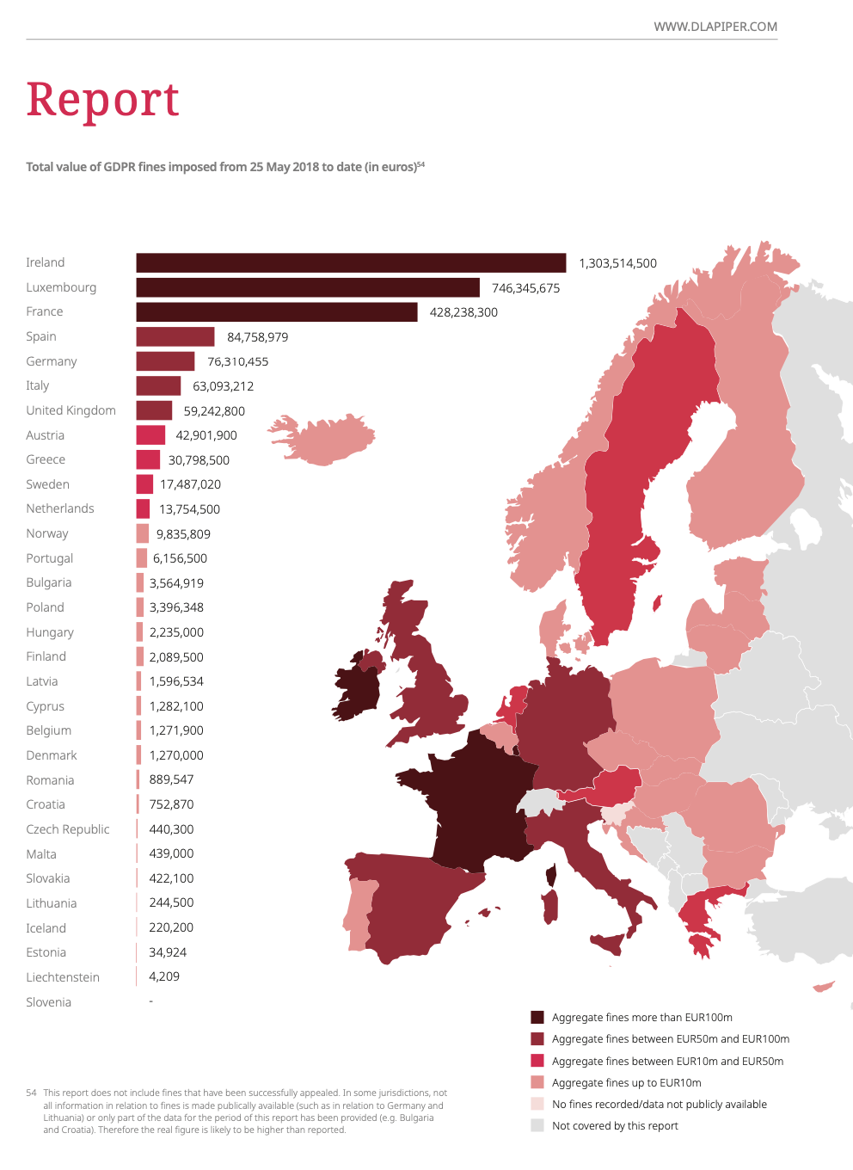
Unknown impact of fines
Extent of fines being a “deterrence” to avoid bad practices?
Extent of fines being a “motivator” to improve and innovate?
Harshvardhan J. Pandit | EMILDAI Summer School | 09-MAY-2023 | https://harshp.com/research/presentations | CC-by-NC 4.0

Slide 9
Foreseeing Legal Enforcement Challenges
Time technology change ~5 years, case law ~5 years
Space
global internet + multi-nationals = chaotic rules
Money MORE under-funded authorities + SLOW fines
Knowledge disconnected laws and reactive interpretation
Gaps exploit as ‘market’, force to fit into ‘regulation’
Consistency regions, technologies, interpretations
Scope web-scale enforcement, pan-EU actions
(Side-)Effects malicious compliance: e.g. pesky dialogues
Harshvardhan J. Pandit | EMILDAI Summer School | 09-MAY-2023 | https://harshp.com/research/presentations | CC-by-NC 4.0

Slide 10
Foreseeing Legal Enforcement Challenges
Time technology change ~5 years, case law ~5 years
Space
global internet + multi-nationals = chaotic rules
Money MORE under-funded authorities + SLOW fines
Knowledge disconnected laws and reactive interpretation
Gaps exploit as ‘market’, force to fit into ‘regulation’
Consistency regions, technologies, interpretations
Scope pervasive & ubiquitous ‘digital’ presence?
(Side-)Effects compliance is an illusion and creates barriers
Harshvardhan J. Pandit | EMILDAI Summer School | 09-MAY-2023 | https://harshp.com/research/presentations | CC-by-NC 4.0

Slide 11
In Conclusion …
EU has planned an extremely ambitious legal regime to achieve its vision of ‘Data’ markets that aligns with fundamental principles
Specific laws are planned to address ‘Technological Sectors’
But not enough is being planned or discussed about how we there will be effective application and enforcement
”Digital Jurisprudence” needs new mechanisms that are based on the virtuality and momentum that arises because of data + technology
Harshvardhan J. Pandit | EMILDAI Summer School | 09-MAY-2023 | https://harshp.com/research/presentations | CC-by-NC 4.0

Slide 12
Technical Challenges of EU’s Digital Sovereignty Aspirations
Thank you!
Commencing Discussions…
Harshvardhan J. Pandit ADAPT Centre
Dublin City University
harshvardhan.pandit@adaptcentre.ie
Harshvardhan J. Pandit | EMILDAI Summer School | 09-MAY-2023 | https://harshp.com/research/presentations | CC-by-NC 4.0

