Slide 1

Towards an open Data Vocabulary for Canvas-driven Inovation Ethics
Dave Lewis, Harshvardhan J. Pandit, Hannah Devinny, Wessel Reijers
dave.lewis@adaptcentre.ie
Semantic Web for Good workshop
ISWC 2018
Monteray 9 Oct 2018
The ADAPT Centre is funded under the SFI Research Centres Programme (Grant 13/RC/2106) and is co-funded under the European Regional Development Fund.

Slide 2
Innovation Ethics
TRL 1
TRL 2
TRL 3
TRL 4
TRL 5
TRL 6
TRL 7
TRL 8
TRL 9
Basic Research
Technology Concept
Applied Research
Laboratory Prototype
Real-world
Prototype
Real-world
Prototype
System
Real-world
Product
Demo
First Commercial Product
Full-scale Commercial Product
Academia
Industry
Research Ethics
Technology Ethics
ExAnte
Intra
ExPost
Notes:
The commercialisation of technology is often viewed in terms of the TRL (technology readiness level) scale, going from early stage research to full commercial product
The SFI and Enterprise Ireland supports are designed to advance the TRL of a particular technology… EI commercialisation supports typically bring technology from TRL4 to TRL8 but this varies.
Several ADAPT spin-outs have successfully made it to TRL 9, these include Empower The User, Transpiral and Wripl…
And several projects are advancing along this scale… these include SightCAT, VoiceTune and Darwin & Goliath

Slide 3
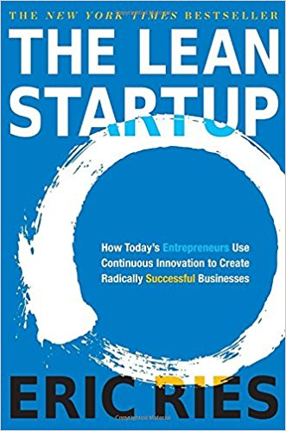

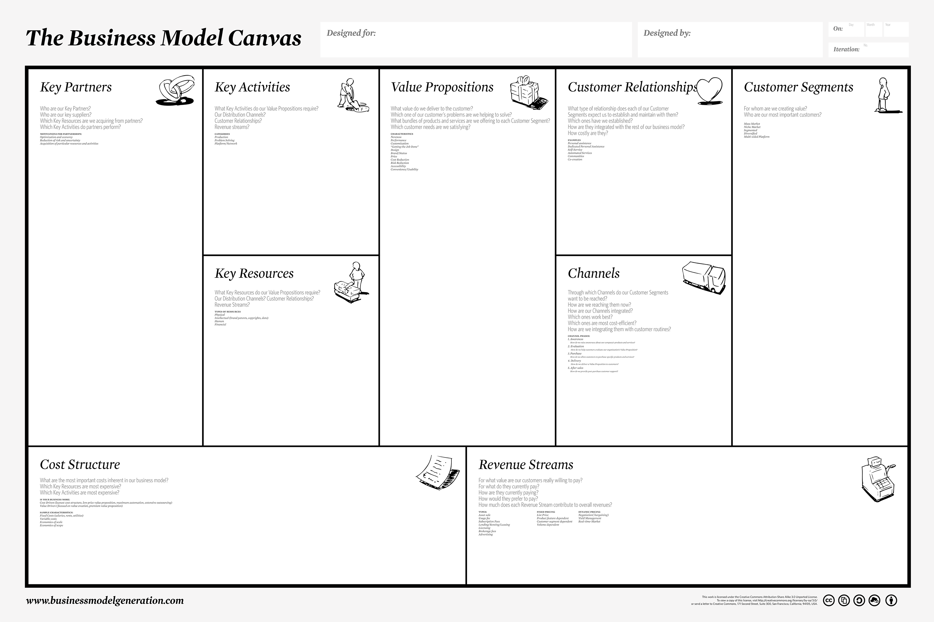
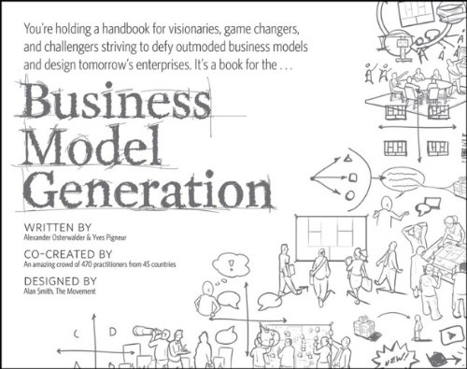
Data Hungry Innovation Methods
The Customer Development Process
Customer Discovery
Customer Validation
Customer Creation
Company Building
Bus Model Canvas
Extract Hypotheses
Test Problem
Test Solution
Pivot or Proceed
How to make ethics part of the process?
Notes:
Rapid hypothesis testing
Reification of evidence collection for hypothesis testing lead to data hungry innovation cycle

Slide 4
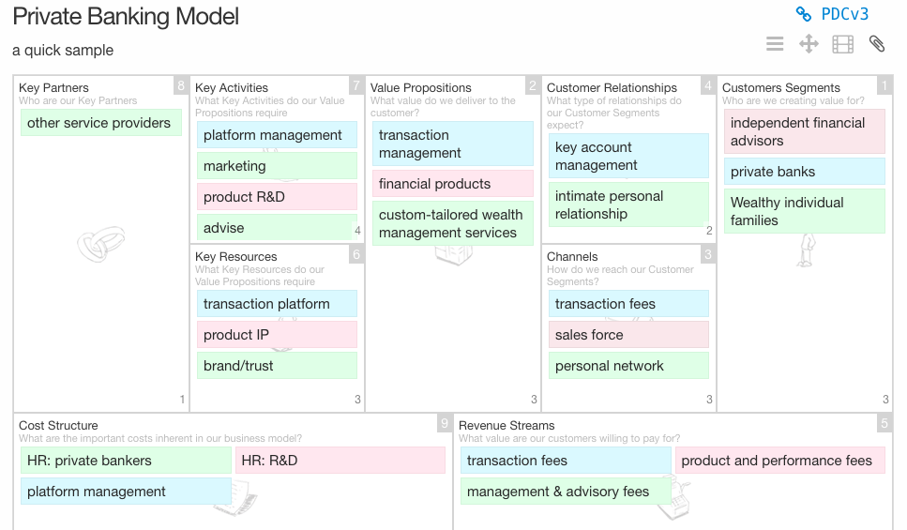
Innovation Tool Affordances: Business Model Canvas
https://bmfiddle.com

Slide 5
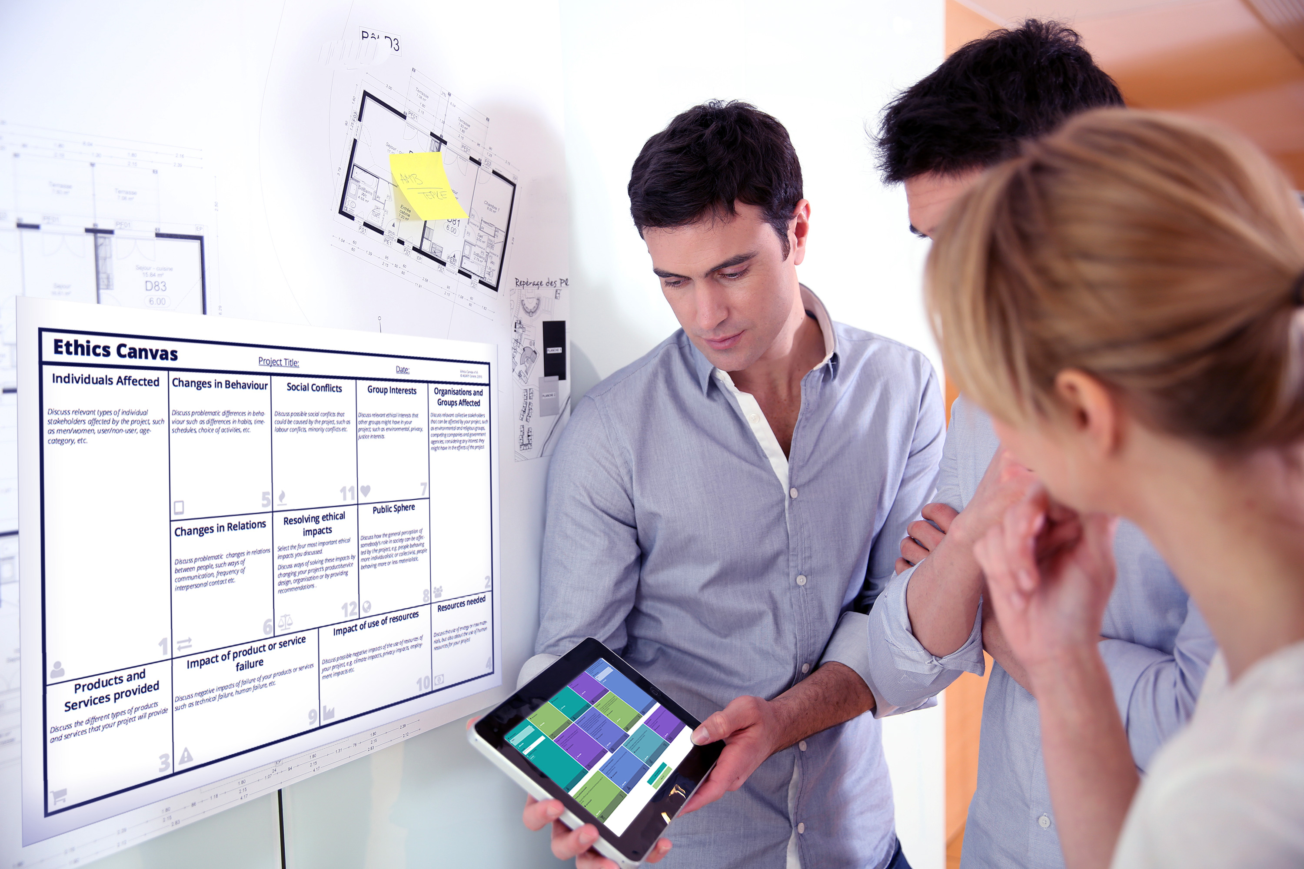
Ethic Canvas
Need tools for capture and reflection of ethical implications within highly iterative data hungry, test & pivot innovation processes
Ethics Canvas is a reflective, unmediated & easy-to-use approach to the analysis of ethical issues
Applied an iterative, usability-driven approach to the design of the ethics canvas
Tested it in classroom settings with promising results
Freely available: ethicscanvas.org

Slide 6
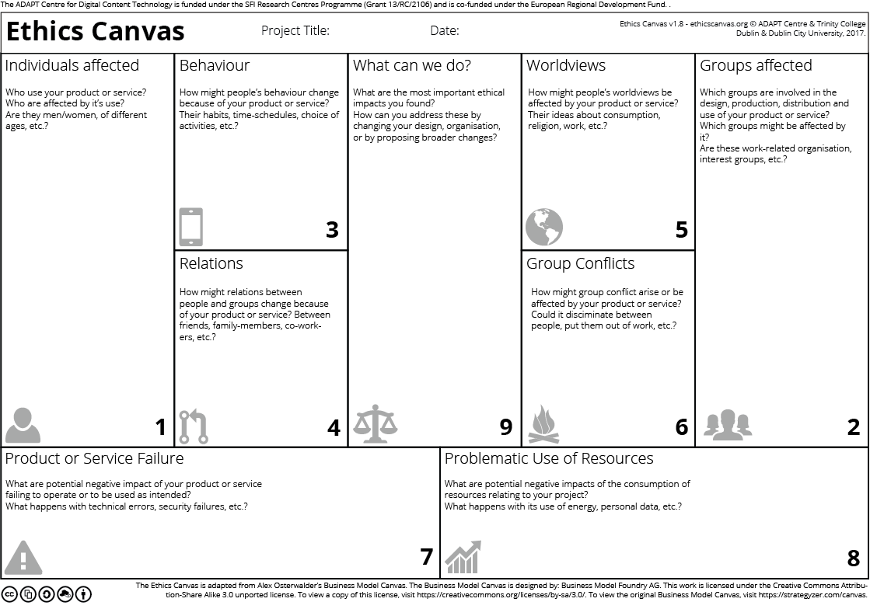
Ethics Canvas

Slide 7
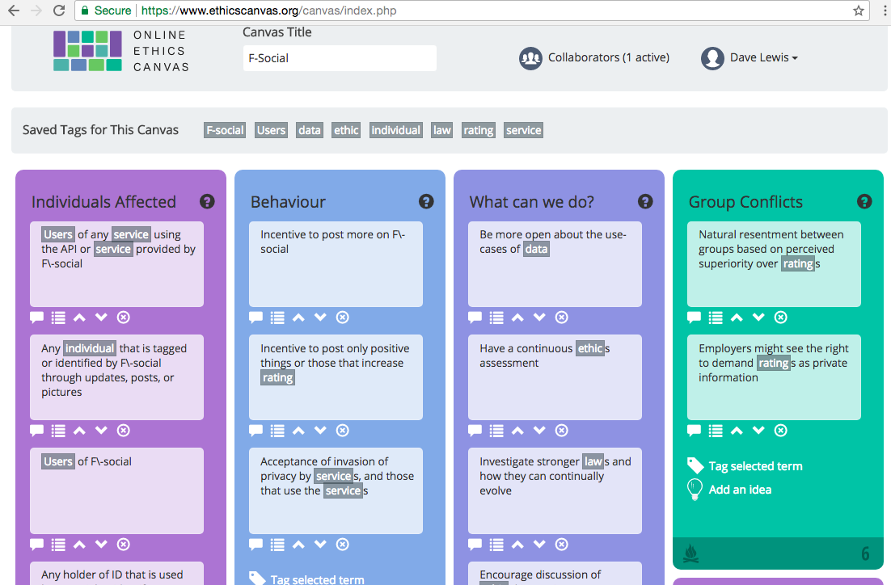
ethicscanvas.org

Slide 8
Why a Linked Data Vocabulary?
Online version offers basic sharing of whole canvas and linking via plain text tags
No federation of repositories
No support for structuring tags
Linked Data for sharing analyses and best practice
Ex-ante: share and link technology ethics analyses between researchers
Intra: Systematic process for ethical analysis and organisational learning,
Ex-post: Evidence gathering and issue generalisation for public policy studies, organsiation logs for future scrutiniy

Slide 9
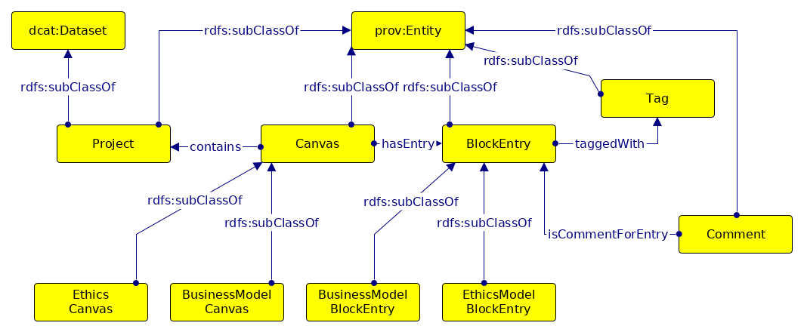
Linked Open Data Vocabulary
PROV-O
Track changes over iterations of canvas
Track multi-stakeholder engagement in a canvas
DCAT as basis for sharable data

Slide 10
Conclusions & Future Work
The need for ethical consideration of the impact of Big Data and AI is clear
BUT we lack tools and best practice – ethic canvas is an early approach
The structure and tag sharing of the online canvas points to a way of sharing case studies and experience with innovation Ethics as interlinked Structured Data
Future tools could further populate such data sets.
Have started using name entity recognition and text classification to highlight stakeholder classes, specific organisations, resources and technologies
Widen to structured data capture for other innovation ethics methods

