Slide 1
Harshvardhan J. Pandit
Assistant Professor, ADAPT Centre, School of Computing, Dublin City University me@harshp.com
Semantic Interoperability of Legal Compliance
From GDPR to Data Spaces

Slide 2

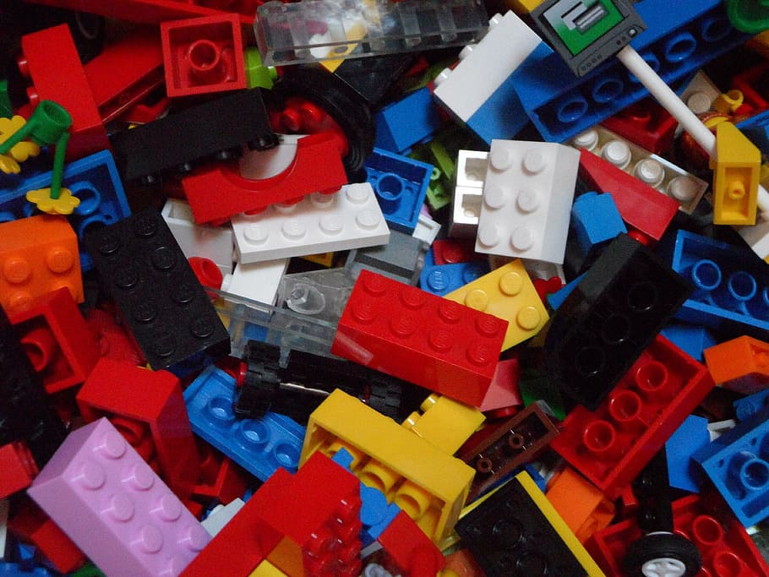
EU is building a repertoire of ‘Data’ Laws
Current: GDPR, DSA, DMA, DGA
Proposed: AI Act, ePrivacy, Data Act, (Health) Data Space, Interoperability Act
vs
“Jigsaw” Laws
one (correct) solution where everything fits, discovered progressively
“Lego” Laws
Many (correct) solutions can work, needs agreement on which one to choose
Semantic Interoperability of Legal Compliance: From GDPR to Data Spaces | Harshvardhan J. Pandit | https://harshp.com/research

Slide 3
Known Challenges for GDPR Enforcement^{[1]}
[1] Four Years under the EU GDPR: How to fix its Enforcement https://www.accessnow.org/cms/assets/uploads/2022/07/GDPR-4-year-report-2022.pdf
Time investigations, decisions, appeals, final decisions
Space jurisdiction, establishment, transfers, adequacy
Money under-funded authorities, effective fines
Knowledge new technologies, new use-cases
Gaps new technologies, loopholes, interpretations
Consistency need for EDPB, under-investigated areas
Scope web-scale enforcement, pan-EU actions
(Side-)Effects malicious compliance: e.g. pesky dialogues
Semantic Interoperability of Legal Compliance: From GDPR to Data Spaces | Harshvardhan J. Pandit | https://harshp.com/research

Slide 4
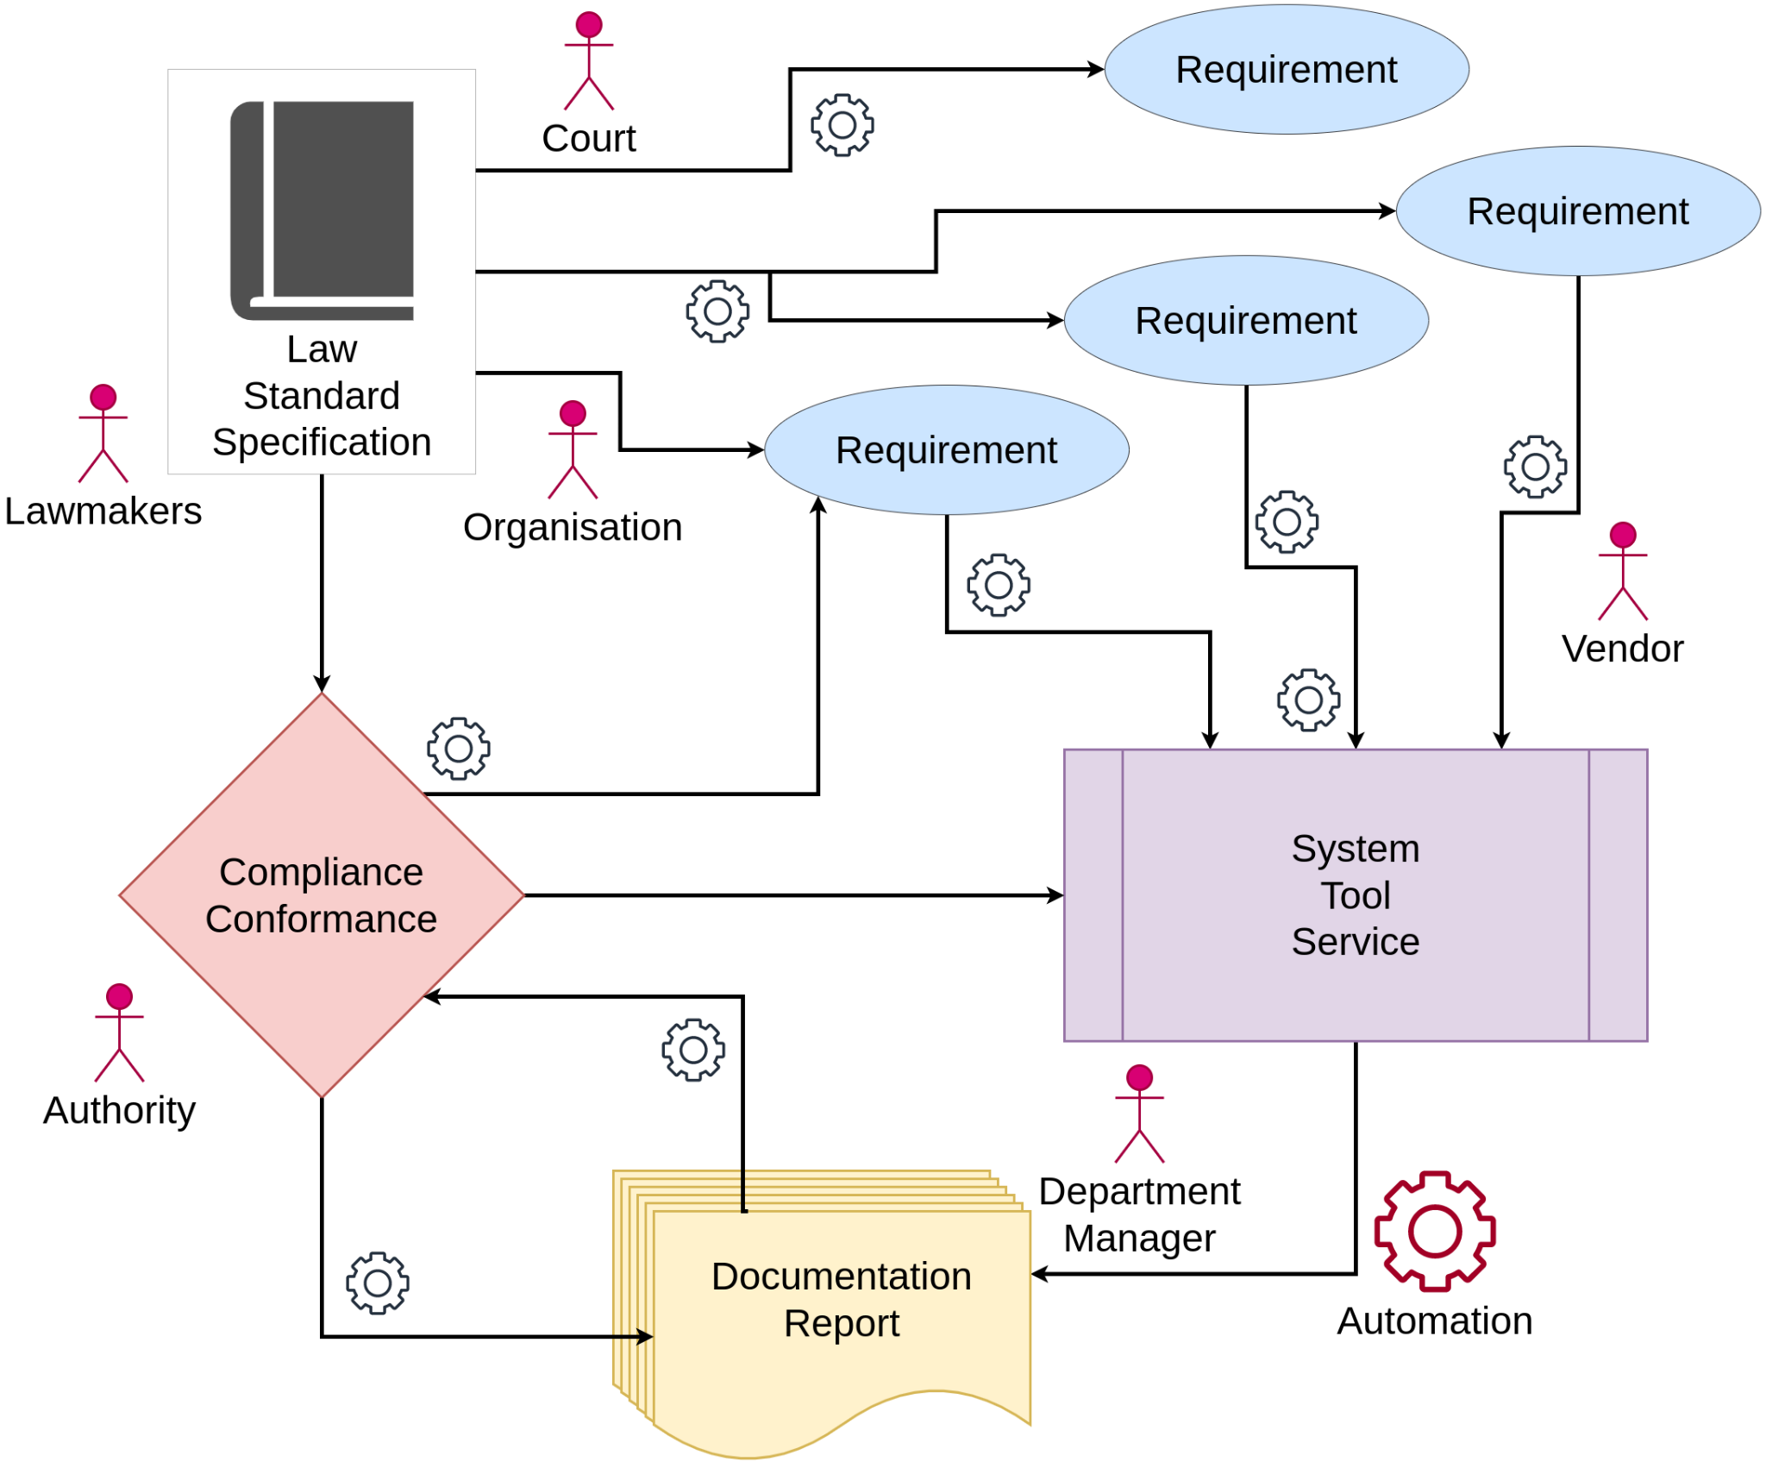
From Compliance to Compliance Automation
1) Automation ➔ IF information is machine-readable
2) Interoperable ➔ IF information has defined schema/ontology + is FAIR
3) Consistent ➔ IF compliance is uniform and has ‘shared interpretation’
Semantic Interoperability of Legal Compliance: From GDPR to Data Spaces | Harshvardhan J. Pandit | https://harshp.com/research

Slide 5
“how to create effective compliance mechanisms based on proven information management practices and standards?”
How to do this:
(1) Interoperable specifications for legal metadata
(2) Automated solutions to validate information
(3) Focus on conformity rather than compliance
Semantic Interoperability of Legal Compliance: From GDPR to Data Spaces | Harshvardhan J. Pandit | https://harshp.com/research

Slide 6
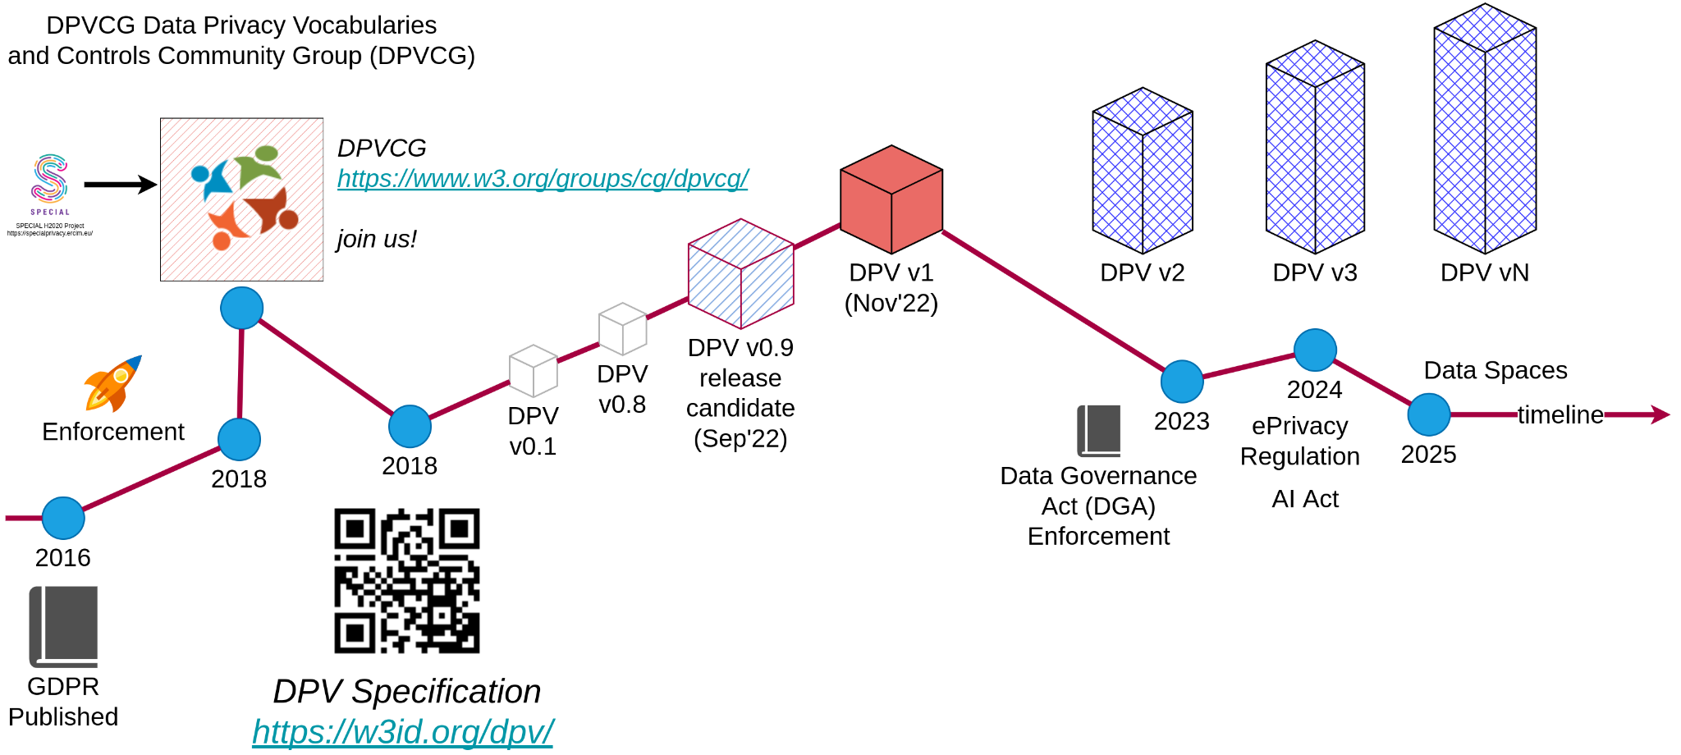
DPVCG
https://w3.org/groups/cg/dpvcg/
Join us!
Data Privacy Vocabulary (DPV) provides a rich set of vocabularies for documenting what/who/where/why/when/etc. regarding data.
https://w3id.org/dpv
Semantic Interoperability of Legal Compliance: From GDPR to Data Spaces | Harshvardhan J. Pandit | https://harshp.com/research

Slide 7
DPV enables a single knowledge base to target all compliance related information and tasks
Privacy Policies Consent Records Compliance Checking Data Portability Data Input/Output Assistance Annotating code / documents Expressing and Evaluating Rules
Risk Management Data Breach Records Subject Access Request Impact Assessments (PIA / DPIA) Data Transfers Register of Processing Activities (ROPA) Standards & Guidelines
Semantic Interoperability of Legal Compliance: From GDPR to Data Spaces | Harshvardhan J. Pandit | https://harshp.com/research

Slide 8

Future Solution
Modular + Simple Vocabularies focused on making practical tasks more effective rather than theoretical logical correctness
We NEED this for fast & adaptive solutions for the new data regulatory regime.
Law | Enforcement
GDPR | MAY-2018
DSA | NOV-2022
DMA | MAY-2023
DGA | SEP-2023
AI Act | draft
ePrivacy Reg | draft
Data Act | proposed
Health Data Space | proposed
Interop. Act | proposed
Semantic Interoperability of Legal Compliance: From GDPR to Data Spaces | Harshvardhan J. Pandit | https://harshp.com/research

Slide 9
Harshvardhan J. Pandit
me@harshp.com | https://harshp.com/research

