Slide 1
A review on
‘Siamese Neural Networks for One-shot Image Recognition’
2018.07.27
신동진

Slide 2
01 One-shot learning task
Contents
02 Siamese neural networks
03 Comparison of learned features
- Siamese neural nets
- Discriminative models(CNN)
- Generative models(GAN)

Slide 3
One-shot
learning task
01

Slide 4
One-shot learning task
01 One-shot learning task
Neural networks has been successfully used In variety of applications
Image recognition
Computer security
Recommendation system
Bio, medical, advertisement, etc.
The performances of these tasks can be guaranteed with heavy training data and high computational costs
Further more, in classification methods, most of classifiers need lots of samples in each labels
But in real world, we should be often faced with asymmetric data

Slide 5
One-shot learning task
01 One-shot learning task(cont’d)
But, human need few attributes to recognize something new
A child can learn easily differences between cups and cats
It is used that similarities with what a child already knows
A child may think cups are looked like dishes he saw on dish table
This concept is the motivation of this approach
One-shot learning is to learn a classifier under the restriction that we may only observe a single example of each possible class before making a prediction about a test instance

Slide 6
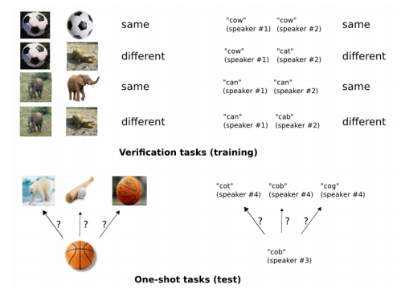
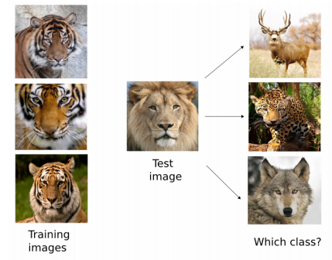
One-shot learning task
01 One-shot learning task(cont’d)
Classifiers’ task
Authors’ task

Slide 7
Siamese
neural networks
02

Slide 8
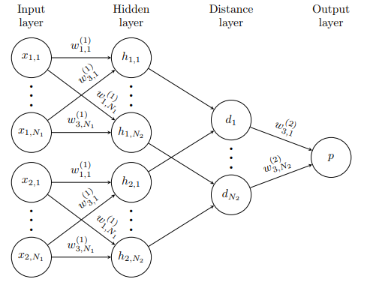
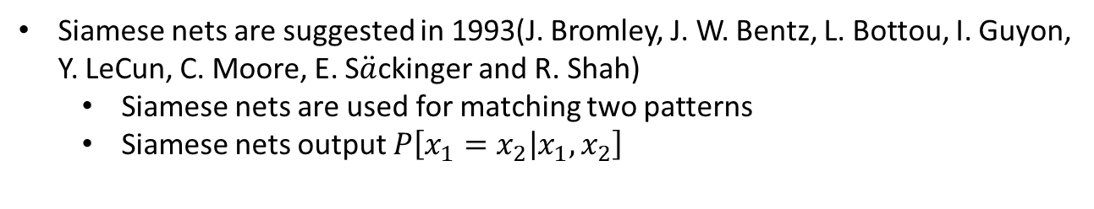
Siamese neural networks
02 Siamese neural networks
Siamese nets are suggested in 1993(J. Bromley, J. W. Bentz, L. Bottou, I. Guyon, Y. LeCun, C. Moore, E. S$\ddot{a}$ckinger and R. Shah)
Siamese nets are used for matching two patterns
Siamese nets output $P\left[x_{1}=x_{2} | x_{1},x_{2}\right]$

Slide 9
Siamese neural networks
02 Siamese neural networks(cont’d)
How are Siamese nets used for one-shot learning?
The author showed that the classifier with features from Siamese nets can achieve high performance
Also, the classifiers with Siamese nets in one-shot learning setting achieve state-of-art performance
Is it useful the learned features in Siamese nets for image recognition?
Siamese nets can represent data point into latent space without targets
It is similar with pre-training with generative models
Siamese nets need fewer computational resource than Convolutional AutoEncoder which is generally used for pre-training the image recognition models

Slide 10
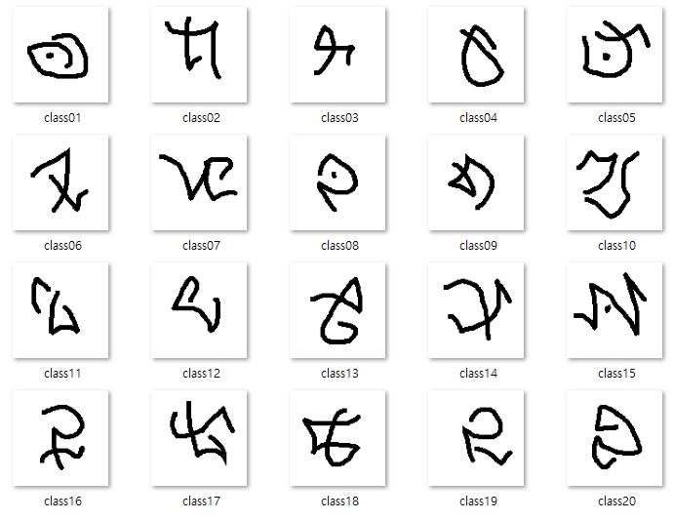
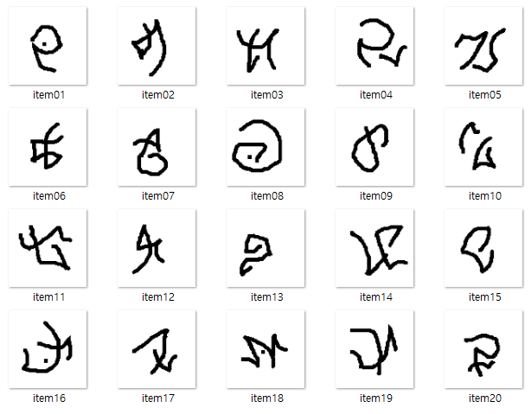
Siamese neural networks
02 Siamese neural networks(cont’d)
How to evaluate their approach?
One-shot learning setting
Training set
Test set

Slide 11
Comparison of learned features
03

Slide 12
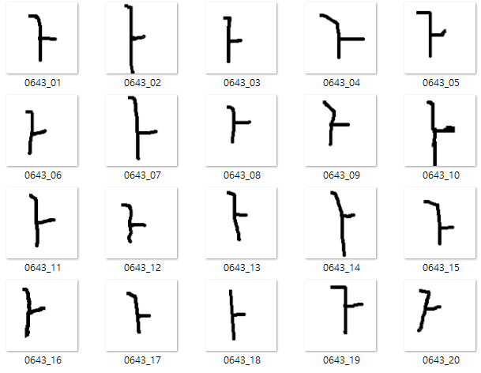
Comparison of learned features
03 Comparison of learned features
Experiments settings
Datasets : Omniglot dataset, MNIST dataset
Settings : After feature(image kernel) learning with Siamese nets, then evaluate with one-shot learning setting
Metrics : Accuracy, mean of f-measure
Dataset | Omniglot(Kr)
# of instances(tr) | 800
# of classes | 40
Statistics of dataset for
Training Siamese nets

Slide 13
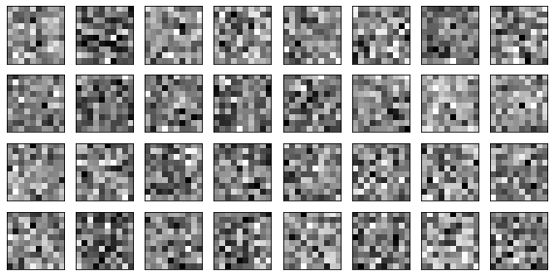
Comparison of learned features
03 Comparison of learned features

