Slide 1
20180806 랩미팅
김현지

Slide 2
RNN for
Customer Visiting Journey Modeling
Input:
Feature vector extracted from CNN layer
Output:
One-hot encoded page name
Loss Function:
Computed as sum of cross-entropy
between the prediction at each step t
And the true visited page at step t+1

Slide 3
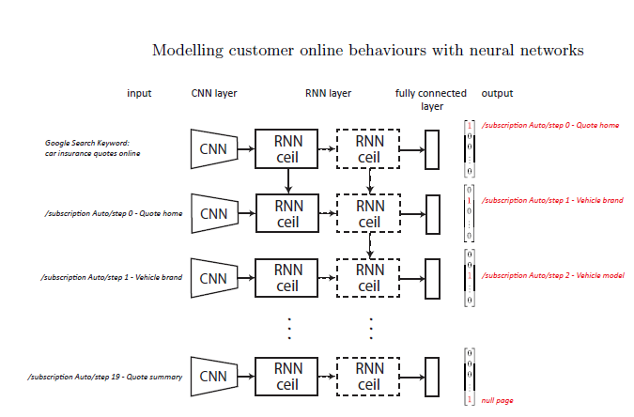
Dropout technique applied

Slide 4
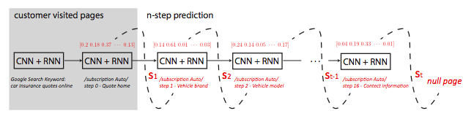
Monte Carlo
Objective:
To estimate the customer conversion rates knowing their visited pages.
Importance Sampling:
Example of 난쟁이족/키다리족
Null Page:
Indicates that the customer finished the visit and quit the site

Slide 5
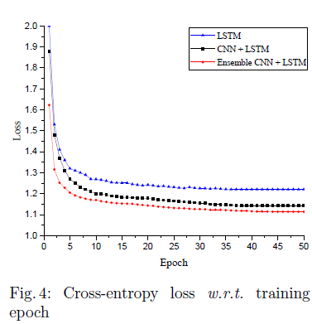
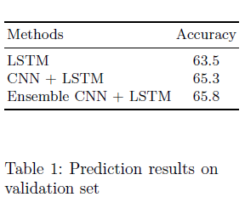
LSTM
CNN + LSTM
CNN + LSTM (5 parallel identical architectures)

