Slide 1
Deep neural network for
Image translation
2018.08.17
신동진

Slide 2
01 Translation works
Contents
02 Approaches
- AEs(VAEs)
- GANs
03 Examples
- edge2shoes
- Google maps

Slide 3
Translation works
01

Slide 4
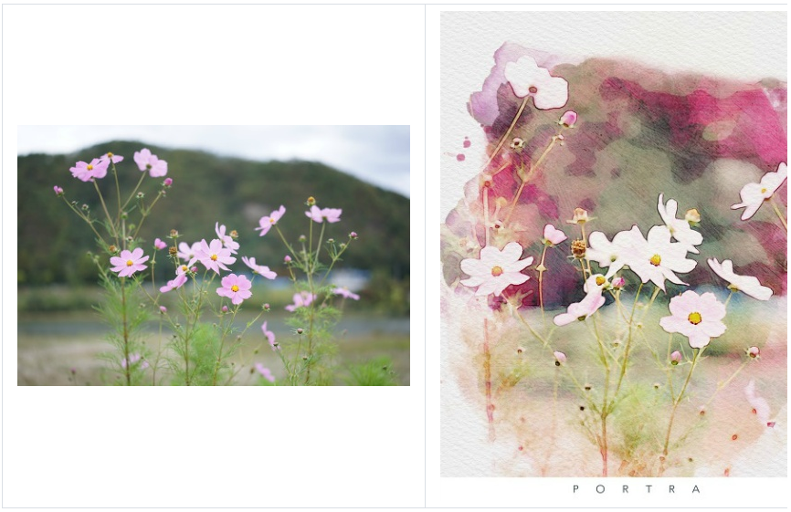
Translation works
01 Translation works
Image translation
It means to transfer the color or style of the images
Some applications carry out image translation by machine learning approaches
< Portra >

Slide 5
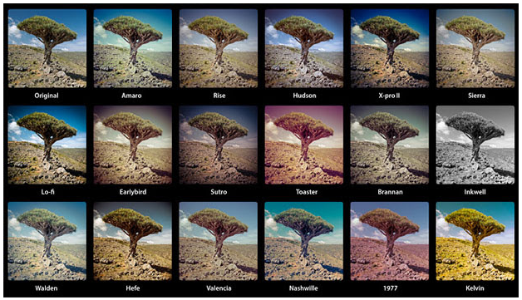
Translation works
01 Translation works(cont’d)
Classical approach for image translation
Image kernel
Some known image kernels(filters) used for translation
< Image filters provided by Instagram >

Slide 6
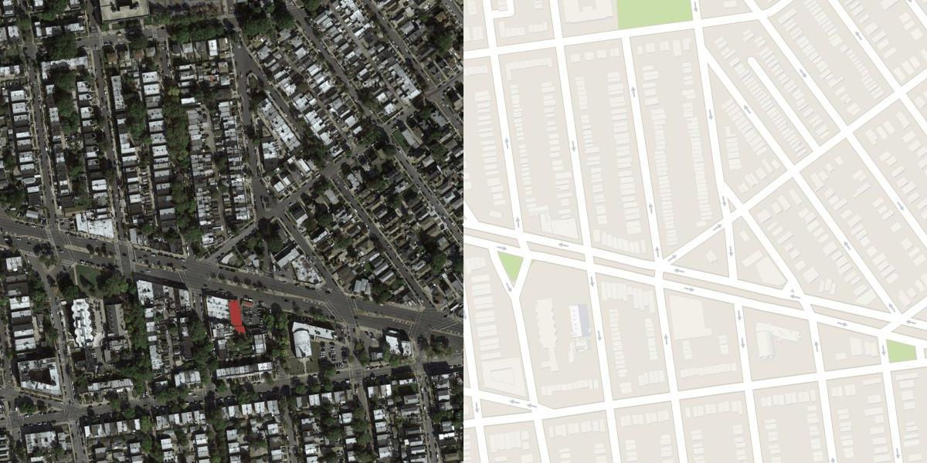
Translation works
01 Translation works(cont’d)
Convolution image feature
The features from 2D convolution are used for transferred image
But this approach has a limitation that it can only cause a very partial change
$$X∗K=X_{transfered} where ∗ :2D convolution$$
< Google Maps data >

Slide 7





Translation works
01 Translation works(cont’d)
Deep neural networks conduct image translation works successfully
Generative models could be used for image translation
AutoEncoder and GANs are generally used
The translation of an image is a task of mapping data to a lower dimension and mapping it back to a higher dimensional image
dataset
Transferred images
workflow

Slide 8
Approaches
02

Slide 9
Approaches
02 Approaches
AEs, GANs
They are neural networks based image translation approaches
AEs acts as a one-to-one function
Even GANs acts as a one-to-one function
It means we need dataset with ‘pairs’
AEs for image transfer
An encoder of AE map the datapoint to latent space
An decoder of AE map the latent point to transffered space
GANs for image transfer
A generator of GAN for image transfer acts as a decoder of AEs
A discriminator of GAN for image transfer acts as a encoder of AEs

Slide 10



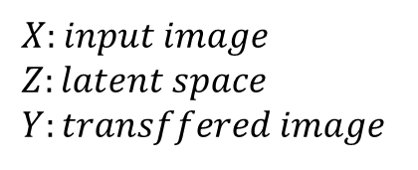


Approaches
02 Approaches(cont’d)
- AEs
Encoder
Decoder
$$X$$
$$h$$
$$Z$$
$$h$$
$$X$$
$$X:input image \\ Z:latent space \\ Y:transffered image$$

Slide 11






Approaches
02 Approaches(cont’d)
- GANs
$$Y$$
DISCRIMINATOR
$$discriminator$$
$$P[Y]$$
$$X$$
$$generator$$
$$Y′$$
GENERATOR
$$X:input image \\ Z:latent space \\ Y:transffered image$$

Slide 12
Examples
03

Slide 13
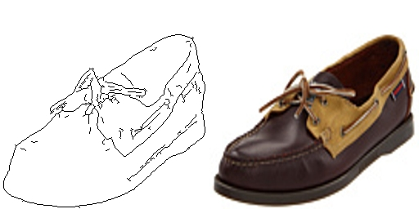
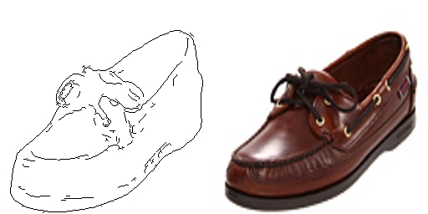
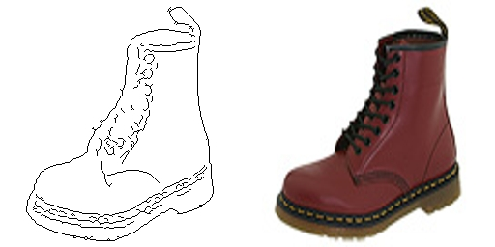
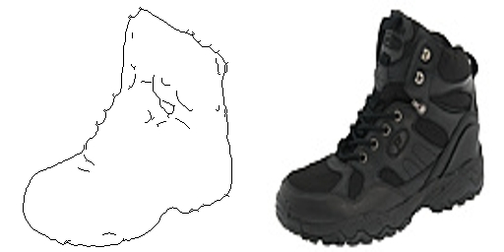
Examples
03 Examples
- edge2shoe

Slide 14
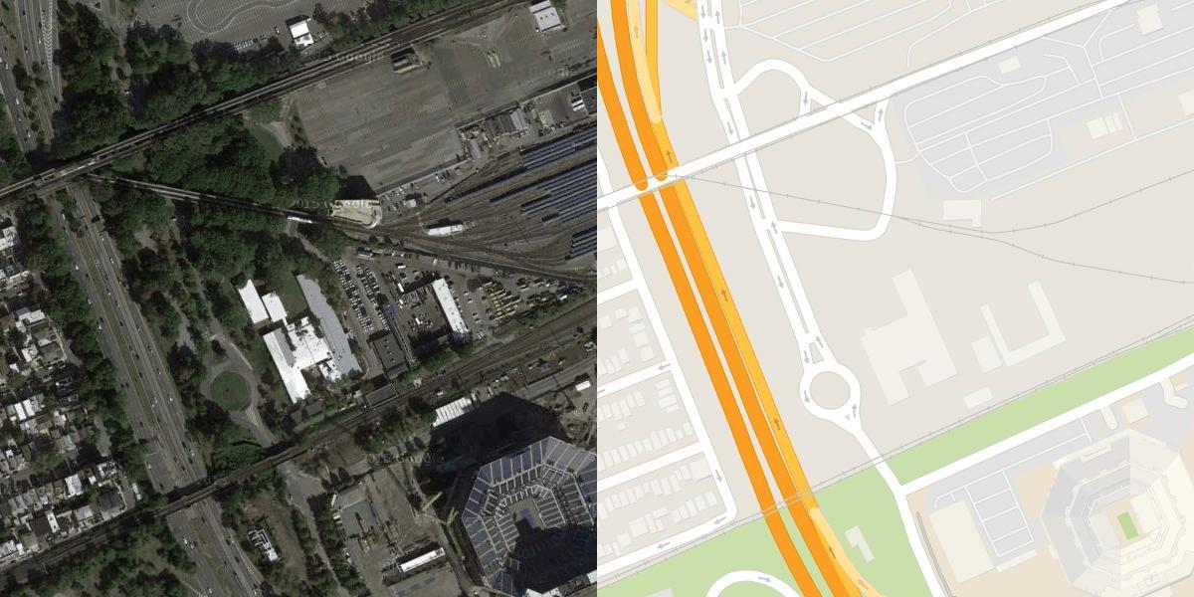
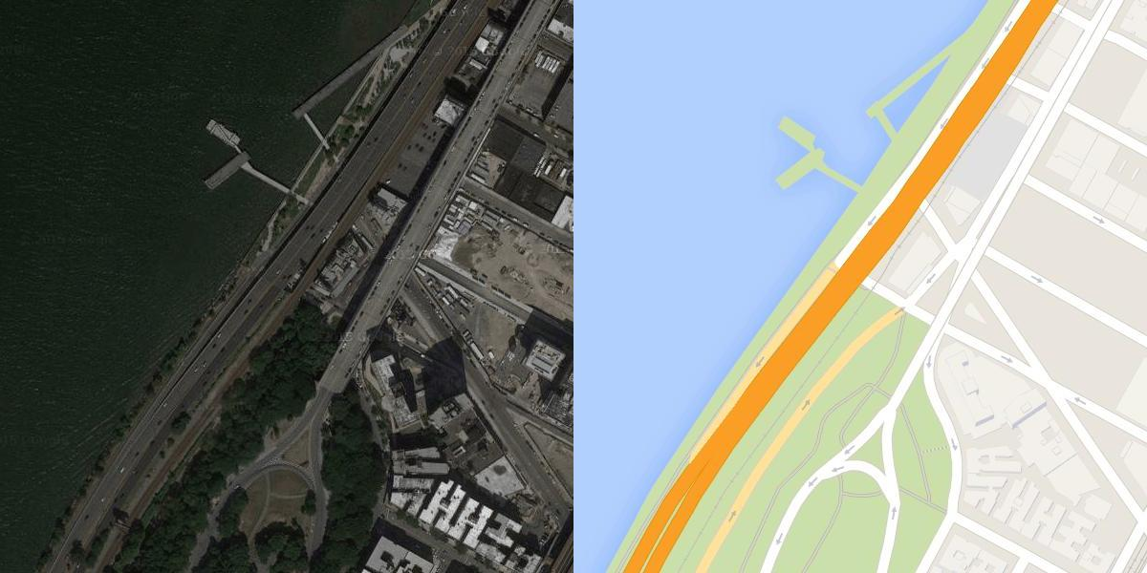
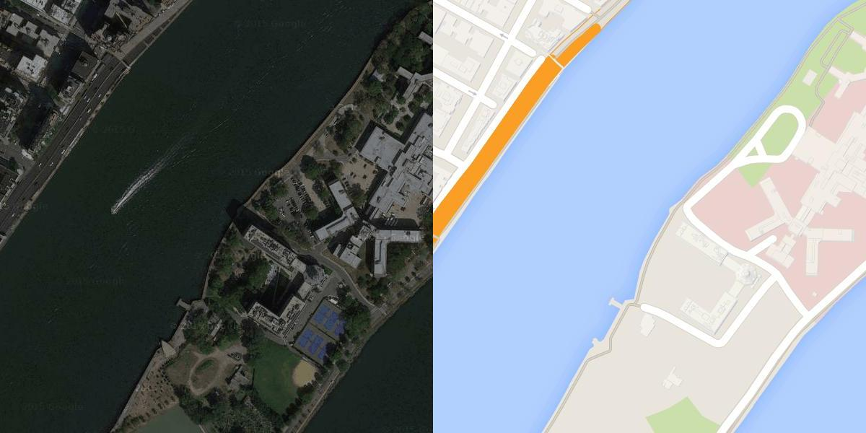
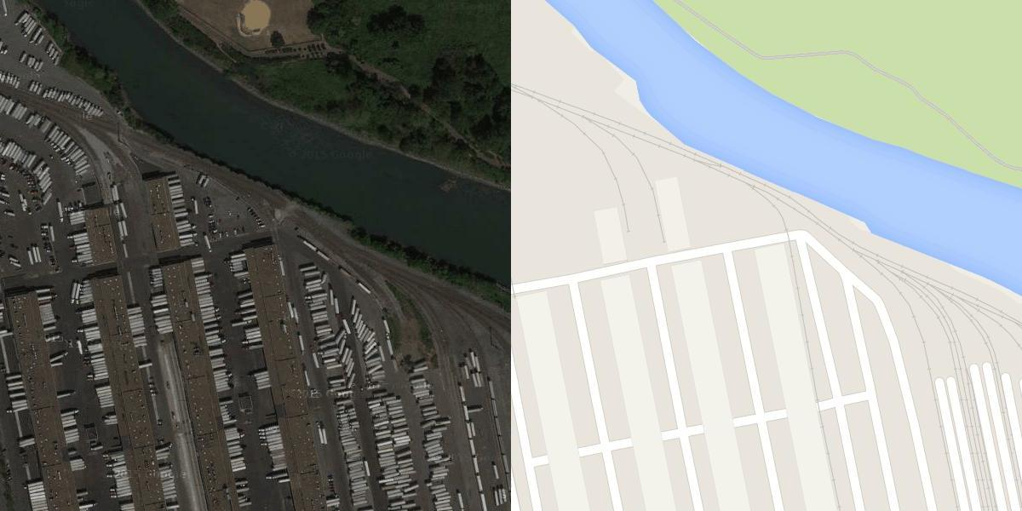
Examples
03 Examples
- GoogleMaps

