Slide 1
A Neural Representation of Sketch Drawings
김현진

Slide 2
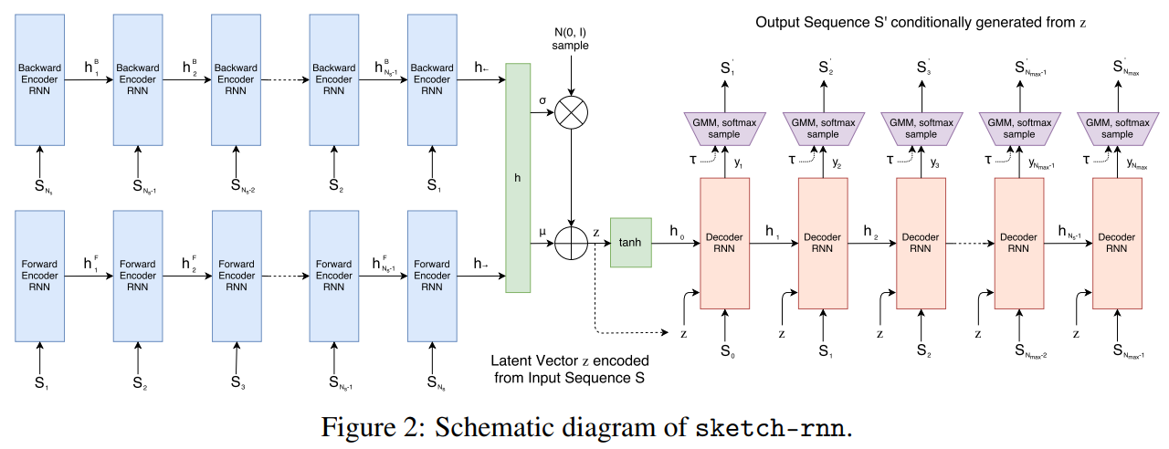
Sketch-RNN

Slide 3
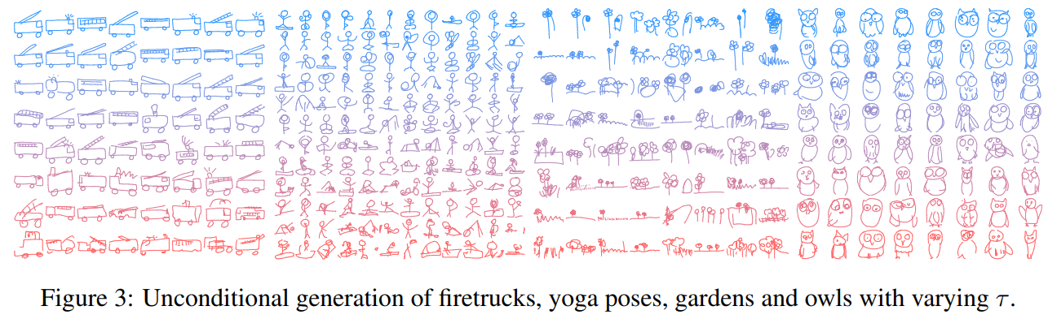
Unconditional generation
0.2
0.9

Slide 4
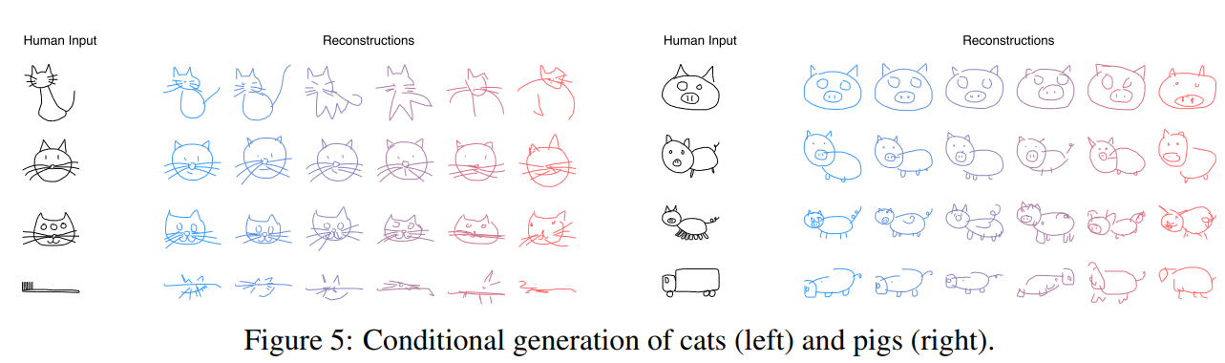
Conditional generation

Slide 5
