Slide 1
Using the features from infoGAN for discriminative works
2018.08.03
신동진

Slide 2
01 GANs
Contents
02 infoGAN
03 Comparison of learned features
- Discriminative models(CNN)
- Generative models(infoGAN)

Slide 3
GANs
01

Slide 4

GANs
01 GANs
Generative adversarial networks(GANs)
Generative network models
$P\left[x | z\right]$ where $z\sim f\left(⋅\right)$
$f$ is the prior such that Gaussian dist., Uniform dist., etc.
There is two networks in GANs
One is a ‘discriminator’
A discriminator detects generated samples
Other is a ‘generator’
A generator deceives a discriminator
A generator compete with discriminator
Eventually, we want to get a well-deceiving generator
There are some researches on using discriminator for classification works

Slide 5



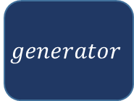


GANs
01 GANs(cont’d)
$$X$$
DISCRIMINATOR
GENERATOR
$$discriminator$$
$$P[data=real]$$
$$noise$$
$$generator$$
$$X′$$

Slide 6
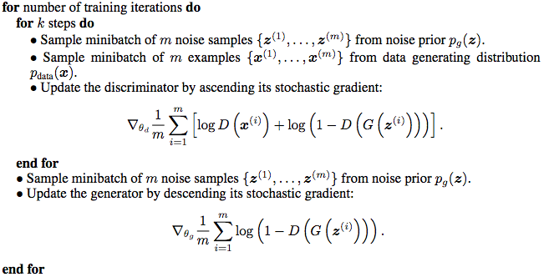
GANs
01 GANs(cont’d)
Pseudo codes of GANs

Slide 7

GANs
01 GANs(cont’d)
Workflow of GANs
We can split the objective function into two terms
Objective function for discriminator
${obj}_{dis}=\sum{\left\{\log\left(D\left(x\right)\right)+\log\left(1−D\left(G\left(z\right)\right)\right)\right\}}$
We want to maximize ${obj}_{dis}$(or minimize $−{obj}_{dis}$)
For efficient convergence, we can apply least square objective function
${LSobj}_{dis}=\sum{\left\{{\left(1−D\left(x\right)\right)}^{2}+{\left(D\left(G\left(z\right)\right)\right)}^{2}\right\}}$
We want to minimize $LS{obj}_{dis}$
Objective function for generator
${obj}_{gen}=\sum{\left\{\log\left(1−D\left(G\left(z\right)\right)\right)\right\}}$
We want to minimize ${obj}_{gen}$(or we can use ${LSobj}_{gen}$)

Slide 8
infoGANs
02

Slide 9

infoGANs
02 infoGANs
One of problems of GANs(vanilla GANs) is that we cannot interpret and control the noise
That means we can generate some random samples only
We want to generate sample from specific class or attributes
Conditional GANs
Previously, we solve that problem by adding conditional layers
But it is an supervised way, so has lots of biases
Mutual information inducing latent codes
$I\left(X;C\right)=H\left(X\right)−H\left(X|C\right)=H\left(C\right)−H\left(C|X\right)$
It means amount of information
Also, It is the reduction of uncertainty in X when C is observed
Given any $x\sim P_{G}(x)$, we want $P_{G}(c|x)$ to have small entropy
Random noise have few information (Do we know attributes or class when given a generated sample?)

Slide 10
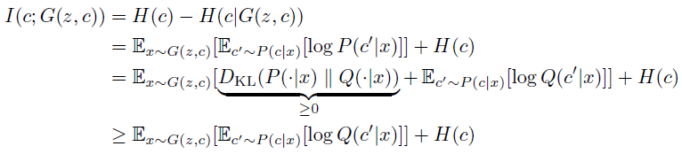
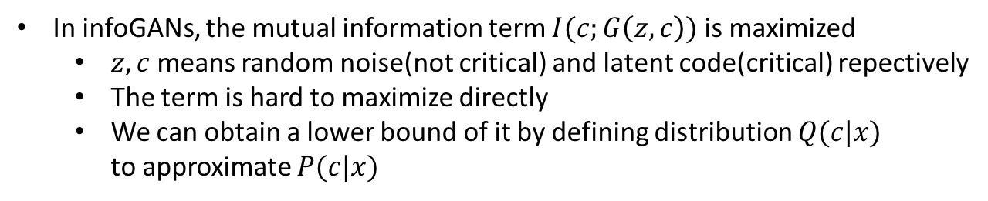
infoGANs
02 infoGANs(cont’d)
In infoGANs, the mutual information term $I(c;G\left(z,c\right))$ is maximized
$z,c$ means random noise(not critical) and latent code(critical) repectively
The term is hard to maximize directly
We can obtain a lower bound of it by defining distribution $Q(c|x)$ to approximate $P(c|x)$

Slide 11








infoGANs
02 infoGANs(cont’d)
$$X$$
DISCRIMINATOR
GENERATOR
$$discriminator$$
$$P[x=real]$$
$$z$$
$$generator$$
$$X′$$
$$Q[c|x]$$
$$c$$

Slide 12
Comparison of learned features
03

Slide 13
Comparison of learned features
03 Comparison of learned features

