Slide 1
20180803 랩미팅
김현지

Slide 2
Modeling customer online behaviors with neural networks:
applications to conversion prediction and advertising retargeting (2018)

Slide 3
CNN
: Embedding
- User Searched Keywords
- Visited Page Names
RNN
: Modeling
In-session customer visited journey
(using embedded feature vectors)
Monte Carlo
: Simulating N-steps forecasting
Predicting Conversion rates

Slide 4
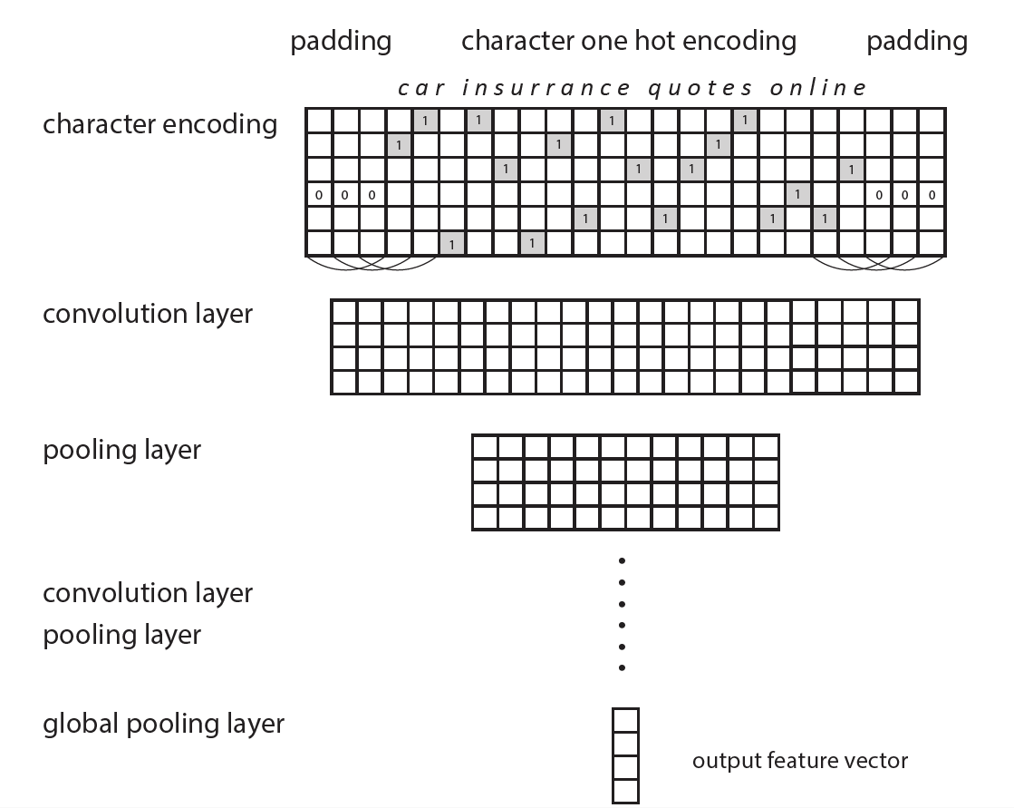

Slide 5
To be continued…….
RNN for customer visiting journey modeling
Multi-layer LSTM as recurrent architecture
Monte Carlo for customer journey simulation
Results

