Slide 1

JinnieNet:
A Weight Estimation Based Denoising Autoencoder for Effective Collaborative Filtering
단국대학교 김현진, 신동진, 신원용, 황창하

Slide 2
CONTENT
1
Recommendation System
for Collaborative Filtering(CF)
2
Denoising AutoEncoder (DAE)
3
JinnieNet
4
Result & Conclusion

Slide 3
01
Recommendation System for CF

Slide 4

Netflix Prize는 넷플릭스 사용자들의 영화 별점 데이터를 가지고
2006년 10월부터 2009년 7월까지 약 3년에 걸쳐 이어진 기계학습을 통한 영화 평가 데이터 예측 대회

Slide 5

Recommendation System for CF
Collaborative Filtering (CF)
CF is a technique that automatically predicts user’s preference with taste information of users
Item user | item 1 | item 2 | item 3 | item 4 | item 5
user 1 | 5 | 3 | 4 | 4 | ?
user 2 | 3 | 1 | 2 | 2 | 3
user 3 | 4 | 3 | 4 | 3 | 5
user 4 | 3 | 3 | 1 | 5 | 4
user 5 | 1 | 5 | 5 | 2 | 1
User-based
nearest-neighbor
collaborative filtering
Item-based
nearest-neighbor
collaborative filtering
Source: wikipedia

Slide 6
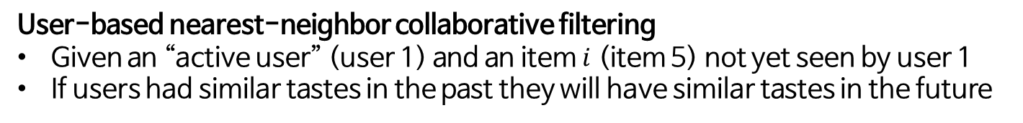
Recommendation System for CF
User-based nearest-neighbor collaborative filtering
Given an “active user” (user 1) and an item $i$ (item 5) not yet seen by user 1
If users had similar tastes in the past they will have similar tastes in the future
Item user | item 1 | item 2 | item 3 | item 4 | item 5
user 1 | 5 | 3 | 4 | 4 | ?
user 2 | 3 | 1 | 2 | 2 | 3
user 3 | 4 | 3 | 4 | 3 | 5
user 4 | 3 | 3 | 1 | 5 | 4
user 5 | 1 | 5 | 5 | 2 | 1
User-based
nearest-neighbor
collaborative filtering
Source: http://www.recommenderbook.net/

Slide 7
Recommendation System for CF
Item-based collaborative filtering
Use the similarity between items (and not users) to make predictions
Item user | item 1 | item 2 | item 3 | item 4 | item 5
user 1 | 5 | 3 | 4 | 4 | ?
user 2 | 3 | 1 | 2 | 2 | 3
user 3 | 4 | 3 | 4 | 3 | 5
user 4 | 3 | 3 | 1 | 5 | 4
user 5 | 1 | 5 | 5 | 2 | 1
Item-based
nearest-neighbor
collaborative filtering
Source: http://www.recommenderbook.net/

Slide 8
Recommendation System for CF
Sparsity
If a user purchased few items from the shop and has rated any of them
Sparsity is the problem of lack of knowledge.
Item user | item 1 | item 2 | item 3 | item 4 | item 5
user 1 | 5 | ? | ? | ? | ?
user 2 | ? | 1 | ? | ? | ?
user 3 | ? | 3 | ? | ? | 5
user 4 | ? | ? | 1 | ? | 4
user 5 | ? | ? | ? | 2 | ?
MovieLens: 0.937
1- (100k ratings /
943 users
on 1682 movie)
Jester: 0.442
1 - (4.1M ratings /
73,496 users
on 100 jokes)
Source: http://www.recommenderbook.net/

Slide 9
02
Denoising AutoEncoder (DAE)

Slide 10

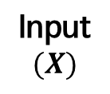






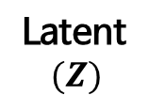



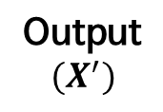
DAE
Autoencoder(AE)
An unsupervised neural network model generating a latent space that represent input vector
It is usually used for data denoising or data embedding
$$x_{1}$$
$${x′}_{1}$$
$$x_{2}$$
$$z_{1}$$
$${x′}_{2}$$
$$x_{3}$$
$$z_{2}$$
$${x′}_{3}$$
$$x_{4}$$
Latent
$$(Z)$$
$${x′}_{4}$$
Input
$$(X)$$
Output
$$(X^{′})$$
Source: M. A. Kramer, “Autoassociative neural networks”

Slide 11
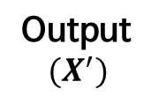
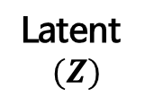
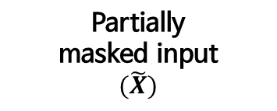
DAE
Denoising AutoEncoder(DAE)
A type of AE
It is known as a efficient model for sparse input data and is trained with partially masked input vector
$$x_{1}$$
$${x′}_{1}$$
$$x_{2}$$
$$z_{1}$$
$${x′}_{2}$$
$$x_{3}$$
$$z_{2}$$
$${x′}_{3}$$
$$x_{4}$$
Latent
$$(Z)$$
$${x′}_{4}$$
Partially
masked input
$$(\tilde{X})$$
Output
$$(X^{′})$$
Source: P. Vincent, H. Larochelle, Y. Bengio and P. A. Manzagol, “Extracting and composing robust features with denoising autuencoders”

Slide 12
03
JinnieNet

Slide 13
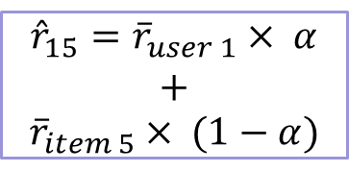


JinnieNet
Motivation
Z.Qian’s algorithm predicts a rating with weighted summation of neighbor’s average ratings
Item user | item 1 | item 2 | item 3 | item 4 | item 5
user 1 | 5 | 3 | 4 | 4 | ?
user 2 | 3 | 1 | 2 | 2 | 3
user 3 | 4 | 3 | 4 | 3 | 5
user 4 | 3 | 3 | 1 | 5 | 4
user 5 | 1 | 5 | 5 | 2 | 1
$${\overline{r}}_{user 1}× α$$
$${\hat{r}}_{15}={\overline{r}}_{user 1}× α$$
$$+$$
$${\overline{r}}_{item 5}× (1−α)$$
$${\overline{r}}_{item 5}× (1−α)$$
Source: Z. Qian, L. Qing and Z. Xue, “A Collaborative Filtering Recommendation Algorithm based on Correlation and Improved Weighted Prediction ”

Slide 14




JinnieNet
JinnieNet Idea
But in JinnieNet, these weights are trained as parameters
$${\hat{r}}_{15}= α×{\overline{r}}_{user 1}+(1−α)×{\overline{r}}_{ item 5}$$
$$γ$$
$$δ$$
$${\hat{r}}_{ui}=γ\left(r_{ui}\right)×{\overline{r}}_{u}+δ\left(r_{ui}\right)×{\overline{r}}_{i}$$

Slide 15
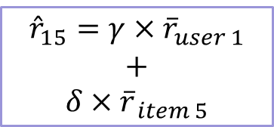


JinnieNet
JinnieNet
To predict a missing rating, JinnieNet trains the weights based on similar patterns
Item user | item 1 | item 2 | item 3 | item 4 | item 5
user 1 | 5 | 3 | 4 | 4 | ?
user 2 | 3 | 1 | 2 | 2 | 3
user 3 | 4 | 3 | 4 | 3 | 5
user 4 | 3 | 3 | 1 | 5 | 4
user 5 | 1 | 5 | 5 | 2 | 1
$${\overline{r}}_{user 1}×γ$$
$${\hat{r}}_{15}=γ×{\overline{r}}_{user 1}$$
$$+$$
$$δ×{\overline{r}}_{ item 5}$$
$${\overline{r}}_{item 4}×δ$$

Slide 16
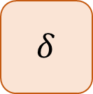

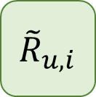

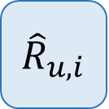

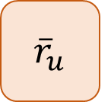

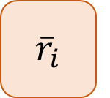
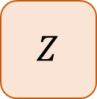
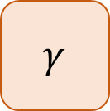
JinnieNet
JinnieNet’s structure
$$γ$$
$${\overline{r}}_{u}$$
$$×$$
$${\tilde{R}}_{u,i}$$
$$Z$$
$${\hat{R}}_{u,i}$$
$$+$$
$$δ$$
$${\overline{r}}_{i}$$
$$×$$
$${\hat{r}}_{ui}=γ\left(r_{ui}\right)×{\overline{r}}_{u}+δ\left(r_{ui}\right)×{\overline{r}}_{i}$$

Slide 17
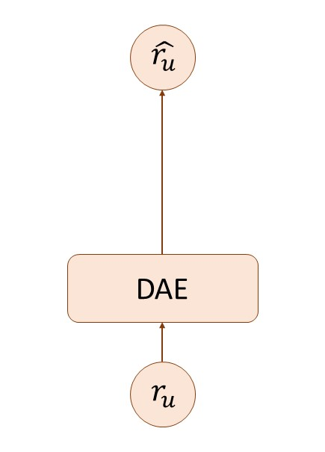
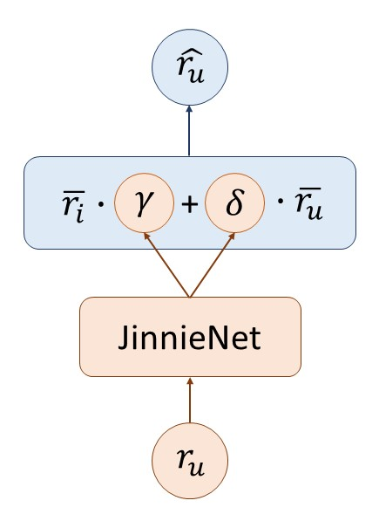
JinnieNet
DAE vs JinnieNet

Slide 18
04
Result & Discussion

Slide 19
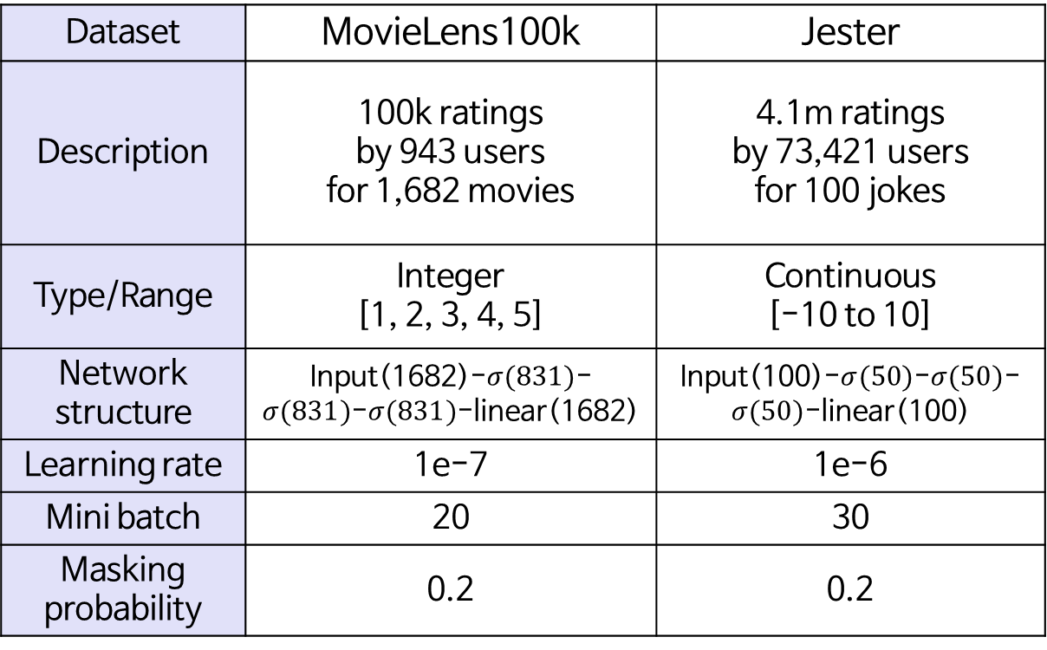
Result
Environment of experiments
Dataset | MovieLens100k | Jester
Description | 100k ratings by 943 users for 1,682 movies | 4.1m ratings by 73,421 users for 100 jokes
Type/Range | Integer [1, 2, 3, 4, 5] | Continuous [-10 to 10]
Network structure | Input(1682)-$σ(831)$-$σ(831)$-$σ(831)$-linear(1682) | Input(100)-$σ(50)$-$σ(50)$-$σ(50)$-linear(100)
Learning rate | 1e-7 | 1e-6
Mini batch | 20 | 30
Masking probability | 0.2 | 0.2
Notes:
03 RESULT
파트의 첫 슬라이드로 하면 어떨까??

Slide 20
Result
Precision
: The ratio of the products satisfied by the user from the items recommended through the recommendation system.
nDCG(Normalized Discounted Cumulative Gain)
: One of the popular evaluating measures ranked results in information retrieval.
For CF applications, the ratings on items assigned by the users can serve as the graded relevance judgements.
Source: N. N. Liu and Q. Yang, “EigenRank: A Ranking-Oriented Approach to Collaborative Filtering”

Slide 21
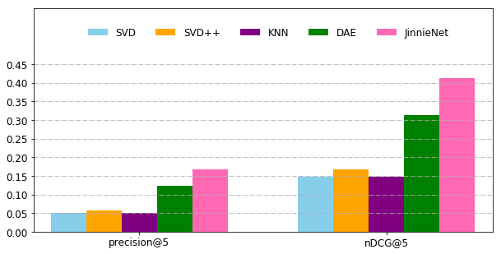
Result
Performance on MovieLens100k
In terms of precision@5 and nDCG@5, JinnieNet each showed an increase of 36% and 32% compared with DAE(state-of-art)
32%
36%

Slide 22
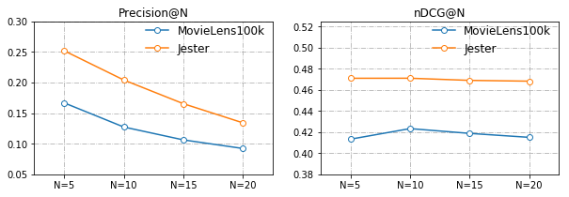
Result
Performance on MovieLens100k & Jester by N
Despite the increase in N, JinnieNet showed a high level of performance

Slide 23
Discussion
Conclusion
JinnieNet showed novel performance on MovieLens 100k and Jester dataset
JinnieNet could be applied to various recommendation system
Future work
Because most of dataset used in recommendation system is huge, JinnieNet needs to be tested with large dataset
Also, reduction of computational complexity is required

Slide 24
Thank you

