Slide 1


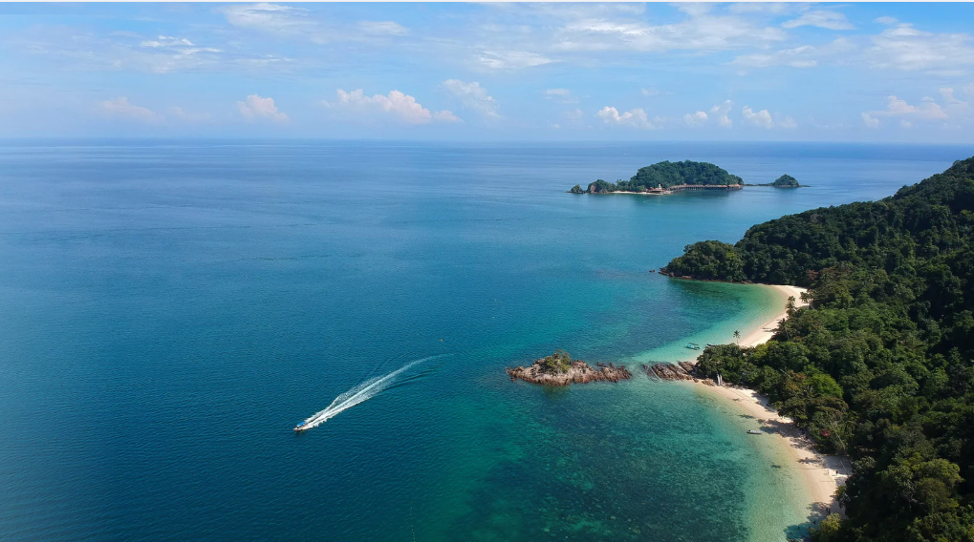


IT 126A (T142)
BEACH RESORT BOOKING SYSTEM
Presented by:
Castro, Kate | Gabonada, Renzo | Ricablanca, John Dyll | Sagayoc, Armando | Tagud, Janus

Slide 2


Introduction
The Beach Booking System is designed to manage guest reservations at a beach resort. It keeps track of guest information, room bookings, amenities, payment details, and stay dates. Through this system, guests can easily reserve their preferred room types like "Ocean View," "Garden View," or "Suite" while adding special amenities such as pool access, beach chairs, and kayak rentals. The system ensures smooth operations for both guests and staff by organizing all booking details efficiently, aiming for a comfortable and worry-free beach vacation experience.

Slide 3
Unormalized Form (Original Data)
BookingID | GuestName | GuestPhone | RoomNumber | RoomType | CheckInDate | CheckOutDate | Amenity | PaymentDate | PaymentAmount
B001 | Alice Jones | 555-1234 | 101 | Ocean View | 2024-07-01 | 2024-07-05 | Pool Access | 2024-06-15 | 800
B001 | Alice Jones | 555-1234 | 101 | Ocean View | 2024-07-01 | 2024-07-05 | Beach Chair | 2024-06-15 | 800
B002 | Bob Smith | 555-9876 | 202 | Garden View | 2024-07-02 | 2024-07-04 | Spa Access | 2024-06-20 | 450
B002 | Bob Smith | 555-9876 | 202 | Garden View | 2024-07-02 | 2024-07-04 | Pool Access | 2024-06-20 | 450
B003 | Alice Jones | 555-1234 | 101 | Ocean View | 2024-08-10 | 2024-08-12 | Beach Chair | 2024-08-01 | 350
B003 | Alice Jones | 555-1234 | 101 | Ocean View | 2024-08-10 | 2024-08-12 | Kayak Rental | 2024-08-01 | 350
B004 | Carla White | 555-2222 | 303 | Suite | 2024-07-15 | 2024-07-18 | Pool Access | 2024-07-10 | 1200
B004 | Carla White | 555-2222 | 303 | Suite | 2024-07-15 | 2024-07-18 | Spa Access | 2024-07-10 | 1200
B005 | Bob Smith | 555-9876 | 202 | Garden View | 2024-08-05 | 2024-08-08 | Kayak Rental | 2024-07-30 | 600
B005 | Bob Smith | 555-9876 | 202 | Garden View | 2024-08-05 | 2024-08-08 | Beach Chair | 2024-07-30 | 600

Slide 4
First Normal Form (1NF)
BookingID | GuestName | GuestPhone | RoomNumber | RoomType | CheckInDate | CheckOutDate | Amenity | PaymentDate | PaymentAmount
B001 | Alice Jones | 555-1234 | 101 | Ocean View | 2024-07-01 | 2024-07-05 | Pool Access | 2024-06-15 | 800
B001 | Alice Jones | 555-1234 | 101 | Ocean View | 2024-07-01 | 2024-07-05 | Beach Chair | 2024-06-15 | 800
B002 | Bob Smith | 555-9876 | 202 | Garden View | 2024-07-02 | 2024-07-04 | Spa Access | 2024-06-20 | 450
B002 | Bob Smith | 555-9876 | 202 | Garden View | 2024-07-02 | 2024-07-04 | Pool Access | 2024-06-20 | 450
B003 | Alice Jones | 555-1234 | 101 | Ocean View | 2024-08-10 | 2024-08-12 | Beach Chair | 2024-08-01 | 350
B003 | Alice Jones | 555-1234 | 101 | Ocean View | 2024-08-10 | 2024-08-12 | Kayak Rental | 2024-08-01 | 350
B004 | Carla White | 555-2222 | 303 | Suite | 2024-07-15 | 2024-07-18 | Pool Access | 2024-07-10 | 1200
B004 | Carla White | 555-2222 | 303 | Suite | 2024-07-15 | 2024-07-18 | Spa Access | 2024-07-10 | 1200
B005 | Bob Smith | 555-9876 | 202 | Garden View | 2024-08-05 | 2024-08-08 | Kayak Rental | 2024-07-30 | 600
B005 | Bob Smith | 555-9876 | 202 | Garden View | 2024-08-05 | 2024-08-08 | Beach Chair | 2024-07-30 | 600

Slide 5
Second Normal Form (2NF)
Booking_ID | Guess name | Address | GuestPhone | RoomNumber
B001 | Alice Jones | Casisang | 555-1234 | 101
B001 | Alice Jones | Casisang | 555-1234 | 101
B002 | Bob Smith | Kalasungay | 555-9876 | 202
B002 | Bob Smith | Kalasungay | 555-9876 | 202
B003 | Alice Jones | Casisang | 555-1234 | 101
B003 | Alice Jones | Casisang | 555-1234 | 101
B004 | Carla White | Bangcud | 555-2222 | 303
B004 | Carla White | Bangcud | 555-2222 | 303
B005 | Bob Smith | Kalasungay | 555-9876 | 202
B005 | Bob Smith | Kalasungay | 555-9876 | 202

Slide 6
Second Normal Form (2NF)
Roomtype_ID | Room type | CheckInDate | CheckoutDate | Amenity | PaymentDate | PaymentAmount
301 | Ocean View | 2024-07-01 | 2024-07-05 | Pool Access | 2024-06-15 | 800
301 | Ocean View | 2024-07-01 | 2024-07-05 | Beach Chair | 2024-06-15 | 800
303 | Garden View | 2024-07-02 | 2024-07-04 | Spa Access | 2024-06-20 | 450
303 | Garden View | 2024-07-02 | 2024-07-04 | Pool Access | 2024-06-20 | 450
301 | Ocean View | 2024-08-10 | 2024-08-12 | Beach Chair | 2024-08-01 | 350
301 | Ocean View | 2024-08-10 | 2024-08-12 | Kayak Rental | 2024-08-01 | 350
304 | Suite | 2024-07-15 | 2024-07-18 | Pool Access | 2024-07-10 | 1200
304 | Suite | 2024-07-15 | 2024-07-18 | Spa Access | 2024-07-10 | 1200
303 | Garden View | 2024-08-05 | 2024-08-08 | Kayak Rental | 2024-07-30 | 600
303 | Garden View | 2024-08-05 | 2024-08-08 | Beach Chair | 2024-07-30 | 600

Slide 7
Second Normal Form (2NF)
Booking_ID | RoomNumber | Roomtype_ID
B001 | 101 | 301
B001 | 101 | 301
B002 | 202 | 303
B002 | 202 | 303
B003 | 101 | 301
B003 | 101 | 301
B004 | 303 | 304
B004 | 303 | 304
B005 | 202 | 303
B005 | 202 | 303

Slide 8
Third Normal Form (3NF)
Booking_ID | Guess name | Address | GuestPhone | RoomNumber_ID
B001 | Alice Jones | Casisang | 555-1234 | 101
B001 | Alice Jones | Casisang | 555-1234 | 101
B002 | Bob Smith | Kalasungay | 555-9876 | 202
B002 | Bob Smith | Kalasungay | 555-9876 | 202
B003 | Alice Jones | Casisang | 555-1234 | 101
B003 | Alice Jones | Casisang | 555-1234 | 101
B004 | Carla White | Bangcud | 555-2222 | 303
B004 | Carla White | Bangcud | 555-2222 | 303
B005 | Bob Smith | Kalasungay | 555-9876 | 202
B005 | Bob Smith | Kalasungay | 555-9876 | 202

Slide 9
Third Normal Form (3NF)
Roomtype_ID | Room type | CheckInDate | CheckoutDate | Amenity | PaymentDate | PaymentAmount
301 | Ocean View | 2024-07-01 | 2024-07-05 | 2024-07-05 | 2024-06-15 | 800
301 | Ocean View | 2024-07-01 | 2024-07-05 | 2024-07-05 | 2024-06-15 | 800
303 | Garden View | 2024-07-02 | 2024-07-04 | 2024-07-04 | 2024-06-20 | 450
303 | Garden View | 2024-07-02 | 2024-07-04 | 2024-07-04 | 2024-06-20 | 450
301 | Ocean View | 2024-08-10 | 2024-08-12 | 2024-08-12 | 2024-08-01 | 350
301 | Ocean View | 2024-08-10 | 2024-08-12 | 2024-08-12 | 2024-08-01 | 350
304 | Suite | 2024-07-15 | 2024-07-18 | 2024-07-18 | 2024-07-10 | 1200
304 | Suite | 2024-07-15 | 2024-07-18 | 2024-07-18 | 2024-07-10 | 1200
303 | Garden View | 2024-08-05 | 2024-08-08 | 2024-08-08 | 2024-07-30 | 600
303 | Garden View | 2024-08-05 | 2024-08-08 | 2024-08-08 | 2024-07-30 | 600

Slide 10
Third Normal Form (3NF)
Booking_ID | RoomNumber_ID | Roomtype_ID
B001 | 101 | 301
B001 | 101 | 301
B002 | 202 | 303
B002 | 202 | 303
B003 | 101 | 301
B003 | 101 | 301
B004 | 303 | 304
B004 | 303 | 304
B005 | 202 | 303
B005 | 202 | 303
Amenity_ID | Amenity
201 | Pool Access
202 | Beach Chair
203 | Spa Access
204 | Kayak Rental

Slide 11
Fourth Normal Form (4NF)
Guest Booking Table
Booking_ID | Guess name | Address | GuestPhone | RoomNumber_ID
B001 | Alice Jones | Casisang | 555-1234 | 101
B001 | Alice Jones | Casisang | 555-1234 | 101
B002 | Bob Smith | Kalasungay | 555-9876 | 202
B002 | Bob Smith | Kalasungay | 555-9876 | 202
B003 | Alice Jones | Casisang | 555-1234 | 101
B003 | Alice Jones | Casisang | 555-1234 | 101
B004 | Carla White | Bangcud | 555-2222 | 303
B004 | Carla White | Bangcud | 555-2222 | 303
B005 | Bob Smith | Kalasungay | 555-9876 | 202
B005 | Bob Smith | Kalasungay | 555-9876 | 202

Slide 12
Fourth Normal Form (4NF)
Resort Info Table
Roomtype_ID | Room type | CheckInDate | CheckoutDate | Amenity | PaymentDate | PaymentAmount
301 | Ocean View | 2024-07-01 | 2024-07-05 | 2024-07-05 | 2024-06-15 | 800
301 | Ocean View | 2024-07-01 | 2024-07-05 | 2024-07-05 | 2024-06-15 | 800
303 | Garden View | 2024-07-02 | 2024-07-04 | 2024-07-04 | 2024-06-20 | 450
303 | Garden View | 2024-07-02 | 2024-07-04 | 2024-07-04 | 2024-06-20 | 450
301 | Ocean View | 2024-08-10 | 2024-08-12 | 2024-08-12 | 2024-08-01 | 350
301 | Ocean View | 2024-08-10 | 2024-08-12 | 2024-08-12 | 2024-08-01 | 350
304 | Suite | 2024-07-15 | 2024-07-18 | 2024-07-18 | 2024-07-10 | 1200
304 | Suite | 2024-07-15 | 2024-07-18 | 2024-07-18 | 2024-07-10 | 1200
303 | Garden View | 2024-08-05 | 2024-08-08 | 2024-08-08 | 2024-07-30 | 600
303 | Garden View | 2024-08-05 | 2024-08-08 | 2024-08-08 | 2024-07-30 | 600

Slide 13
Fourth Normal Form (4NF)
Primary Keys
Amenity Table
Booking_ID | RoomNumber_ID | Roomtype_ID
B001 | 101 | 301
B001 | 101 | 301
B002 | 202 | 303
B002 | 202 | 303
B003 | 101 | 301
B003 | 101 | 301
B004 | 303 | 304
B004 | 303 | 304
B005 | 202 | 303
B005 | 202 | 303
Amenity_ID | Amenity
201 | Pool Access
202 | Beach Chair
203 | Spa Access
204 | Kayak Rental

Slide 14
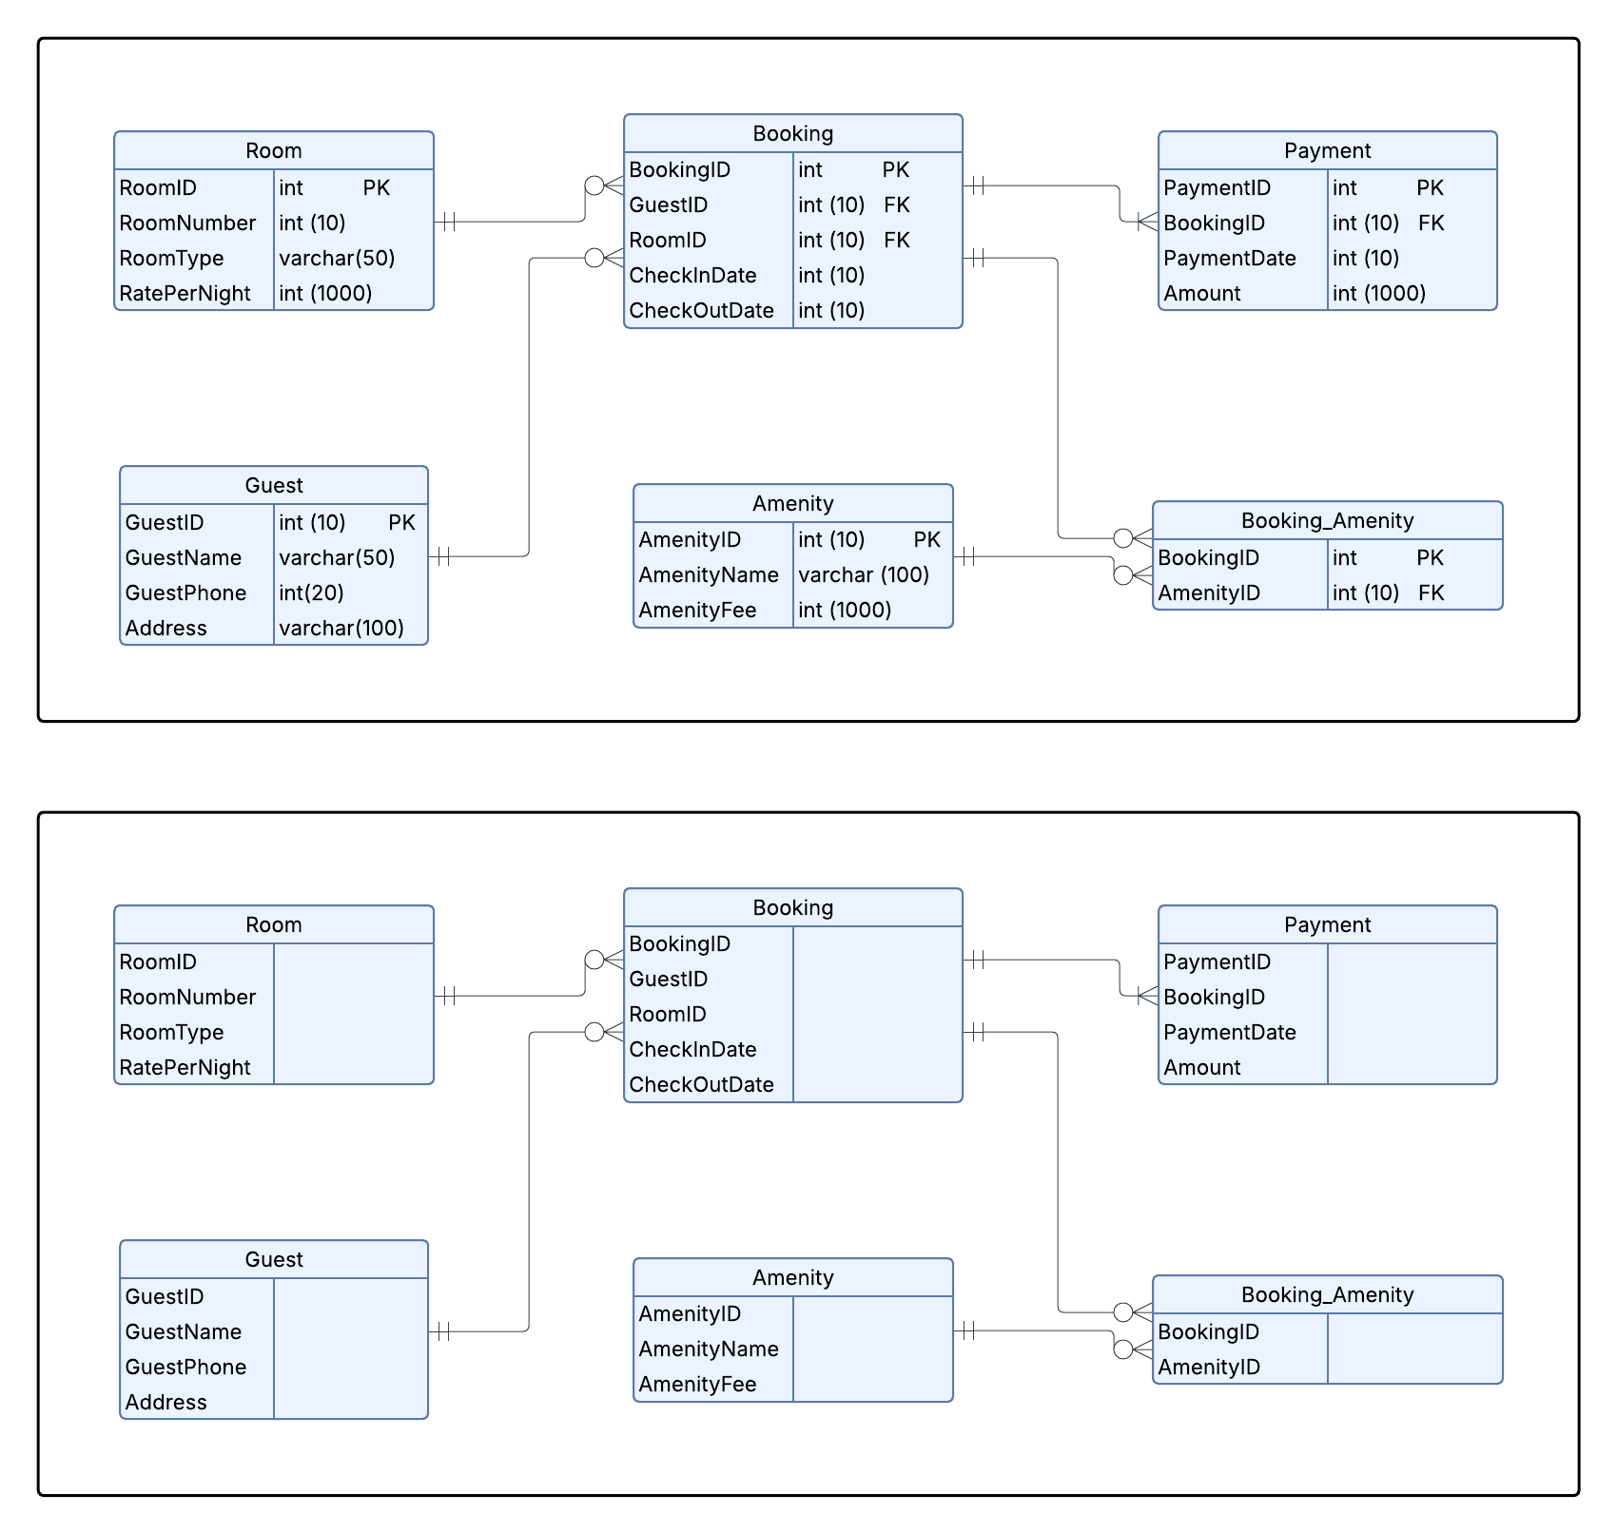
Entity Relationship Diagram (Logical)

Slide 15
Entity Relationship Diagram (Physical)

Slide 16

Conclusion
The Beach Booking System was optimized through normalization (1NF to 4NF) and an ERD, resulting in a structured, consistent, and scalable database that minimizes redundancy and clearly defines relationships between guests, rooms, bookings, and amenities.

Slide 17


THANK YOU!

