Slide 1


Engineering Analytics & Machine Learning (ECSE202)
Seminar 2
Essential
Statistics
AY2018/2019 OCT SEMESTER

Slide 2
Introduction to Probability
Our lives consists of uncertain events. For example, what bus will arrive at the bus stop when you reach it after school today ? How long will the queue be at your favorite stall during lunch tomorrow ?
The field of statistics includes the study of probabilities, which is an attempt to quantify how likely an event can happen. If an event is deemed highly probable, then we may need to prepare for it. If it is highly likely to rain in the afternoon, you may want to make plans so that you are affected as little as possible by the wet weather should it happen.
“Mama always said life was like a box of
chocolates. You never know what you're gonna get.” –Forrest Gump (played by Tom Hanks )
AY2018/2019 OCT SEMESTER
Notes:
This is to lead students to think of events in real life as random process from the prospective of statistic
Let them relate that even if there is actual same number of people at the same queue, the queue time would varied due to many factors
If we collected enough of these data, soon we would know what is the mean (average), standard deviation, mode, median and etc
With enough sufficient samples, we could confidently predict what is the waiting time within a certain probability
We could also share with them example on quality control for manufacturing where product is always within a certain tolerance.
The manufacturing process need to ensure it produce product within tolerance most of the time such as 99% or even higher

Slide 3


Introduction to Probability
Random experiment such as tossing a coin, a probability measure is a population quantity that summarizes the randomness
Discrete outcome (x) of the coin is either 1 (Head) or 0 (Tail)
The probability of the union of any two sets of outcomes that have nothing in common (mutually exclusive) is the sum of their respective probabilities
X=0
X=1
AY2018/2019 OCT SEMESTER

Slide 4
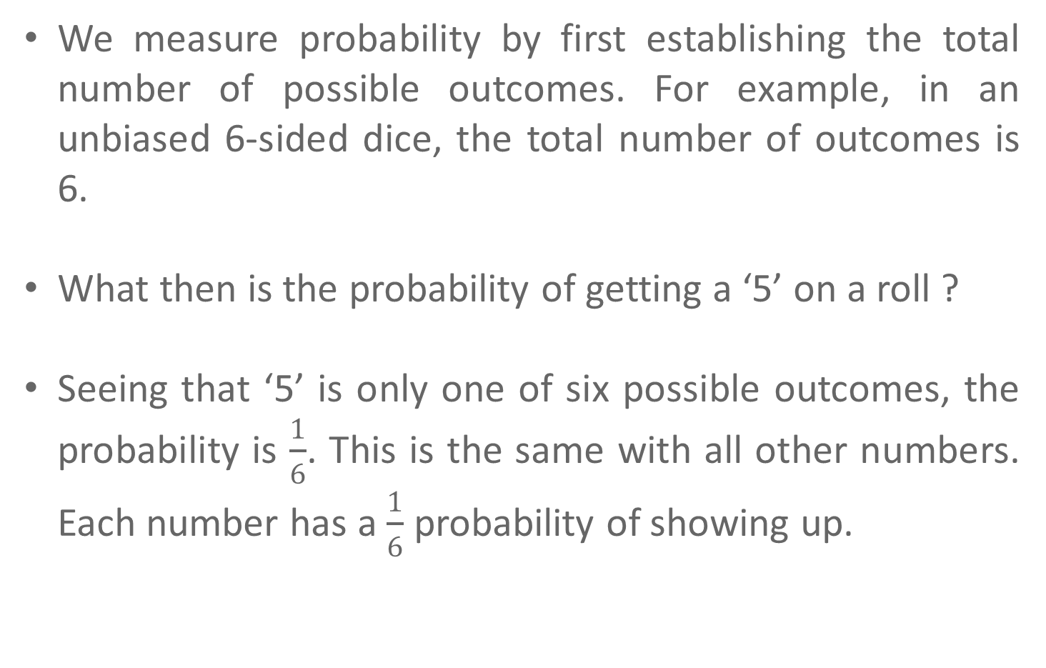
Introduction to Probability
We measure probability by first establishing the total number of possible outcomes. For example, in an unbiased 6-sided dice, the total number of outcomes is 6.
What then is the probability of getting a ‘5’ on a roll ?
Seeing that ‘5’ is only one of six possible outcomes, the probability is $\frac{1}{6}$. This is the same with all other numbers. Each number has a $\frac{1}{6}$ probability of showing up.
AY2018/2019 OCT SEMESTER

Slide 5

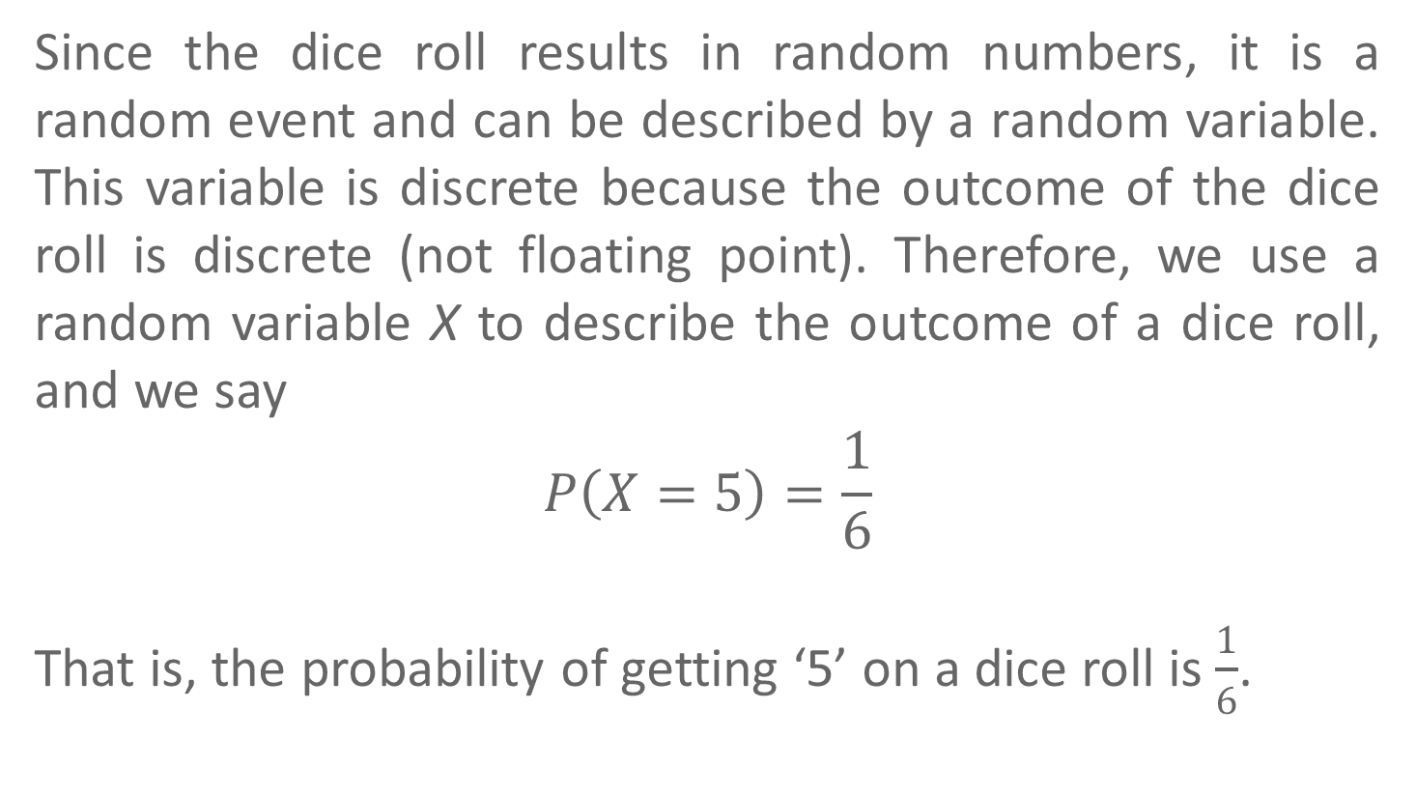
Introduction to Probability
Since the dice roll results in random numbers, it is a random event and can be described by a random variable. This variable is discrete because the outcome of the dice roll is discrete (not floating point). Therefore, we use a random variable X to describe the outcome of a dice roll, and we say
$$P\left(X=5\right)=\frac{1}{6}$$
That is, the probability of getting ‘5’ on a dice roll is $\frac{1}{6}$.
AY2018/2019 OCT SEMESTER

Slide 6
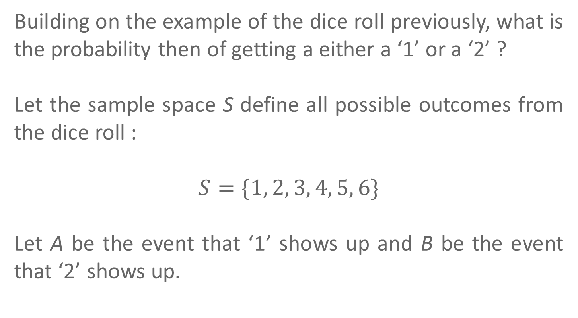
Introduction to Probability
Building on the example of the dice roll previously, what is the probability then of getting a either a ‘1’ or a ‘2’ ?
Let the sample space S define all possible outcomes from the dice roll :
$$S=\{1, 2, 3, 4, 5, 6\}$$
Let A be the event that ‘1’ shows up and B be the event that ‘2’ shows up.
AY2018/2019 OCT SEMESTER

Slide 7
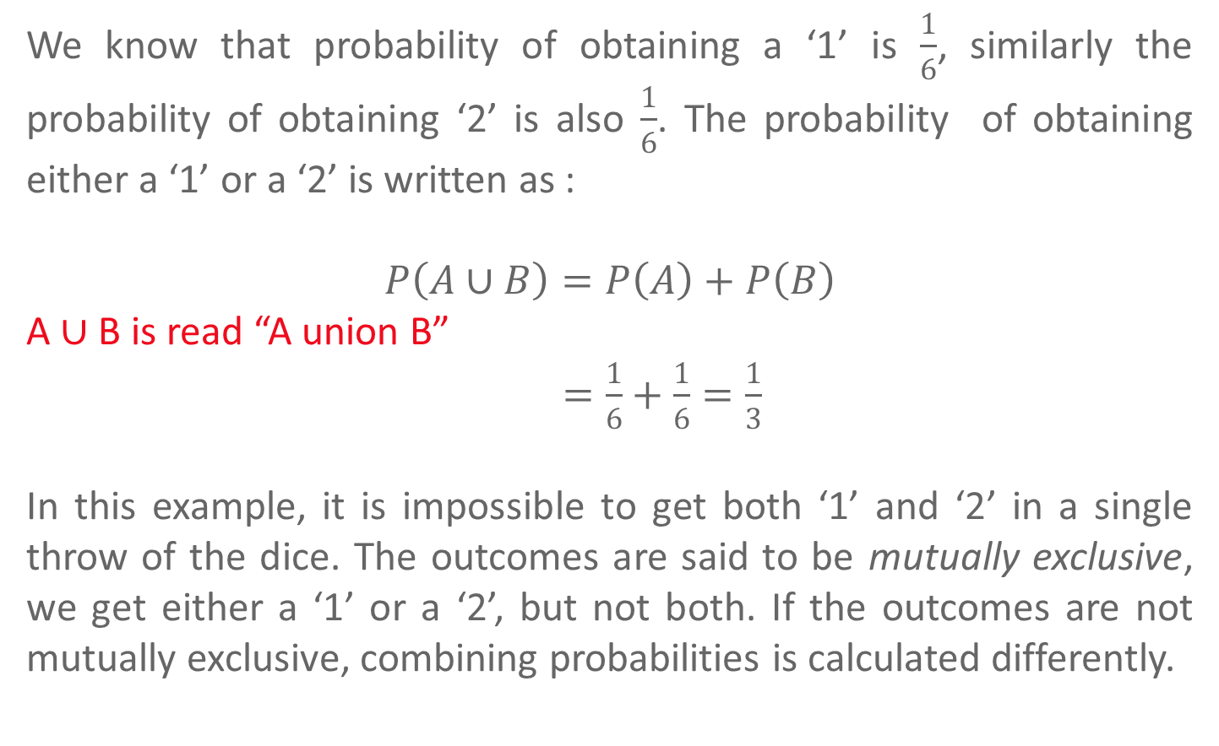
Introduction to Probability
We know that probability of obtaining a ‘1’ is $\frac{1}{6}$, similarly the probability of obtaining ‘2’ is also $\frac{1}{6}$. The probability of obtaining either a ‘1’ or a ‘2’ is written as :
$$P\left(A∪B\right)=P\left(A\right)+P\left(B\right)$$
A $∪$ B is read “A union B”
$=\frac{1}{6}+\frac{1}{6}=\frac{1}{3}$
In this example, it is impossible to get both ‘1’ and ‘2’ in a single throw of the dice. The outcomes are said to be mutually exclusive, we get either a ‘1’ or a ‘2’, but not both. If the outcomes are not mutually exclusive, combining probabilities is calculated differently.
AY2018/2019 OCT SEMESTER

Slide 8
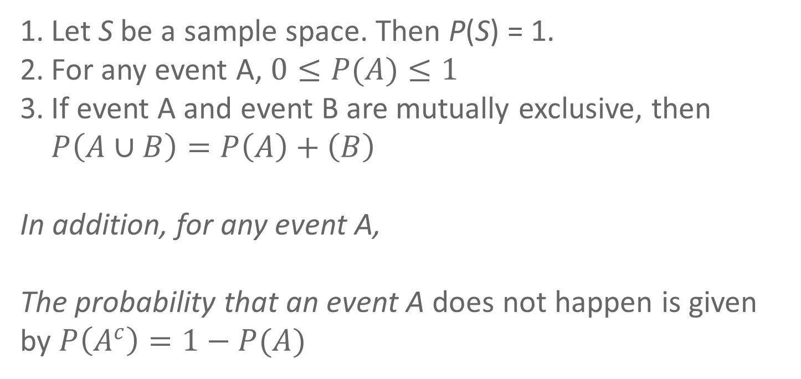
Axioms of Probability
Let S be a sample space. Then P(S) = 1.
For any event A, $0≤P(A)≤1$
If event A and event B are mutually exclusive, then $P\left(A∪B\right)=P\left(A\right)+\left(B\right)$
In addition, for any event A,
The probability that an event A does not happen is given by $P\left(A^{c}\right)=1−P(A)$
AY2018/2019 OCT SEMESTER

Slide 9
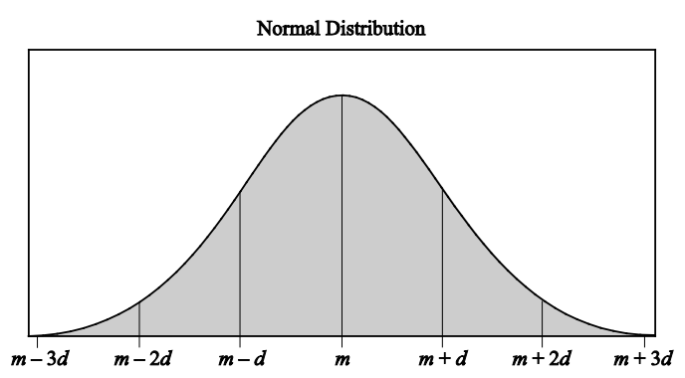
Expected Values
Expected values are useful for characterizing a distribution
The mean is a characterization of its center
The variance and standard deviation are characterizations of how spread out it is
Sample expected values (the sample mean and variance) will estimate the population mean and variance
AY2018/2019 OCT SEMESTER
Notes:
It is not possible to access the whole population, we could only sample the population to estimate the statistical parameter of the population

Slide 10
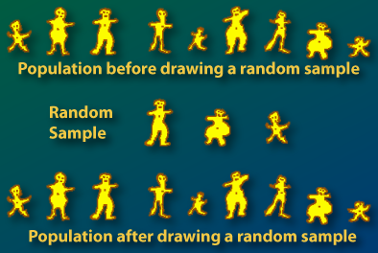
  Sampling
AY2018/2019 OCT SEMESTER

Slide 11
  Sample vs. Population
The mean, variance and standard deviation of a random sample is referred to as the sample mean, sample variance and sample standard deviation
The sample mean, variance, standard deviation can only give us an approximation to the population mean, the population variance and population standard deviation
When the value of the sample, n, is large enough, the sample mean, variance and standard deviation gives a good estimation of the population statistic parameters.
AY2018/2019 OCT SEMESTER

Slide 12
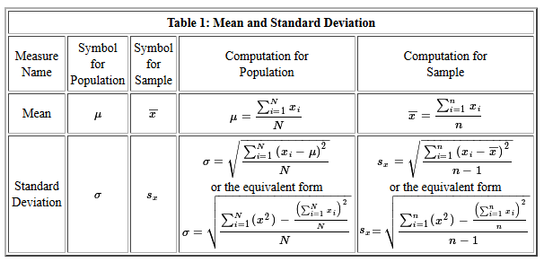
  Sample vs. Population
AY2018/2019 OCT SEMESTER

Slide 13
Central Limit Theorem
The Central Limit Theorem (CLT) is one of the most important theorems in statistics.
The central limit theorem (CLT) is a statistical theory that states that given a sufficiently large sample size from a population with a finite level of variance, the mean of all samples from the same population will be approximately equal to the mean of the population.
Furthermore, all of the samples will follow an approximate normal distribution pattern, with all variances being approximately equal to the variance of the population divided by each sample's size.
Read more: Central Limit Theorem (CLT) https://www.investopedia.com/terms/c/central_limit_theorem.asp#ixzz5CwasEIcJ
AY2018/2019 OCT SEMESTER

Slide 14
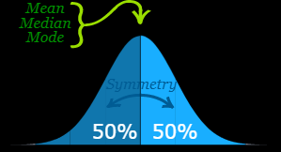
Normal Distribution
Mean=median=mode
Symmetry about the center
50% of values less than the mean and 50% greater than the mean
AY2018/2019 OCT SEMESTER
Notes:
Spend some time to talk about this graph and it implication

Slide 15
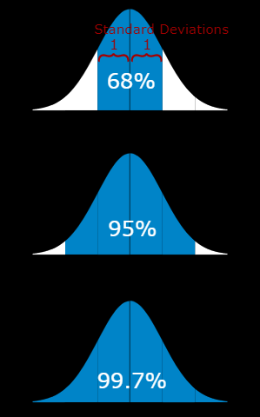
Normal Distribution
68% of values are within 1 standard deviation of the mean
95% of values are within 2 standard deviation of the mean
99.7% of values are within 3 standard deviation of the mean
AY2018/2019 OCT SEMESTER
Notes:
Students are expected to remember these three percentage and their equivalent within how many standard deviation
Example, students should know that 99.7% of values are within 3 standard deviation of the mean.

Slide 16
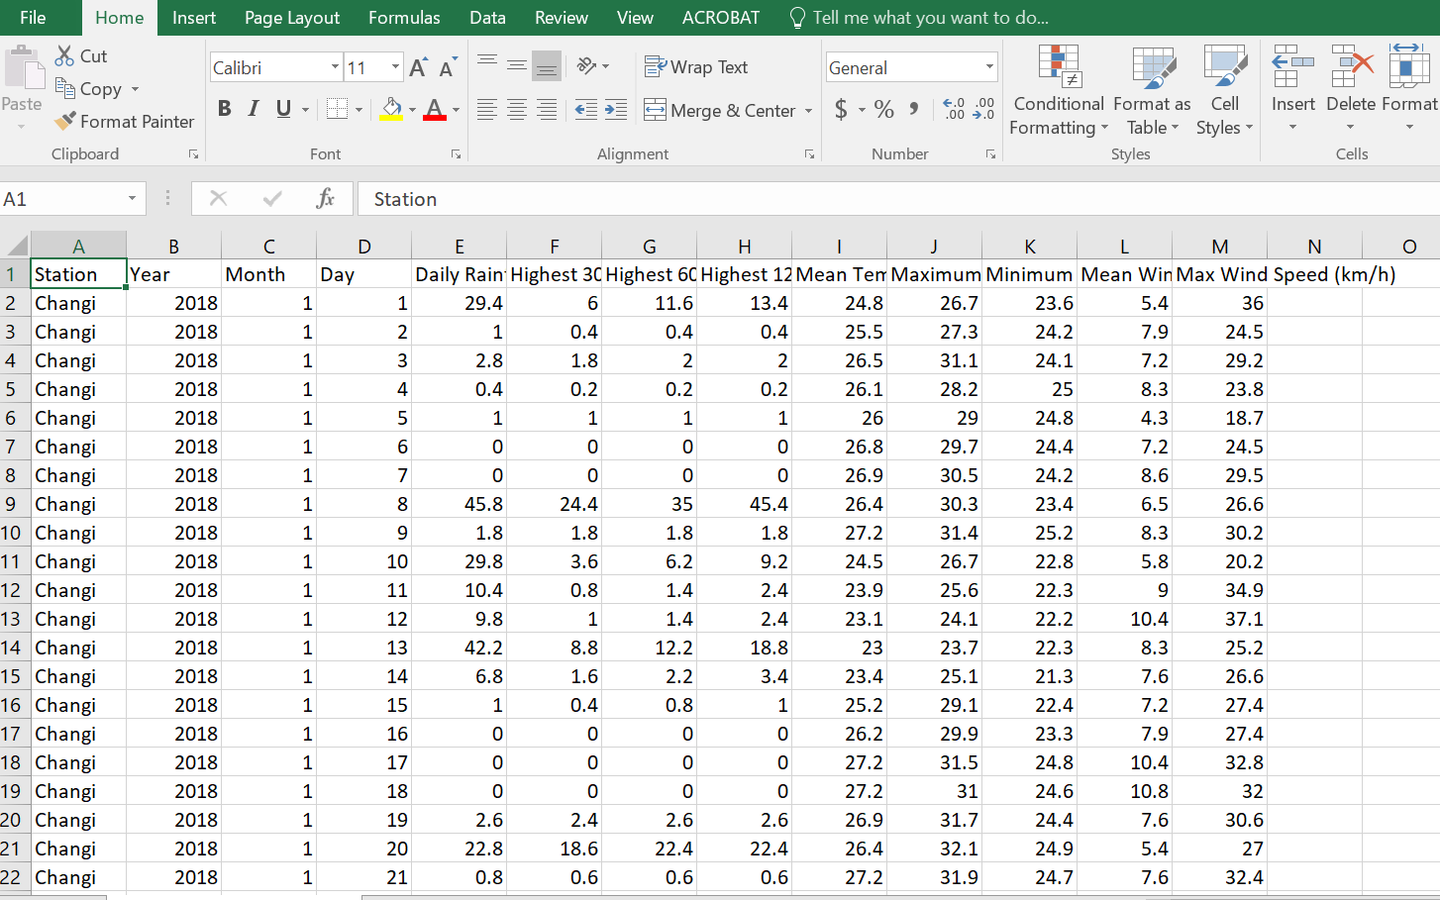
Historical Weather Data
Still remember the Historical Weather Data?
We may want to know what is the probability that it would rain on any day in January.
AY2018/2019 OCT SEMESTER
Notes:
This again is attempt to relate the idea of data as a statistical random process to data that students had handle in the two previous lab

Slide 17
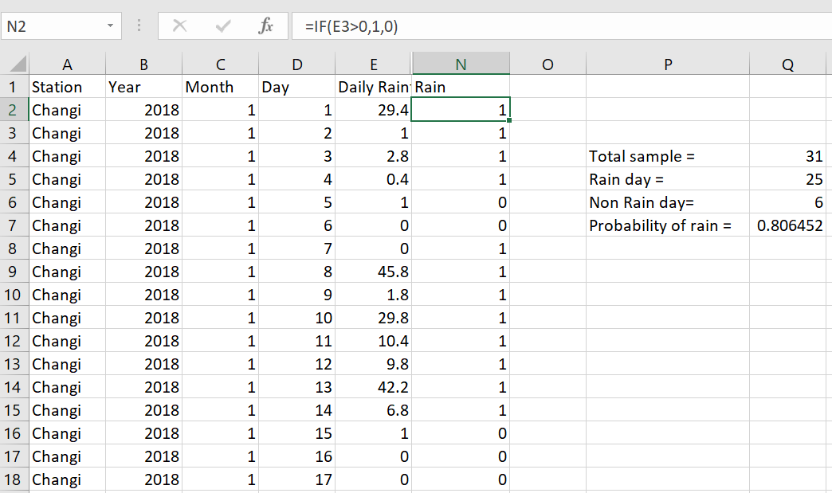
Data Variable as Random Process
Create a new column call Rain.
Rain would have value of ‘1’ if Daily Rain > 0
Rain would have value ‘0’ if Daily rain<=
AY2018/2019 OCT SEMESTER
Notes:
If you want, you could start an excel and demo this part

Slide 18
Data Variable as Random Process
AY2018/2019 OCT SEMESTER
Notes:
Remind students that in this example the data is too little to be conclusive
It is just an example to illustrate the idea

Slide 19
Worked Example 1
A sensor collected temperature data of a boiler. 95% of the temperature values are between 100 degrees to 120 degrees. Assume the data is normally distributed, what is the mean and standard deviation?
Solution:
The mean is halfway between 100 and 120 degrees:
mean = (100+120)/2 = 110 degrees
95% is 2 standard deviations (std) either side of the mean (total 4 standard deviation):
std = (120-100)/4 = 5 degrees
AY2018/2019 OCT SEMESTER
Notes:
Please go thru this worked example in detail

Slide 20
Worked Example 1
110
105
115
120
100
AY2018/2019 OCT SEMESTER
Notes:
Discuss about the distribution

Slide 21
Worked Example 2
Company XYZ wants to buy a laser cutter to cut metal bar to length of 10mm with a tolerance of +/-0.1mm and can only accept a failure rate of 5%. The technician tested four models of cutter and produce the following report:
Model | Mean (mm) | Standard Deviation
A | 9.99 | 0.04
B | 10.03 | 0.05
C | 10.01 | 0.07
D | 9.98 | 0.06
Assuming the data is normally distributed. Which model of the laser cutter should the company buy? Show workings to justify your recommendation.
AY2018/2019 OCT SEMESTER
Notes:
Remind students that in this example the data is too little to be conclusive
It is just an example to illustrate the idea

Slide 22
Worked Example 2
Error rate of 5% mean 95% of the product must be within +/-0.1mm
Require cutter to be within tolerance 95% of the time, the accuracy from 9.90mm to 10.10mm
Model A: 95% of the time, the accuracy will be from 9.91mm to 10.07mm
Model B: 95% of the time, the accuracy will be from 9.93mm to 10.13mm
Model C: 95% of the time, the accuracy will be from 9.87mm to 10.15mm
Model D: 95% of the time, the accuracy will be from 9.86mm to 10.1mm
Model A is well within the range required.
AY2018/2019 OCT SEMESTER
Notes:
Remind students that in this example the data is too little to be conclusive
It is just an example to illustrate the idea

