Slide 1


ENGINEERING ANALYTICS & MACHINE LEARNING
Data Cleaning

Slide 2
Data Analytic Process
Notes:
This is just to recap

Slide 3
What is raw data? (Recap)
No software had been run on the data
No manipulation ad been done any numbers in the data
No data or number had been remove
The data are not summarize in any way
The strange binary file generated by the measurement machine
The JSON data you got from scrapping the Twitter API or Facebook API
The hand-entered numbers collected from paper survey forms
Random like numbers generated by sensor network
Notes:
Again recap

Slide 4
Data Cleaning
Happy families are all alike; every unhappy family is unhappy in its own way ---- Leo Tolstoy
Huge amount of effort is spent cleaning data to get it ready for analysis
It is often said that 80% of data analysis is spent on the process of cleaning and preparing the data.
Data preparation is not just the first step but must be repeated over the course of analysis as new problems come to light or new data is collected
Data cleaning is sometime painfully manual
Notes:
In statistics, the term Anna Karenina principle is used to describe significance tests: there are any number of ways in which a dataset may violate the null hypothesis and only one in which all the assumptions are satisfied.
Lot of effort is put into data cleaning as there is no fixed formula or method for data cleaning as there is no fixed way data is “dirty”

Slide 5

Data Cleaning
This is an important stage and is necessary because the data that is collected is often “dirty” due to:
Missing data
Unacceptable formats
Erroneous values
Data could be embedded inside text or other information and needs to be extracted
Collected data in an unacceptable format
Remove or compensate for outliers that skews the data unrealistically

Slide 6
Missing Data In Pandas
None
Python objects
If we perform any aggregation function such as sum() or min() across an arrary with a None value will lead to an error
NaN : Not a Number
It is a special floating-point value recognized by all systems that use the standard IEEE floating-point representations
Regardless of the operation, the result of arithmetic with NaN will be another NaN

Slide 7
Data Transformation / Extraction
Data collected and read into analysis tools may need to be preprocessed because
The data types may be unsuitable for processing. For example, a floating point number may be wrongly formatted as strings. If mathematical computations are required. These “floating point strings” need to be reformatted as floating point numbers.
The additional variables need to be calculated from the existing data to facilitate meaningful analysis. For example, the data sample below contains measurements of flower sepal and petal dimensions :
Notes:
For example, the data sample below contains measurements of flower sepal and petal dimensions : ??

Slide 8
Date Time
Engineering data such as those from sensors, measurement equipment or machines usually come with date time
We usually refer to these type of data as time series data
The data change according to time instead of some event
The relationship between the data point and time such as cyclic effort or time-pattern event are pretty important
The identification of such events would assist in analysis and also building of model for prediction purposes.
Notes:
Date Time conversion is one type of Data transformation
Date time in dd/mm/yy hh:mm:ss may not be useful for operation such as sort
If we convert the date time to unix timestamp, we could do a simple numerical sort
What is cyclic effort or time-pattern event? I can’t find online.

Slide 9
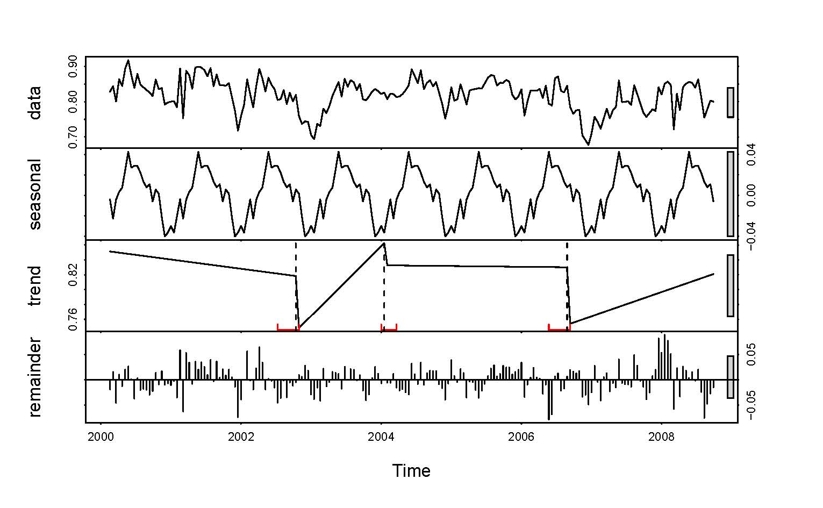
Data Transformation
Notes:
Date Time conversion is one type of Data transformation
Date time in dd/mm/yy hh:mm:ss may not be useful for operation such as sort
If we convert the date time to unix timestamp, we could do a simple numerical sort
What is cyclic effort or time-pattern event? I can’t find online.

Slide 10
Unix Epoch
The Unix epoch (or Unix time or POSIX time or Unix timestamp) is the number of seconds that have elapsed since January 1, 1970 (midnight UTC/GMT), not counting leap seconds (in ISO 8601: 1970-01-01T00:00:00Z).
Literally speaking the epoch is Unix time 0 (midnight 1/1/1970), but 'epoch' is often used as a synonym for 'Unix time’.
Most epoch time stamp is in seconds, milliseconds or microseconds.
Notes:
The students should know that Unix timestamp is the number of s or ms from 1970 1st January midnight (00:00)
Again this is also to have a efficient way to represent date time that would be easy to store and process

Slide 11
Unix Epoch
Human readable time | Seconds
1 hour | 3600 seconds
1 day | 86400 seconds
1 week | 604800 seconds
1 month (30.44 days) | 2629743 seconds
1 year (365.24 days) | 31556926 seconds
Notes:
Follow the link to go to the online epoch converter and demo some operation

Slide 12
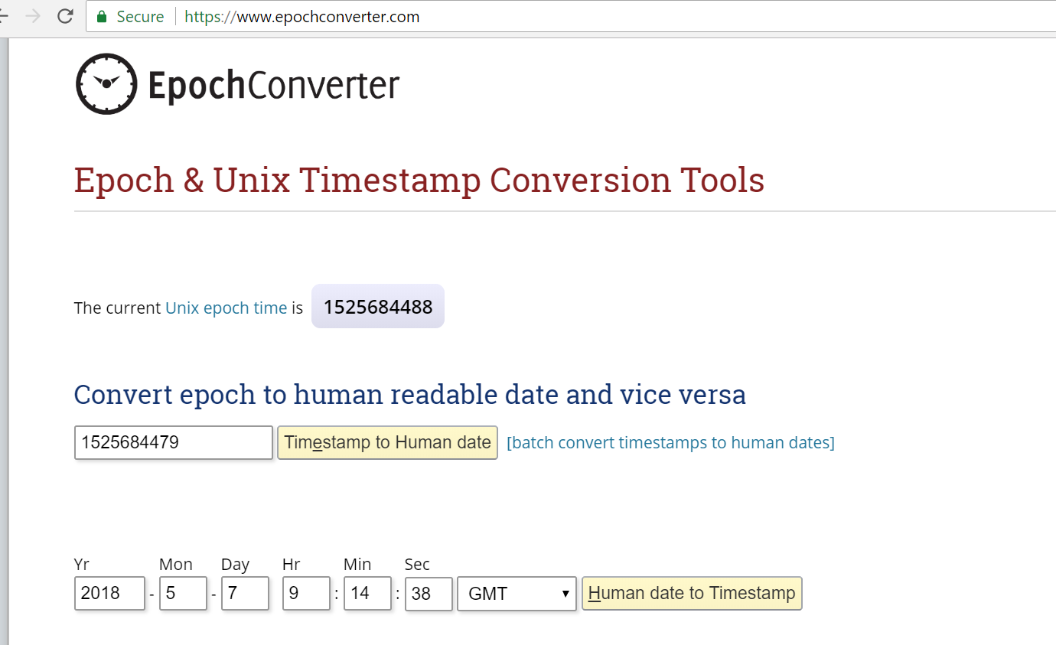
Online Epoch Converter
https://www.epochconverter.com/
Notes:
Just an example

