Slide 1


Engineering Analytics & Machine Learning
(ECSE202)
Seminar 5
Data
Visualization
AY2018/2019 OCT SEMESTER

Slide 2
Histogram
It is an estimate of the probability distribution of a continuous variable (quantitative variable) and was first introduced by Karl Pearson.
It differs from a bar graph, in the sense that a bar graph relates two variables, but a histogram relates only one.
To construct a histogram, the first step is to "bin" the range of values—that is, divide the entire range of values into a series of intervals—and then count how many values fall into each interval.
The bins are usually specified as consecutive, non-overlapping intervals of a variable. The bins (intervals) must be adjacent, and are often (but are not required to be) of equal size.
AY2018/2019 OCT SEMESTER

Slide 3
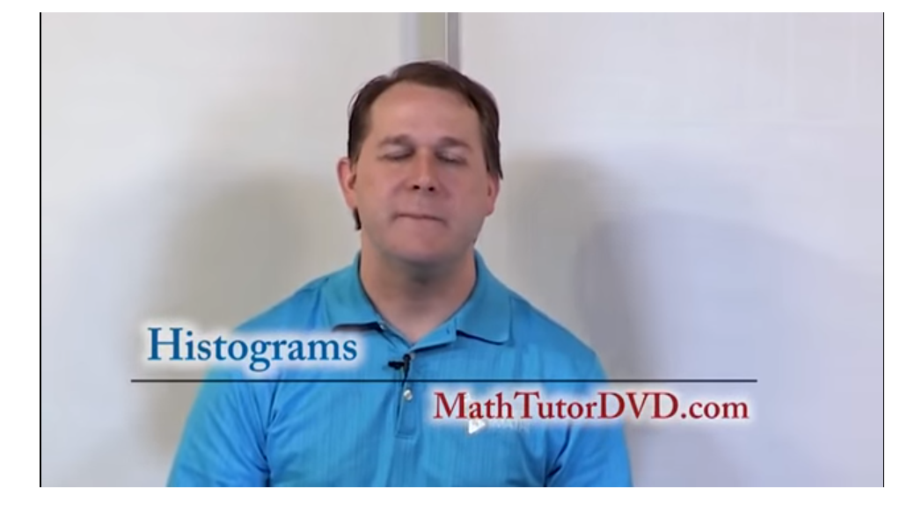
Histogram
https://www.youtube.com/watch?v=0Ul8SOlOu8c
AY2018/2019 OCT SEMESTER

Slide 4
Example
The U.S. Census Bureau found that there were 124 million people who worked outside of their homes.
Using their data on the time occupied by travel to work, the table below shows the absolute number of people who responded with travel times "at least 30 but less than 35 minutes" is higher than the numbers for the categories above and below it.
This is likely due to people rounding their reported journey time.
The problem of reporting values as somewhat arbitrarily rounded numbers is a common phenomenon when collecting data from people.
AY2018/2019 OCT SEMESTER

Slide 5
Example - Data
Data by absolute numbers
Interval | Width | Quantity | Quantity/width
0 | 5 | 4180 | 836
5 | 5 | 13687 | 2737
10 | 5 | 18618 | 3723
15 | 5 | 19634 | 3926
20 | 5 | 17981 | 3596
25 | 5 | 7190 | 1438
30 | 5 | 16369 | 3273
35 | 5 | 3212 | 642
40 | 5 | 4122 | 824
45 | 15 | 9200 | 613
60 | 30 | 6461 | 215
90 | 60 | 3435 | 57
AY2018/2019 OCT SEMESTER

Slide 6
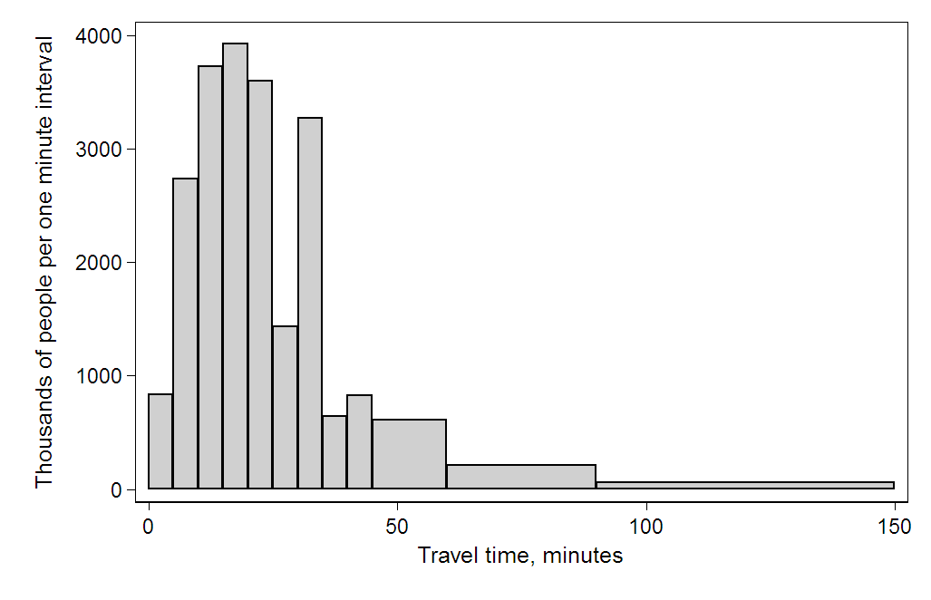
Example - Histogram
AY2018/2019 OCT SEMESTER

Slide 7
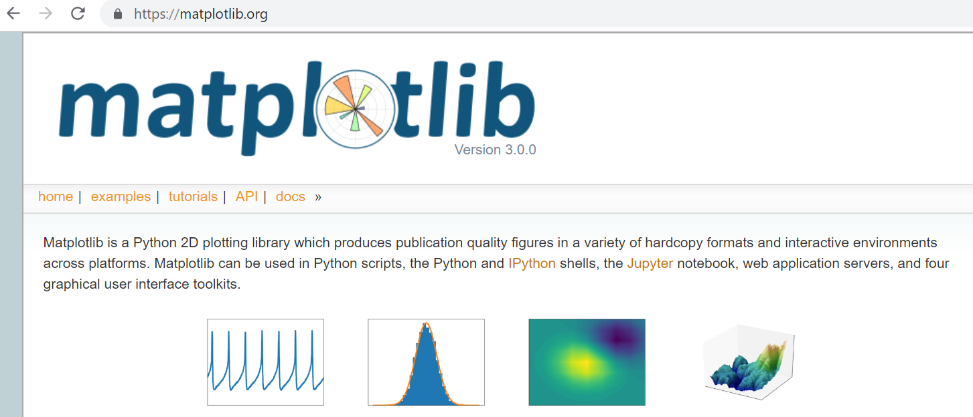
Matplotlib
Matplotlib is a Python 2D plotting library which produces publication quality figures in a variety of hardcopy formats and interactive environments across platforms.
https://matplotlib.org/
AY2018/2019 OCT SEMESTER

Slide 8
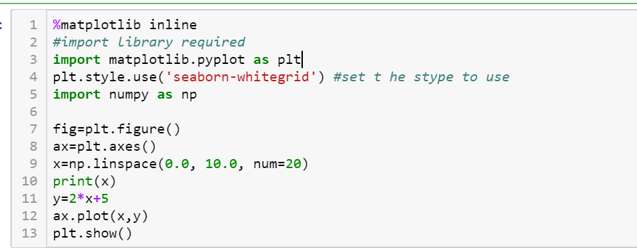
Matplotlib: Simple line Graph
Inline command only for Jupyter Notebook to display the graph
Import matplotlib for used
Set the style of the graph
Start figure instance
Create a ax
Plot at axes ax with x and y
Show the graph
AY2018/2019 OCT SEMESTER

Slide 9
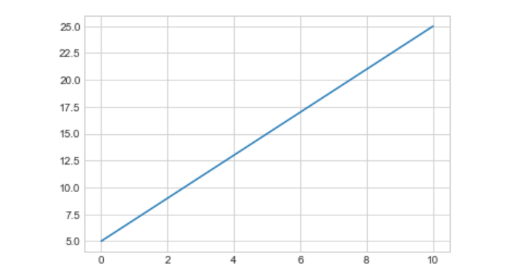
Matplotlib: Simple Line Graph
A simple line graph displayed
AY2018/2019 OCT SEMESTER

Slide 10
Matplotlib: Color
In almost all places in matplotlib where a color can be specified by the user it can be provided as:
an RGB or RGBA tuple of float values in [0, 1] (e.g., (0.1, 0.2, 0.5) or (0.1, 0.2, 0.5, 0.3))
a hex RGB or RGBA string (e.g., '#0F0F0F' or '#0F0F0F0F')
a string representation of a float value in [0, 1] inclusive for gray level (e.g., '0.5')
one of {'b', 'g', 'r', 'c', 'm', 'y', 'k', 'w'}
a X11/CSS4 color name
a name from the xkcd color survey prefixed with 'xkcd:' (e.g., 'xkcd:sky blue')
one of {'C0', 'C1', 'C2', 'C3', 'C4', 'C5', 'C6', 'C7', 'C8', 'C9'}
one of {'tab:blue', 'tab:orange', 'tab:green', 'tab:red', 'tab:purple', 'tab:brown', 'tab:pink', 'tab:gray', 'tab:olive', 'tab:cyan'} which are the Tableau Colors from the ‘T10’ categorical palette (which is the default color cycle).
AY2018/2019 OCT SEMESTER

Slide 11
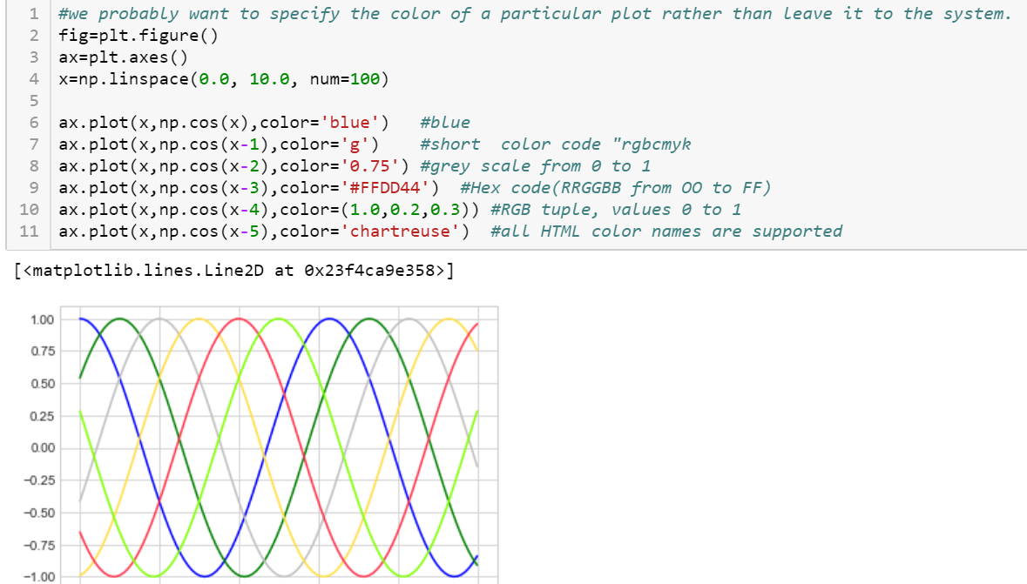
Matplotlib: Color
AY2018/2019 OCT SEMESTER

Slide 12
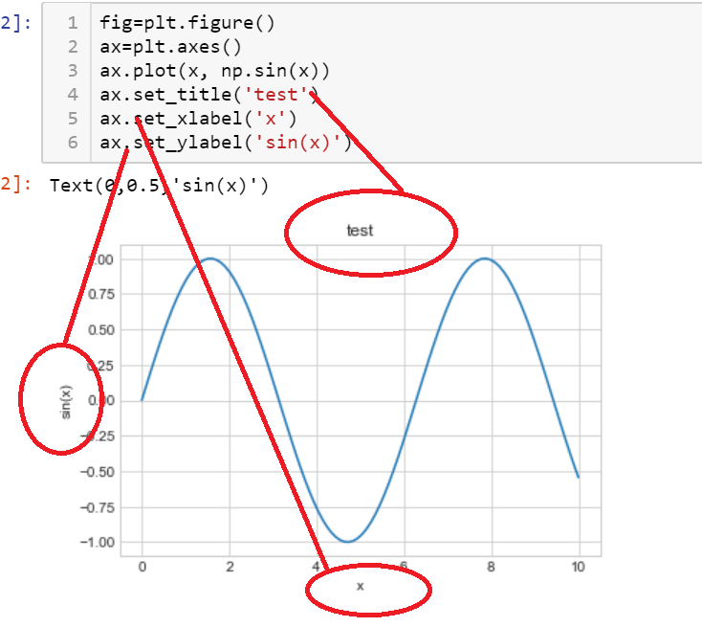
Matplotlib: Customize axes
AY2018/2019 OCT SEMESTER

Slide 13
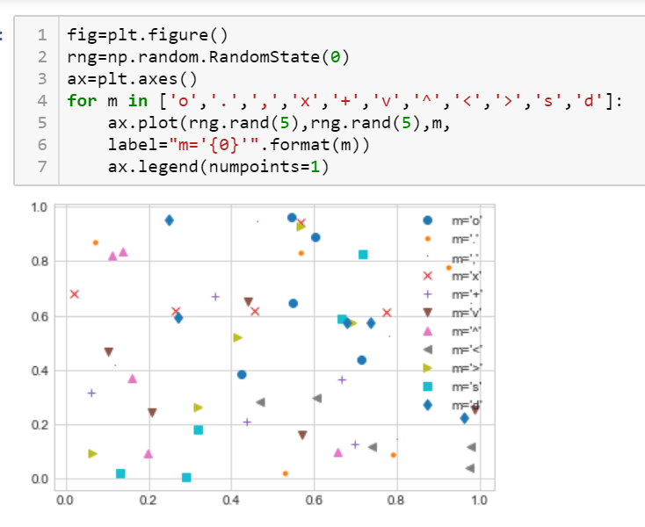
Matplotlib: Scatter Plots
AY2018/2019 OCT SEMESTER

Slide 14
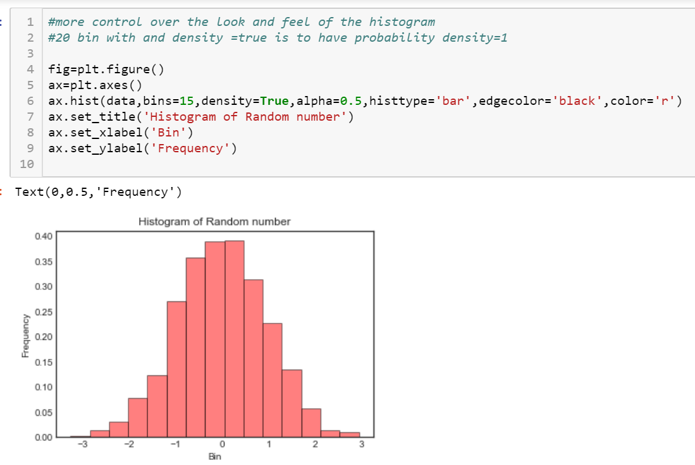
Matplotlib: Histogram
AY2018/2019 OCT SEMESTER

Slide 15
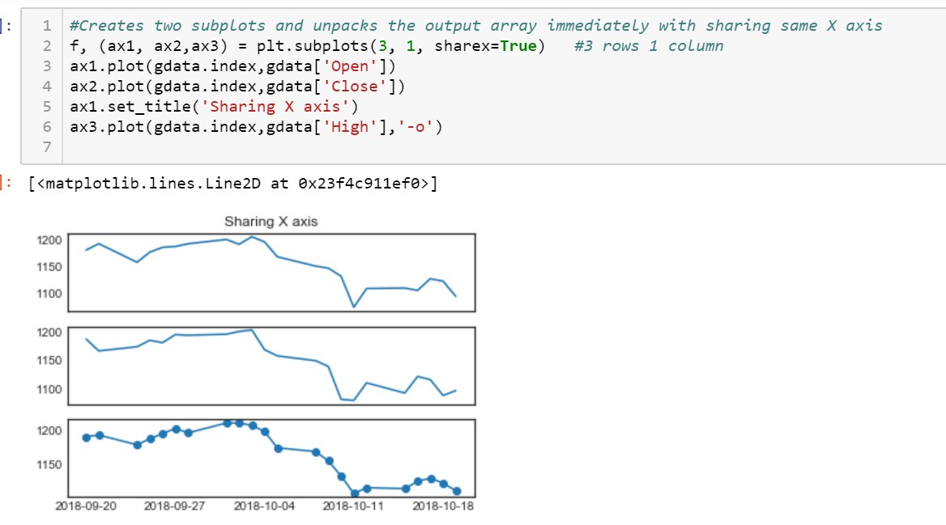
Matplotlib: Subplot
AY2018/2019 OCT SEMESTER

Slide 16
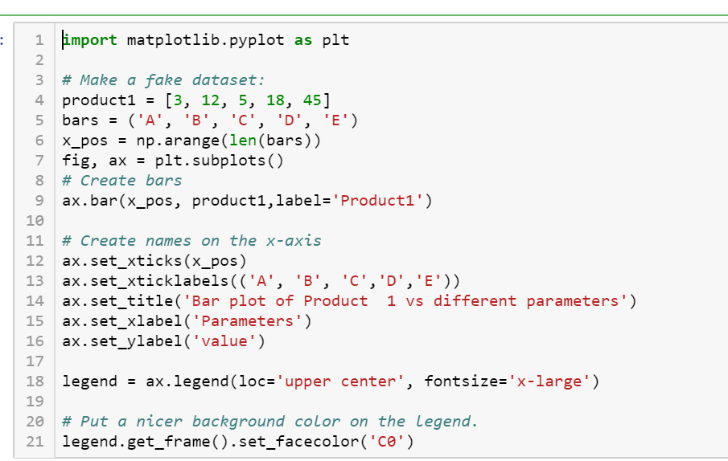
Matplotlib: Subplot
AY2018/2019 OCT SEMESTER

Slide 17
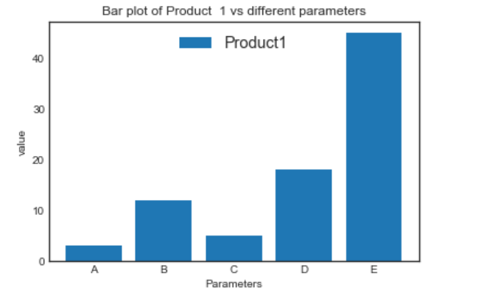
Matplotlib: Subplot
AY2018/2019 OCT SEMESTER

