Slide 1


Engineering Analytics & Machine Learning
(ECSE202)
Seminar 7
Artificial Neural Network
AY2018/2019 OCT SEMESTER

Slide 2
Objective of AI

Slide 3


Human Learning
Show sample of examples for learning
Not for the kid to be fixed to the material
Able to apply
Able to extrapolate
Able to adapt to similar cases
Able to innovate

Slide 4

Generalize
Not to fit the train data

Slide 5
Fundamental

Slide 6
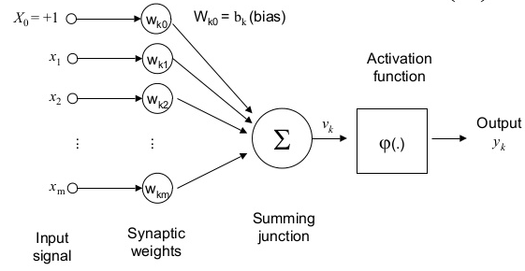


Single Perceptron

Slide 7
Type of Activation Function
Activation functions are transfer functions which is nonlinear that act as threshold. Desired characteristic:
Mostly smooth, continuous, differentiable
Fairly linear
Activation functions are need as they provide the nonlinearities to handle complex problem.
Layers of linear function is just a combined linear function
A combined linear function can only learn linear transformation of the input

Slide 8
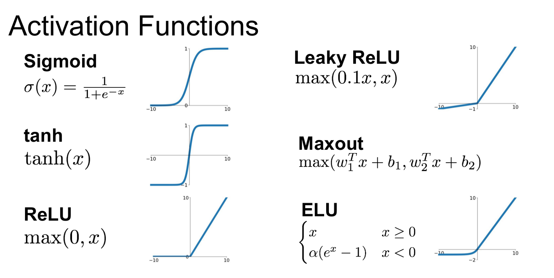
Type of Activation Function

Slide 9
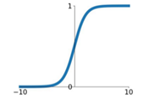

Activation Functions
Squashes number to range from 0 to 1
Historically popular as it could be interpreted as a “firing rate” of a neuron
Issues:
Saturated Neuron “kill” the gradient
Output is not zero centered
Exponential is computational expensive
Sigmoid

Slide 10
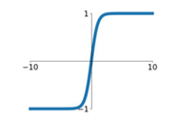

Activation Functions
tanh
Squashes number to range from 0 to 1
Zero centred
Issues:
Saturated Neuron “kill” the gradient

Slide 11
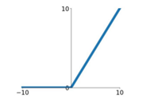

Activation Functions
Relu
Does not saturate
Computationally efficient
Converges much faster than sigmoid/tanh
Issues:
Not zero centred

Slide 12
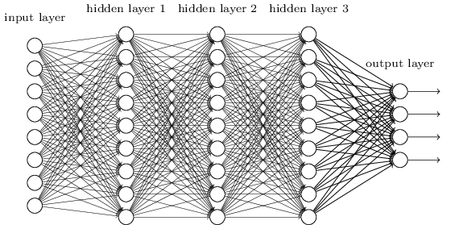
Fully Connected Multiple Layer Perceptron Network (MLP)
Source: https://hackernoon.com/training-an-architectural-classifier-iii-84dd5f3cf51c

Slide 13
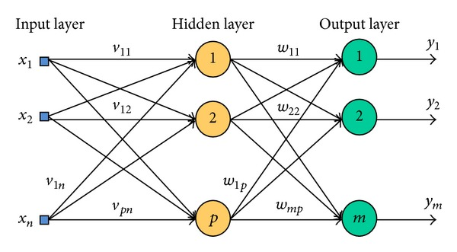
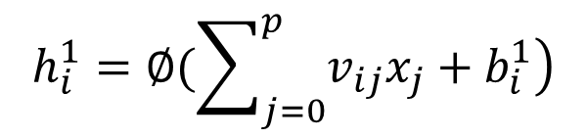
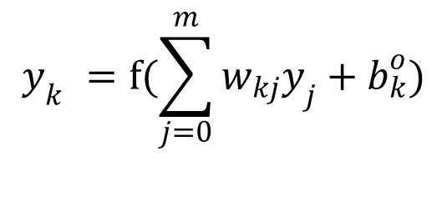
Multi-Layer Perceptron(MLP)
Output of hidden layer:
$$h_{i}^{1}=∅(\sum_{j=0}^{p}{\left.v_{ij}x_{j}+b_{i}^{1}\right)}$$
Output of output layer:
$$y_{k}^{}=f(\sum_{j=0}^{m}{w_{kj}y_{j}+b_{k}^{o})}$$
Image Source: https://www.researchgate.net/figure/258524366_fig5_Neural-network-with-one-hidden-layer-of-neurons
Notes:
https://machinelearningmastery.com/binary-classification-tutorial-with-the-keras-deep-learning-library/

Slide 14
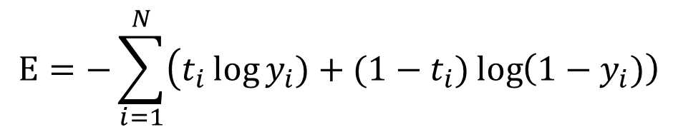
Classification Loss functions
Cross entropy loss function with sigmoid as output activation function:
$$E=−\sum_{i=1}^{N}{\left(t_{i}\log{y_{i}})+(1−t_{i})\log\left(1−y_{i})\right)\right.}$$
Where t_{i} is the target vector where it is either 1 or 0 and yi is the output vector
Notes:
https://machinelearningmastery.com/binary-classification-tutorial-with-the-keras-deep-learning-library/

Slide 15
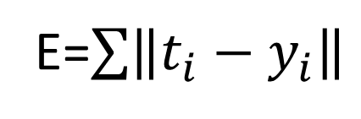
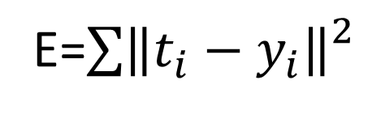
Regression Loss functions
The loss function when the task is to predict real value such as measurement of houses or blood pressure:
E=$\sum{\left\|t_{i}−y_{i}\right\|}$
L1 Norm
E=$\sum{{\left\|t_{i}−y_{i}\right\|}_{}^{2}}$
L2 Norm
Where ti is the target vector and y is the output vector
Notes:
https://machinelearningmastery.com/binary-classification-tutorial-with-the-keras-deep-learning-library/

Slide 16
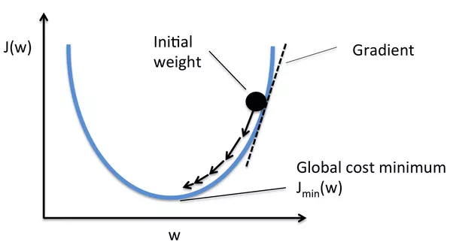
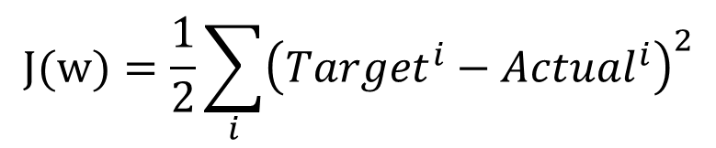


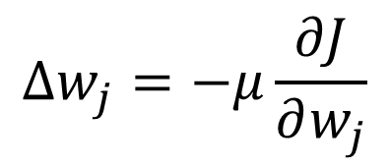
Gradient Descent (GD)
$$J(w)=\frac{1}{2}\sum_{i}{{\left({Target}^{i}−{Actual}^{i}\right)}^{2}}$$
$$∆w_{j}=−μ\frac{∂J}{∂w_{j}}$$
$$w_{j}=w_{j}+∆w_{j}$$
Where $μ$ is the learning rate
Source: https://www.quora.com/Whats-the-difference-between-gradient-descent-and-stochastic-gradient-descent
Notes:
https://machinelearningmastery.com/binary-classification-tutorial-with-the-keras-deep-learning-library/

Slide 17
Stochastic Gradient Descent (SGD)
GD is too computation expensive for the entire training set
For SGD instead the entire training set is divide into mini-batch and weights are update in each mini-batch
The name stochastic as the gradient is estimated by each sample (mini-batch) rather the entire training set
SGD had shown to almost surely converges to the global cost minimum if the cost function is convex (or pseudo-convex).
Notes:
https://machinelearningmastery.com/binary-classification-tutorial-with-the-keras-deep-learning-library/

Slide 18
Backpropagation
Feedfoward
Input Signal
Backpropagation was invented in the 1970s as a general optimization method for performing automatic differentiation of complex nested functions. However, it wasn't until 1986, with the publishing of a paper by Rumelhart, Hinton, and Williams, titled "Learning Representations by Back-Propagating Errors," that the importance of the algorithm was appreciated by the machine learning community at large.
Error Signal
Source: https://brilliant.org/wiki/backpropagation/
Backpropagation
Notes:
https://machinelearningmastery.com/binary-classification-tutorial-with-the-keras-deep-learning-library/

Slide 19

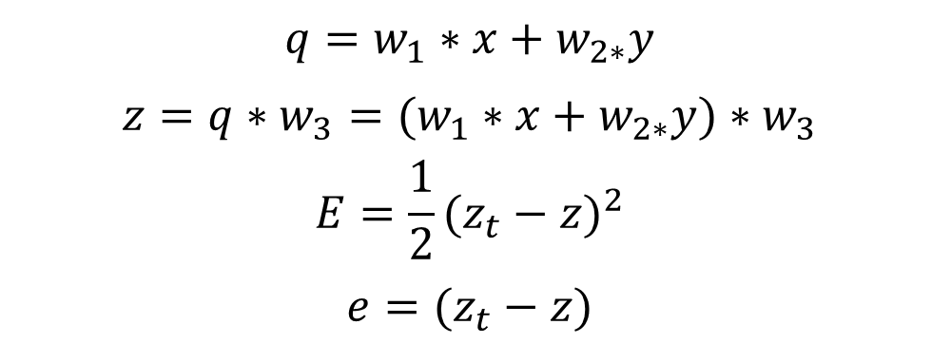
Simple Example of Backpropagation
w1
w3
z
q
w3
X
+
y
w2
$$q=w_{1}∗x+w_{2∗}y$$
$$z=q∗w_{3}=(w_{1}∗x+w_{2∗}y)∗w_{3}$$
$$E=\frac{1}{2}{(z_{t}−z)}^{2}$$
$$e=(z_{t}−z)$$
Where $zt is the desired output$
Notes:
https://machinelearningmastery.com/binary-classification-tutorial-with-the-keras-deep-learning-library/

Slide 20

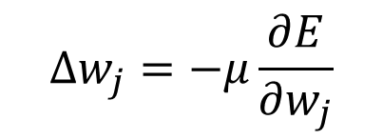
Simple Example of Backpropagation
w1
w3
z
q
w3
X
+
y
w2
Objective is to find:
$$∆w_{j}=−μ\frac{∂E}{∂w_{j}}$$
Where $μ is the learning rate$
Notes:
https://machinelearningmastery.com/binary-classification-tutorial-with-the-keras-deep-learning-library/

Slide 21

Simple Example of Backpropagation
w1
w3
z
q
w3
X
+
$$\frac{∂E}{∂w_{3}}=\frac{∂E}{∂z}∗\frac{∂z}{∂w_{3}}$$
$$\frac{∂E}{∂z}=−(z_{t}−z)=−e$$
$$\frac{∂z}{∂w_{3}}=(w_{1}∗x+w_{2∗}y)=q$$
$$\frac{∂E}{∂w_{3}}=−q∗e$$
y
w2
chain rule
Notes:
https://machinelearningmastery.com/binary-classification-tutorial-with-the-keras-deep-learning-library/

Slide 22
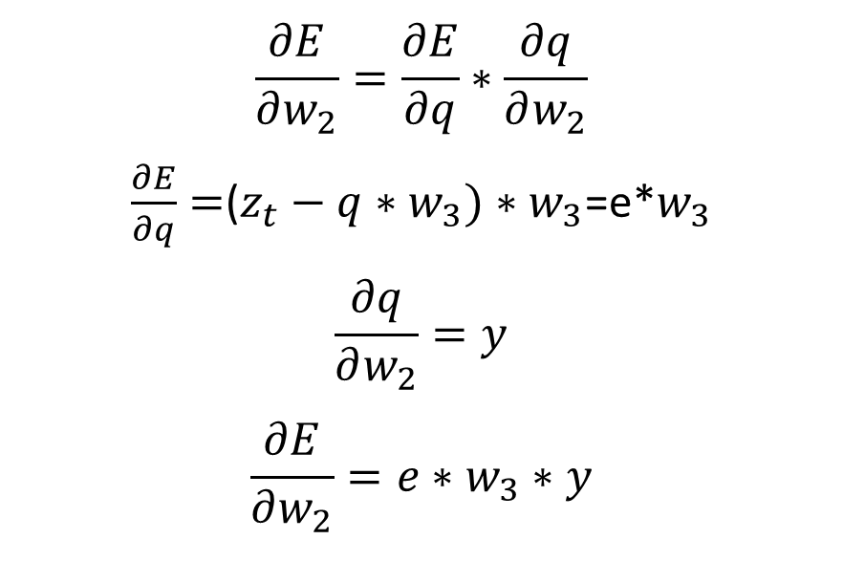
Simple Example of Backpropagation
w1
w3
z
q
w3
X
+
y
w2
$$\frac{∂E}{∂w_{2}}=\frac{∂E}{∂q}∗\frac{∂q}{∂w_{2}}$$
$\frac{∂E}{∂q}=$($z_{t}−q∗w_{3})∗w_{3}$=e*$w_{3}$
$$\frac{∂q}{∂w_{2}}=y$$
$$\frac{∂E}{∂w_{2}}=e∗w_{3}∗y$$
chain rule
Notes:
https://machinelearningmastery.com/binary-classification-tutorial-with-the-keras-deep-learning-library/

Slide 23

Simple Example of Backpropagation
w1
w3
z
q
w3
X
+
y
w2
$$\frac{∂E}{∂w_{1}}=\frac{∂E}{∂q}∗\frac{∂q}{∂w_{1}}$$
$$\frac{∂q}{∂w_{1}}=x$$
$$\frac{∂E}{∂w_{1}}=e∗w_{3}∗x$$
chain rule
Notes:
https://machinelearningmastery.com/binary-classification-tutorial-with-the-keras-deep-learning-library/

Slide 24
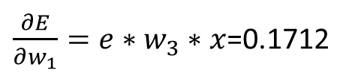
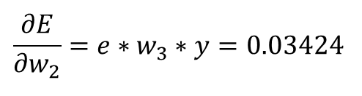
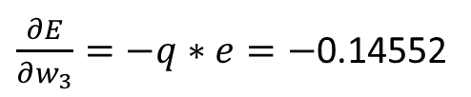
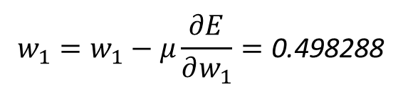

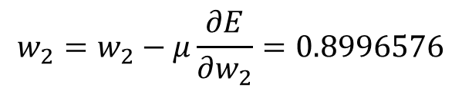

Simple Example of Backpropagation
W1=0.5
q
W3=0.8
X=0.5
+
z
Z_{t}=0.7
Where Z_{t} is the target value of z
Y=0.1
W2=0.9
$$q=w_{1}∗x+w_{2∗}y=0.5∗0.5+0.1∗0.9=0.34$$
$z=q∗w_{3}$=0.272
$w_{3}=w_{3}−μ\frac{∂E}{∂w_{3}}=0.8−0.01∗(0.1712)$=0.801712
$$e=\left(z_{t}−z\right)=0.428$$
$\frac{∂E}{∂w_{3}}=−q∗e=−$0.14552
$$w_{2}=w_{2}−μ\frac{∂E}{∂w_{2}}=0.8996576$$
$$\frac{∂E}{∂w_{2}}=e∗w_{3}∗y=0.03424$$
$$w_{1}=w_{1}−μ\frac{∂E}{∂w_{1}}=\text{0.498288}$$
$\frac{∂E}{∂w_{1}}=e∗w_{3}∗x$=0.1712
Notes:
https://machinelearningmastery.com/binary-classification-tutorial-with-the-keras-deep-learning-library/

Slide 25





Simple Example of Backpropagation
W1=$\text{0.498288}$
W3= 0.801712
z
X=0.1
+
Z_{t}=0.8
Y=0.5
W2=$0.8996576$
$$q=w_{1}∗x+w_{2∗}y=0.4996576$$
$z=q∗w_{3}$=0.4005814938112
$$e=\left(z_{t}−z\right)=0.3994185061888$$
Initially the e=0.428
With the updated weights, e=0.399 which show an improvement of 0.029 (6.78%)
Notes:
https://machinelearningmastery.com/binary-classification-tutorial-with-the-keras-deep-learning-library/

Slide 26
Demo: Backpropagation
W1=0.5
q
W3=0.8
X=0.5
+
z
Z_{t}=0.7
Y=0.1
W2=0.9
Notes:
https://www.kaggle.com/joniarroba/noshowappointments

Slide 27
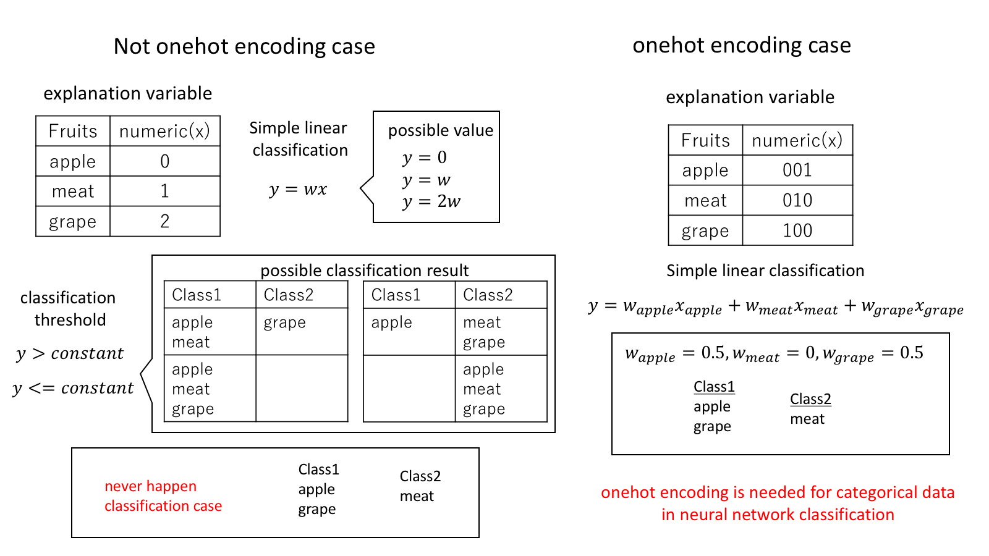
One-Hot Encoding
Notes:
https://www.kaggle.com/joniarroba/noshowappointments

Slide 28
One-Hot Encoding example
0.7
0.3
0.2
0.4
AB
CD
One-Hot Encoding
Argmax
A
A
1,0,0,0
0
B
0,1,0,0
C
0,0,1,0
0.7
0.8
0.9
0.4
AB
CD
Argmax
C
D
0,0,0,1
2
Notes:
https://www.kaggle.com/joniarroba/noshowappointments

Slide 29
AI Frameworks

Slide 30
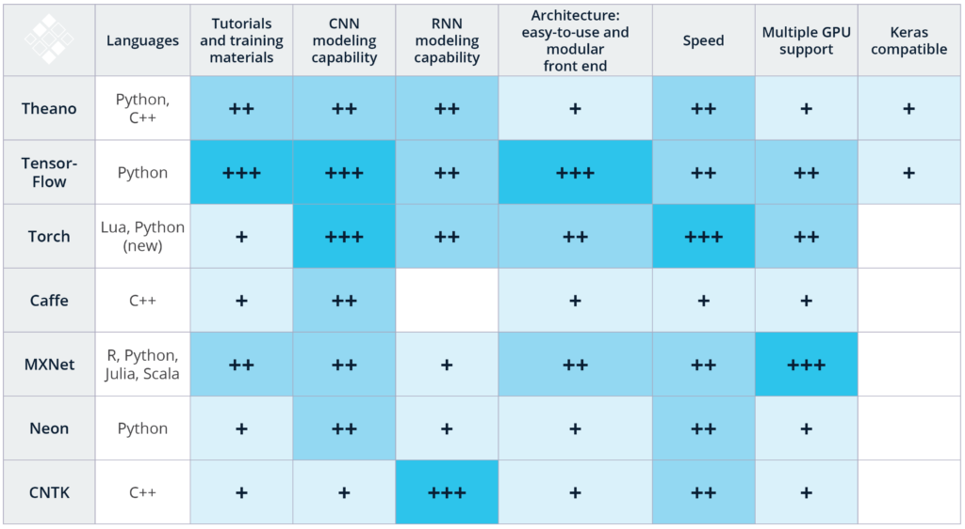
AI Framework
Source: https://www.kdnuggets.com/2017/03/getting-started-deep-learning.html

Slide 31
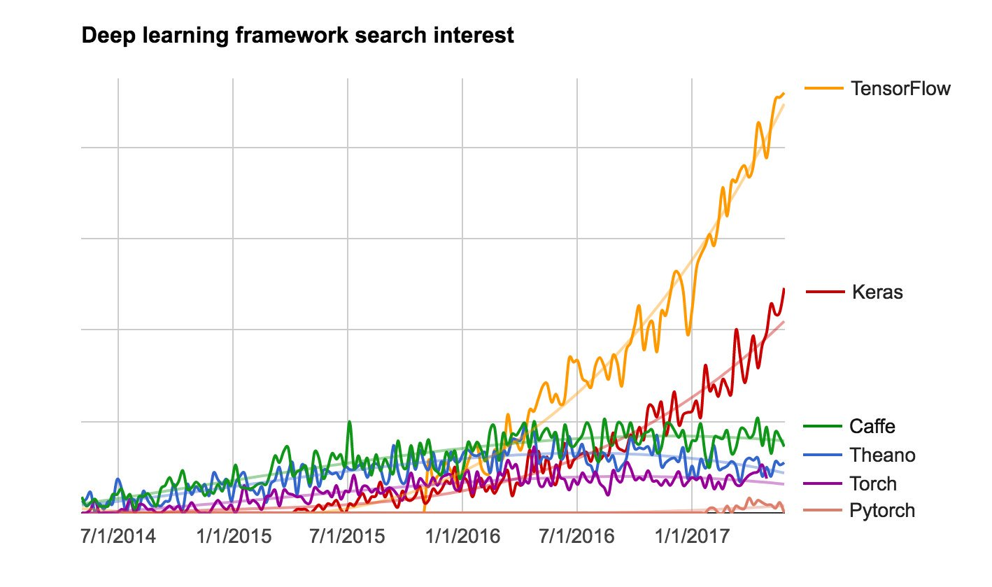
AI Framework
Deep Learning Classification
Source: https://twitter.com/fchollet/status/871089784898310144

Slide 32
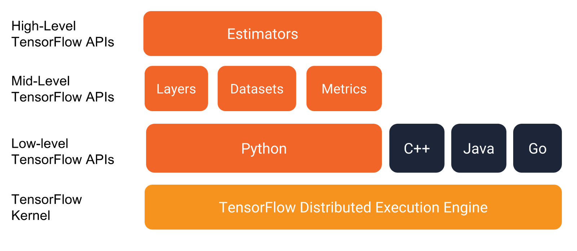
Tensorflow
TensorFlow™ is an open source software library for high performance numerical computation.
Its flexible architecture allows easy deployment of computation across a variety of platforms (CPUs, GPUs, TPUs), and from desktops to clusters of servers to mobile and edge devices.
Originally developed by researchers and engineers from the Google Brain team within Google’s AI organization.
it comes with strong support for machine learning and deep learning and the flexible numerical computation core is used across many other scientific domains.
Tensorflow Layers
You can access link below the access the official site:
https://www.tensorflow.org/
Notes:
https://machinelearningmastery.com/binary-classification-tutorial-with-the-keras-deep-learning-library/

Slide 33
Resources

Slide 34

CS231n: Convolutional Neural Networks for Visual Recognition
(http://cs231n.stanford.edu/)
NUS SoC CS6101 Deep Learning vis Fast.AI
(http://www.comp.nus.edu.sg/~kanmy/courses/6101_2017_2/)
Coursera Deep Learning Specialization
https://www.coursera.org/specializations/deep-learning
Fast.ai
http://www.fast.ai/
Awesome AI Papers (Deep Learning, Computer Vision, Robotics, NLP etc.)
https://www.facebook.com/groups/awesomeaipapers/
My archive of papers to be read
https://github.com/coolingozone/readingdeeplearning
http://www.deeplearningbook.org/
TP Library Open Shelf, Level 7 Q325.5 Goo

