Slide 1
CSP3341 – Programming Languages and Paradigms
Lecture 2 – Evolution of the Major Programming Languages

Slide 2
Overview and Textbook Chapters
This week we cover:
Context and issues surrounding release and evolution of major languages
Evolution of capabilities and features of major languages
Introduction and discussion of major languages
This week covers the following textbook chapter(s):
Chapter 2 – Evolution of the Major Programming Languages
Reading the chapter(s) is required
Notes:
This is quite a long chapter, but the content it covers is somewhat independent of the rest of the unit – it covers the history and evolution of major programming languages. While this is not as central to the unit materials as the content of other modules/chapters, it is an important area to cover (as is the history of any topic).
This chapter should encourage you to think of languages in the context of their existence, and start to see how they relate to and influence each other, and evolve to address the needs of the times.

Slide 3
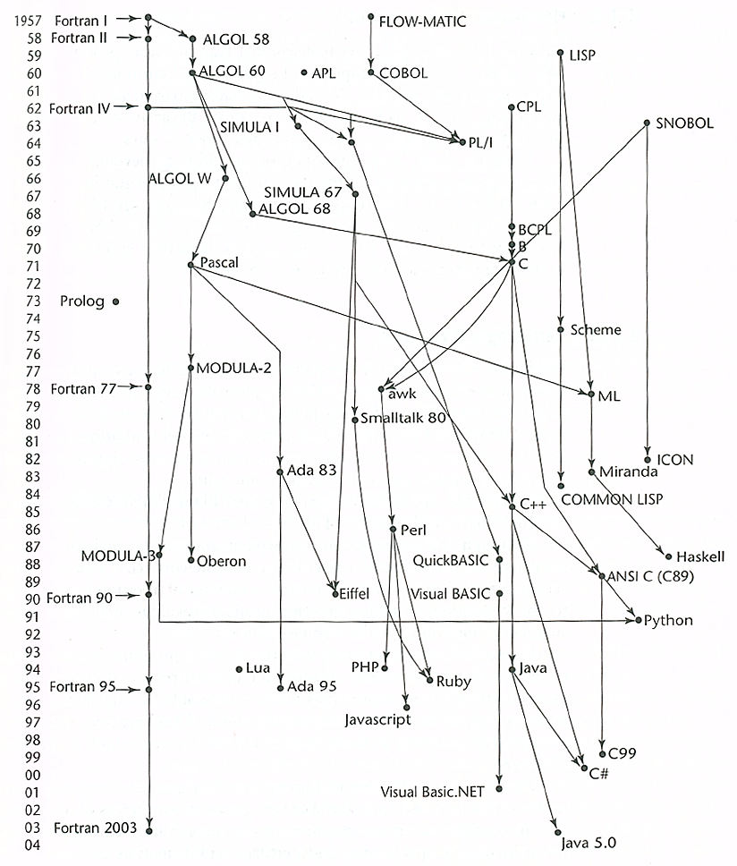
Genealogy of Common Languages
Sebesta, 2009, p57
Notes:
For a more up-to-date and comprehensive diagram which is similar to this, see http://www.levenez.com/lang/

Slide 4
Zuse’s Plankalkül
Designed in 1945, but not published until 1972
Never implemented
Remarkably advanced given its context:
Various data types and structures (arrays, records)
Selection statement (just “if”, no “else”)
Iterative statement (including a “break” statement)
Zuse’s manuscript contained many algorithms written in Plankalkül, including 49 pages of algorithms to play chess
An assignment statement to assign the A[4] + 1 to A[5]
| A + 1 => A
V | 4 5 (array subscripts - optional)
S | 1.n 1.n 1.n (data types)
Notes:
Plankalkül’s fate was very much a case of being in the wrong place at the wrong time. 1945 Germany was not exactly an ideal time and location to be doing such research. The development of Plankalkül was the topic of Zuse’s PhD dissertation.
Zuse’s notation was a bit complicated, with each statement consisting of three lines.
The first line is the statement itself, which resembles modern statements – in this example, adding 1 to a variable and assigning it to a variable
The second line (optional) contained subscripts of arrays referenced in the first line – in this example, A[4] and A[5]
The third line contained the data type name of the variables referenced in the first line – in this example, an integer of n bits.

Slide 5
Machine Code & Pseudocodes
Computers in the late 1940s to early 1950s were slow, unreliable, expensive and difficult to program
No high-level languages – had to use machine code
Instructions use numeric codes not words/symbols
Memory addressing is absolute – error prone and tedious
Higher level languages called “pseudocodes” were developed to make programming easier
Short Code (1949) used codes to represent mathematical functions which could be grouped. Interpreted and hence slow
Speedcoding (1953) implemented floating-point calculation and mathematical functions on the IBM 701. Also interpreted
UNIVAC compiling systems (1951-1953) were created, which expanded source pseudocode into machine code
Notes:
This is NOT the same meaning of pseudocode that you are probably familiar with.
In the late 40s and early 50s, computers were almost more trouble than they were worth. They were expensive, slow, unreliable and difficult to program.
The only way to program them was via direct machine code, which was made harder since instructions were represented by numbers rather than textual function names – e.g. the instruction for ADD may be “14”, rather than something like “ADD”, “A” or “+”.
On top of this, memory addressing was absolute and “hard coded” – if an instruction referenced an address in memory (where data is stored, or to tell the program where to go as the result of a branch statement), that address was absolute. Meaning that if the program was changed and another instruction was added or an instruction was removed, any references after the new/deleted instruction would be off by one and need to be updated.
Sounds like fun to code, doesn’t it? All this made machine code readability, writability and reliability very low, and inspired/encouraged the emergence of higher level languages.

Slide 6
The IBM 704 and Fortran
The slow speed of interpreted pseudocode was tolerable because much more time spent on floating-point operations
Not supported in hardware, had to be simulated in software
The IBM 704 (1954) supported floating-point instructions in hardware - removed the time spent simulating it in software
Hence, the slow speed of interpretation became noticeable
Fortran is generally credited as the first major compiled high-level language. It was designed for the IBM 704
Original report for Fortran (“Fortran 0”) published in 1954
Changed during implementation period, which was between 1955 and 1957, when the compiler was released
Implemented form is what is known as “Fortran I”
Notes:
The 704, with it’s hardware support for floating point numbers, was a massive step in computer hardware – and hence in software. Previously, since computers only supported integers, floating point numbers and arithmetic had to be simulated/implemented in software. This was extremely slow given the hardware capabilities of the time. For that reason, the interpreted languages which replaced machine code were acceptable despite being slow, since the speed of the floating point simulation was so much slower that interpretation delay was negligible.
It’s similar to the tech support person taking a minute to bring up your details, after you’ve been on hold for 15 minutes.
With the 704 and support for floating point numbers in hardware, the software simulation was no longer needed, and hence the slow speed of interpretation became noticeable, ushering in the age of compilation when Fortran 1 was implemented.

Slide 7
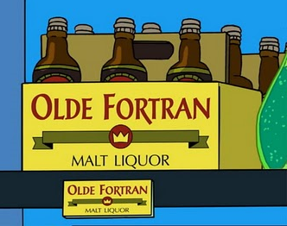
Fortran I
Original compiler was impressively efficient, performing a lot of optimisation which made translated machine code almost half as efficient as hand written machine code
Features of Fortran I included:
Basic input/output formatting
Variable names of up to 6 characters
User-defined subprograms
Arithmetic-based “if” statement
Post-test “do” counter loop statement
No data typing – variables starting in
I, J, K, L, M and N were automatically
integers, everything else was a float
Notes:
As we examine Fortran and see the evolution of its features, you’ll no doubt start to realise its significance in the evolution of major programming languages. Fortran played a role, directly or indirectly, in the emergence of many of the standard features of modern programming languages.
The initial version of Fortran was highly successful, as the compiler’s optimisation technology was sophisticated enough to produce efficient machine code – not as efficient as hand-written machine code, but it was so much more writable and readable that it was well worth it. Unfortunately, the 704’s unreliability put a bit of a cap on the size of Fortran programs.

Slide 8
Fortran II, III, IV, 77, 90, 95 and 2003
The Fortran II compiler was released in 1958 and supported independent compilation of subprograms
IBM 704 was unreliable, so compiling large programs without it crashing was tricky – compiling a part at a time was better
Fortran III happened, but never really took off
Fortran IV (1960-1962) was a major improvement, adding variable type declarations, logical “if” statement...
Fortran 77 added string handling, logical loops, optional “else” clause for “if”...

Slide 9
Fortran II, III, IV, 77, 90, 95 and 2003
Fortran 90 was dramatically different from Fortran 77
Included dynamic arrays, records, pointers, multiple selection statement and modules...
Introduced the concept of depreciating features – included a list of constructs recommended for removal in future versions
Removed the rigid formatting requirements of code that was based upon using punch cards
Fortran 95 happened but didn’t add much of significance
Fortran 2003 added support for object-oriented programming, interoperability with C...
Fortran has had a massive impact on the evolution of programming languages in many ways
Notes:
For a Summary of the new features in Fortran 90, see http://www.nsc.liu.se/~boein/f77to90/a3.html
Alan Perlis, one of the designers of ALGOL, described Fortran as the “lingua franca” of the computing world. If you’re unfamiliar with that expression, it essentially describes a “bridge language” – a language that two people who do not speak the same language can use to communicate.

Slide 10
Functional Programming and LISP
Need for functional programming emerged with the first applications in the area of artificial intelligence in the 1950s
Interest in fields of linguistics, psychology and mathematics
All interests needed a language to store and process symbolic data in linked lists, as opposed to numeric data in arrays
LISP (1958) was the first major functional language
Designed by John McCarthy at MIT
Syntax based on lambda calculus
Only two data types: atoms and lists
Newer dialects of LISP include Scheme and Common Lisp
Scheme is small and simple, useful for education
Common Lisp combines features of many LISP dialects, including Scheme – large and complex
Notes:
In LISP, atoms are the atomic (i.e. indivisible) values that are stored as items in a list, and lists are… well, lists.

Slide 11
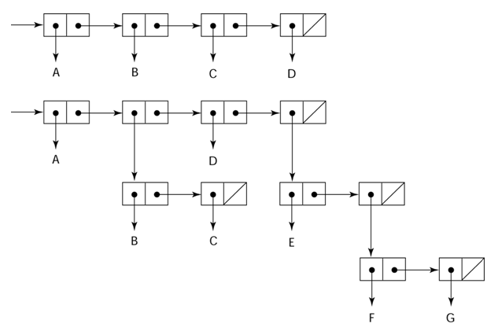
Lists in LISP
This diagram represents two lists in LISP
(A B C D)
(A (B C) D (E (F G)))
Sebesta, 2009, p70
Notes:
In a linked list each item in the list (akin to an index in an array) contains a field which references the next item in the list.
The main difference/benefit of linked lists over arrays is that the order of the items can be different from the order they are stored in memory – the addresses do not need to be consecutive as the address of the next item is stored in the previous item, and hence the list can be manipulated easier – items can be added and removed at any point of the list without needing to change many references or locations.
On the down side, the nature of lists makes it tricker to access or index them and their contents. You can’t simply look into the block of addresses containing the items as you can with an array, since they do not need to be consecutive – making it difficult to, say, find a certain value in a list, or find the last value… These things typically require you to scan through the list one item at a time, following the chain until you find what you need.

Slide 12
ALGOL 58
In the late 1950s, numerous high-level languages were emerging, most of them for one platform (UNIVAC or IBM)
No portability or universal language to communicate in
In 1958, the US Association for Computing Machinery (ACM) and the German Society of Applied Mathematics and Mechanics (GAMM) formed a joint team to develop a machine-independent language
First meeting established the following design goals:
Close to standard mathematical notation
Programs written in it should be easily readable
Good for describing algorithms in publications
Must be translatable to machine code
Notes:
The first point indicates that the language was intended for the scientific domain, which was the most common at the time.
The second and third points concern show a focus on readability – something that until then had not really been as high a concern. As we’ll see, readability becomes an increasingly large concern/factor in decades to come.
The last point is a bit of a “no duh” one, since it’s a crucial part of implementing any compiled language...

Slide 13
ALGOL 58
Eventually known as ALGOL 58, the language designed at the meeting was essentially a generalised and expanded descendent of Fortran, which is understandable
Good combination of simplicity, flexibility and elegance
Included data type declarations, compound statements, long variable names, nested selection statements...
The ALGOL 58 design had some success (e.g. JOVIAL), but IBM dropped it in favour of Fortran since they did not fancy the prospect of getting another language established
ALGOL 58 was debated and changes were suggested throughout 1958, and a new notation for describing syntax was introduced – Backus-Naur Form (BNF)
Notes:
It was a long, difficult and expensive process to get Fortran off the ground – not only developing the compiler, but training and convincing everyone to use it, etc. Hence, while they started off enthusiastic about ALGOL 58, they ended up dropping it and sticking to Fortran.
We’ll be covering BNF next week!

Slide 14
ALGOL 60
In 1960, a second meeting was held to discuss the suggested changes and additions to ALGOL 58
Included block structures (scoping), new parameter passing methods for subprograms, stack-dynamic arrays...
Did not include input/output statements with formatting, as this was deemed to be too machine-dependent
ALGOL 60 became the only formal way to depict algorithms in literature and influenced just about all imperative languages that followed it (including Pascal, Ada, C, Java...)
However, it never became a prominent language
Too flexible, making implementation and understanding tricky
Lack of input/output statements and strings caused problems
BNF was strange and complicated to people at the time
Notes:
Since ALGOL 60 lacked the formatted input/output statements and string handling that users required, implementations of it sometimes added these, which were often machine-dependent.
In one sense, ALGOL 60 was a massive success. It was the first machine independent language, it became the standard way to present/publish algorithms in literature, and just about all subsequent imperative languages are based on it to some degree… But on the other hand, it failed as a “language” – it was never widely used.
In the end, though, Fortran was already too popular and widely used for ALGOL to take much of a grip. Particularly given that IBM were supporting Fortran only.

Slide 15
COBOL
Like ALGOL, COBOL was designed by a committee, for similar reasons – numerous different languages emerging
In the domain of business applications, not scientific
Design goals of COBOL included:
Code should use simple English as much as possible
Easy to use, even at the expense of power (to broaden the base of computer users/code literacy)
Not restricted by current implementation limitations
Initial design published in 1960. Revised in 1961 and 1962… further revisions in 1974, 1985, 2002…
The language is still evolving and in use to this day
Notes:
The trend of designing readable languages is definitely starting to emerge now, as you can see by the emphasis on English statements, ease of use, broadening user base…
Personally, after reading the example COBOL program on pages 81-83 of the textbook, I’m not sure just how effective the whole “English statements” thing is. Sure, you have things like “IS LESS THAN” which may make things easier to read for someone who is really bad at symbols and mathematical notation…
…but then you also have things like “PERFORM 100-PRODUCE-REORDER-LINE UNTIL CARD-EOF-SWITCH IS EQUAL TO “Y””. I’m not sure who that is meant to help. As a programmer familiar with imperative languages similar to Fortran or ALGOL, the English statements make it harder to identify the control/loop structure and determine what the rest of the line does. To someone who isn’t a programmer, this is just as meaningless as something with symbols and operators. They still need to know the concepts at play in order to understand the code. They may be able to read it, but that alone is of little use.

Slide 16
COBOL
Significant features that first appeared in COBOL include:
DEFINE command for macros
Hierarchical data structures (records)
Long variable names that supported hyphens
Variables and records are defined in detail, and commands to output to a printer exist – necessary for business apps
Use mandated by the Department of Defense – established it until computers and compilers were powerful and cheap enough for COBOL to be widely used by businesses
No other major languages in business application domain
COBOL is still capable of meeting business application needs
These days, off-the-shelf application software is often used
Notes:
The features listed were all “firsts” – no other language had done them before. It was also the first language to be mandated by the DoD. Surprisingly, the initial version of COBOL did not support functions/subprograms. Versions before the 1974 one did not support parameters in subprograms.
COBOL is a very well-designed business language, but despite its success and widespread usage it has had little influence on other languages. The business application domain as a whole has stagnated, and many of the aspects of COBOL are tailored towards that domain.

Slide 17
BASIC
Designed by Dartmouth College in 1963 to be easy for non-science students to learn and use. Design emphasised:
Pleasant and friendly to use, free and private to access
Fast turnaround time for small programs (e.g. homework)
Must not require understanding of computer hardware to use
Must consider user time more important than computer time
BASIC was the first major language to use timesharing
Accessed via terminals connected to remote computer
Decreasing cost and availability of computers recognised
Timesharing made better use of a single powerful computer
Many, many versions of BASIC exist
Resurgence of use from 1990s with Visual BASIC – easy GUI
VB.NET is now the most widely used
Notes:
Being designed as a learner language and to be small, early versions of BASIC were pretty rudimentary and didn’t really compare to languages like Fortran or ALGOL. They were never really intended for any big/significant programs.
The concept of timesharing was revolutionary. In the early 1960s, computers were still very expensive, but they were becoming more powerful. Shelling out big money for a computer that could execute programs nice and quickly was a waste if it spent most of its time sitting idle with no jobs the do.
The developers of BASIC realised that one computer had the power to handle many users, who would not notice the difference since their individual processing demands were still being met at the same speed. BASIC was originally deployed on the GE-265 mainframe, which supported multiple terminals. Hence, multiple users could be served at once, using the processing power more efficiently.

Slide 18
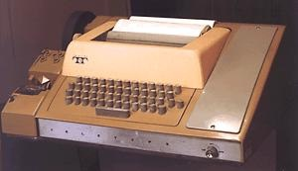
BASIC
A timeshare BASIC terminal – output was to paper, and programs could be saved to punch cards/tape
The terminal interacts with a mainframe for processing
This what Bill Gates and Paul Allen wrote programs on in 1969

Slide 19
PL/I
PL/I was the first attempt to create a language that could cater for many different application domains
The science (Fortran) and business (COBOL) domains were becoming increasingly sophisticated in disparate ways, potentially leading to two computers, two technical staff…
IBM developed a computer that could do both floating-point and decimal arithmetic, suitable for science and business
The IBM System/360 line of computers, 1964
To support this, they also designed a universal language to support science and business applications
…and systems programming and list processing too!
Notes:
IBM saw that the two groups were on a collision course which was going to cause problems – each area was starting to need some capabilities of the other, and the only two solutions were duplication (which would be costly, complicated, and generally a bad idea) or the development of a computer and associated language that could do BOTH things.
Thus, the IBM System/360 line of computers was born, capable of handling decimal and floating point arithmetic suitable for science and business. And along with it, a programming language that could cover both bases… and any other bases that strayed too close. Potential to replace/succeed Fortran, ALGOL, COBOL, LISP, assembly…

Slide 20
PL/I
Originally called NPL, named changed to PL/I in 1965
Language included just about everything from everywhere:
From ALGOL 60 came recursion and block structure
From Fortran IV came separate compilation of subprograms
From COBOL came data structures, I/O and report-generating facilities
But wait, there’s more! New features included:
First unit-level concurrency
First exception handling
Switch-selectable recursion
First pointer data type
First array cross sections
Notes:
PL/I – everything, and the kitchen sink

Slide 21
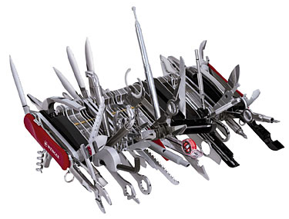
PL/I
The result was a massive and complex language that was cobbled together and hard to understand or use
Several of the new features were poorly designed or badly implemented (to be fair, they had not previously existed)
PL/I saw significant use in scientific and business domains, as well as in education (although usually a simplified subset version of it was used for this)
Notes:
While PL/I was responsible for numerous important new features and concepts in programming languages, it was not all that well constructed. It had too many constructs, was generally too large and complex, and many of the new features were not well designed, despite the theory being sound.
They essentially tossed in everything they thought might be useful, without thinking about how anyone was meant to understand it all and use it effectively, or making great effort to test that it all worked smoothly. This touches upon the concepts of orthogonality and simplicity discussed in week/chapter 1.
PL/I did a few things wrong, but to be fair, it’s not exactly like they had much experience to learn from – many of the features were new, and the scope of the language was wider than seen before… Let PL/I serve as a lesson to the next person who decides to make “One Language To Rule Them All”

Slide 22

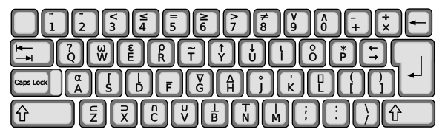
APL (A Programming Language)
Designed in 1960 at IBM by Ken Iverson
Still in use, minimal changes (although never widely used)
Many powerful operators (many for arrays), making it very expressive and writable, but very hard to read and maintain
Hence often thought of as being good for “throw-away” code
Originally used special terminals
and typeballs to support the
characters needed for operators
Notes:
Those typeballs look pretty awesome... I wonder if someone has made geek-jewellery out of them...

Slide 23
SNOBOL
Designed in early 1960s as a string processing language
Many powerful operators for string pattern matching
Early uses included writing text editing applications
Still used for certain text processing tasks
APL and SNOBOL similarities:
Minimal influence from languages that came before them
Minimal influence on languages that came after them
Both featured dynamic typing and dynamic storage allocation
A variable takes on a type when a value is allocated to it, and the storage space for the variable is allocated at that point
Notes:
Of course, most languages at the time were very much focused on numbers – arithmetic and numeric manipulation.
APL and SNOBOL did influence other languages that followed them – just not any particularly well-known or popular ones...

Slide 24
SIMULA 67
SIMULA I designed in early 1960s, replaced by SIMULA 67
Influenced by ALGOL 60 (essentially an extension of it)
Never achieved widespread usage or high influence
Introduced concept of coroutines – subprograms that run in parallel, rather than as a caller/callee and can enter/exit at more than the start and end of the code block
Introduced classes – i.e. Data abstraction
Allows definition of data structure and functions to manipulate
Instance of class is an object, etc...

Slide 25
ALGOL 68
Dramatically different from ALGOL 60
Never achieved widespread use
Again used a confusing new syntax description language
Design based on high orthogonality
A few primitive types and structures provided
User can combine these into many different structures
Has been included in most imperative languages since and had a strong influence on C, Pascal and Ada
Also introduced dynamic arrays – array declaration doesn’t include subscript bounds, stored allocated on assignment
Notes:
The ability to combine primitive data types and structures into user-defined data structures was a big deal, and was incorporated into most major imperative languages from then on.
Via the orthagonal approach, ALGOL 68 achieved high writability in a simple and elegant manner.
PL/I, on the other hand, tried to achieve high writability by providing a massive pile of data types and structures...

Slide 26
Pascal
Released in 1971, based on ALGOL 60
Designed for teaching structured programming
Was widely used for this from early 1970s to late 1990s
Design focus resulting in it lacking several important features that are necessary for application development
Can’t compile subprograms separately or handle variable-length arrays as subprogram parameters
Led to development of other dialects such as Turbo Pascal
High simplicity and expressivity, and relatively safe to code
Notes:
It’s worth noting that most major imperative languages designed after 1960 were heavily influenced by ALGOL and/or Fortran.

Slide 27
C
Originally designed in 1972 for systems programming, but well suited to many different applications
Influenced by CPL, BCPL, B and ALGOL 68
Highly expressive and writable due to adequate operators, control structures and data structures
Complete lack of type checking in earlier versions
Some appreciate the flexibility, some find it dangerous/insecure
Several dangerous/insecure features, such as pointers, make it a language with high flexibility that must be used wisely/safely
A C compiler was included in UNIX, making it freely available
Contributed greatly to its rise in popularity in the 1980s
Notes:
As well known and used as C is, it did not particularly contribute much that was new in the way of programming language concepts and design. C is generally an “unsafe” language – it doesn’t go out of its way to stop people doing stupid things that will cause their programs to crash or contain security flaws. In fact, the C compiler chuckles every time it spots one of these errors and doesn’t tell you.

Slide 28
Logic Programming and Prolog
Use of formal logic to communicate computational processes to a computer
Can be summarised as an intelligent database system that uses an inferencing process to infer the truth of queries
Based on predicate calculus
Logical languages are declarative, i.e. non-procedural
statements describe what to accomplish, not how to do it
Prolog, 1972, is a logic language. Consists of facts, rules and goals/queries that resolve to true or false
Inefficient (not designed around von Neumann architecture)
Not widely used – only a few areas of application, e.g. AI and DBMSs

Slide 29
Ada
Developed for the U.S. Department of Defense in 1974
Had hundreds of languages in use in embedded devices
No standardisation, low reuse of software, no development tools, many languages not suitable for embedded devices...
Most extensive and expensive language design ever – hundreds of people, a lot of money, about 8 years...
Aim was to design one language to use, which was suitable for embedded systems
Design process was long and tedious, with many submissions that needed to be evaluated and refined
First specifications released in 1980, standardised in 1983
Took until 1985 to release the first truly usable Ada compilers
Notes:
Essentially, the DoD’s language usage was one giant big mess. They needed a single language that was suitable for embedded devices.
Pop quiz: What properties / language evaluation criteria are the most important for a language designed for embedded systems, particularly embedded systems used by the DoD?

Slide 30
Ada
Ada made 4 major contributions:
Packages, allowing data objects, specifications and procedures to be encapsulated (data abstraction)
Exception handling, allowing run-time errors to be caught
Generic program units, allowing untyped procedures which increase code reuse and minimise duplication of code
Concurrency, allowing procedures to run at the same time
Ada 95 replaced Ada, introducing:
Type derivation (i.e. Inheritance, a fundamental part of OO)
Dynamic binding of subprogram calls (i.e. Polymorphism, also a fundamental part of OO)
Improved concurrency mechanisms
Used slowed when DoD stopped requiring it, and C++ released
Notes:
Concurrency support was much more efficient, allowing communication/data sharing between concurrent processes to be much easier.
It supported OO programming, but with C++ on the scene and the DoD not requiring its use, Ada 95 lost popularity…

Slide 31
Object-Oriented Programming and Smalltalk
Smalltalk (1972) was the first language to fully support OOP
Supported data abstraction, inheritance, and dynamic binding
Some OO features emerged in SIMULA and Ada, really reached maturation in Smalltalk
Everything is an object – from integers to software systems
All computing done by calling methods on objects
Syntax looks odd, as even arithmetic and logic are done via method calls on objects
Replaced by Smalltalk-80
Pioneered the graphical user interface design such as that used in Windows and promoted/established OOP

Slide 32
Combining Imperative and OOP – C++
C++ evolved from C, incorporating language facilities of SIMULA and the OOP support of Smalltalk
Increased safety via type checking and exception handling
Emerged between 1983 and 1985 after numerous expansions to C, and continued to evolve since then
Quite a large and complex language due to many influences
C++ includes:
Support for both procedural and OO programming
Multiple inheritance for classes/objects
Overloading of operators and class methods
Very popular and widely used – good, free compilers, high compatibility with C, OO support, suitable for apps dev...
Notes:
Since C++ inherited just about everything that C had, it’s still quite unsafe compared to languages like Ada.

Slide 33
Java
Developed by Sun in the 1990s
Started with C++, removed/changed/added some bits, and came up with a smaller, simpler and safer language that retains much of the power and flexibility of C++
Designed for embedded consumer electronics (toasters, etc) and hence needed to be very reliable
This never really eventuated, but Java was found to be very useful for applets on the World Wide Web and took off
Some of the Java features that make it safer/more reliable:
References, which are similar to but safer than pointers
Index range checking for arrays
Garbage collection to deallocate storage for objects
Implicit type coercion only for widening assignments
Notes:
Sun considered C but although it was small it didn’t support OOP. They considered C++, but although it supported OOP it was too large and complex. Both of them weren’t reliable enough, as well.
Java does not include struct, union, enum, pointer arithmetic, and half of the assignment coercions of C++. It also does not support multiple inheritance.

Slide 34

Java
Java has become widely used in various areas
Some appreciate its design – trimming C++ and making it safer and more reliable
Others appreciate the portability – it runs on any computer that has a Java Virtual Machine (although this originally meant that it was much slower than other languages)
It is also freely available online
Java is still widely used and developed
Notes:
Java is still an live language which is being actively developed.
The book mentions something which I’ve always felt about Java – essentially, that the cross-platform nature of it is nothing special. The reason for this is that it’s achieved via compiling it into a “generic” state (byte-code) that can run on any platform... Assuming that platform has the Java Virtual Machine installed in order to run it. Not only is running these apps relatively slow (due to interpretation), but it’s sort of like buying an “internationally compatible” piece of electronic equipment, only to find that this is achieved via the inclusion of a universal power socket adaptor you need to plug the appliance into before plugging it into the wall.

Slide 35
Scripting Languages
Concept evolved from batch files / shell scripts – list of commands that execute system subprograms
Added variables and control structures to make this more powerful, and eventually evolved into complete languages
Now often serve as general purpose interpreted languages
Perl is a general purpose but quite simple scripting language
Unusual as it is compiled, at least into intermediate form
First character of variable name denotes namespace ($, @, %)
Includes dynamic length and associative arrays
Powerful but somewhat dangerous due to type coercion and issues with error detection regarding arrays
Notes:
Perl’s method of variable naming makes the language much more readable, as you are informed about a variable just by reading its name.

Slide 36

Web Scripting Languages – JavaScript and PHP
JavaScript designed by Netscape and Sun in 1995
Server-side processing was possible with CGI, but client-side needed in order to create dynamic and interactive pages
JavaScript interpreter usually embedded in web browser
PHP was released as a package to help people track visitors to their websites in 1995. Purely interpreted language
Evolved into general purpose server-side scripting language
Mainly used for web applications – scripts usually produce HTML page as output, which is sent to client (browser)
Includes OOP support, associative/dynamic arrays, dynamic typing, easy web form processing, DBMS integration...
Notes:
JavaScript is not Java. By 3rd year nobody should be under that illusion, but it’s still something worth pointing out. It only became called JavaScript when Sun got their fingers into Netscape’s scripting-language-pie. But hey, given the rest of Sun’s naming scheme, I guess we’re luck they didn’t end up calling it MochaScript or ArabicaScript. JavaScript evolved as a way to include client side scripting in web pages – server side was possible via CGI calls to programs, and while Java Applets allowed for client side scripting, they were more of an external plug-in than an integrated part of the webpage/browser.
While JavaScript interpreters are implemented in browsers, i.e. The client side, PHP interpreters are implemented/added to web servers – server-side. The client never sees the PHP code. It is processed on the server and the output (usually HTML) is sent to the client.

Slide 37

Python
Object-oriented interpreted scripting language, 1991
Similar application areas as Perl – system administration, CGI programming, relatively small application development
Python includes:
OO support, exception handling, garbage collection, CGI module for form processing and modules for other things...
Like PHP, Python is open source – easily extendible by users
Known for its peculiar syntax and structure
Designed to be highly readable and clear
Indentation (whitespace) used instead of curly brackets or keywords to delimit blocks

Slide 38


Ruby and Lua
Ruby (1996) is purely OO based, like Smalltalk
Methods can be dynamically added to both classes and objects – different instantiations can be different
Dynamic typing with scope specified by first character of variable name – letter is local, @ is instance, $ is global
Lua (1993) supports both procedural and functional programming, and is also highly extensible
Only one data structure – tables. Incorporates the capabilities of associative/traditional arrays
Includes garbage collection and dynamic typing
Relatively small and simple language
Both used for CGI programming and form processing

Slide 39



Microsoft .NET Framework
Released by Microsoft in 2002, the .NET framework adds a common library and virtual machine for a range of inter-operable languages to the Windows operating system
C#, influenced by C++, Java, Visual BASIC and Delphi – tweaked parts of C++ and made them safer
J# – .NET version of Java (now discontinued)
VB.NET – .NET version of Visual BASIC, has OO support
ASP.NET – server-side web application language
PowerShell – OO command line shell scripting language
Many, many more – a version of most modern languages!
All .NET languages compile into a single intermediate language, which is then compiled (Just-In-Time compiler)
Notes:
C# includes most of the stuff from C++ that was taken out in Java to make it safer and more reliable, but most of the versions of those features in C# have been made safer. They’ve also made changes to some of the C++ stuff that wasn’t so useful or well-designed.

Slide 40
Summary
This lecture covers a lot of ground and many languages
Context of language in history of languages is important
Design goals and motivations
Situation it emerged and evolved in
What it added to the area of programming languages
Reasons for success or failure
What languages influenced it and what it influenced
Some languages such as Fortran, ALGOL, Ada, C/C++, Java are well known and had major impacts or usage
Others are not as common or widely used but still introduced something new or expanded something important

