Slide 1
CSI3344 Distributed Systems
Unit Revision
Contents covered in this unit
Highlights of weekly materials
Exam
Exam coverage & format
Exam Preparation

Slide 2
Major Points
Modules 1-2: Distributed Systems in General
Benefits provided by distributed systems
Challenges in distributed system design
Application layering
Client-server architecture & interaction procedure
Modules 3-4: Communications
The layered (ISO) OSI Protocols
Specific aspect of each of the seven layers
General structures of RPC and RMI
Procedures of RPC and RMI
Variations of RPCs & RMIs
Notes:
Distributed Systems in General (Seminars 1-2)
1. Introduction to DS
(1) Share resources, (2) Expandability – add new systems, (3) Local Autonomy - local policies, settings, and access controls to its resources and services (4) Improved Performance , e.g., allows resources to be distributed in different machines (5) Improved Reliability and Availability - resources are spread or replicated across multiple computers (6) Potential Cost Reduction
2. Architectures of DS
(1). Heterogeneity (2) Openness: Hardware &Software extensibility (3) Security - protect these resources against any unauthorised activities Scalability: Failure handling: 6. Concurrency: 7. Transparency:
System Model: Applications + Middleware + Platform
Communications (Seminars 3-4)
3. Communication Protocol & 4. RPC & RMI

Slide 3
Major Points
Module 5: Processes and Naming
Processes & threads
Server classification
Relations between entity, name, address, and identifier
Module 6: Synchronization
Happened-before relation
Logical time and time stamps
Classification and features of distributed transactions
Module 7: Consistency
Consistency models – With/Without synchronization operations
Strict consistency; Sequential consistency; Causal consistency; FIFO consistency
Weak consistency; Release consistency; Entry consistency

Slide 4
Major Points
Module 8: Replication
Replication protocols
Quorum schemes
Module 9: Fault Tolerance
Dependability of distributed systems
Classification of redundancy
Replicas needed to achieve fault tolerance
Reliable multicasts
Module 10: Security
Features of cryptosystems
Authentication process
Variations in authorisation
Module 11: Middleware
CORBA and DCOM
Middleware services

Slide 5
Exam Structure
Time
3 hours (No extra reading time)
Special Instructions
Closed book exam
(Non-Programmable) calculator permitted
17 pages in total – space reserved for answers
Your answers:
MCQs on the computer answer sheet provided; and
All other questions on the Exam paper
Note: Anything written on answer booklets will not be marked/counted unless you RUN OUT of reserved space for individual questions on the Exam paper

Slide 6
Exam Structure cont…
Section A (attempt all questions)
Q1 (30 marks):
30 multiple choice questions, 1 mark each
Questions drawn from
lecture slides,
weekly Workshop & Review questions,
weekly readings
Choose only ONE from A, B, C, and D given, and mark the related circle on the Computer Answer Sheet provided

Slide 7
Exam Structure cont…
Section B (attempt all questions, a total of 25 marks)
Q2 (15 marks):
Consists of 5 sub-questions, each carries 2-4 marks
Short answers or brief descriptions required
Q3 (10 marks):
2 sub-questions, each carries 5 marks
-- from Weekly Advanced readings (see last slide of Lecture Slides 6~ 10)
Short answers or brief descriptions required

Slide 8
Exam Structure cont…
Section C (attempt all questions, a total of 45 marks)
Q4 & Q5
Two questions are similar in structure
-- Each has 4 or 5 sub-questions
Requires in-deep discussion, descriptions or explanations, etc.
Themes:
-- Q4: Synchronization & Consistency (25 marks)
-- Q5: Replica & Fault Tolerance (25 marks)

Slide 9
Exam Coverage
Mark Breakdown:
Modules 1 ~ 5 + 11: ~30%
DSs in general +Communications + Processes & Naming + Middleware
Mostly in the form of MCQs
Modules 6~10: ~ 60%
5~20% in each of the following knowledge areas:
Synchronization
Consistency & Replication
Fault Tolerance, and
Security
Advanced Readings 10%

Slide 10
Example questions
Examples for multiple choice
For a client-server system that potentially has Byzantine failures in its servers, how many replicated servers are needed to achieve 5-degree of fault tolerance?
(A) 5 (B) 6 (C) 10 (D) 11
Notes:
(D) 11
(as of 2k+1)

Slide 11
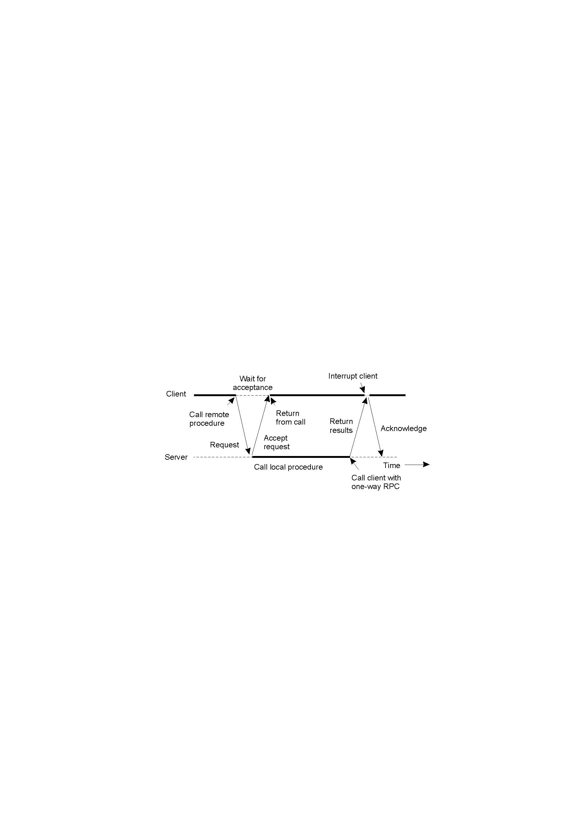
Example questions
Examples for multiple choice
The following diagram shows the interactions using
(A) a traditional RPC.
(B) an asynchronous RPC.
(C) a deferred synchronous RPC.
(D) an one-way RPC.
Notes:
c) A client and server interacting through two asynchronous RPCs, or a deferred synchronous RPC

Slide 12
Example questions
Examples for multiple choice
3. A file is replicated on 9 servers. Which of the following combination of write and read quorums (in form of (N_{W}, N_{R})) are permitted by the Gifford’s voting algorithm (or Gifford’s Quorum Scheme) ?
(A) (9, 1)
(B) (4, 5)
(C) (8, 1)
(D) All of above.
Notes:
(A),
Based on Legal constraints:
N_{R} + N_{W} > N (prevent read-write conflicts)
N_{W} > N/2 (prevent write-write conflicts)
For N = 9, the combination of read quorum N_{R} and write quorum N_{W} can be any of the following (i.e., (N_{W}, N_{R}) =…): (9, 1), (9, 2), (9, 3), (9, 4), (9, 5), (9, 6), (9, 7), (9, 8), (9, 9), (8, 2), (8, 3), (8, 4), (8, 5), (8, 6), (8, 7), (8, 8), (8, 9), (7, 3), (7, 4), (7, 5), (7, 6), (7, 7), (7, 8), (7, 9), (6, 4), (6, 5), (6, 6), (6, 7), (6, 8), (6, 9), (5, 5), (5, 6), (5, 7), (5, 8), (5, 9). The best combination should be one of (9, 1), (8, 2), (7, 3), (6, 4), (5, 5).

Slide 13
Example questions
Briefly explain the characteristic properties of flat transactions.
What are the two simple points, on which the causal ordering is based?
(Space reserved for recording your answers here, i.e., on the Exam paper)
(Space reserved for recording your answers here)

Slide 14
Time Management
The best way to allocate time in an exam is based on the marks per question
Target :1 minute per mark for MCQ
2 minutes per mark for other type of questions
Allowing a 10 minute buffer given 100 marks in 180 minutes
Use buffer at end for revision and finishing off longer or hard questions
If you finish a section before the time is up, add this time to your buffer, not to the next section/question

Slide 15
Answering Multiple Choice Q’s
Read the question carefully
look out for words that change the meaning of the question, like not, and underline them
If you don’t know, guess
If you have to guess, be clever about it
Eliminate obviously wrong answers
Watch out for distracters – answers that try to distract you from the correct answer

Slide 16
Exam Tips
Before Exam
Review all lecture slides; complete required readings
-- Lecture slides are not enough
* Only ~ 20 marks come directly from the lecture slides
Read texts and review all notes; Re-attempt weekly review questions
-- Covers majority of MCQs
Re-attempt A1 workshop questions
-- 15+ marks from here
During Exam
Don’t panic (tight? – only makes things worse)
Don’t expect perfect solution/s in the first go
Timing, timing, and timing!!!

Slide 17
Review Checklist
Did you
Pass both assignments?
Go through lecture slides & required readings?
Attempt weekly workshop/review questions?
If your answer is “no” to any of the above questions, ACTION now!
Know the exam format?
Are you
Clear with the basic concepts listing in the weekly reviews?

Slide 18
Be Prepared!!!!!
If you cover the materials, the exam should contain NO SURPRISE.
Wish you well with your EXAM!
GOOD LUCK!

