Slide 1
Class #509
The Heisenberg Principal of Debugging
A Method for Recording Execution and Program State in a Live Embedded System, for Later Playback and Debugging.

Slide 2
Why Trace Debugging?
Stopping a real-time program may change its behavior.
It may also have real-world, mechanical consequences!
  Motors overrunning their limits.
  Holding tanks overflowing.
  Disk heads crashing.
  Cars not stopping.
Some types of events that you would like to debug:
  happen only when running at native speed.
  happen over very short time intervals.
  happen over very long time intervals.
  are difficult to predict, reproduce, and capture.
  happen only in actual field conditions.

Slide 3
Methods of Trace Debugging
Emulators
Logic Analyzers
Hand-instrumented code (“printf debugging”)
Automated code instrumentation systems
GDB with Introspect
  Interactively instrument the binary image using the source language.
  Specify the exact program data you want to collect.
  Run program at nearly-native speed.
  Replay execution trace and review collected data at leisure, using the full (and familiar) power and functionality of GDB.

Slide 4
A Typical Trace Debugging Session
Specify “tracepoints” (analogous to breakpoints).
  trace tree.c:find
  trace main.c:123
Specify variables, registers etc. to collect at each tracepoint.
  collect tree->vector.p[tree->vector.n - 1]
  collect $d1, $a2
Run the program.
Replay at leisure the sequence of tracepoint ‘hits’, examining the collected data using any GDB command.
  tfind line 123
  display tree->vector.p[tree->vector.n - 1]
  tfind next

Slide 5
Comparison: breakpoint vs. tracepoint

Slide 6
Breakpoints vs. Tracepoints
Breakpoint-style
  Run until breakpoint
  Note where it occurred
  Look at current program state
  Continue, step, ...
Tracepoint-style
  Select a trace event
  Note where it occurred
  Look at collected values
  Select another event

Slide 7
Comparison: step/continue vs. trace

Slide 8
Example: Walking a Tree
struct point {
double x, y;
};
struct vector {
int n;
struct point *p;
};
struct tree {
struct tree *left, *right;
int key;
struct vector *vector;
};

Slide 9
Example: Walking a Tree
struct tree *
find (struct tree *tree, int key)
{
if (! tree)
return 0;
if (key < tree->key)
return find (tree->left, key);
else if (key > tree->key)
return find (tree->right, key);
else
return tree;
}

Slide 10
Setting a Tracepoint
(gdb) trace find
(gdb) actions
> collect $stack
> collect $locals
> collect *tree
> collect tree->vector.p[tree->vector.n - 1]
> end
(gdb)

Slide 11
Running the Experiment
(gdb) tstart
(gdb) continute

Slide 12
The Results: Selecting a Logged Event
(gdb) tfind start
Tracepoint 1, find (tree=0x8049a50, key=5) at tree.c:24
24 if (! tree)

Slide 13
The Results: Selecting a Logged Event
(gdb) tfind start
Tracepoint 1, find (tree=0x8049a50, key=5) at tree.c:24
24 if (! tree)
(gdb) where
#0 find (tree=0x8049a50, key=5) at tree.c:24
#1 0x8048744 in main () at main.c:8
(gdb) print *tree
$1 = {left = 0x80499b0, right = 0x8049870, key = 100,
vector = 0x8049a68}
(gdb) print tree->key
$2 = 100

Slide 14
The Results: Only What You Asked For
(gdb) print tree->left
$3 = (struct tree *) 0x80499b0
(gdb) print *tree->left
Data not collected.
(gdb)

Slide 15
The Results: But Everything On The Way
(gdb) print *tree->vector
$4 = {n = 2, p = 0x8049a78}
(gdb) print tree->vector.p[1]
$5 = {x = 3, y = -46}
(gdb) print tree->vector.p[0]
Data not collected.
(gdb)

Slide 16
The Results: What We Collected
> collect *tree
> collect tree->vector.p[tree->vector.n - 1]
left
right
key
vector
n
p
x,y
x,y

Slide 17
The Results: Selecting Other Events
(gdb) tfind
Tracepoint 1, find (tree=0x80499b0, key = 5) at tree.c:24
24 if (! tree)
(gdb) where
#0 find (tree=0x80499b0, key=5) at tree.c:24
#1 0x80484fa in find (tree=0x80499b0, key=5) at tree.c:28
#2 0x8048744 in main () at main.c:8

Slide 18
The Results: Selecting Other Events
(gdb) tfind
Tracepoint 1, find (tree=0x80498f0, key=5) at samp.c:24
24 if (! tree)
(gdb) where
#0 find (tree=0x80498f0, key=5) at tree.c:24
#1 0x8048523 in find (tree=0x80499b0, key=5) at tree.c:30
#2 0x80484fa in find (tree=0x80499b0, key=5) at tree.c:28
#3 0x8048744 in main () at main.c:8

Slide 19
The Results: Selecting Other Events
(gdb) tfind
Target failed to find requested trace event.
(gdb)

Slide 20
Implementation
All symbolic information is handled by the debugger.
A simplified, non-symbolic description of the tracepoints and data to be collected (including expressions) is downloaded to a debug agent on the target board.
  Expressions are reduced to a byte-code form which the target debug agent can interpret at trace collection time.
  Can ‘cut-and-paste’ expressions from the source code.
Debug agent collects all trace data into a local buffer at runtime, without any intervention from the debugger.
Debugger then queries the contents of the trace buffer as needed to satisfy user requests.

Slide 21
Evaluating an Expression
To evaluate an expression like this:
  tree->vector.p[tree->vector.n - 1]
we need to know:
  the syntax of C
  names of local variables, arguments, etc. (scopes)
  physical locations of variables, etc.
  types of variables
  C expression semantics

Slide 22
Compiling Expressions to Bytecode
The C expression:
  *tree
compiles to the bytecode sequence:
  reg 8
  const8 16
  trace
  end

Slide 23
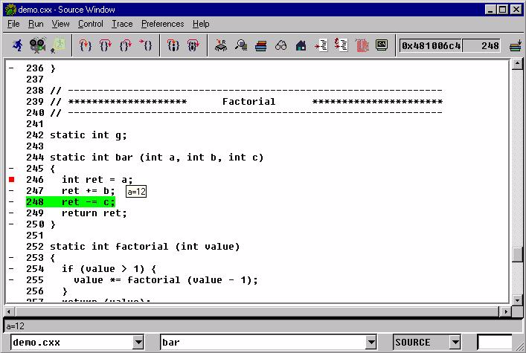
GDB Ready to Define a Tracepoint

Slide 24
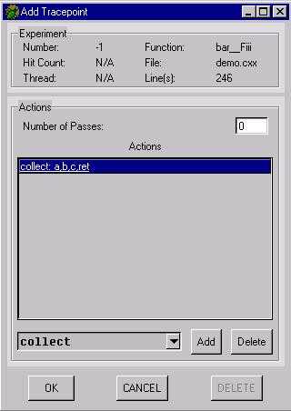
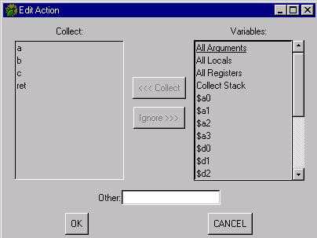
Tracepoint Definition Dialog Boxes

Slide 25
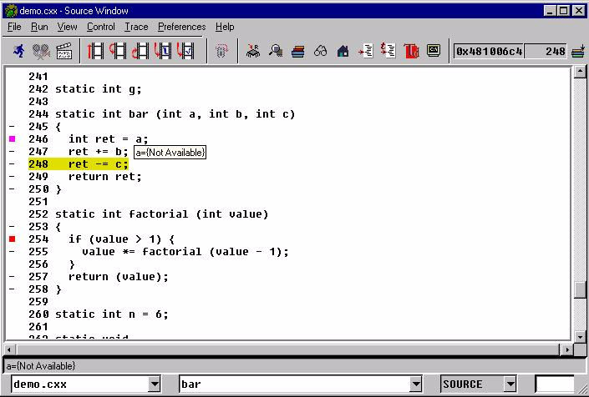
Replaying the Trace Record

Slide 26
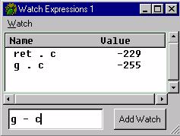
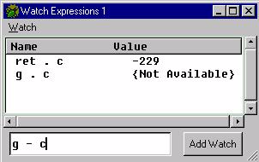
Expressions Window
‘Live’ data
Collected data

Slide 27
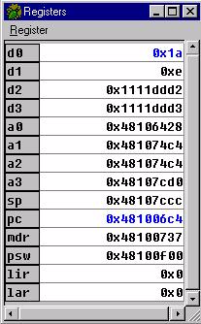
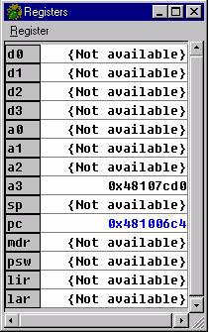
Registers Window
‘Live’ registers
Collected registers

Slide 28
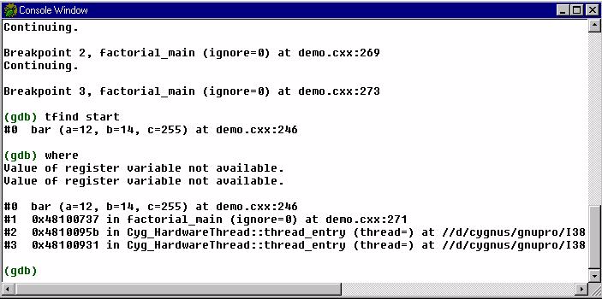
‘Where’ command, using collected stack

Slide 29
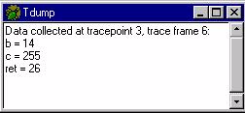
Trace Dump Window
Displays all collected data for current trace record.

