Slide 1

ZOMATO DATASET | EXPANSION ANALYSIS
Restaurant
Expansion Screener
Where should a new restaurant brand look first outside India?
Prepared by Kunal Prasad
Newton School Data Analytics(Excel)
October 2026

Slide 2
01 | INTRODUCTION
A large home market makes international screening important
The dataset is a screening tool—not a final investment decision.
RESTAURANT RECORDS
INDIA LISTINGS
COUNTRIES OUTSIDE INDIA
RATED RESTAURANTS
9,551
8,652
14
7,403
15 countries in the dataset
About 90.6% of all records
Potential markets to screen
After treating rating 1.0 as not rated
Project objective
What the dataset cannot tell us
Identify countries and cities worth deeper research by comparing restaurant listings, customer engagement, ratings, costs and price tiers.
• No revenue, footfall, rent or operating-cost data.
• Votes indicate recorded engagement—not market demand.
• Shortlisted locations require local validation.
Decision goal: narrow the research scope, not declare a guaranteed winning market.
ZOMATO DATASET | RESTAURANT EXPANSION ANALYSIS
02

Slide 3
02 | DATA
Cleaning protects the quality of comparisons
Raw Data was preserved; transformations were applied to the analysis copy.
Key preparation steps
TOTAL RECORDS
COUNTRIES
• Rating 1.0 was treated as not rated; Rating_Clean is blank for those records.
• Zero costs and zero coordinates were treated as missing for relevant analysis.
• Country names were mapped from country codes using the lookup sheet.
• Currency labels were checked and costs were converted to INR for comparison.
• Opening dates and years, price labels and primary cuisine were added as helper fields.
9,551
15
Original dataset
Country-level coverage
RATED RECORDS
NOT RATED
7,403
2,148
Rating_Clean populated
Rating 1.0 excluded
Use the same cleaned ranges for every pivot, chart and KPI to avoid inconsistent totals.
ZOMATO DATASET | RESTAURANT EXPANSION ANALYSIS
03

Slide 4
03 | METHODOLOGY
Five repeatable steps turned the raw file into a market screen
Tools: Google Sheets, pivot tables, formulas, charts and slicers.
01
CLEAN
Blanks for invalid zero values; Rating_Clean; corrected labels
TRIM • IF • Find & replace
02
ENRICH
Country name, opening year, currency symbol, INR cost
VLOOKUP • MID • FIND • YEAR
03
SUMMARISE
Counts and averages by country, city and cuisine
Pivot tables • COUNTIFS • AVERAGEIFS
04
TEST
Ratings against price tier, delivery, booking and cuisine
CORREL • FILTER • array formulas
05
VISUALISE
Charts and dashboard with Year and Country filters
Charts • slicers • conditional formatting
Keep a clear chain from raw data → cleaned data → analysis → recommendation.
ZOMATO DATASET | RESTAURANT EXPANSION ANALYSIS
04

Slide 5
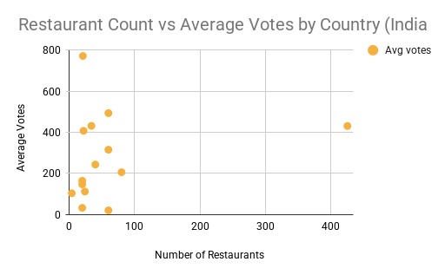
04 | MARKET SCREENING
Indonesia and Turkey show strong engagement with relatively few listings
Use restaurant count and average votes together; neither metric alone proves demand.
What the screen suggests
• Indonesia: 21 listings and roughly 772 average votes in the earlier country screen.
• Turkey: 34 listings and roughly 432 average votes.
• Qatar and Sri Lanka have fewer listings but lower average votes.
• Shortlist for deeper research: Indonesia, Turkey, Qatar and Sri Lanka.
Restaurant count by country
ZOMATO DATASET | RESTAURANT EXPANSION ANALYSIS
05

Slide 6
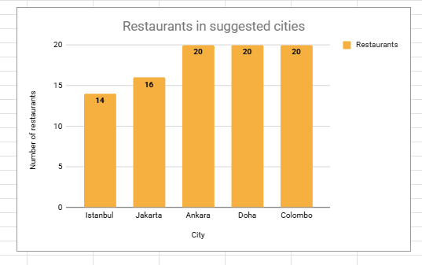
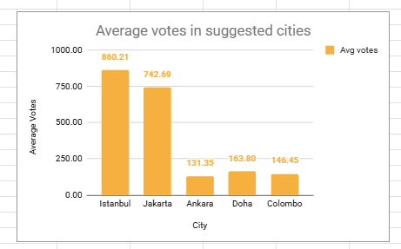
05 | CITY SCREENING
Jakarta, Ankara and Istanbul have the strongest average ratings
Each city has a small sample of 14–20 listed restaurants; interpret small differences cautiously.
City comparison
• Jakarta — 16 listings | 742.69 avg votes | 4.36 rating
• Istanbul — 14 | 860.21 avg votes | 4.29 rating
• Ankara — 20 | 131.35 avg votes | 4.31 rating
• Doha — 20 | 163.80 avg votes | 4.06 rating
• Colombo — 20 | 146.45 avg votes | 3.87 rating
These counts are dataset listings, not the total size of each city's restaurant market.
ZOMATO DATASET | RESTAURANT EXPANSION ANALYSIS
06

Slide 7
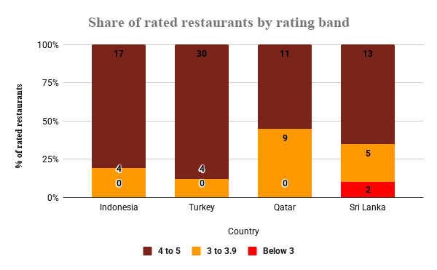
06 | RATING QUALITY
Turkey and Indonesia set the strongest rating benchmarks
Share rated 4+ is useful as a quality signal, but the samples remain limited.
Key findings
• Turkey: 88.2% of rated restaurants score 4+.
• Indonesia: 81.0% score 4+.
• Sri Lanka: 65.0% score 4+.
• Qatar: 55.0% score 4+.
• Use the differences as signals for research, not a guarantee of future performance.
denominator visible on the chart: percentages are based on rated restaurants.
ZOMATO DATASET | RESTAURANT EXPANSION ANALYSIS
07

Slide 8
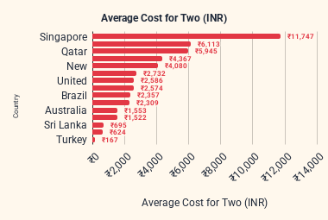
07 | COST & PRICE
Cost for two must be compared in a common currency
INR conversion supports cross-country comparison; local currency and exchange-rate assumptions matter.
Interpretation
• Dataset averages vary substantially by country.
• Local-currency medians are often easier to interpret than converted averages.
• Use average price range alongside INR cost to understand the restaurant tier.
• Do not use the city pivot's unusually low Turkey cost values until the conversion is verified.
Before finalising: verify Turkish conversion values and the source/date of exchange rates.
ZOMATO DATASET | RESTAURANT EXPANSION ANALYSIS
08

Slide 9
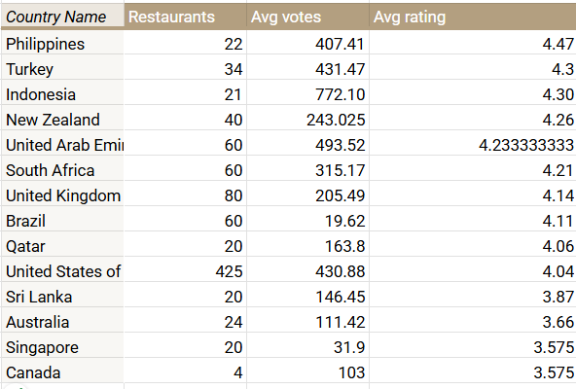
08 | LOCAL CONTEXT
High-vote competitors show where engagement is concentrated
Votes help identify visible competitors; they are not a market-share measure.
Examples from the analysis
• Jakarta: Talaga Sampireun and Skye appear among high-vote venues.
• Istanbul: J'adore Chocolatier and Karaköy Güllüoğlu have high vote counts.
• Doha: Indian Coffee House has high engagement but a lower rating (3.4).
• Colombo includes a highly voted venue rated 2.4—check service and quality context.
ZOMATO DATASET | RESTAURANT EXPANSION ANALYSIS
09

Slide 10
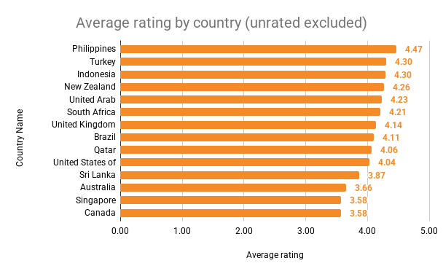
09 | CUISINE INSIGHT
Indonesian and Turkish cuisine categories rate strongly in the shortlist
Only show cuisines with a sufficient rated sample; cuisine labels can overlap.
Key findings
• Indonesian cuisine: 4.51 average rating (n=7).
• Kebab: 4.38 (n=10); Turkish Pizza: 4.33 (n=8).
• Western and desserts also rate well in the broader cuisine view.
• These are associations within a small sample—not proof that cuisine alone drives ratings.
Used the latest verified cuisine pivot; avoid mixing Primary_Cuisine results with multi-cuisine counts.
ZOMATO DATASET | RESTAURANT EXPANSION ANALYSIS
10

Slide 11
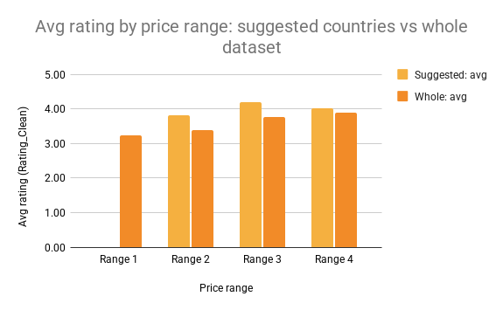
10 | RATING DRIVERS
Higher price tiers do not consistently produce higher ratings
Keep price range and average rating definitions consistent across comparison groups.
What it means
• In the shortlisted countries, ratings are broadly flat across price ranges 2–4.
• The earlier analysis reported a pooled correlation near 0.02 in the shortlist.
• The whole-dataset relationship was stronger, partly influenced by India.
• Price is not a reliable substitute for food quality or customer experience.
Retain the correlation only if the underlying formula and sample filters are still valid in the workbook.
ZOMATO DATASET | RESTAURANT EXPANSION ANALYSIS
11

Slide 12
11 | RECOMMENDATIONS
Prioritise a staged research plan—not an immediate launch
Use the screen to focus resources, then validate each market with local data.
01
MARKET
02
CONCEPT
Start deeper diligence in Indonesia and Turkey; retain Qatar and Sri Lanka as comparison markets.
Test Indonesian, kebab/Turkish and dessert concepts in small market research pilots.
Strong engagement / rating signals, but limited dataset coverage.
Cuisine ratings are promising but observational.
03
PRICE
04
OPERATIONS
Set price tests around local medians and restaurant tier, not converted averages alone.
Validate delivery, booking, rent, footfall, revenue and competitor menus.
Cost and price-range distributions differ materially.
These business drivers are not fully represented in the dataset.
Recommendation: use a shortlist to guide due diligence; the dataset alone cannot establish profitability.
ZOMATO DATASET | RESTAURANT EXPANSION ANALYSIS
12

Slide 13
12 | DECISION GATES
Move from 14 international markets to a focused four-country research plan
The expected impact is a narrower research scope, not a predicted increase in revenue.
MARKETS TO RESEARCH
SHORTLIST
CITY CANDIDATES
NEXT PHASE
14
4
5
Local
Countries outside India
Indonesia • Turkey • Qatar • Sri Lanka
Jakarta • Istanbul • Ankara • Doha • Colombo
Validate before committing
Pilot decision gates
• Customer research confirms a real target segment and price acceptance.
• Local cost, rent, staffing and delivery economics fit a viable business case.
• Competitor mapping shows a defensible positioning opportunity.
• Pilot success measures are defined before launch: rating, repeat intent, cost and operational performance.
Any targets such as rating ≥4.2 or 75% rated 4+ are proposed benchmarks—not guaranteed outcomes.
ZOMATO DATASET | RESTAURANT EXPANSION ANALYSIS
13

Slide 14
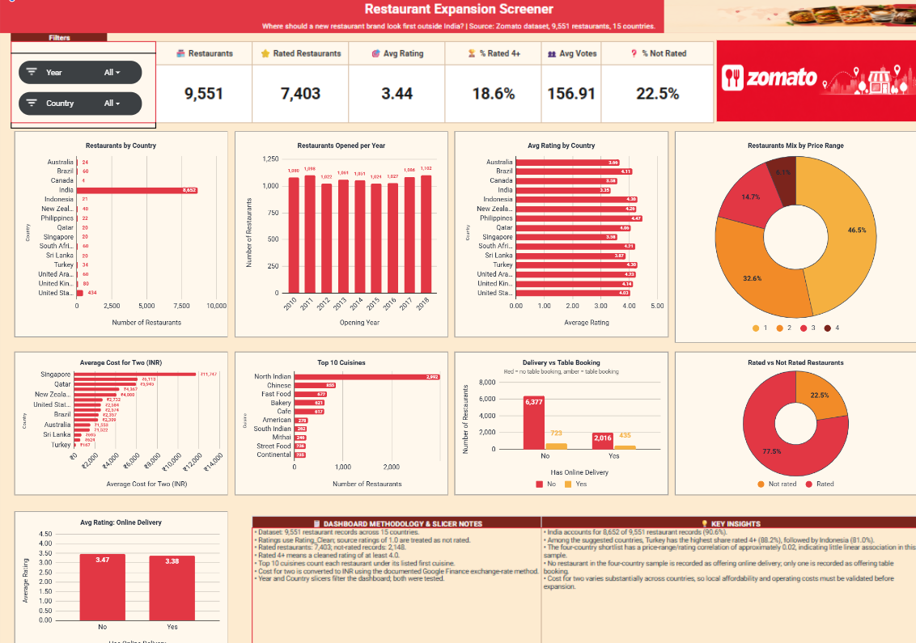
13 | DASHBOARD
One interactive view connects market size, quality, price and service
Use the clean dashboard screenshot with both slicers set to All.
How to read it
• Top cards summarise the overall dataset.
• Country and year filters should update every connected chart.
• Use the dashboard to explore; use detailed pivots to validate individual findings.
Final check: confirm every chart and KPI responds to both slicers
Replace this embedded dashboard image if it is not the latest version.
ZOMATO DATASET | RESTAURANT EXPANSION ANALYSIS
14

