Slide 1
RAMDisk Concept
121027 – Kunjan Patel

Slide 2
What is ramdisk?
A block of RAM that an OS is treating as a disk drive
It is a memory based file system
They are 10s of times faster than modern SSD drives in terms of reading and writing speed

Slide 3
Drawbacks
When the system restarts, or crashes, file system is lost along with all its data (RAM is volatile)
In Windows, the data written back to disk while shutdown
Data retrieved on boot up.
This can cause potential delay in booting.

Slide 4
ramfs
Uses same mechanism for storage space as Linux file system cache
Cannot be limited in size
Continues using memory storage until the system runs out of RAM and crashes or becomes unresponsive

Slide 5
tmpfs
A more recent RAM file system
Overcomes drawbacks of ramfs
You can specify the size limit in tmpfs
Behaves same as partition of a physical disk

Slide 6
Creating RAMDisk in Linux
mkdir /mnt/ramdisk
mount -t [TYPE] -o size = [SIZE] [FSTYPE] [MOUNTPOINT]
[TYPE] is the type of RAM disk to use; either tmpfs or ramfs.
[SIZE] is the size to use for the file system. Remember that ramfs does not have a physical limit and is specified as a starting size.
[FSTYPE] is the type of RAM disk to use; either tmpfs, ramfs, ext4
mount -t tmpfs -o size=512m tmpfs /mnt/ramdisk

Slide 7
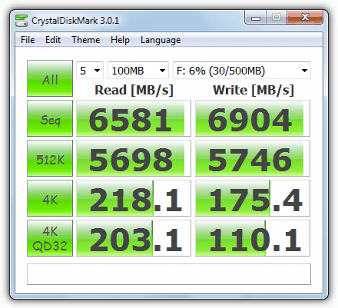
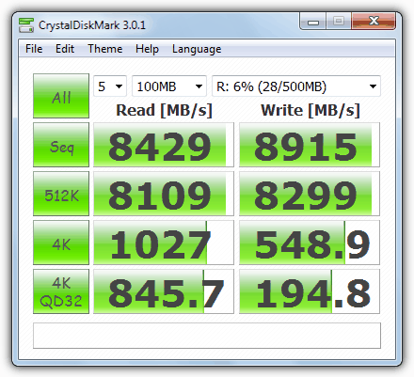
DataRAM
SoftPerfect

Slide 8
References
https://www.raymond.cc/blog/12-ram-disk-software-benchmarked-for-fastest-read-and-write-speed/ (for images)
http://www.jamescoyle.net/knowledge/951-the-difference-between-a-tmpfs-and-ramfs-ram-disk
http://www.jamescoyle.net/how-to/943-create-a-ram-disk-in-linux

