Slide 1
LexicAL ANALYZER USING TKINTER
Dhruv Wadhera (RA2011026010071)
Parth Madan (RA2011026010114)

Slide 2
ABSTRACT
The Lexical Analyzer with Tkinter GUI and PostgreSQL Integration project presents a user-friendly graphical interface for performing lexical analysis on C programming code. The project utilizes the Tkinter library for GUI development and integrates with a PostgreSQL database using the psycopg2 library.
The application allows users to select a C code file, which is then analyzed by the lexical analyzer. The lexical analysis phase involves breaking down the code into a sequence of tokens and removing extra spaces and comments. The analysis results are displayed in a tabular format, showing the token type and corresponding lexeme.
The Tkinter GUI provides an intuitive interface with features such as a file dialog for selecting code files and buttons for initiating the analysis. The user can browse for a C code file, and upon analysis, the results are presented in a text area within the GUI.

Slide 3
INTRODUCTION
The Lexical Analyzer is an essential component of a compiler that performs the task of breaking down the source code into meaningful tokens or lexemes. It acts as the first phase of the compilation process and serves as the foundation for subsequent stages such as parsing and semantic analysis. In this project, we have developed a Lexical Analyzer using the Tkinter GUI and the database postgres SQL and excessing it with administration tool PG ADMIN4,
The purpose of our Lexical Analyzer project is to demonstrate the implementation of lexical analysis techniques using the Tkinter.

Slide 4
OBJECTIVES:
Develop a custom algorithm for tokenization that is both accurate and efficient, and which can be easily adapted to different input text formats.
Implement an automated token identification and classification system that accurately recognizes keywords, identifiers, constants, string literals, operators, and punctuators in the provided C code.
Enhance the efficiency and productivity of software development by automating the process of lexical analysis, reducing the manual effort required for token identification and classification.
Improve code comprehension and facilitate software maintenance by providing clear and organized tokenized output, enabling programmers to identify and understand the structure of the C code more effectively.
The lexical analyzer project aims to provide a comprehensive tool for performing lexical analysis of C programming code. The tool will be designed to handle a wide range of C codebases, including small programs and large-scale software projects. It will support various features such as token identification, classification, and organized output of tokenized code. The project will be developed using Python and the Tkinter library, ensuring cross-platform compatibility

Slide 5
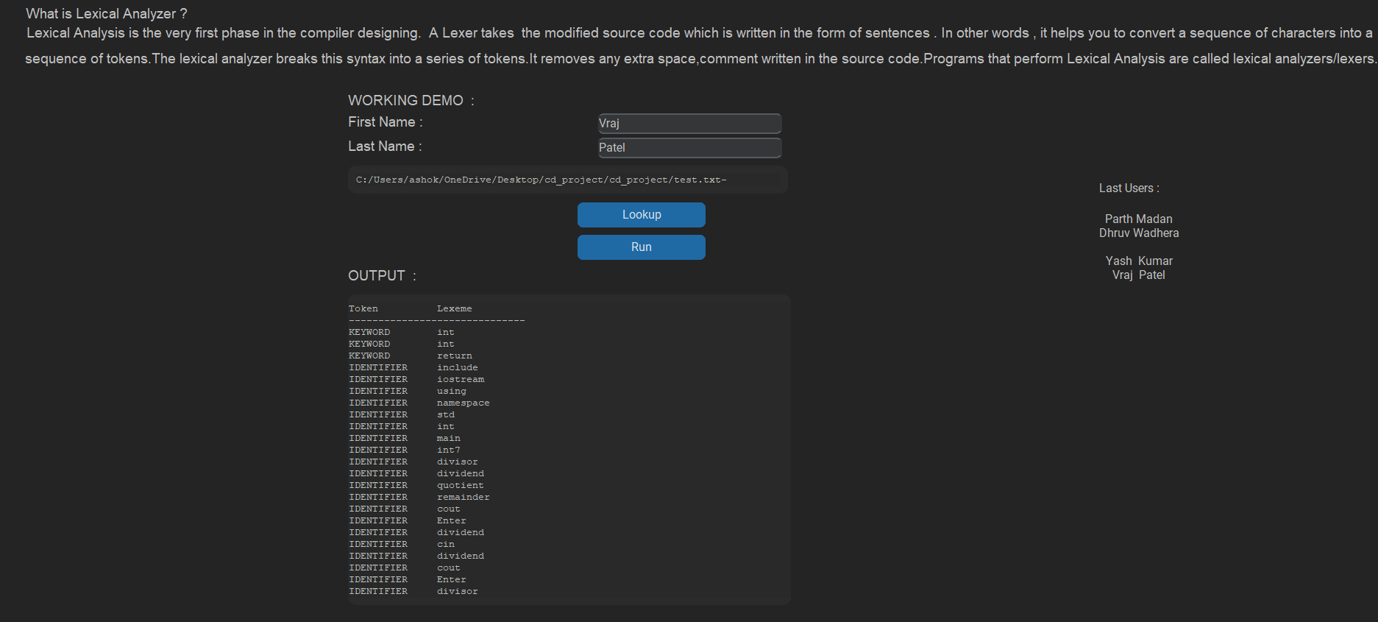
MODULE DESCRIPTION:

Slide 6
CONCLUSION
In conclusion, the lexical analyzer project successfully developed a Python script to perform lexical analysis on source code files. The project aimed to analyze and extract tokens from the input code, identify their types, and generate meaningful output. The project utilized the regular expression module in Python to define patterns for different types of tokens.
Through the implementation of the lexical analyzer, it was demonstrated that the script could effectively process source code files, tokenize the input, and categorize the tokens into different classes such as keywords, identifiers, operators, and literals. The output of the lexical analyzer provided valuable information about the structure and components of the source code.

Slide 7
THANK YOU

