Slide 1
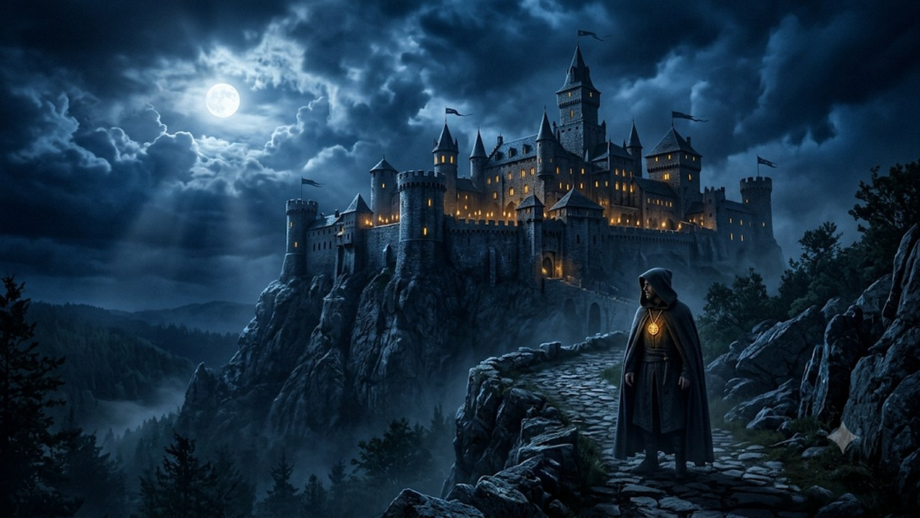
A VISUAL STORYBOARD
The Kingdom of
Ultra Secure Collaboration
How a medieval kingdom explains Cisco's Zero-Trust meetings, calls and identity — story slides 15–19, one panel per beat.
Cisco Tech Elevate Sessions at GSX · July 2026

Slide 2
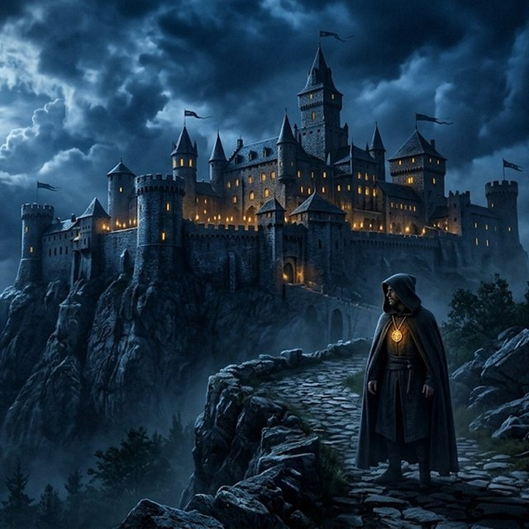
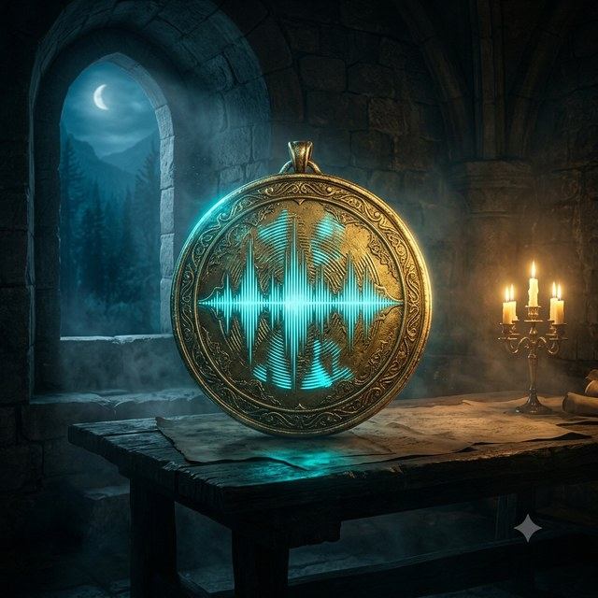
One story, told twice
Every panel that follows carries the fable on the left and the technology on the right. The allegory is exact — each character and prop maps to a real Cisco Ultra Secure capability.
THE STORY
IN CISCO TERMS
A kingdom, its Lords, and a guarded castle. Identities are proven, secrets are sealed in a magic book, and unwelcome crows are shut out.
Zero-trust identity, end-to-end encryption with rotating keys, on-prem AI services, and secure external access — all under customer control.
Read each panel left → right: the fable sets the scene, the decoder line names the real control.
Story premise
Ultra Secure Collaboration · Cisco GSX 2026 · Cisco Confidential

Slide 3
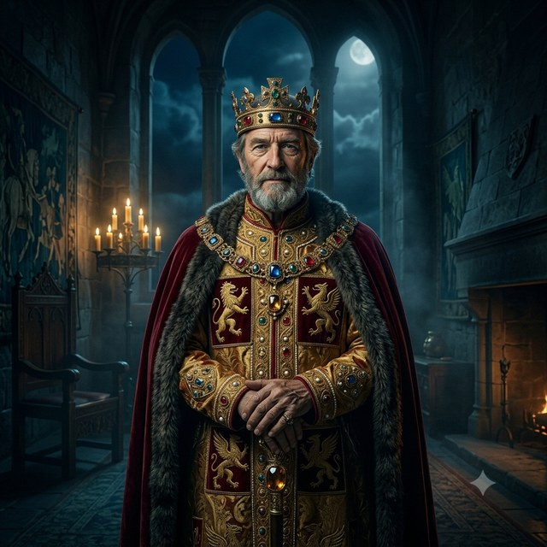
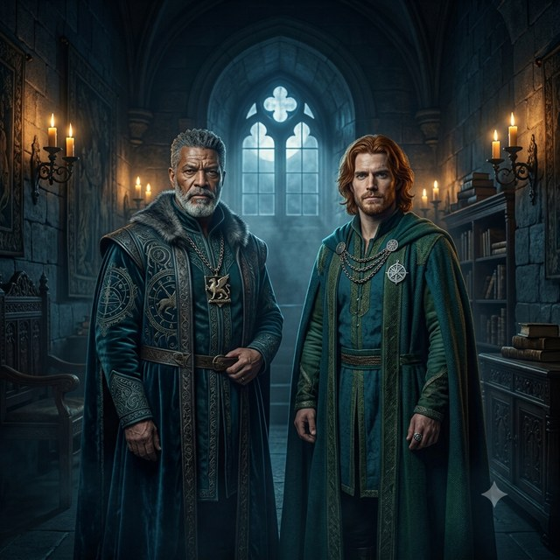
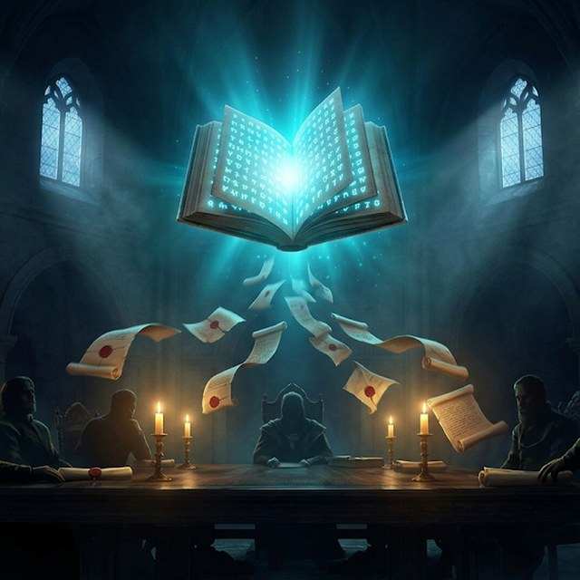
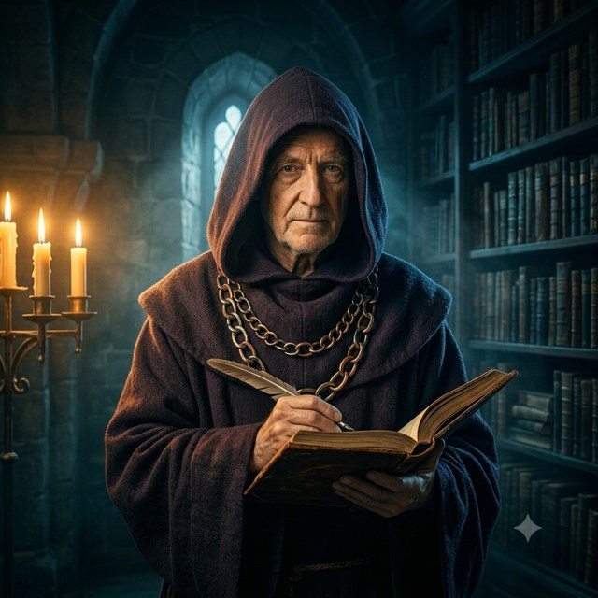
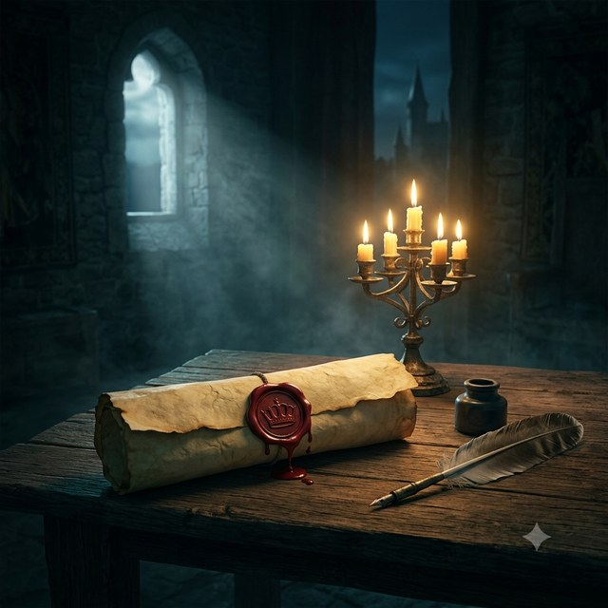
The Cast
Taxonomy from the story bible — who's who, and what each one really is.
The King
The Lords
The Castle
Meeting Chamber
Customer / Enterprise
Management team — the participants
Collaboration SaaS provider (Cisco)
The meeting itself
Maesters
Medallion
Letters Patent
Video Mesh Node & on-prem AI
Webex identity + voiceprint
Individual, per-user identity
Cast of characters · from story slide 13
Ultra Secure Collaboration · Cisco GSX 2026 · Cisco Confidential

Slide 4
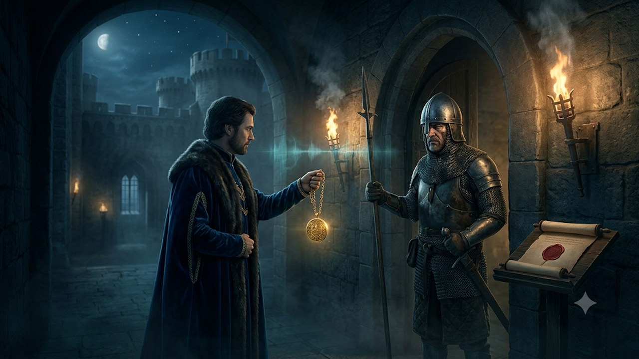
CHAPTER 1
Independently Verified Identity
Only independently verified individuals get in — and deepfakes don't.
IN CISCO TERMS Zero-Trust Identity for every meeting GA Q3 CY26
Story slide 15 · Chapter 1 of 5
Ultra Secure Collaboration · Cisco GSX 2026 · Cisco Confidential

Slide 5
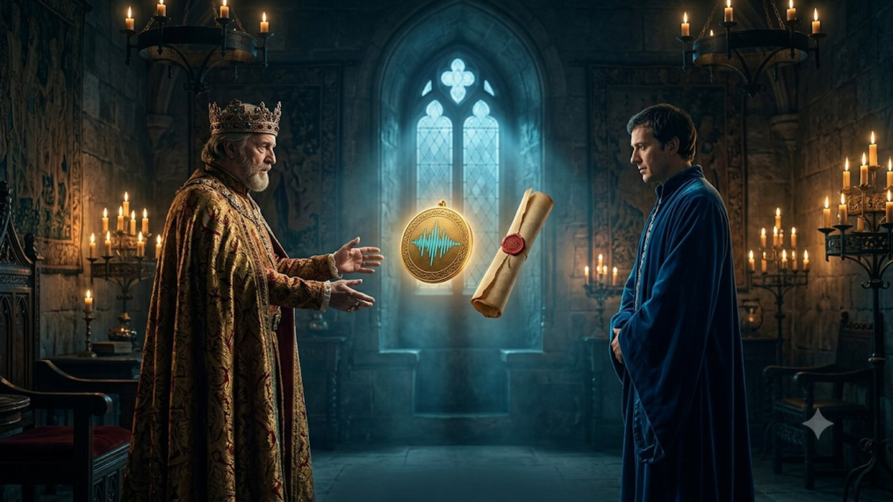
CHAPTER 1 · INDEPENDENTLY VERIFIED IDENTITY
Story slide 15
THE STORY
Each Lord is issued with two forms of identity.
PANEL 1.1
IN CISCO TERMS
Every participant is provisioned two independent identity factors — no single token grants trust.
Story slide 15 · bullet 1 · panel 1.1
Ultra Secure Collaboration · Cisco GSX 2026 · Cisco Confidential

Slide 6
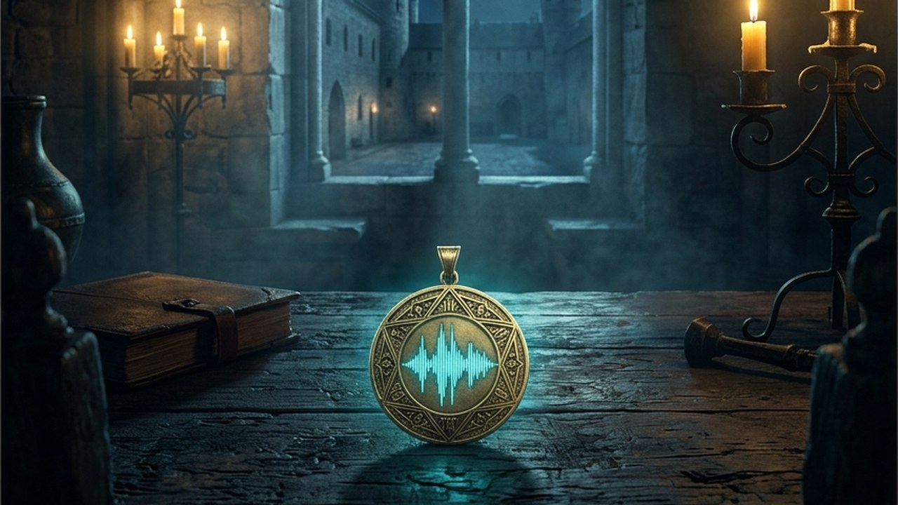
CHAPTER 1 · INDEPENDENTLY VERIFIED IDENTITY
Story slide 15
THE STORY
A Medallion that marks them a Lord, used together with their voice.
PANEL 1.2
IN CISCO TERMS
Webex Identity (the medallion) is bound to a live voiceprint — mitigating impersonation and deepfakes.
Story slide 15 · bullet 2 · panel 1.2
Ultra Secure Collaboration · Cisco GSX 2026 · Cisco Confidential

Slide 7
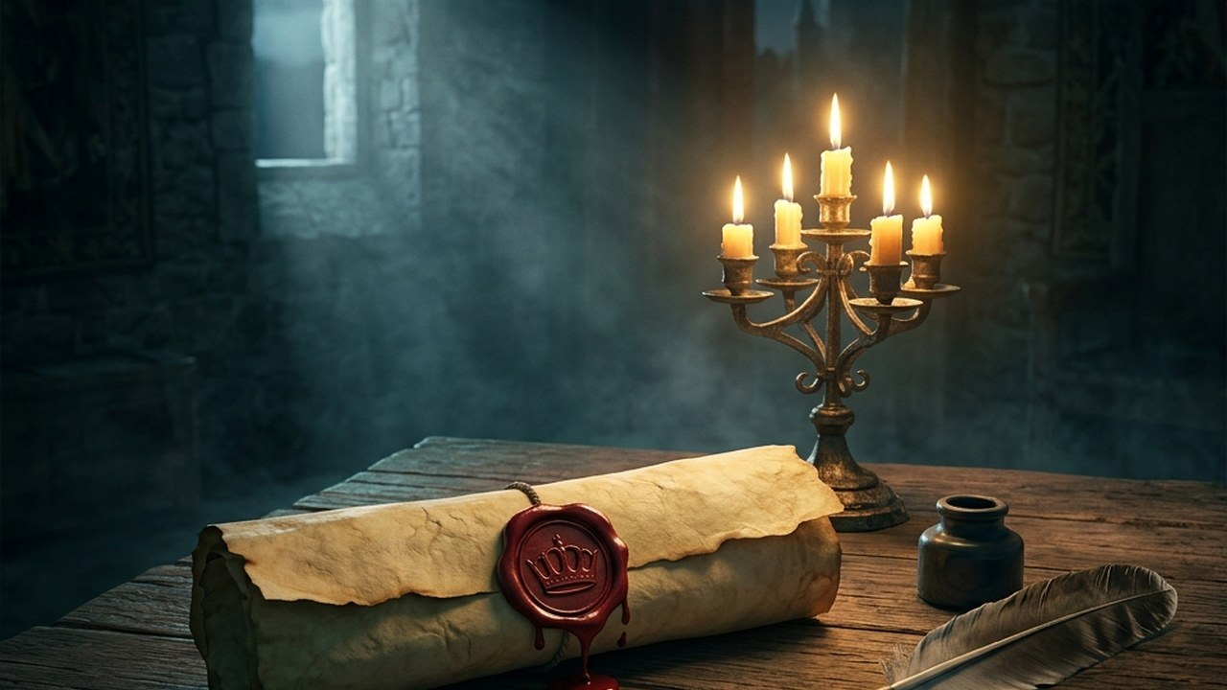
CHAPTER 1 · INDEPENDENTLY VERIFIED IDENTITY
Story slide 15
THE STORY
A “letters patent” — signed and sealed by the King.
PANEL 1.3
IN CISCO TERMS
A unique, per-user credential (individual identity) is cryptographically issued by the enterprise.
Story slide 15 · bullet 3 · panel 1.3
Ultra Secure Collaboration · Cisco GSX 2026 · Cisco Confidential

Slide 8
CHAPTER 1 · INDEPENDENTLY VERIFIED IDENTITY
Story slide 15
THE STORY
To enter the chamber, participant Lords show their medallions to the guards, verify with their voice, and must be on the invite list.
PANEL 1.4
IN CISCO TERMS
Admission requires identity + voice verification + presence on the invite list — a true zero-trust join.
Story slide 15 · bullet 4 · panel 1.4
Ultra Secure Collaboration · Cisco GSX 2026 · Cisco Confidential

Slide 9
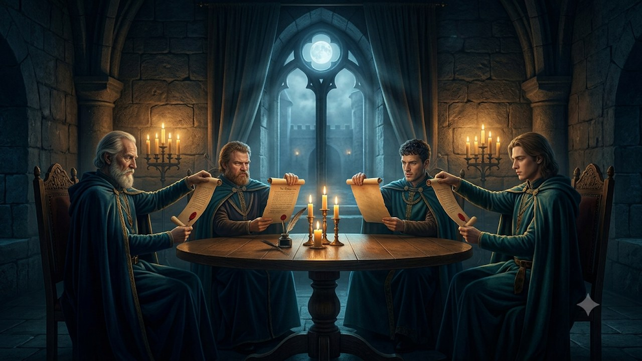
CHAPTER 1 · INDEPENDENTLY VERIFIED IDENTITY
Story slide 15
THE STORY
Inside, the Lords show their letters patent to one another to prove who they say they are.
PANEL 1.5
IN CISCO TERMS
Participants mutually verify individual identities in-meeting — only verified individuals take part.
Story slide 15 · bullet 5 · panel 1.5
Ultra Secure Collaboration · Cisco GSX 2026 · Cisco Confidential

Slide 10
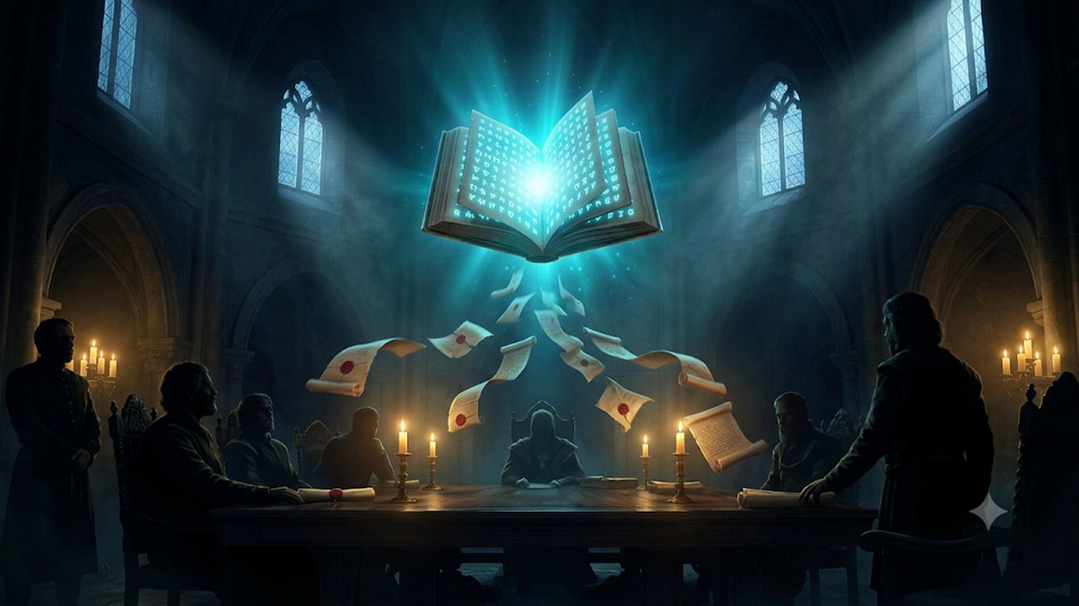
CHAPTER 2
Zero-Trust End-to-End Encryption
A shared secret only the participants hold — the provider can't listen in.
IN CISCO TERMS Zero-Trust Encryption for all calls & meetings GA Q3 CY26
Story slide 16 · Chapter 2 of 5
Ultra Secure Collaboration · Cisco GSX 2026 · Cisco Confidential

Slide 11
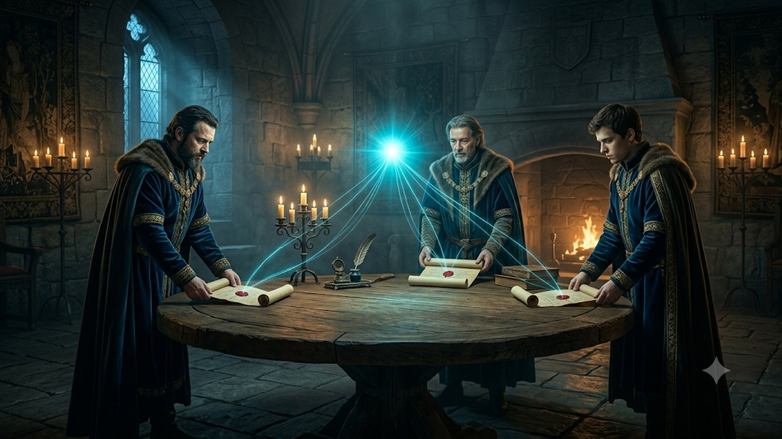
CHAPTER 2 · ZERO-TRUST END-TO-END ENCRYPTION
Story slide 16
THE STORY
All the Lords share their letters patent.
PANEL 2.1
IN CISCO TERMS
Every participant contributes their individual identity to establish the session.
Story slide 16 · bullet 1 · panel 2.1
Ultra Secure Collaboration · Cisco GSX 2026 · Cisco Confidential

Slide 12
CHAPTER 2 · ZERO-TRUST END-TO-END ENCRYPTION
Story slide 16
THE STORY
Combined, the letters patent create a “magic” book holding the code the Lords use to speak inside the chamber.
PANEL 2.2
IN CISCO TERMS
Their combination derives the shared meeting key used for end-to-end encryption.
Story slide 16 · bullet 2 · panel 2.2
Ultra Secure Collaboration · Cisco GSX 2026 · Cisco Confidential

Slide 13
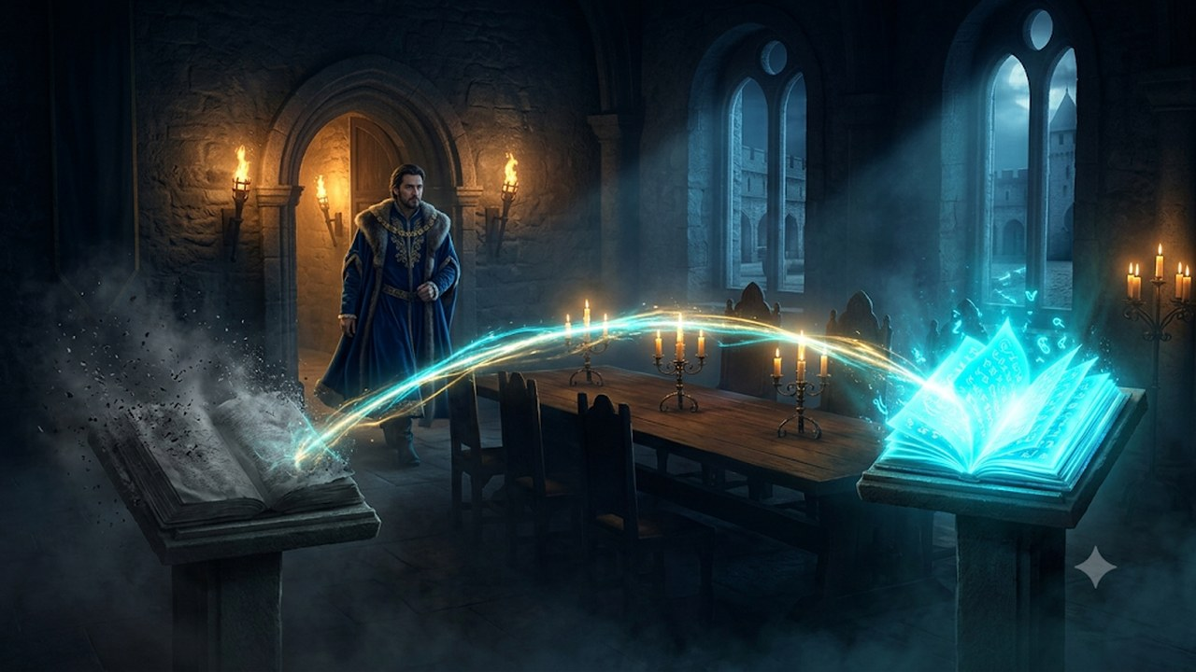
CHAPTER 2 · ZERO-TRUST END-TO-END ENCRYPTION
Story slide 16
THE STORY
Each time a Lord enters or leaves, a new book is created and replaces the old — everyone uses the new one from then on.
PANEL 2.3
IN CISCO TERMS
The key is re-derived on every join and leave — giving forward and backward secrecy.
Story slide 16 · bullet 3 · panel 2.3
Ultra Secure Collaboration · Cisco GSX 2026 · Cisco Confidential

Slide 14
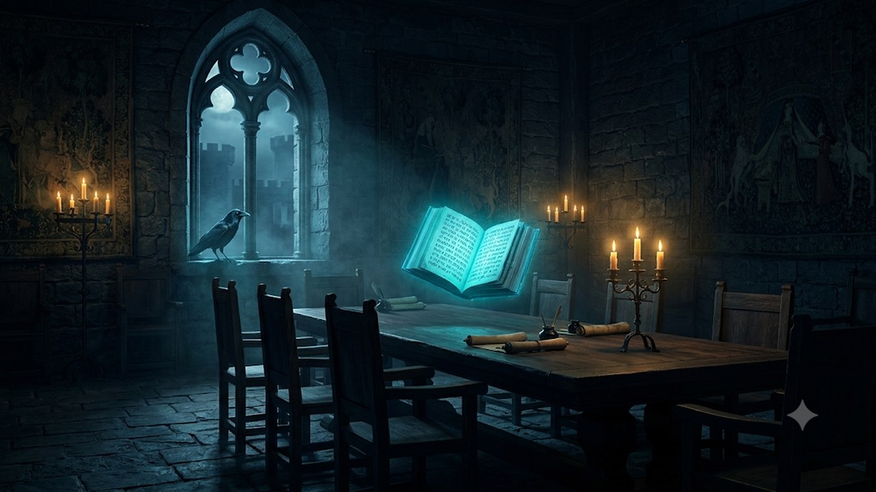
CHAPTER 2 · ZERO-TRUST END-TO-END ENCRYPTION
Story slide 16
THE STORY
A crow eavesdropping at the window has no book, so it cannot understand a word.
PANEL 2.4
IN CISCO TERMS
An eavesdropper without the key sees only ciphertext — even the SaaS provider cannot decrypt.
Story slide 16 · bullet 4 · panel 2.4
Ultra Secure Collaboration · Cisco GSX 2026 · Cisco Confidential

Slide 15
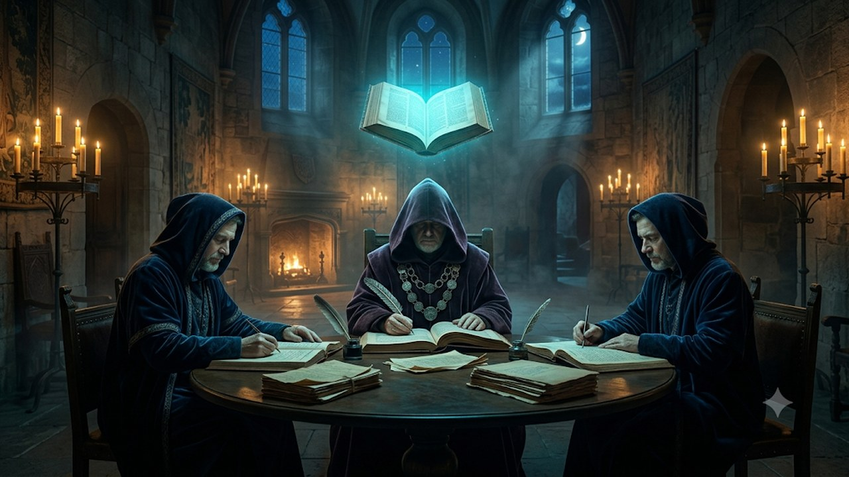
CHAPTER 3
Adding Services into the Meeting
Trusted scribes and advisors join under the same rules — records stay with the customer.
IN CISCO TERMS Fully-featured Zero-Trust Meetings — recording & AI GA Q3 CY26
Story slide 17 · Chapter 3 of 5
Ultra Secure Collaboration · Cisco GSX 2026 · Cisco Confidential

Slide 16
CHAPTER 3 · ADDING SERVICES INTO THE MEETING
Story slide 17
THE STORY
The King employs Maesters — learned scholars, doctors and advisors — to serve as scribes in sensitive meetings.
PANEL 3.1
IN CISCO TERMS
Optional services — Video Mesh Node and on-prem AI — act as trusted scribes and advisors.
Story slide 17 · bullet 1 · panel 3.1
Ultra Secure Collaboration · Cisco GSX 2026 · Cisco Confidential

Slide 17
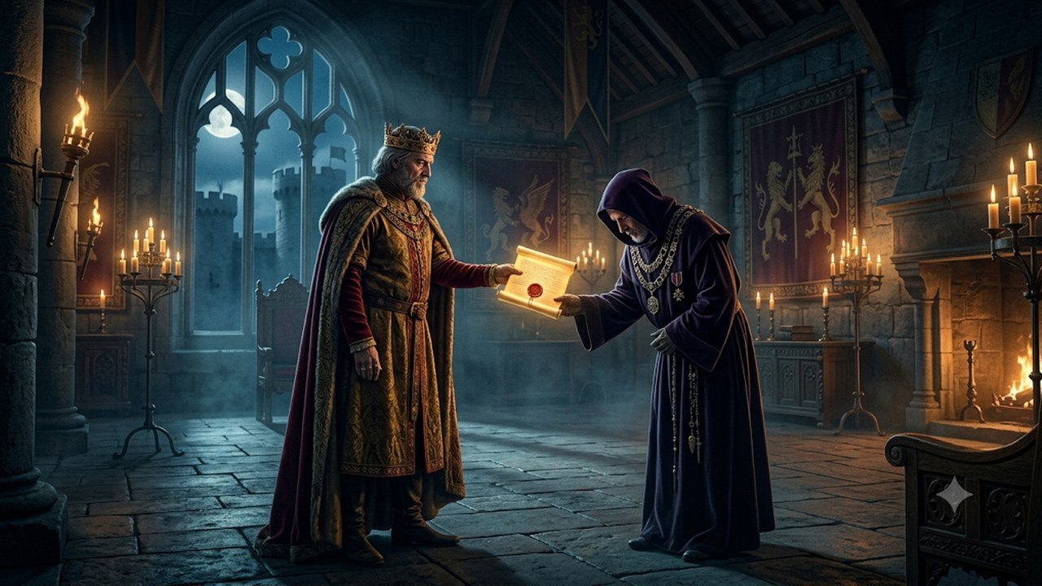
CHAPTER 3 · ADDING SERVICES INTO THE MEETING
Story slide 17
THE STORY
The King issues the Maesters their own special letters patent, used just like a Lord’s.
PANEL 3.2
IN CISCO TERMS
Those services are issued their own verifiable identity and admitted like any other participant.
Story slide 17 · bullet 2 · panel 3.2
Ultra Secure Collaboration · Cisco GSX 2026 · Cisco Confidential

Slide 18
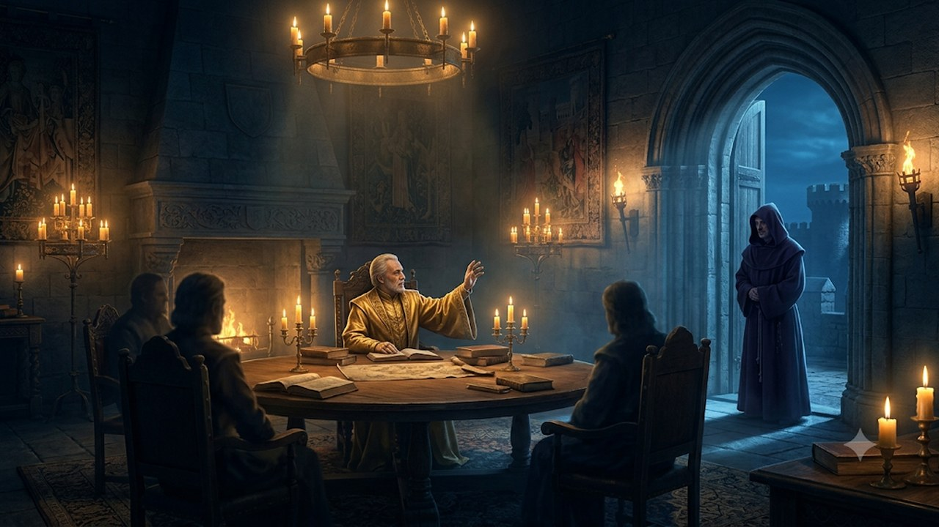
CHAPTER 3 · ADDING SERVICES INTO THE MEETING
Story slide 17
THE STORY
The chairperson may ask a Maester to enter the room.
PANEL 3.3
IN CISCO TERMS
The meeting organizer explicitly invites the service into the session.
Story slide 17 · bullet 3 · panel 3.3
Ultra Secure Collaboration · Cisco GSX 2026 · Cisco Confidential

Slide 19
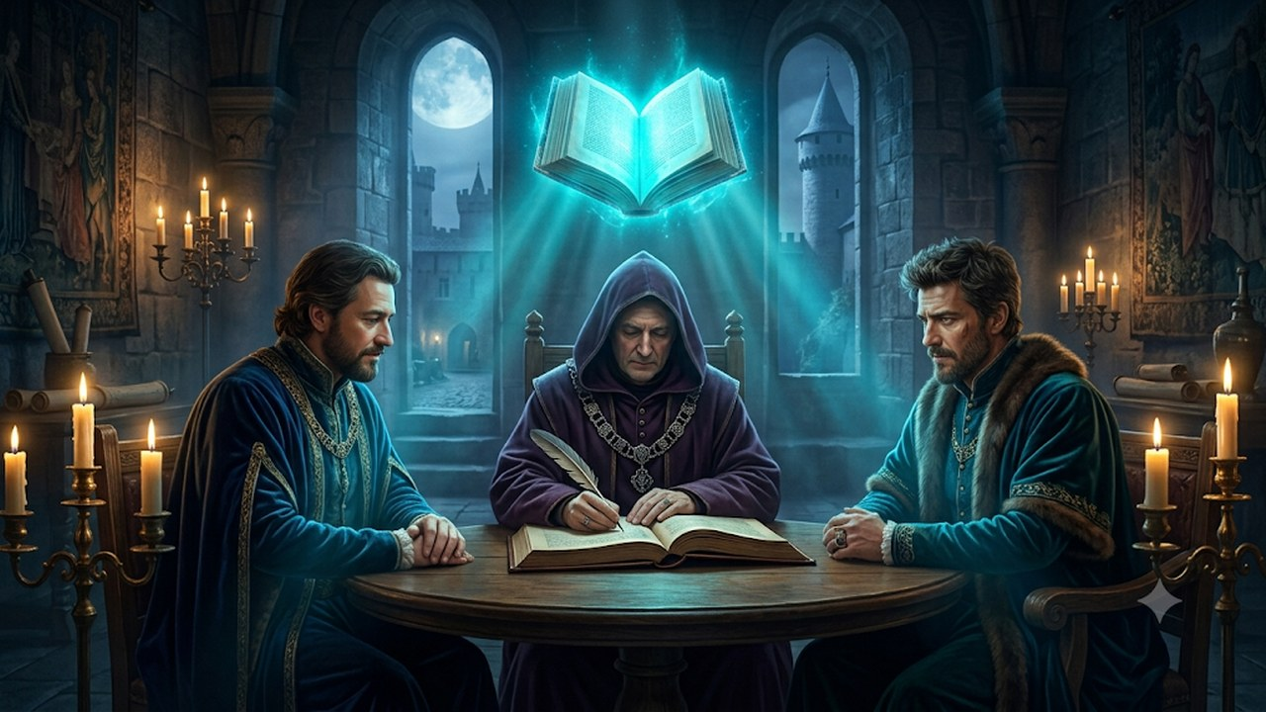
CHAPTER 3 · ADDING SERVICES INTO THE MEETING
Story slide 17
THE STORY
The Maester shows their letters patent, a new book is generated, and they can then follow, document and advise.
PANEL 3.4
IN CISCO TERMS
On join the key rotates to include it; it can transcribe, record and advise inside the meeting.
Story slide 17 · bullet 4 · panel 3.4
Ultra Secure Collaboration · Cisco GSX 2026 · Cisco Confidential

Slide 20
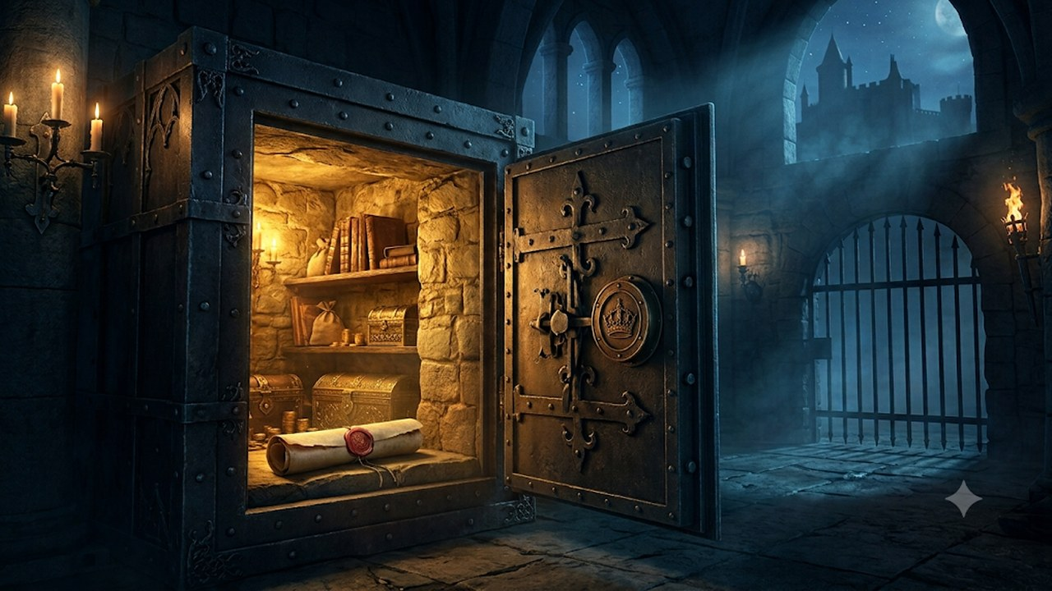
CHAPTER 3 · ADDING SERVICES INTO THE MEETING
Story slide 17
THE STORY
When done, all records go to the King’s secure vault — which the castle operator cannot open.
PANEL 3.5
IN CISCO TERMS
Records are stored under customer control; the SaaS provider holds no keys and has no access.
Story slide 17 · bullet 5 · panel 3.5
Ultra Secure Collaboration · Cisco GSX 2026 · Cisco Confidential

Slide 21
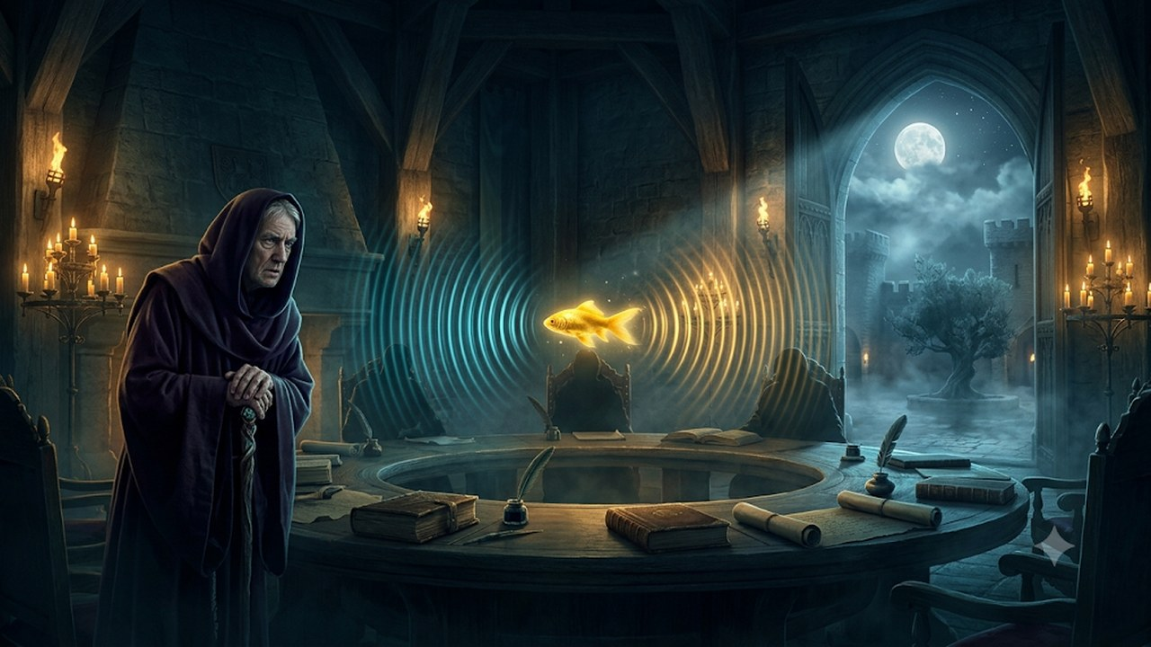
CHAPTER 4
Including Others (PSTN & Beyond)
A controlled gateway lets the chamber speak to the outside world.
IN CISCO TERMS Bridging legacy & external audio into Zero-Trust meetings GA Q4 CY26
Story slide 18 · Chapter 4 of 5
Ultra Secure Collaboration · Cisco GSX 2026 · Cisco Confidential

Slide 22
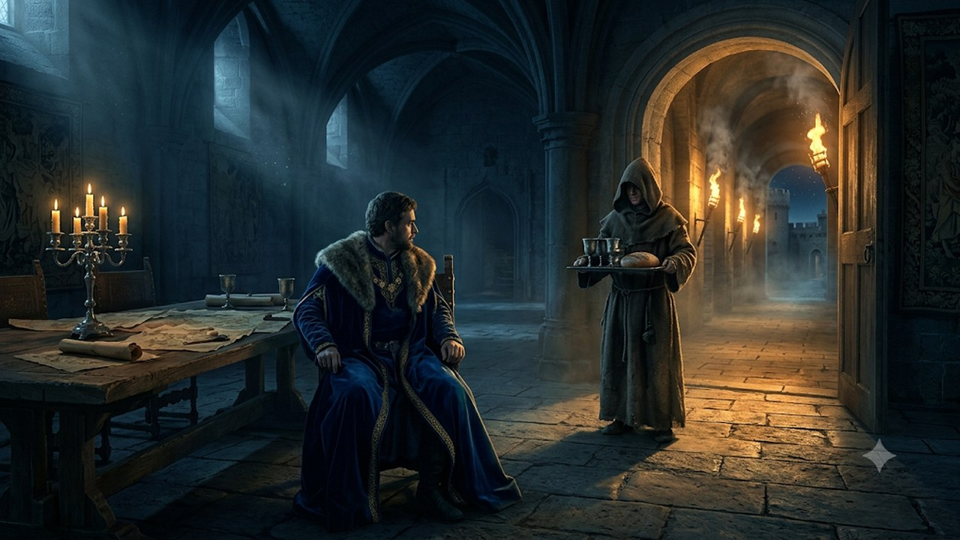
CHAPTER 4 · INCLUDING OTHERS (PSTN & BEYOND)
Story slide 18
THE STORY
Sometimes the Lords must speak to servants — to call for food and wine.
PANEL 4.1
IN CISCO TERMS
Some conversations must reach the outside world, e.g. PSTN or legacy endpoints.
Story slide 18 · bullet 1 · panel 4.1
Ultra Secure Collaboration · Cisco GSX 2026 · Cisco Confidential

Slide 23
CHAPTER 4 · INCLUDING OTHERS (PSTN & BEYOND)
Story slide 18
THE STORY
Via the Maester, the Chairman adds a special Babel Fish to translate between the coded conversation and the outside world.
PANEL 4.2
IN CISCO TERMS
A controlled gateway bridges the encrypted meeting and external audio, in both directions.
Story slide 18 · bullet 2 · panel 4.2
Ultra Secure Collaboration · Cisco GSX 2026 · Cisco Confidential

Slide 24
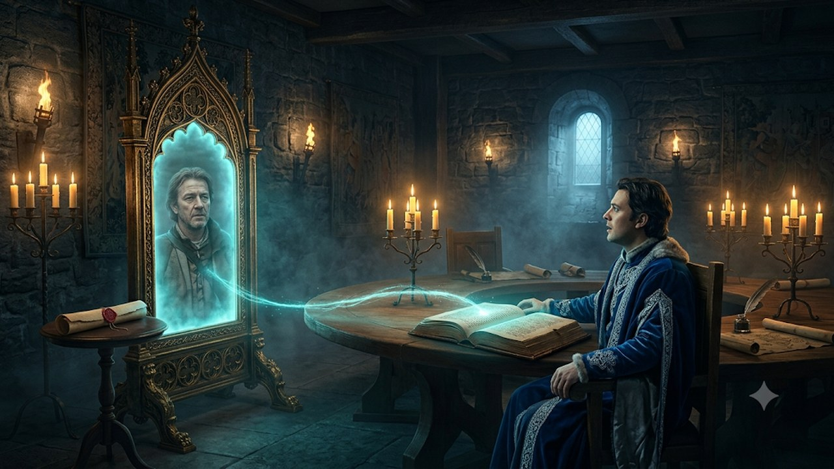
CHAPTER 5
Adding External Participants
Guests join securely from anywhere with a temporary, time-bound identity.
IN CISCO TERMS External participants via standard browser — C2B GA Q3 CY26
Story slide 19 · Chapter 5 of 5
Ultra Secure Collaboration · Cisco GSX 2026 · Cisco Confidential

Slide 25

CHAPTER 5 · ADDING EXTERNAL PARTICIPANTS
Story slide 19
THE STORY
Sometimes Lords bring in people on other systems to discuss alliances — the Kingdom of the Isles.
PANEL 5.1
IN CISCO TERMS
External parties on different platforms can be brought in for cross-org and C2B collaboration.
Story slide 19 · bullet 1 · panel 5.1
Ultra Secure Collaboration · Cisco GSX 2026 · Cisco Confidential

Slide 26
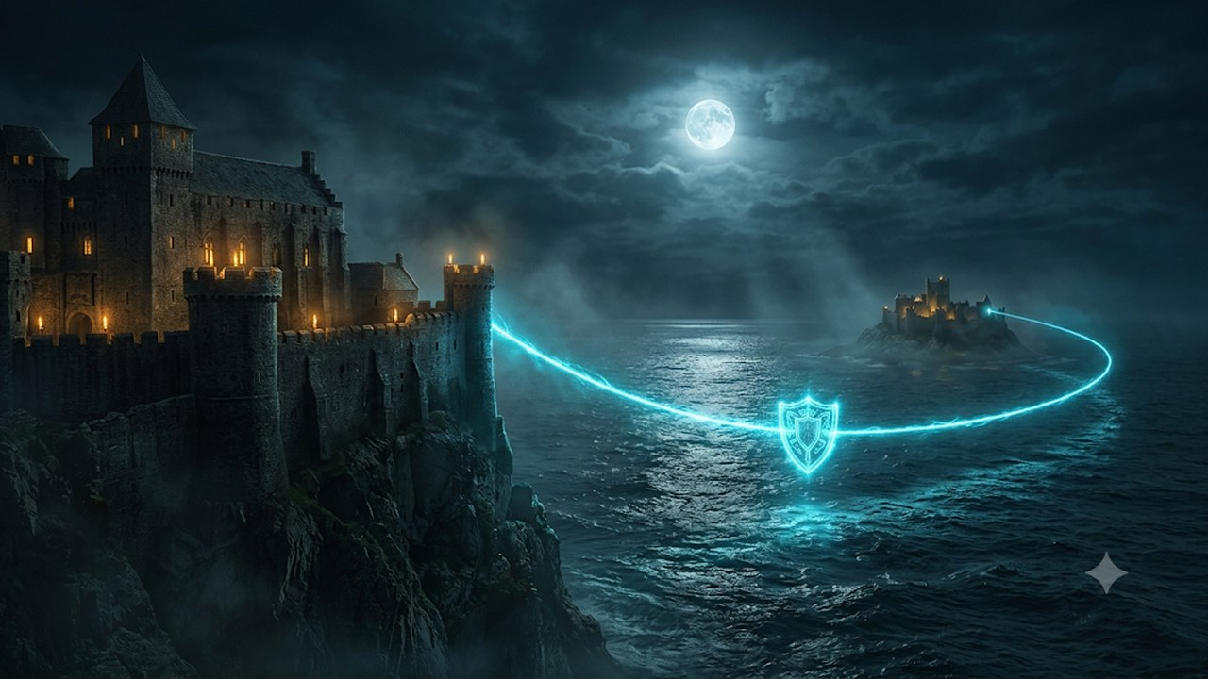
CHAPTER 5 · ADDING EXTERNAL PARTICIPANTS
Story slide 19
THE STORY
These talks are sensitive and must stay protected — yet cannot be confined to the chamber.
PANEL 5.2
IN CISCO TERMS
The exchange stays protected even as it extends beyond the core meeting.
Story slide 19 · bullet 2 · panel 5.2
Ultra Secure Collaboration · Cisco GSX 2026 · Cisco Confidential

Slide 27

CHAPTER 5 · ADDING EXTERNAL PARTICIPANTS
Story slide 19
THE STORY
The King issues a temporary letters patent, sent by Carrier Crow.
PANEL 5.3
IN CISCO TERMS
A temporary, time-bound identity is issued and delivered to the external participant.
Story slide 19 · bullet 3 · panel 5.3
Ultra Secure Collaboration · Cisco GSX 2026 · Cisco Confidential

Slide 28
CHAPTER 5 · ADDING EXTERNAL PARTICIPANTS
Story slide 19
THE STORY
The envoy uses a Magic Mirror — standard across all kingdoms — to join remotely, presents the temporary patent, and a new book is shared.
PANEL 5.4
IN CISCO TERMS
They join via a standard browser; presenting the temp identity rotates the key to include them.
Story slide 19 · bullet 4 · panel 5.4
Ultra Secure Collaboration · Cisco GSX 2026 · Cisco Confidential

Slide 29
Five chapters, one guarantee
1 · Verified Identity
Independently verified individuals — no deepfakes.
2 · E2E Encryption
Rotating keys the provider can never hold.
3 · Services
AI & recording join under the same trust — records stay yours.
4 · Including Others
Controlled bridges to PSTN and the outside world.
5 · External Guests
Secure browser access with temporary identities.
Meeting customers where they are — securely.

