Slide 1
SHA3
Presented by: Suraj Kumar & Nishant Raj
Date: July 2nd,2019
Working under:
Prof. N. Balakrishnan
Guided by:
Swetha H.

Slide 2
Outline
Introduction
SHA3
Security Analysis
Experiments
Conclusion

Slide 3
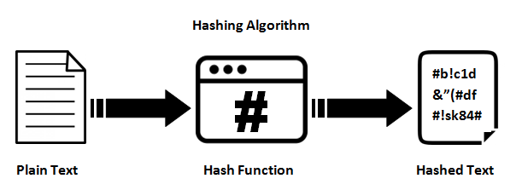
What is an hash?
h: {0,1}* = {0,1}^n

Slide 4
Well Known Hash Functions
MD5
output 128 bits
collision resistance completely broken by researchers in China in 2004
SHA1
output 160 bits
no collision found yet, but method exist to find collisions in less than 2^80
considered insecure for collision resistance
one-wayness still holds
SHA2 (SHA-224, SHA-256, SHA-384, SHA-512)
outputs 224, 256, 384, and 512 bits, respectively
No real security concerns yet

Slide 5
Introduction - SHA3
In 2005, Wang et al. introduced serious concerns about the security of SHA-1.
NIST opened a public competition on November 2, 2007, to develop a new cryptographic hash algorithm (referred to as SHA-3) to augment the hash algorithms specified in Federal Information Processing Standard (FIPS) 180-2, Secure Hash Standard
1st -round: 51 candidates in 2008.
2nd-round: 14 candidates in 2009.
3rd -round: 5 candidates in 2010.

Slide 6
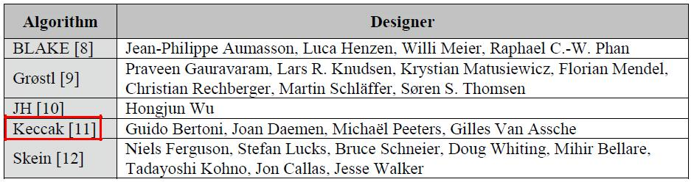
Introduction: Keccak wins!
. Keccak (Bertoni, G., Daemen, J., Peeters, M., Van Assche, G.) announced as the SHA-3 winner on October 2, 2012

Slide 7
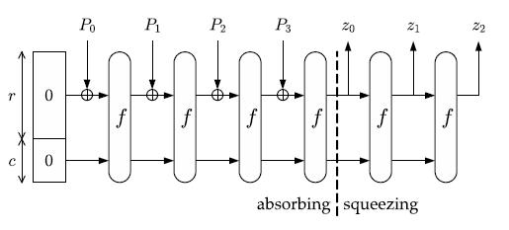
Sponge Construction Backbone of SHA3
SPONGE[f, pad, r]
f: fixed-length permutation which operates b bits.
pad: padding rule which is denoted by M||pad[b](|M|), where M is the sign of message.
r: bit rate.
c:capacity equals to b – r and c<b

Slide 8
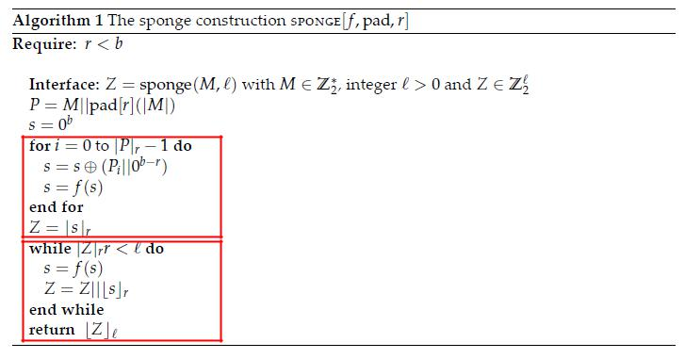
Sponge Construction(2)

Slide 9


KECCAK Functions
By default, c=576 , b=1600, n_{r}=24.

Slide 10
Keccak-f Efficiency Summary
High level of Parallelism
Flexibility: Bit-Interleaving
Software: competitive on wide range of CPU
Suited for protection against side-channel attack
Faster than SHA-2 on all Modern PC
If an attacker has access to one billion computers, each performing one billion evaluations of Keccak-f per second, it would take about 1.6×10⁶¹ years (1.1×10⁵¹ times the estimated age of the universe) to evaluate the permutation 2²⁸⁸ times

Slide 11
Security Analysis
Attacking one-wayness
Goal: given h:X→Y, y∈Y, find x such that h(x)=y
Algorithm:
pick a random value x in X, check if h(x)=y, if h(x)=y, returns x; otherwise iterate
after failing q iterations, return fail
The average-case success probability is
Let |Y|=2^{m}, to get ε to be close to 0.5, q ≈2^{m-1}

Slide 12
Bruteforce Attacks on Hash Functions
Attacking collision resistance
Goal: given h, find x, x’ such that h(x)=h(x’)
Algorithm: pick a random set X₀ of q values in X for each x∈X₀, computes y_{x}=h(x) if y_{x}=y_{x’} for some x’≠x then return (x,x’) else fail
The average success probability is
Let |Y|=2^{m}, to get ε to be close to 0.5, q ≈2^{m/2}
This is known as the birthday attack.

Slide 13
Byte vs Bit Orientated SHA3
Byte Oriented:
Input is in the multiple of 8 bits (1 byte).
Bit Oriented
Input can be of any size.
This arbitrary input size works with padding to make it multiple of 8.
They used Pad10*1 padding.

Slide 14
Experiments: My Experiment
Platform: Windows 10
CPU : Intel i7 7th gen RAM:16GB
Programming Language: JAVA
Testing Data: NIST Test Vector
Algorithm for Testing: SHA3
Table 2: The experimental result in milliseconds
Case(bytes) | MD5 | SHA256 | SHA3-512
1 million | 1.56001 | 31.20007 | 118.56019
10 million | 35.88007 | 110.7602 | 1180.92206
100 million | 352.56065 | 1098.24191 | 12124.34128

Slide 15
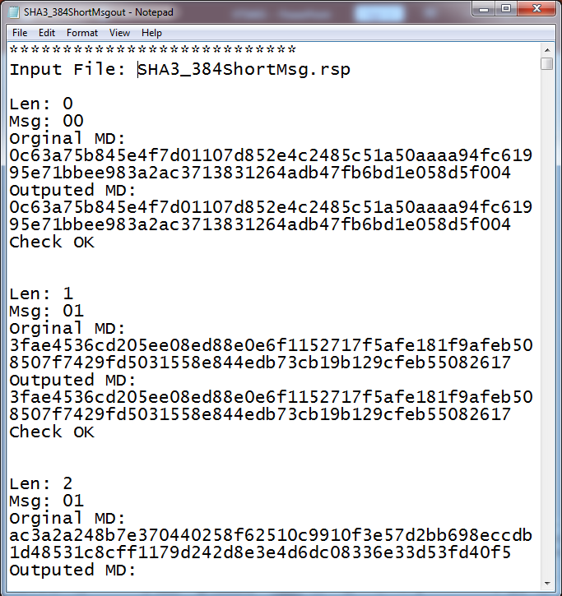
Experiments: Result

Slide 16
Conclusions
The objective of this project is to make an automation tool which verifies implementation of all standard cryptographic algorithms which are recommended by NIST.
SHA3 is the next hash function in the future. It can provide a secure scheme which provides the closest thing to a random oracle with a finite state.
It is slower than SHA-256
However ,it provides a good hardware design architecture to make manufactures implement it.

