Slide 1
XTS-AES
Presented by: Suraj Kumar & Nishant Raj
Date: July 2nd,2019
Working under:
Prof. N. Balakrishnan
Guided by:
Swetha H.

Slide 2
Outline
Introduction
Block Ciphers and AES
XTS-AES
Result
Conclusion

Slide 3
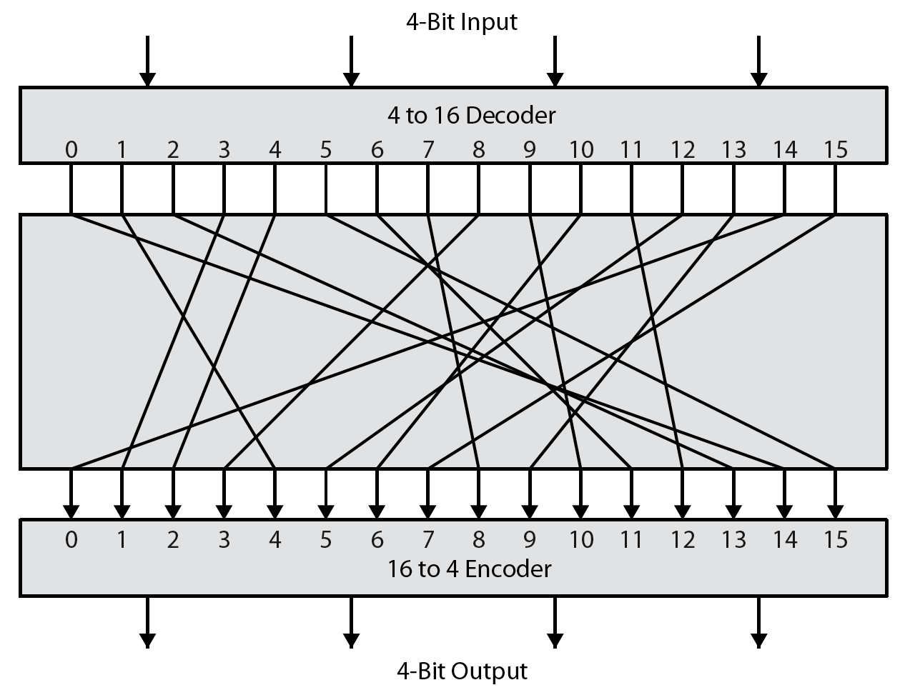
What is an Block Cipher?

Slide 4
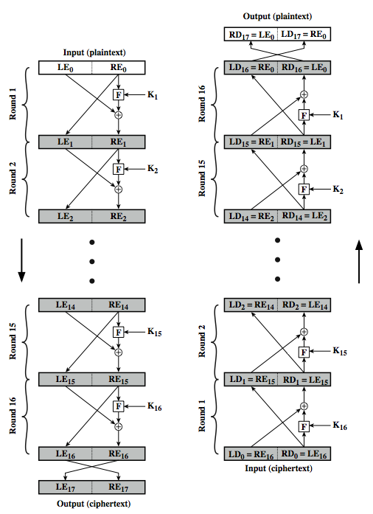
Horst Feistel Cipher Structure

Slide 5
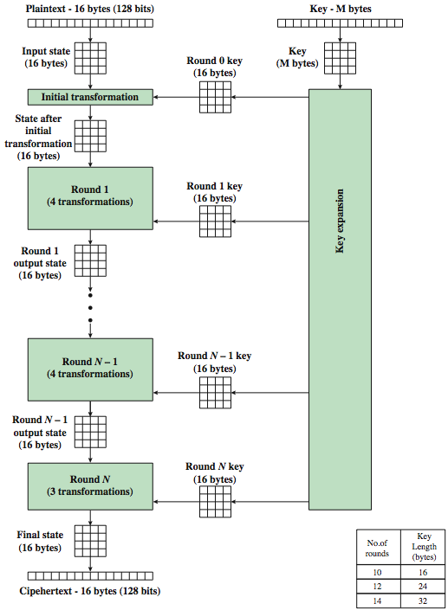
AES Encryption Process

Slide 6
Introduction - XTS-AES
XTS-AES is a tweakable block cipher designed for encryption of sector-based storage.
XTS-AES acts on 8 data units of 128 bits or more.
The AES block cipher as a subroutine.
The key material for XTS9 AES consists of a data encryption key (used by the AES block cipher) as well as a “tweak key”.
IEEE Std 1619-2007

Slide 7
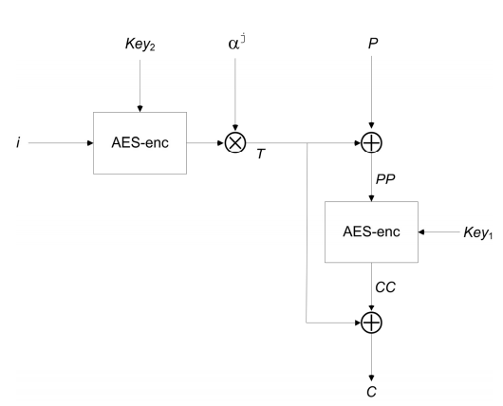

XTS AES Algorithm
XTS-AES Block Encryption

Slide 8
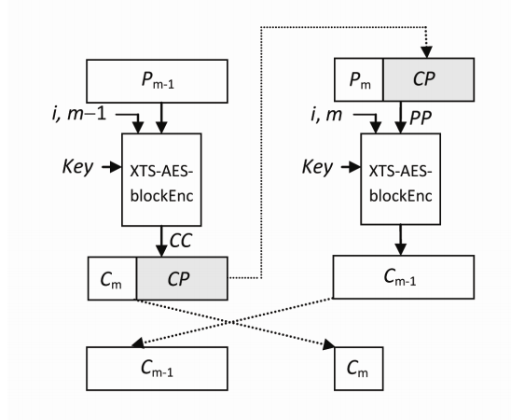
XTS AES Algorithm (contd.)
C ← XTS-AES-Enc (Key, P, i)
Where, Key is the 256 or 512 bit XTS-AES key
P is the plaintext
i is the value of the 128-bit tweak
C is the ciphertext resulting from the operation, of the same bit-size as P
XTS-AES encryption of last two blocks

Slide 9
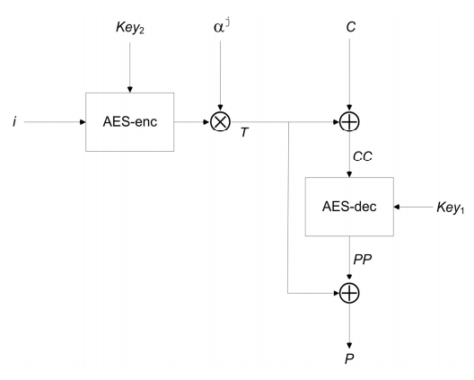
XTS AES Algorithm (contd.)
P ← XTS-AES-blockDec(Key, C, i, j)
Where
Key is the 256 or 512-bit XTS-AES key
C the 128-bit block of ciphertext
i is the value of the 128-bit tweak
j is the sequential number of the 128-bit block inside the data unit
P is the 128-bit block of plaintext resulting from the operation
XTS-AES decryption of last two blocks

Slide 10
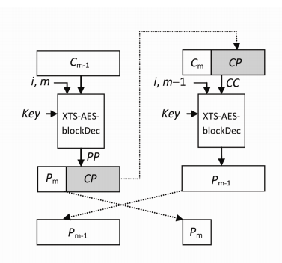
XTS AES Algorithm (contd.)
P ← XTS-AES-Dec(Key, C, i)
Where
Key is the 256 or 512-bit XTS-AES key
C is the ciphertext corresponding to the data unit
i is the value of the 128-bit tweak
P is the plaintext data unit resulting from the operation, of the same bit-size as C
XTS-AES Block Decryption

Slide 11
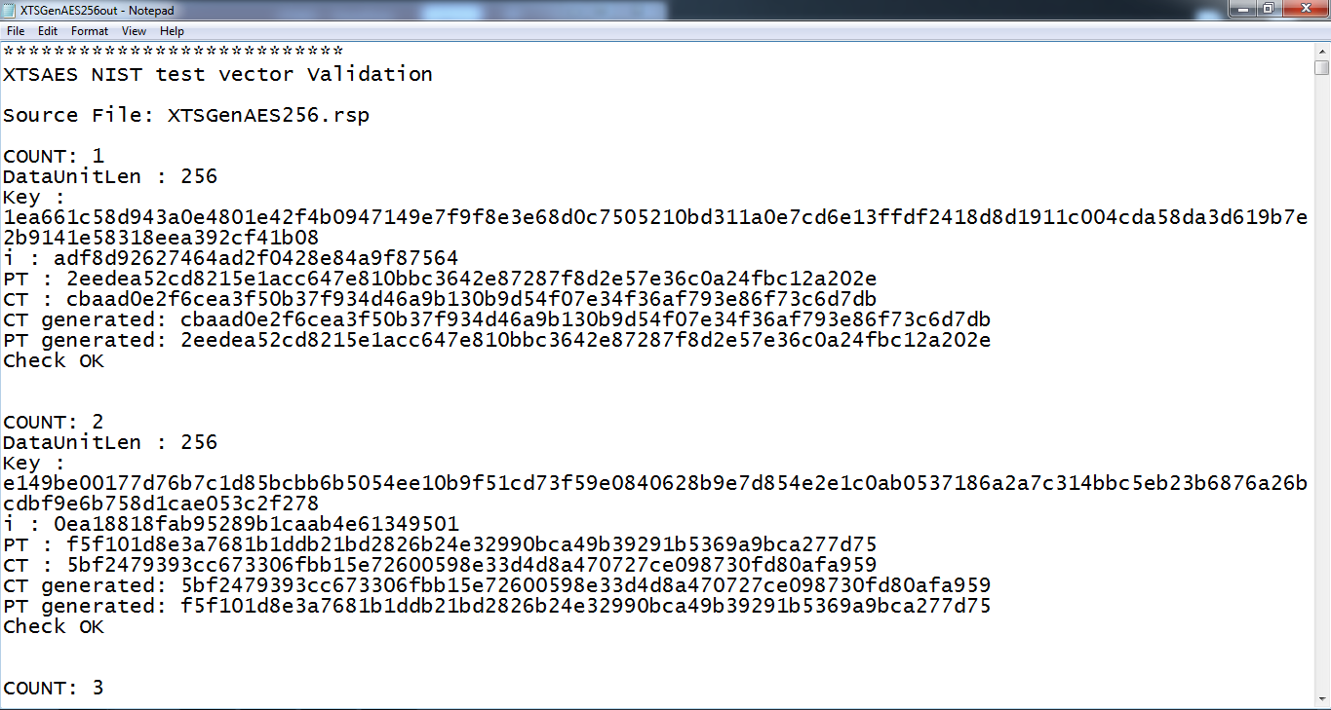
Result
XTS Test Vector
format tweak value input - 128 hex str
format tweak value input - data unit seq no

Slide 12
Conclusions
The objective of this project is to make an automation tool which verifies implementation of all standard cryptographic algorithms which are recommended by NIST.
According to literature Survey XTS-CTC is better for storage encryption.
But it working on already existing hardware.

