Slide 1
How openQA works
Technical background
Stephan Kulow
Dude
coolo@suse.de

Slide 2
About me
Working for SUSE
openSUSE Release Manager until Leap 42.1
Acting as openQA Architect
Father of 2

Slide 3
What is this talk about?
Details you might not know
Architecture of openQA
Implementation details that can bite you
Q & A

Slide 4
What is this talk not?
Introduction into the tests API
Beginner’s Guide to openQA

Slide 5
(brief) Introduction to openQA
openQA started as ‘Create videos of installations’ project of Bernhard M. Wiedemann early 2010 (isotovideo)
End of 2011 first release of openQA – still mainly a tool for Bernhard to create bug reports
A set of CGI scripts to display results

Slide 6
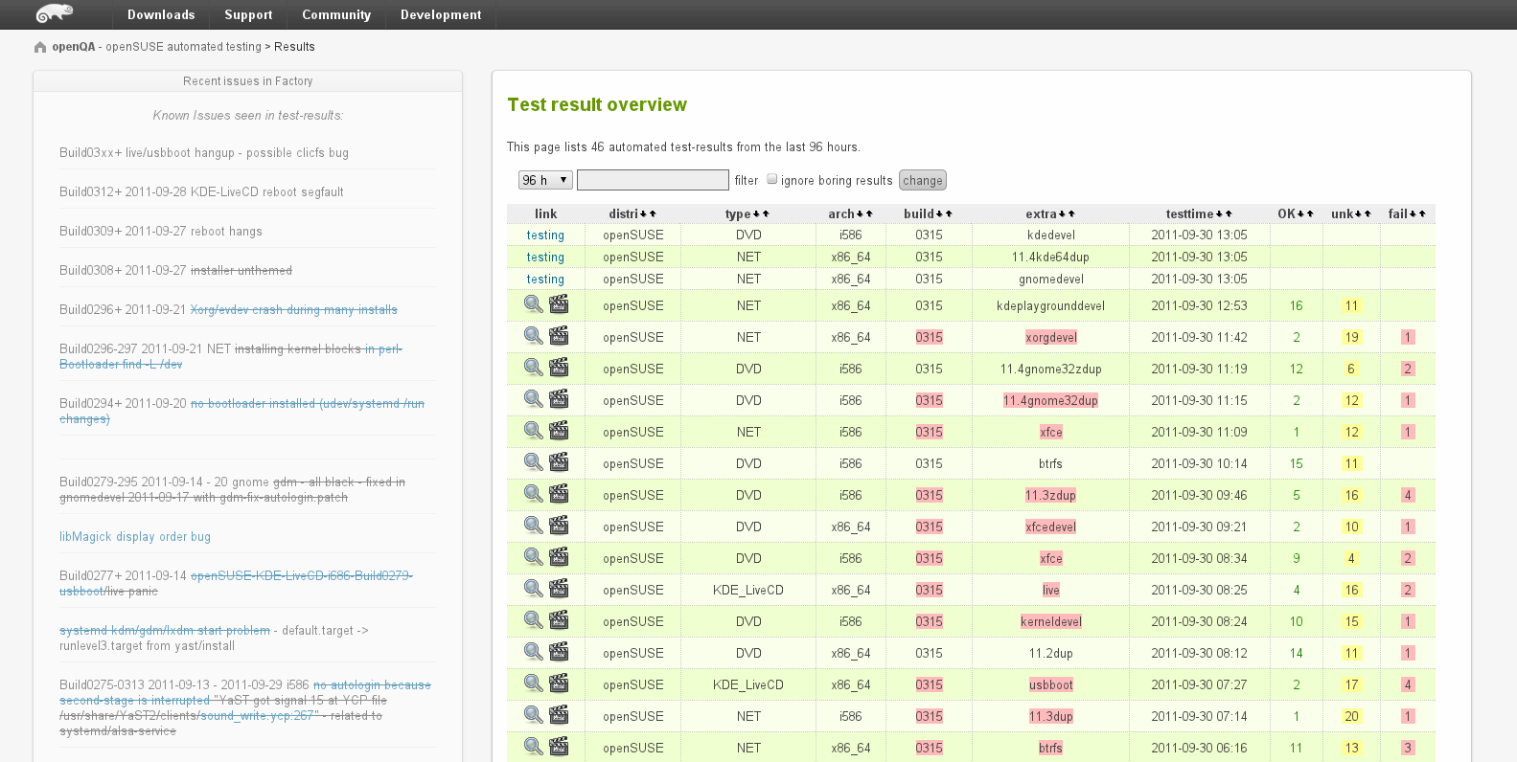
openQA 1.0

Slide 7
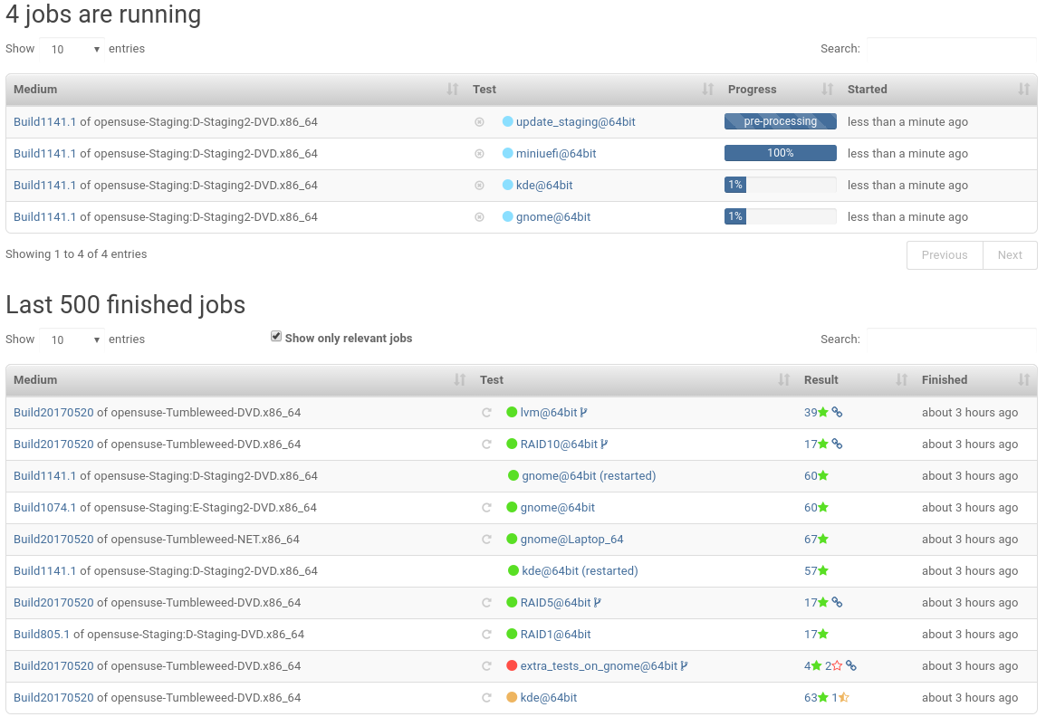
openQA 4.4

Slide 8
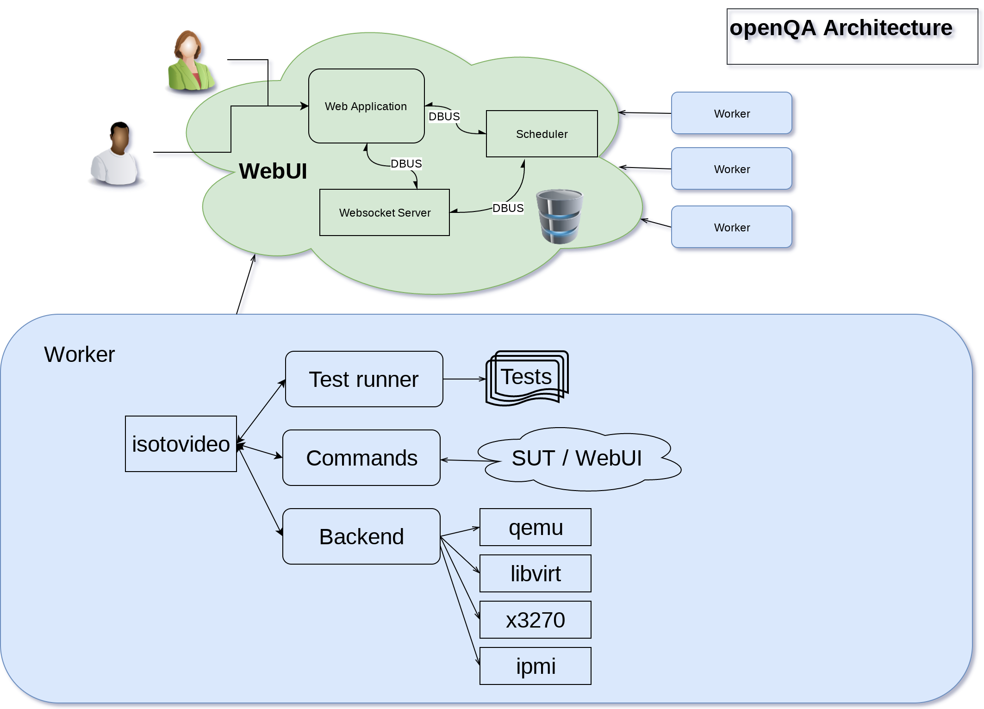

Slide 9
Backends
Common between all backends: VNC and power management
Main use case of openQA is still qemu/kvm.
Qemu covers several ‘hardware’ setups
  Laptop
  Uefi/legacy bios
  IDE/SCSI/NVME
  RAID/Multipath

Slide 10
Advanced Backends
Svirt – access libvirt/virsh through ssh (Xen, zKVM, …)
S390x – access zVM guests through terminal
IPMI – use Remote Management consoles
PVM, generalhw, amt – not in use

Slide 11
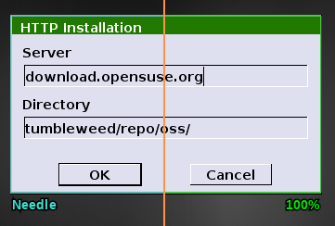
Needle matching
Needle is region of interest in a reference screen

Slide 12
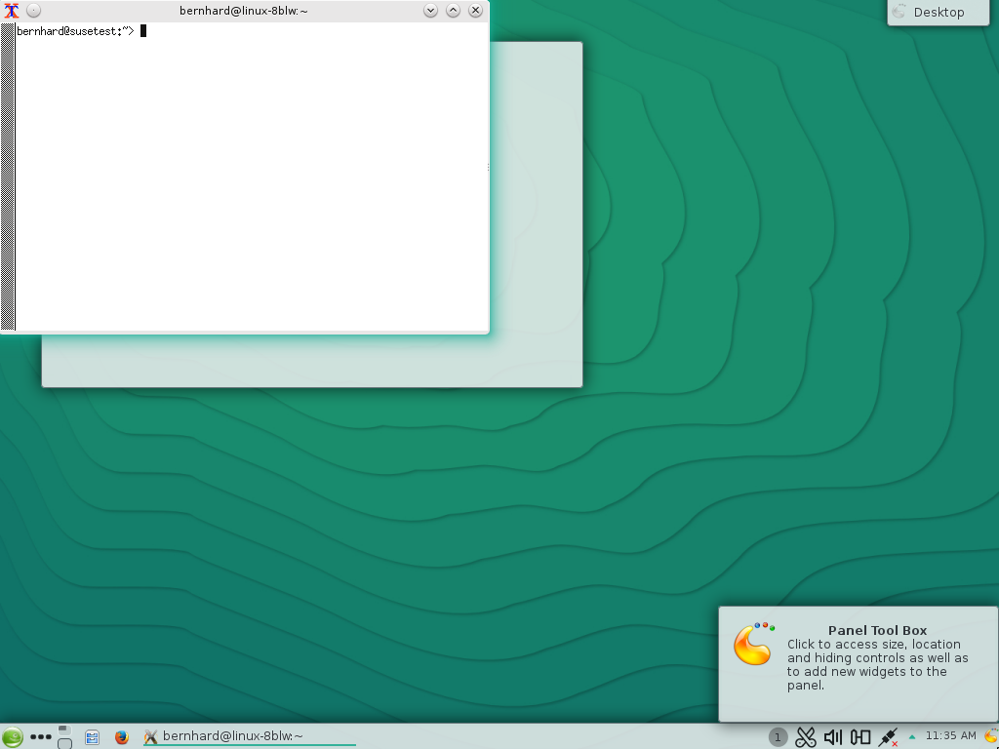
Xterm started!

Slide 13
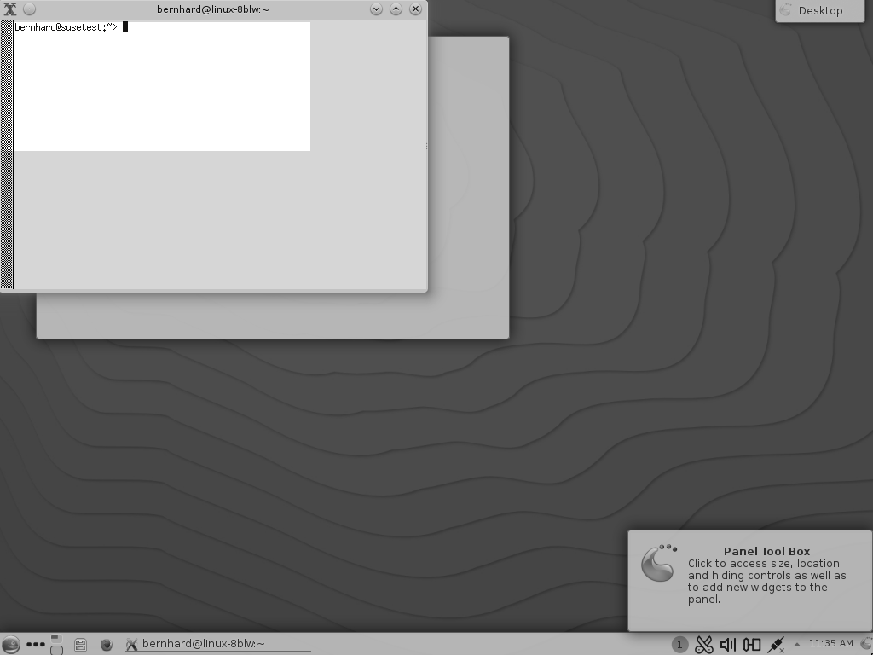
Xterm started!

Slide 14
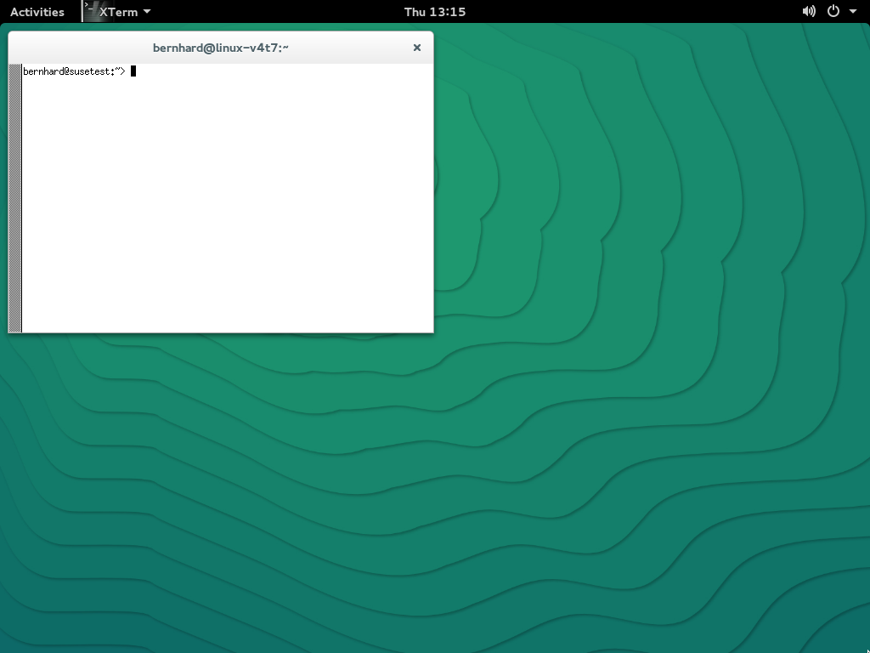
Xterm started!

Slide 15
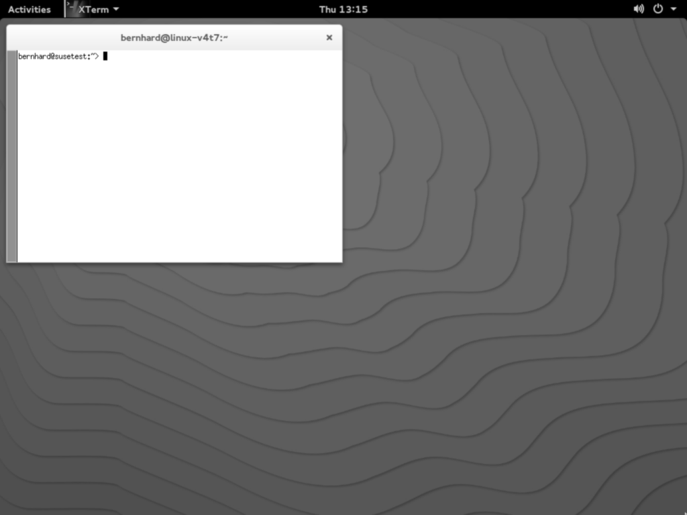
Xterm started!

Slide 16
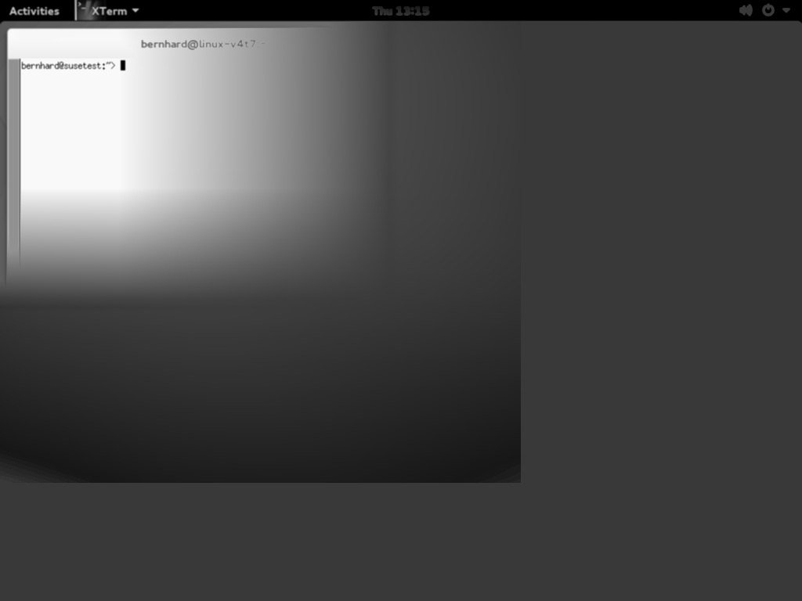
Xterm started!

Slide 17
Error of diff
Most likely spots are evaluated
Number of difference counted and weighted
Match level decides if the area is good

Slide 18
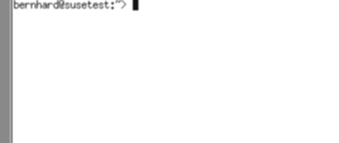

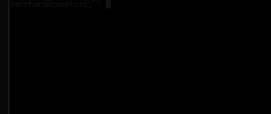
Error of diff
vs
=>
=> 100% Match

Slide 19
Why font changes hurt
Even small font changes can have a big impact on the spacing
To users the change is minimal, but many pixels change
Example...

Slide 20
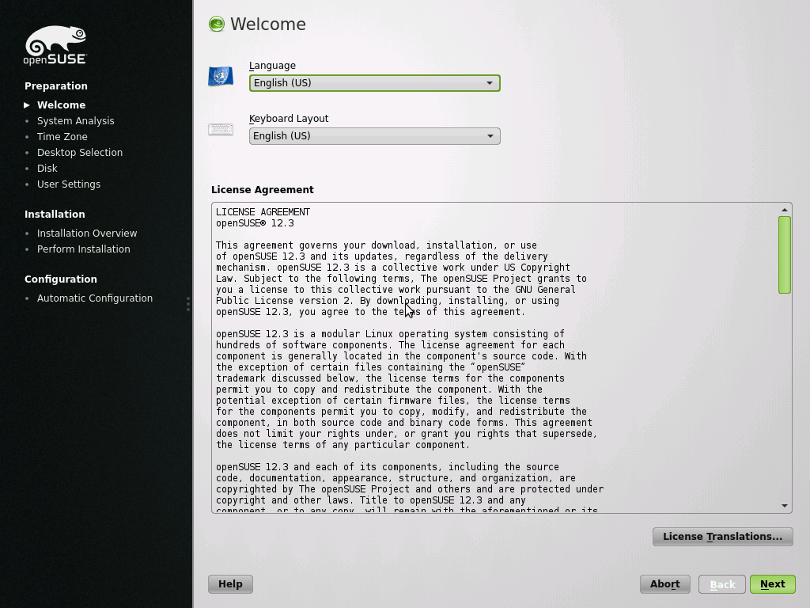
Xterm started!

Slide 21
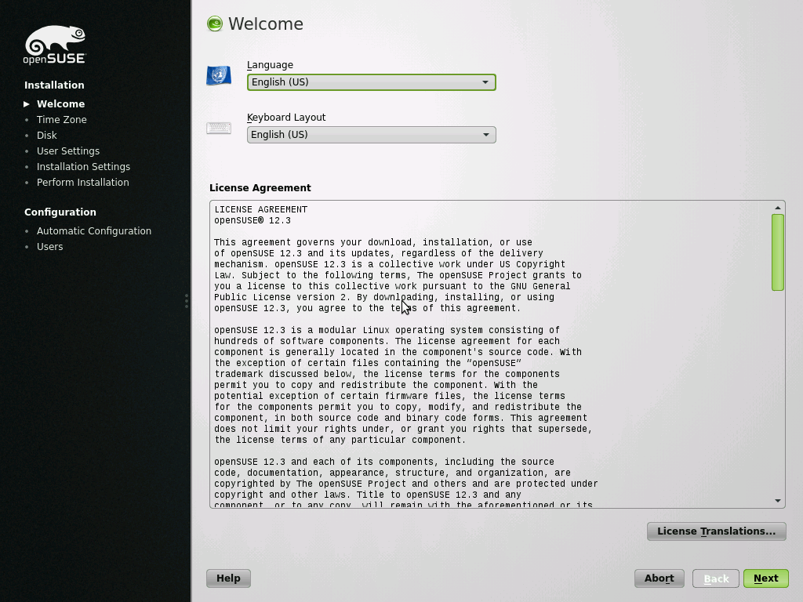
Xterm started!

Slide 22
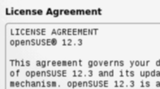
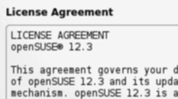
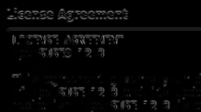
Error of diff
vs
=>
=> 34% Match

Slide 23
assert_screen in action
It’s important to understand the blocking nature of tests
Tests are blocking perl code
assert_screen ‘xterm’;
type_string ‘hallo’;
assert_screen ‘hallo-typed’;

Slide 24
Isotovideo is command based
Test process sends ‘check_screen’ to isotovideo and then blocks waiting for reply
Isotovideo is event loop awaiting events from various parts, but is only the messenger
Heavy lifting is done by the backend process
Regulary (like every 500ms) taking screenshot from VNC
Checking screen against needles

Slide 25
Answers!

