Slide 1
openQA
How to test deployments the SUSE® way
Stephan Kulow
Project Manager - Platform
coolo@suse.com
Richard Brown
Linux Distribution Engineer - Kubic
rbrown@suse.com
@sysrich

Slide 2
Agenda
Introduction to openQA
Core Concepts
Live Demo – openQA Installation
Live Demo – Test Writing
Live Demo – Test Execution

Slide 3
Introduction to openQA

Slide 4
The Need for Testing
Software Development is moving faster
Complexity is increasing
Methods of delivery are proliferating (Packages, Modules, VMs, Containers, etc)

Slide 5
openQA
Open Source distribution testing framework
Started in 2009
Tests Operating Systems and their applications
GUI & Console Testing
Used by the openSUSE Leap, Tumbleweed, SUSE Linux Enterprise & Fedora

Slide 6
openQA: automated testing from outside the box
openQA tests as QA engineers do
Does NOT touch the software directly – no inside knowledge required
Scripted user interactions (keyboard & mouse controls)
WebUI to review results

Slide 7
Usage of it is Big in SUSE
1 Million test jobs and counting
> 800 installations for every build of SUSE Linux Enterprise
> 200 scenarios tested for every SLE Maintenance Update
openSUSE Distributions tested in their own instance

Slide 8
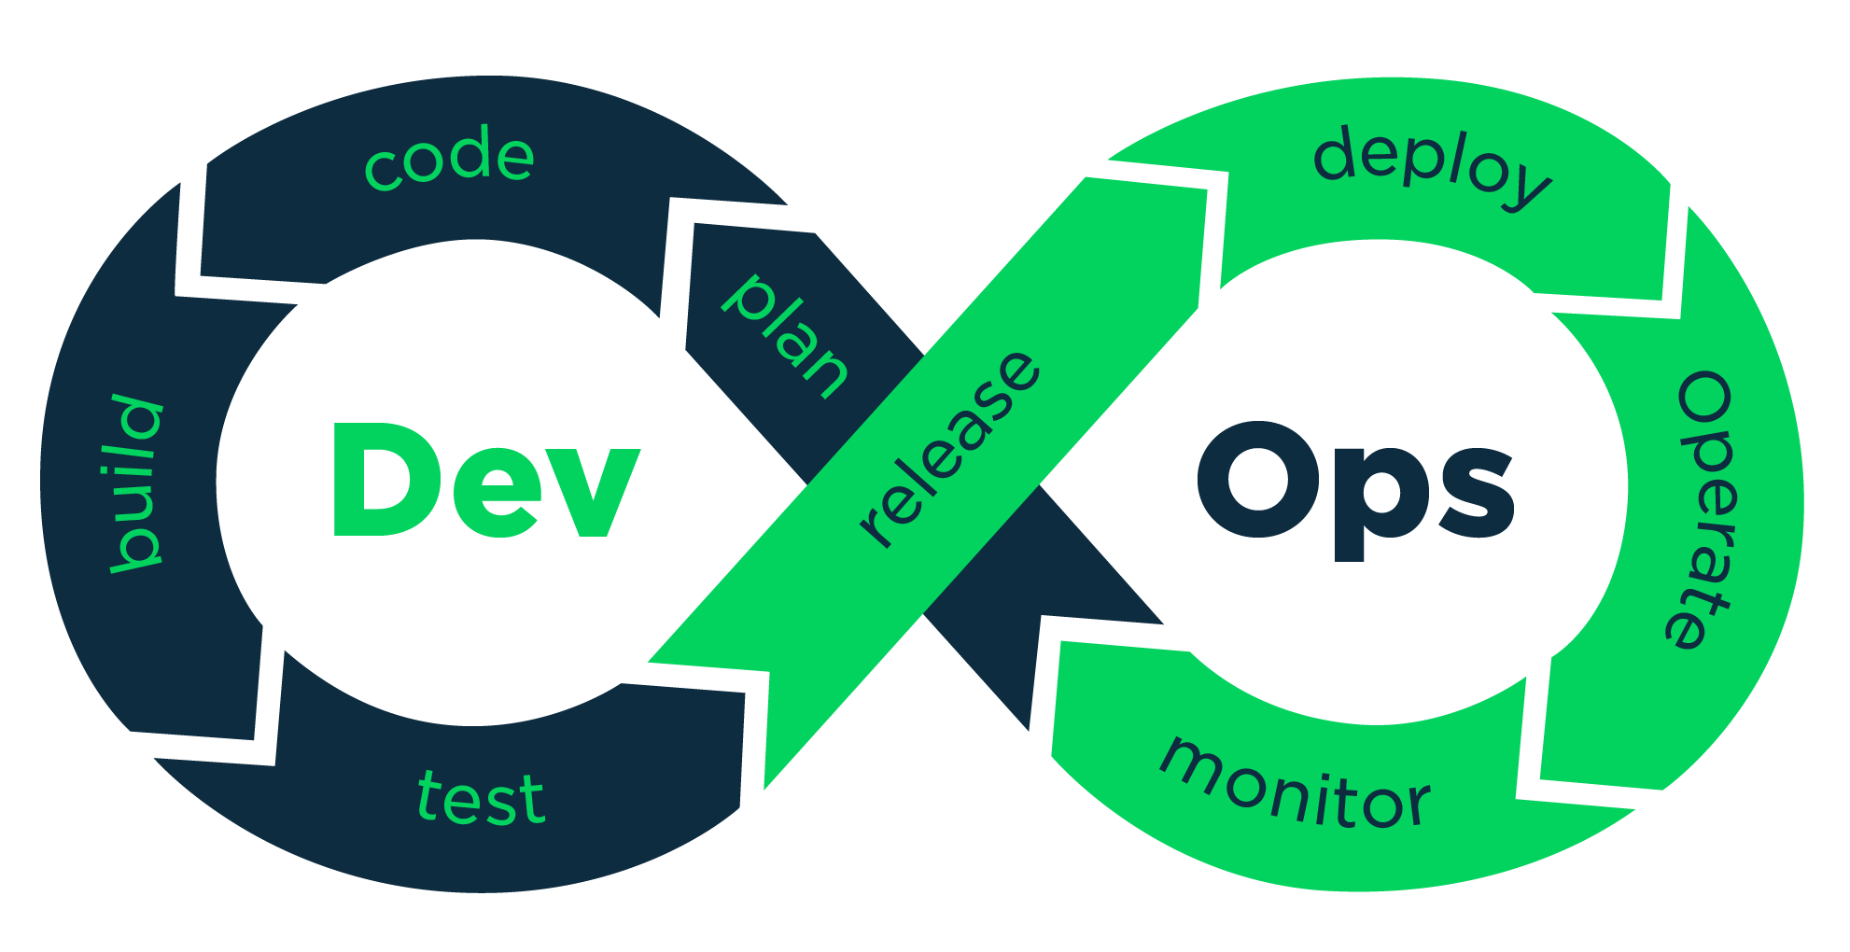
DevOps for Distributions

Slide 9
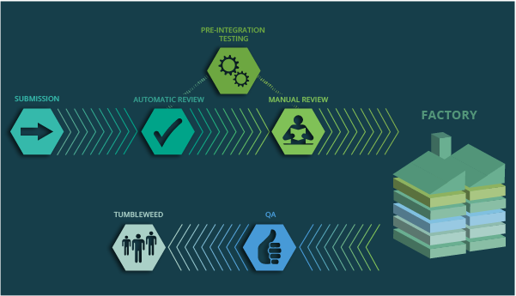

Slide 10
Core Concepts

Slide 11
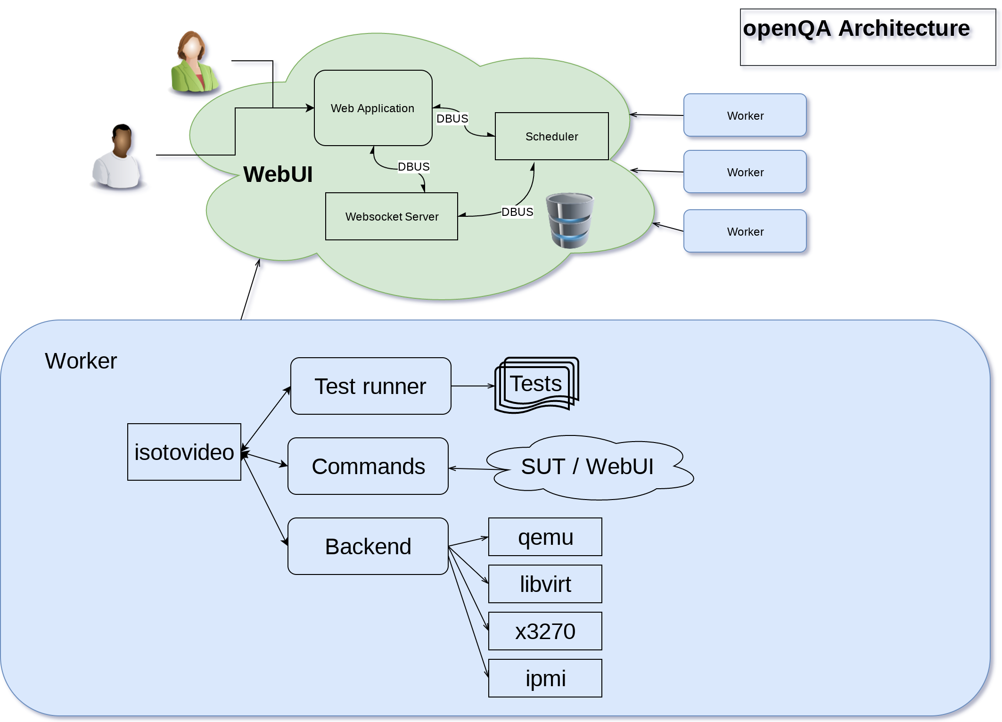

Slide 12
Different scenarios
Testing Servers, Desktops and Kubernetes Clusters
Most installations are KVM
  UEFI, Legacy
  e.g. RAID setups
  Virtual networks connecting clusters
Using libvirt to test on Xen, Hyper-V, VMware
Using x3270 to test on zVM
Using ipmitool to test on bare metal
Most tests reused without modification

Slide 13
Graphics for Review
Images and videos recorded of every test
Tests use Virtual Network Computing (VNC)
  KVM provides VNC natively
  Some installations are done through VNC
  X3270 and impitool are started in local VNC server
Additionally we access serial connection
  KVM outputs it as file
  On other platforms we use a proxy file
  (remote shell on the system and call tail(1) on a file through that tunnel)

Slide 15
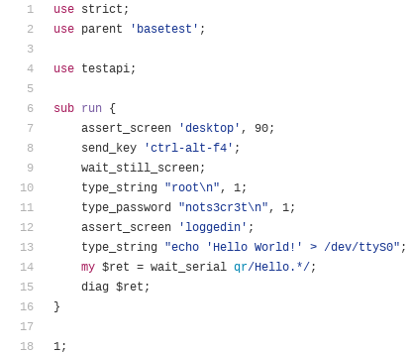
What Do the Tests Look Like?
Tests are basic perl

Slide 16

What Do the Tests Look Like?
Tests are basic perl

Slide 17
What are Jobs
Job Settings
Combine settings
Stateful
  Scheduled
  Running
  Done
    Finished
    Incomplete
    Failed
    Soft failed
Test
Test Suites
Machine
Worker
Product
Medium Type

Slide 18
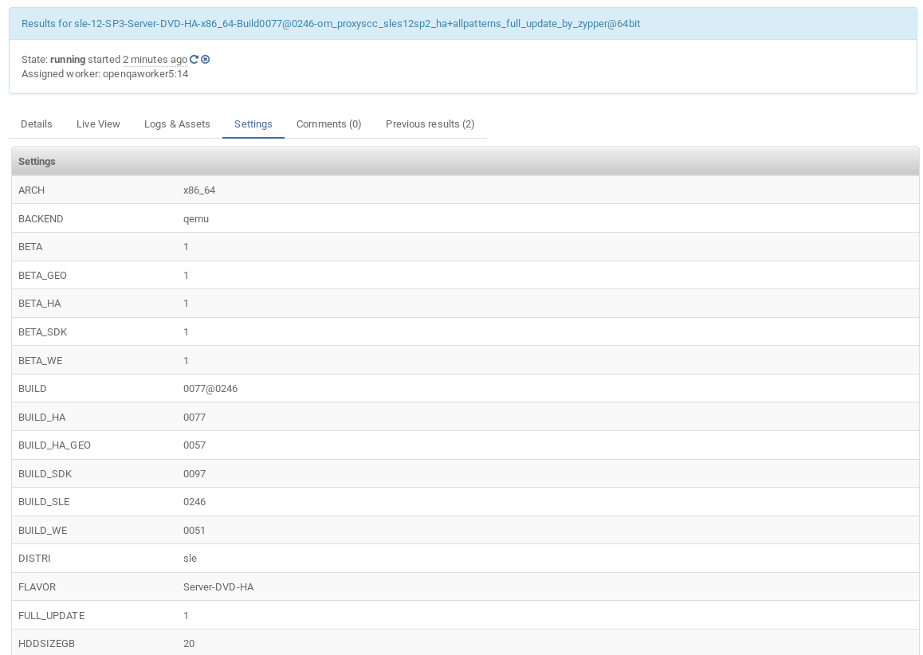
What does a job looks like?

Slide 19
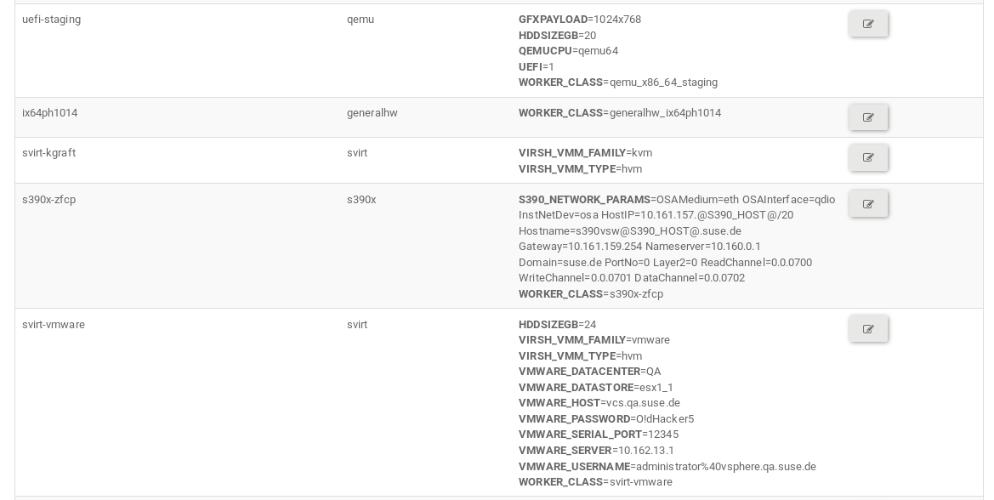
What are Machines?

Slide 20
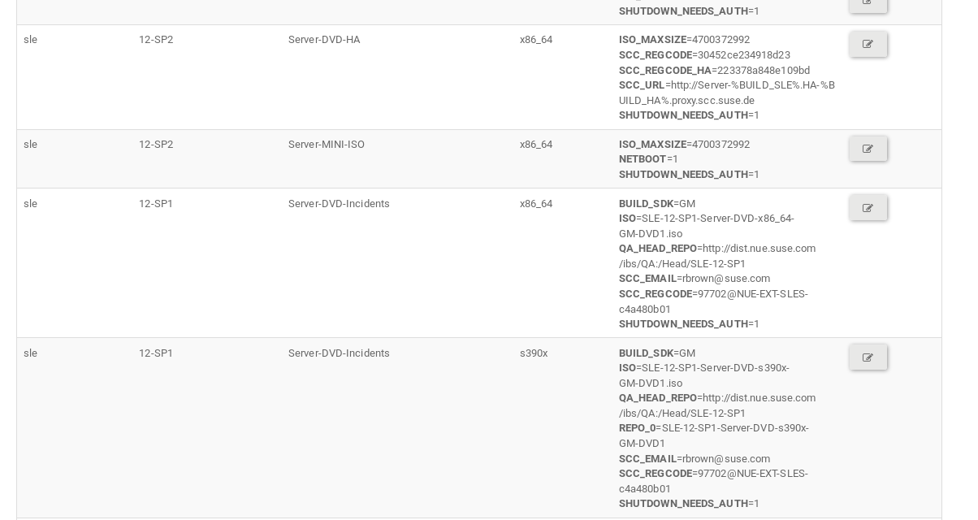
Medium Types

Slide 21
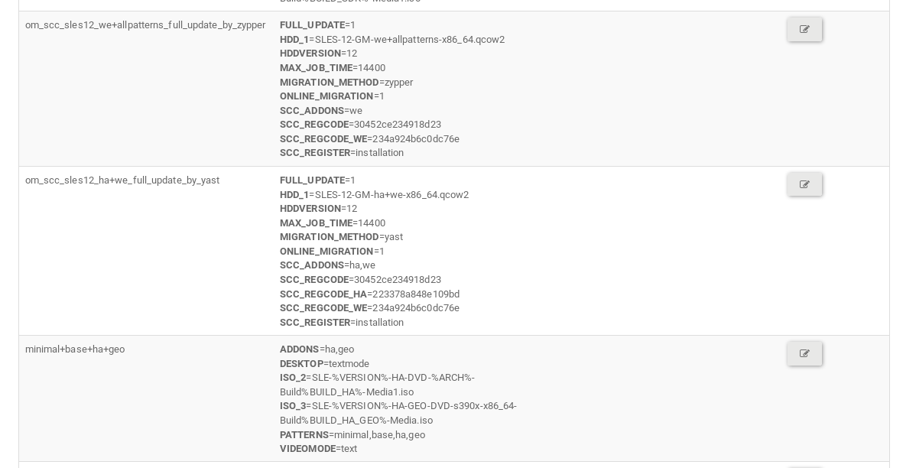
Test Suites

Slide 22
Live Demo – Installation

Slide 23
openQA Installation
Install openQA - http://open.qa/docs/#_installation
Setup Worker - http://open.qa/docs/#_run_workers
Machines - http://open.qa/docs/#_machines
Medium Types - http://open.qa/docs/#_medium_types_products
Test Suites - http://open.qa/docs/#_test_suites
Job Groups - http://open.qa/docs/#_job_groups

Slide 24
Live Demo – Test Writing

Slide 25
Test Writing
Install OBS in a VM - http://openbuildservice.org/help/manuals/
Record the Steps
Write a Test - http://open.qa/docs/#_openqa_tests_developer_guide
Add it to os-autoinst-distri-example

Slide 26
Live Demo – Test Execution

Slide 27
Test Execution
Run the Test - http://open.qa/docs/#_triggering_tests
Review the Result - http://open.qa/docs/#_use_of_the_web_interface
Fix the test
Re-Run the Test
Success

Slide 28
Wrap Up

Slide 29
Summary/Closing
openQA is an open source framework for testing any software
Easy to install & bootstrap for initial testing
We want User Stories
  How will you use/are you using openQA?
  What areas need improvement?
  Contact coolo@suse.com & rbrown@suse.com

