Slide 1
Legal Review Process
Why and how?
Stephan Kulow
Senior Technology Specialist
coolo@suse.de

Slide 2
About me
Working for SUSE
openSUSE Release Manager until Leap 42.1
Acting as openQA Architect – not as lawyer!

Slide 3
Topics
Background
Licencing Hell
How we handle it
Computer Aided VIcious Licensing (CAVIL)

Slide 4
Why are we doing legal reviews
Open source comes in many flavors
Need to have a license to distribute
Protect openSUSE users / SLE customers

Slide 5
Definition of open source
Many definitions actually
“Free Software” as defined by FSF (fsf.org)
“Open Source” as defined by OSI (opensource.org)
openSUSE follows OSI for code and its own rules for content
Packaging Guidelines

Slide 6
Open Source Definition
Free redistribution (as in 0 coins)
Source code available to modify
Allow derived works
No discrimation (against people, use cases, platforms...)

Slide 7
Popular Licenses
Apache License 2.0
BSD 3-Clause "New" or "Revised" license
BSD 2-Clause "Simplified" or "FreeBSD" license
GNU General Public License (GPL)
GNU Library or "Lesser" General Public License (LGPL)
MIT license
Mozilla Public License 2.0

Slide 8
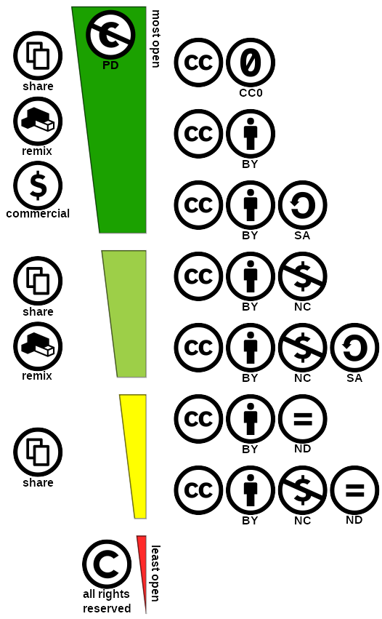
Creative Commons
Understandable concept of rules
CC0 == Public Domain
CC-BY and CC-BY-SA open source
Many other non-open-source
licenses available

Slide 9
Licenses mix
Derived works often pick different origins
Mix of licenses == mix of rules
Not all open source projects are aware
GPL version 2 and version 3 are not compatible
Licenses often contain explicit exceptions

Slide 10
Licensing Hell
‘LibreOffice is Free Software’ - yet its license document has 189 pages
Chromium, openjdk, Firefox are HUGE collections of libraries
with various licenses
Upstream projects love to hide behind source – while license mixing happens when distributing binaries

Slide 11
SPDX.org
Everyone had a different name (e.g. ‘Perl License’, ‘GPL+ or Artistic’)
“The Software Package Data Exchange® (SPDX®) specification is a standard format for communicating the components, licenses and copyrights associated with software packages.”
openSUSE switched to the SPDX naming in 2011
Artistic-1.0 OR GPL-1.0+

Slide 12
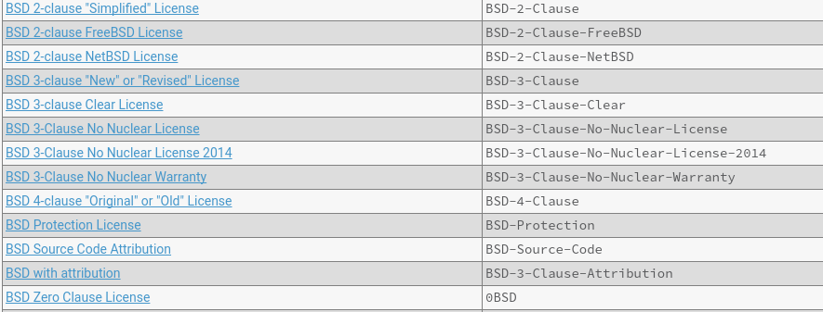
345 Licenses

Slide 13
Our Licenses

Slide 14
How we handle it
Legal-auto bot is part of development process
Reviewing the licenses of the sources and the spec file
Accepts if known combination of licenses for this package
Waits for lawyers to review the combination
Lawyers use external application to review

Slide 15
Cavil
to raise trivial and frivolous objection

Slide 16
Cavil
Application to be open sourced
Unpacks sources recursively
Multi-pattern matching of license patterns
Efficient and scalable indexing of large sources
Lawers are presented with summary

Slide 17
Cavil 2
Licenses have a risk level and a number of patterns
Patterns are checked all in parallel – longest wins
‘licensed under the GPL’ → ‘GPL Unspecified’
‘licensed under the GPL version 2’ → ‘GPL-2.0’
‘licensed under the GPL version 2 or later’ → ‘GPL-2.0+’
SKIP<NR> allows to ignore NR words

Slide 18
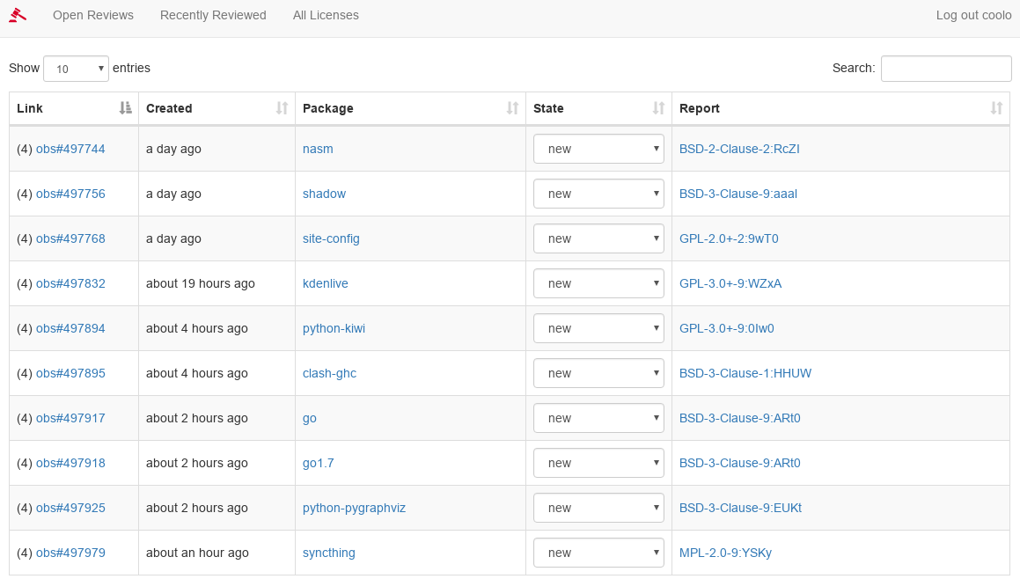

Slide 19
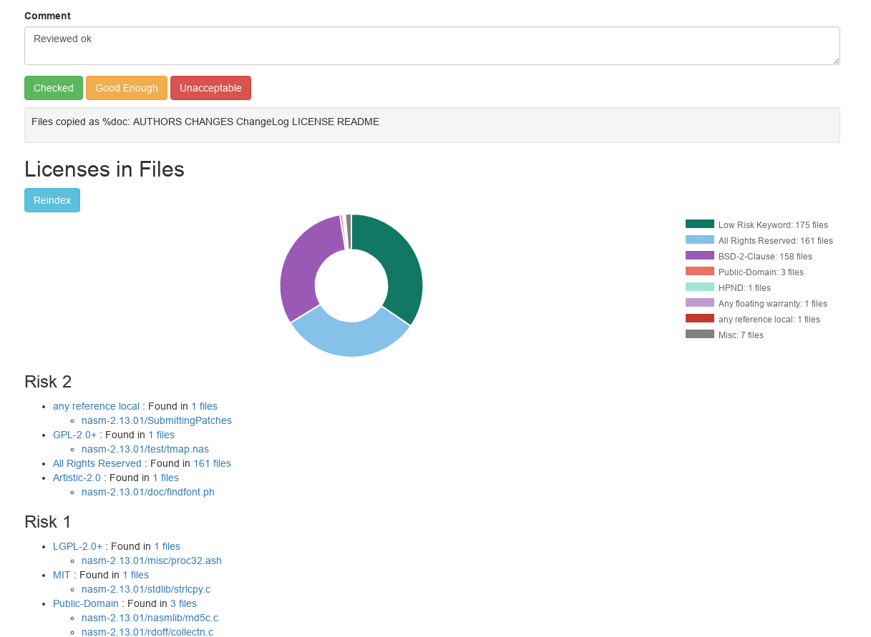

Slide 20
Why is it taking so long?
Legal situation needs to be sorted out per file
Combination of files needs to be identified
Legal consequences derived from that
This is merely a part time job

Slide 21
Creating Patterns
License Texts supposed to be formalized
Still literally thousand of variants
Pattern matching already reduces variants
Still a lot of ways to express the same terms

Slide 22
Redistribution and use in source and binary forms, with or without
modification, are permitted provided that the following conditions are met:
(1) Redistributions of source code must retain the above copyright notice,
this list of conditions and the following disclaimer.
(2) Redistributions in binary form must reproduce the above copyright notice,
this list of conditions and the following disclaimer in the documentation
and/or other materials provided with the distribution.
(3) Neither the name of $SKIP10 nor the names of its contributors may be used to endorse or promote
products derived from this software without specific prior written permission.
THIS SOFTWARE IS PROVIDED BY THE COPYRIGHT HOLDERS AND CONTRIBUTORS "AS
IS" AND ANY EXPRESS OR IMPLIED WARRANTIES, INCLUDING, BUT NOT LIMITED TO,
THE IMPLIED WARRANTIES OF MERCHANTABILITY AND FITNESS FOR A PARTICULAR
PURPOSE ARE DISCLAIMED. IN NO EVENT SHALL THE COPYRIGHT OWNER OR
CONTRIBUTORS BE LIABLE FOR ANY DIRECT, INDIRECT, INCIDENTAL, SPECIAL,
EXEMPLARY, OR CONSEQUENTIAL DAMAGES (INCLUDING, BUT NOT LIMITED TO,
PROCUREMENT OF SUBSTITUTE GOODS OR SERVICES; LOSS OF USE, DATA, OR
PROFITS; OR BUSINESS INTERRUPTION) HOWEVER CAUSED AND ON ANY THEORY OF
LIABILITY, WHETHER IN CONTRACT, STRICT LIABILITY, OR TORT (INCLUDING
NEGLIGENCE OR OTHERWISE) ARISING IN ANY WAY OUT OF THE USE OF THIS
SOFTWARE, EVEN IF ADVISED OF THE POSSIBILITY OF SUCH DAMAGE.

Slide 23
Redistribution and use in source and binary forms, with or without
modification, are permitted provided that the following conditions are met:
(1) Redistributions of source code must retain the above copyright notice,
this list of conditions and the following disclaimer.
(2) Redistributions in binary form must reproduce the above copyright notice,
this list of conditions and the following disclaimer in the documentation
and/or other materials provided with the distribution.
(3) Neither the name of $SKIP10 nor the names of their contributors may be used to endorse or promote
products derived from this software without specific prior written permission.
THIS SOFTWARE IS PROVIDED BY THE COPYRIGHT HOLDERS AND CONTRIBUTORS "AS
IS" AND ANY EXPRESS OR IMPLIED WARRANTIES, INCLUDING, BUT NOT LIMITED TO,
THE IMPLIED WARRANTIES OF MERCHANTABILITY AND FITNESS FOR A PARTICULAR
PURPOSE ARE DISCLAIMED. IN NO EVENT SHALL THE COPYRIGHT OWNER OR
CONTRIBUTORS BE LIABLE FOR ANY DIRECT, INDIRECT, INCIDENTAL, SPECIAL,
EXEMPLARY, OR CONSEQUENTIAL DAMAGES (INCLUDING, BUT NOT LIMITED TO,
PROCUREMENT OF SUBSTITUTE GOODS OR SERVICES; LOSS OF USE, DATA, OR
PROFITS; OR BUSINESS INTERRUPTION) HOWEVER CAUSED AND ON ANY THEORY OF
LIABILITY, WHETHER IN CONTRACT, STRICT LIABILITY, OR TORT (INCLUDING
NEGLIGENCE OR OTHERWISE) ARISING IN ANY WAY OUT OF THE USE OF THIS
SOFTWARE, EVEN IF ADVISED OF THE POSSIBILITY OF SUCH DAMAGE.

Slide 24
Redistribution and use in source and binary forms, with or without
modification, are permitted provided that the following conditions are met:
(1) Redistributions of source code must retain the above copyright notice,
this list of conditions and the following disclaimer.
(2) Redistributions in binary form must reproduce the above copyright notice,
this list of conditions and the following disclaimer in the documentation
and/or other materials provided with the distribution.
(3) Neither the name of $SKIP10 nor the names of their contributors may be used to endorse or promote
products derived from this software without specific prior written permission.
THIS SOFTWARE IS PROVIDED BY THE COPYRIGHT HOLDERS "AS IS" AND ANY EXPRESS OR IMPLIED WARRANTIES, INCLUDING, BUT NOT LIMITED TO,
THE IMPLIED WARRANTIES OF MERCHANTABILITY AND FITNESS FOR A PARTICULAR
PURPOSE ARE DISCLAIMED. IN NO EVENT SHALL THE COPYRIGHT OWNER OR
CONTRIBUTORS BE LIABLE FOR ANY DIRECT, INDIRECT, INCIDENTAL, SPECIAL,
EXEMPLARY, OR CONSEQUENTIAL DAMAGES (INCLUDING, BUT NOT LIMITED TO,
PROCUREMENT OF SUBSTITUTE GOODS OR SERVICES; LOSS OF USE, DATA, OR
PROFITS; OR BUSINESS INTERRUPTION) HOWEVER CAUSED AND ON ANY THEORY OF
LIABILITY, WHETHER IN CONTRACT, STRICT LIABILITY, OR TORT (INCLUDING
NEGLIGENCE OR OTHERWISE) ARISING IN ANY WAY OUT OF THE USE OF THIS
SOFTWARE, EVEN IF ADVISED OF THE POSSIBILITY OF SUCH DAMAGE.

Slide 25
Future Plans

Slide 26
Short term plans
Open Source the application (Spooky::Patterns::XS already is)
Associate packages with a product
Cleanup outdated reviews
Diff view for updates

Slide 27
Mid/Long term plan
‘Machine-Learning’ to suggest patterns
Group patterns semi-automatically
Better risk analysis based on previous examples

Slide 28
Questions?

