Slide 1
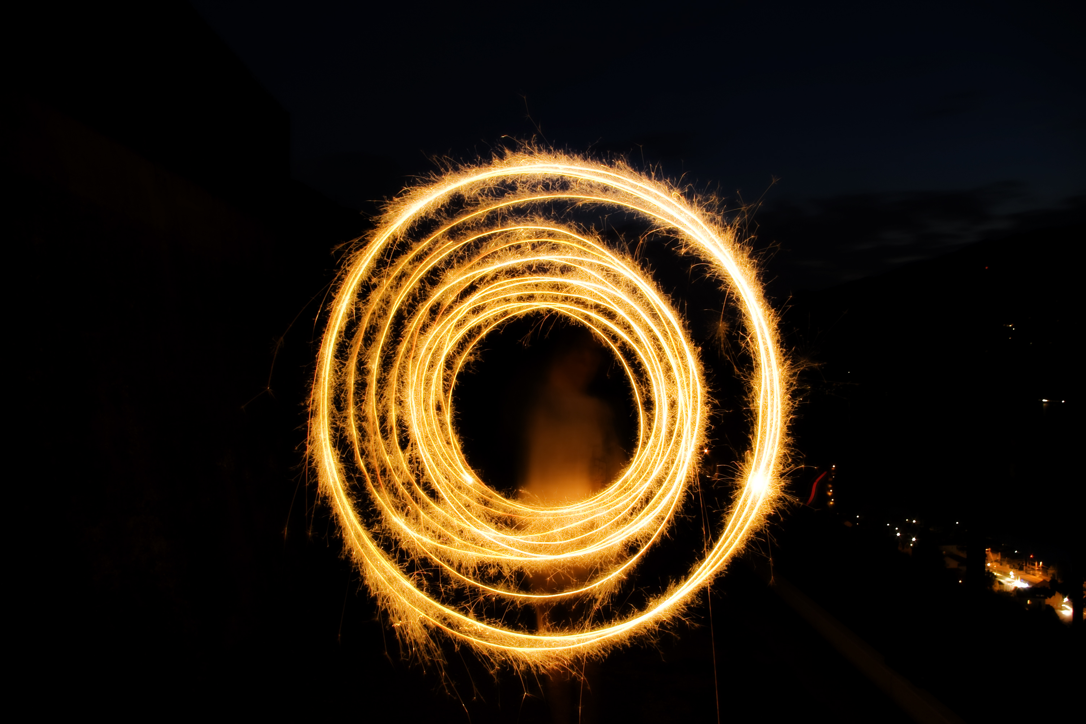
A Ring of Fire
Or: A better Factory using Staging Projects
Stephan „Coolo“ Kulow
coolo@suse.de

Slide 2
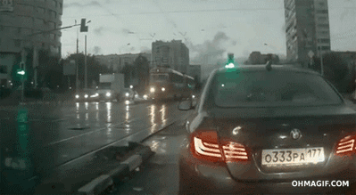

The problem

Slide 3
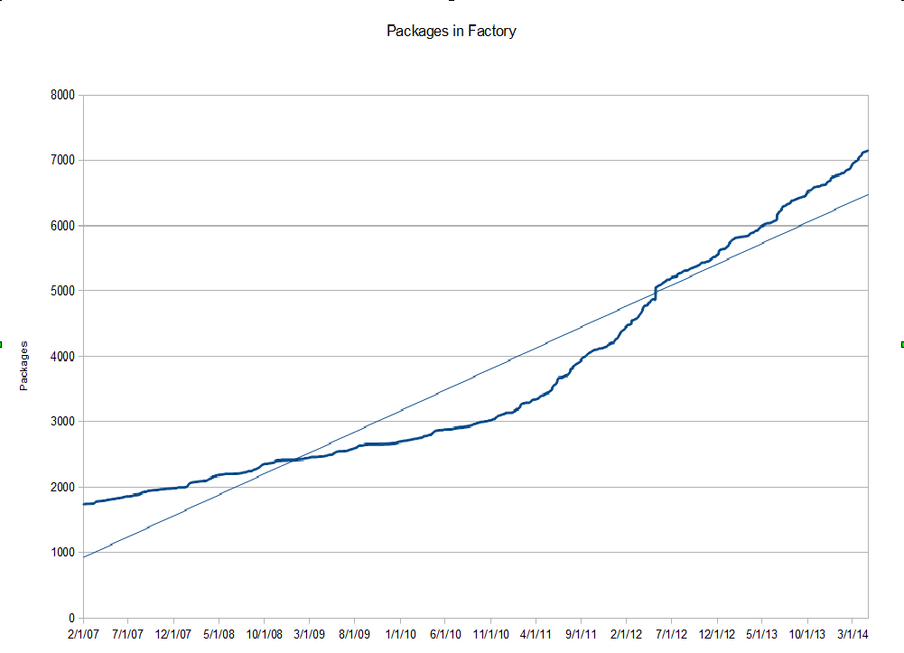
Factory is growing – a lot!

Slide 4
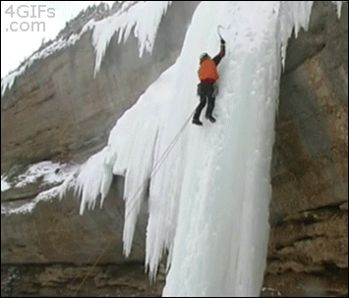
Submissions are not well tested

Slide 5
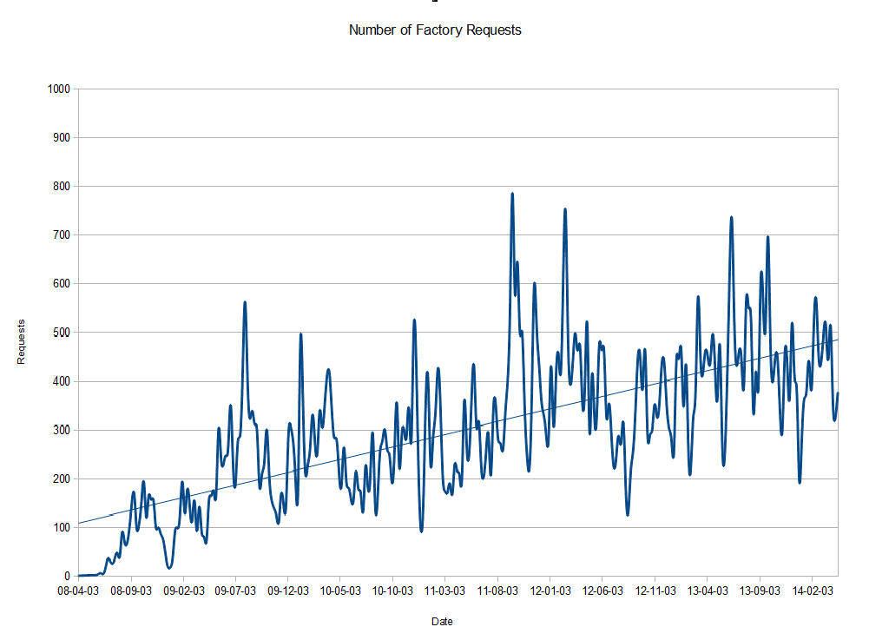

Slide 6

We have reviewers and tools
But they all check one submission at a time

Slide 7

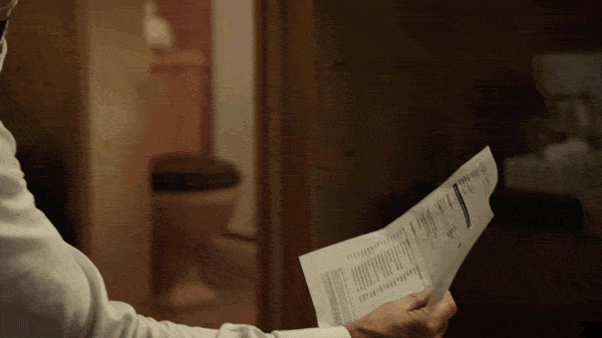

Less risky for me

Slide 8
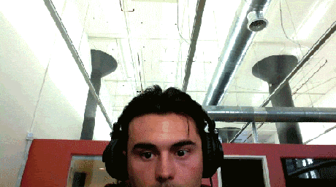
The concept of rings

Slide 9
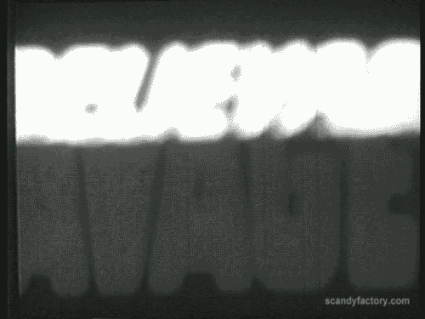
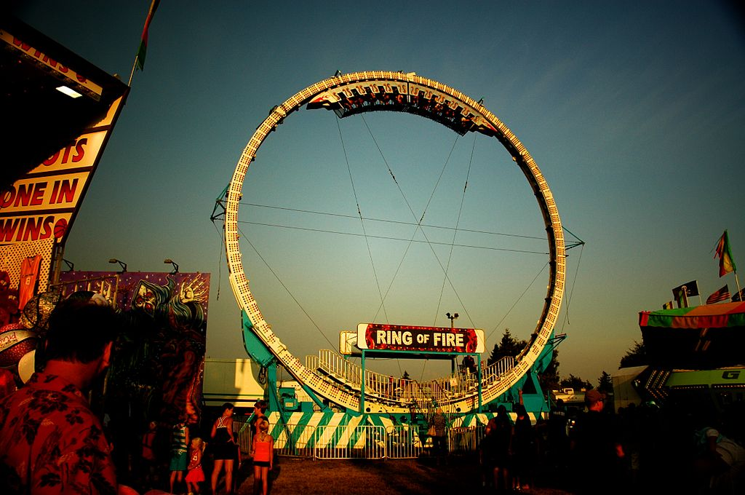
No regression in 2014

