Slide 1
openSUSE Development
Stephan Kulow
openSUSE Release Manager
coolo@suse.de

Slide 2
About Me
Medical Computer Scientist from Uni zu Lübeck, Germany
Thesis about keeping complex software systems consistent
KDE “Dude” from 1997 to 2007
Working since 2002 for SUSE
  KDE Team Lead
  Usability
  Since 2007 openSUSE Release Manager
  Major Contributor to the Open Build Service

Slide 3
About openSUSE Factory
“The Factory distribution is a rolling development distribution and the base for the next stable openSUSE release.”
Powered by the Open Build Service http://build.opensuse.org
No freeze, constant development, automated tested releases almost every day.
Base of both openSUSE and upstream to
SUSE Linux Enterprise releases

Slide 4
Quick History Tour
Oct 2005 first openSUSE release: SUSE Linux 10.0
Dec 2006 openSUSE Build Service
Apr 2008 Collaboration within Build Service
Jul 2012 Introducing OpenSUSE Review Team. OpenSUSE Development is community handled
Jul 2014 openSUSE Factory becomes rolling release

Slide 5
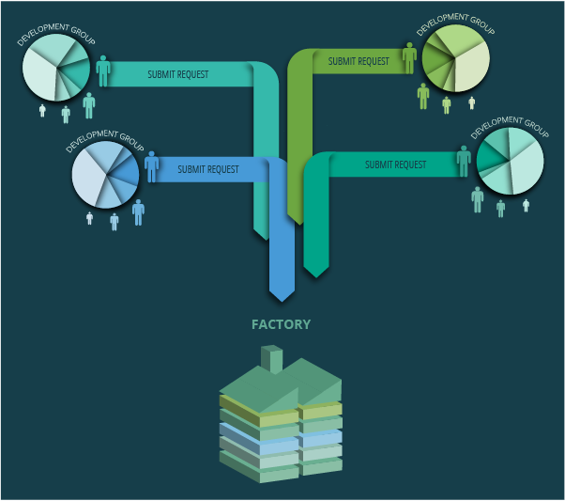
Build Service Collaboration

Slide 6
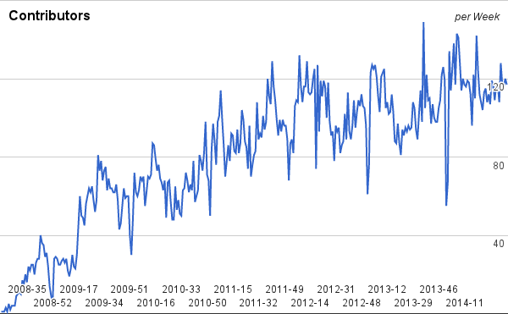
Many People (1098 accounts)

Slide 7
The Problem of Success

Slide 8
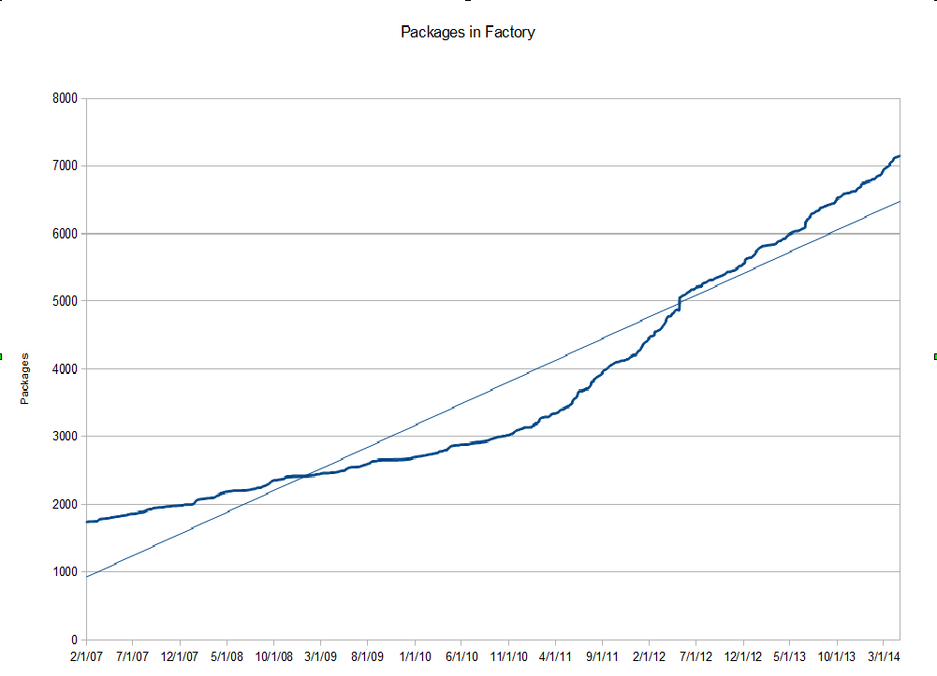
Factory is growing – a lot!

Slide 9
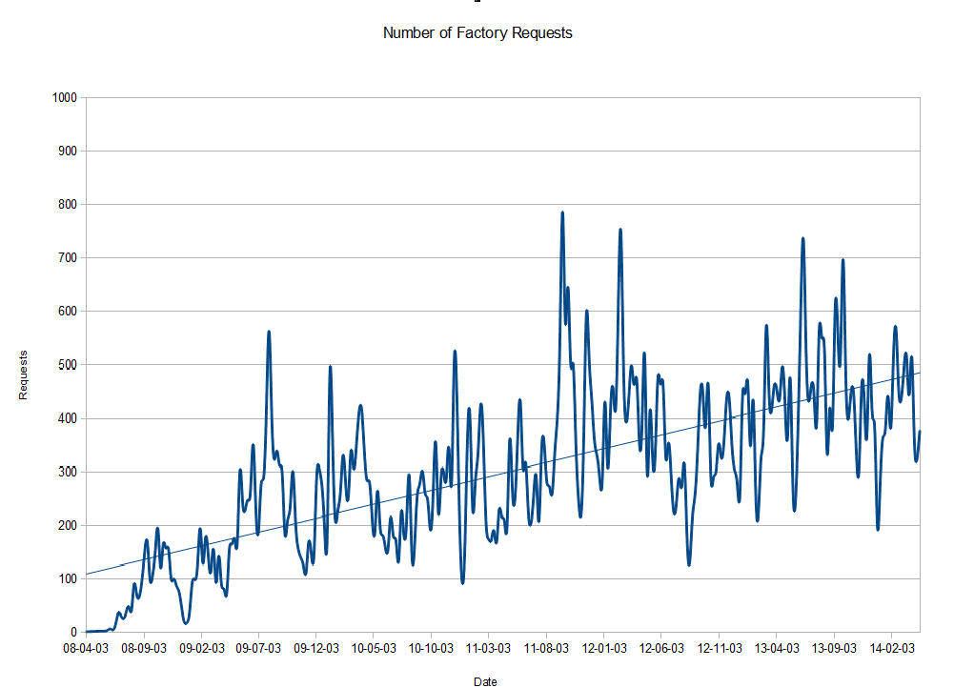
A lot of Changes every week

Slide 10
Debugging Afterwards is Hard
With >500 changes a week it's hard to pin down problems
“Mixing” takes a good day, no time to experiment
While debugging one problem, we get more changes – more problems

Slide 11
Introduced Mechanisms
First line of defense (review) are scripts now
Legal-Team checks for changed license
Checking build success for submissions
Humans doing source reviews only as last step

Slide 12
Hard to Predict the Mixture
Submissions are reviewed package by package
Distribution “mixes” them and we need testing
Problems are endless
  - Fails to build
  - Breaks other packages
  - Plain bugs
  - Missing integration

Slide 13
Introducing Rings and Stagings
Needed a way to limit the impact
Split Factory into 4 rings
  Ring 0: bootstrap cycle (96 packages)
  Ring 1: minimal X installation (990 packages)
  Ring 2: KDE and GNOME desktop (867 packages)
  Ring X: the rest (5602 packages and growing)
Added “Staging Projects” for interim building and testing

Slide 14
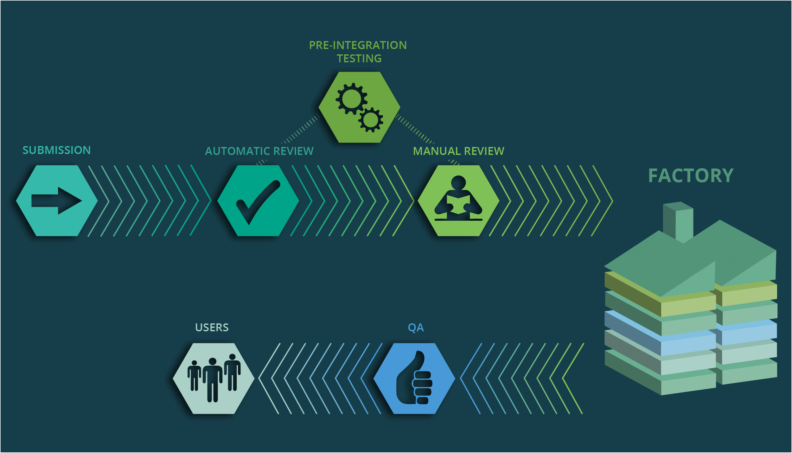
Factory Workflow

Slide 15
Pre-Integration Testing
Need to group the packages
Need to check and adapt dependencies
Feedback to the developers
Possibly provide bug reports

Slide 16
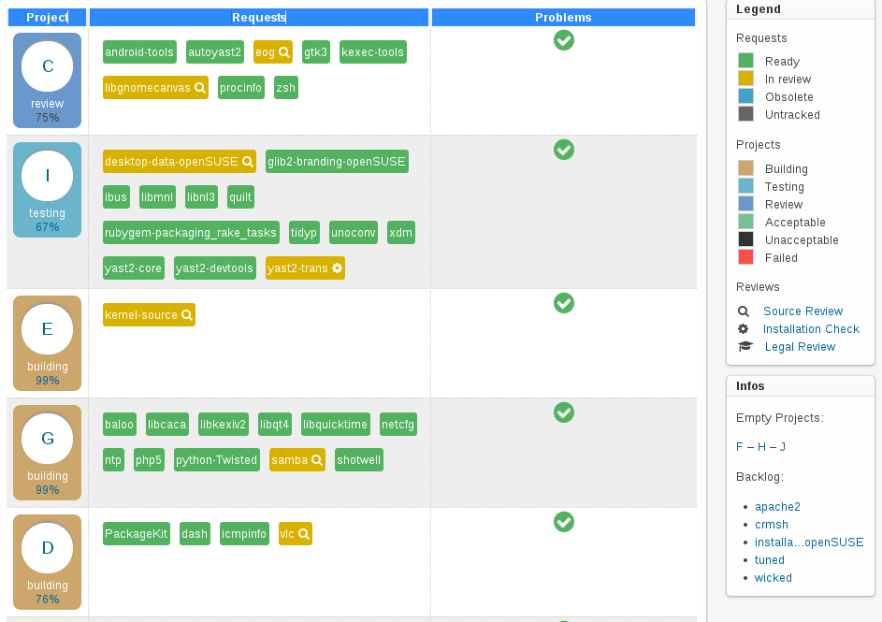
Staging Dashboard

Slide 17
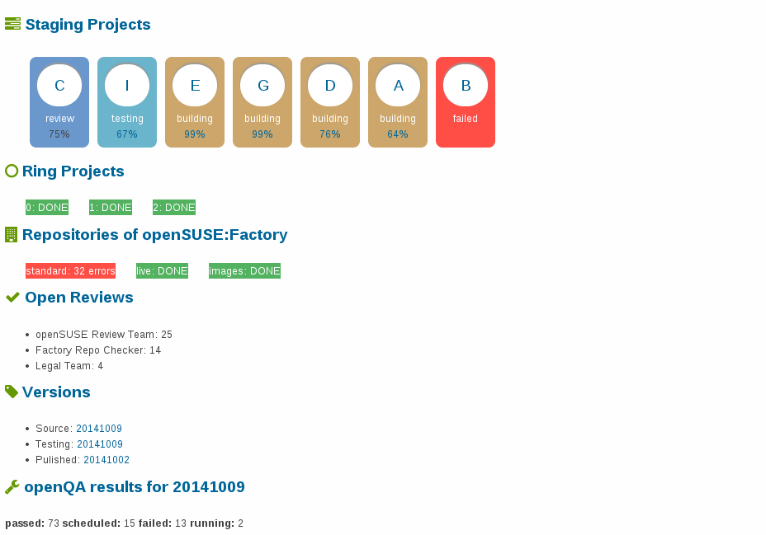
Factory Dashboard

Slide 18
OpenQA – Automated Testing

Slide 19
OpenQA – Automated Testing
Started end of 2009 by Bernhard M. Wiedemann
Perl-Suite to drive a virtual machine through VNC using OpenCV fuzzy image matching
Tests the Machine as black box and records screen shots and a video of the whole process
Offers a web interface to check the results

Slide 20
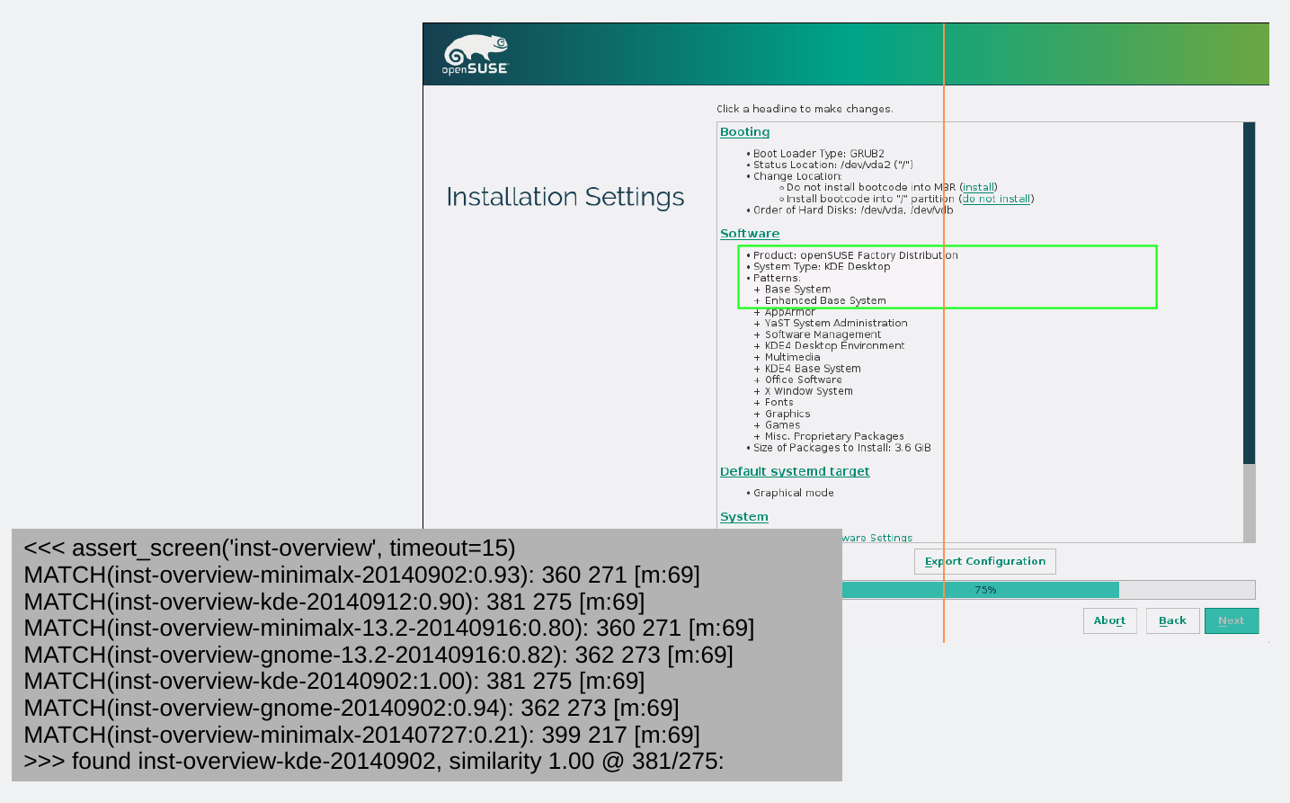
OpenQA – Needle Matching

Slide 21
OpenQA – Tests
Quite simple API
Example: choosing EXT4 in installation
# click the button
assert_and_click 'edit-proposal-settings';
# select the combo box
assert_and_click 'default-root-filesystem';
# select ext4
assert_and_click 'filesystem-ext4';
assert_screen 'ext4-selected';
assert_and_click 'ok-button';
# make sure we're back from the popup
assert_screen 'edit-proposal-settings';

Slide 22
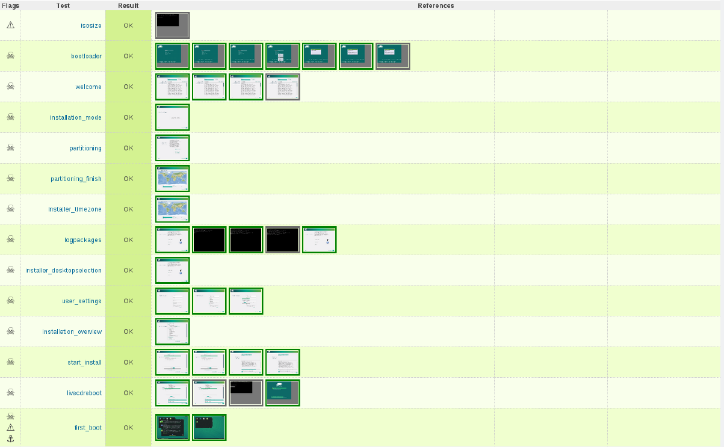
OpenQA – Test Result Overview

