Slide 1
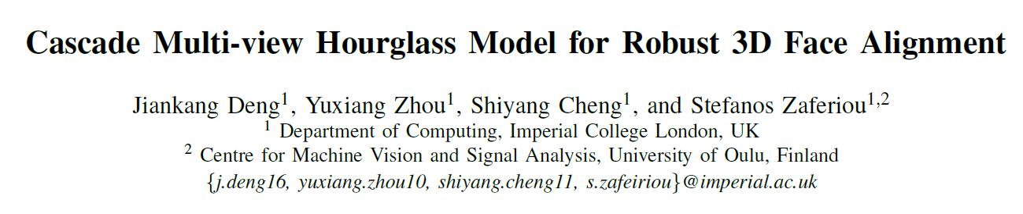
GeometricDL: Journal Club
Kristine Aa. Juhl

Slide 2
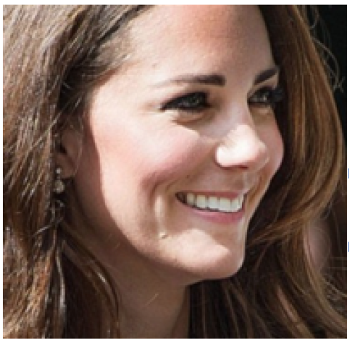
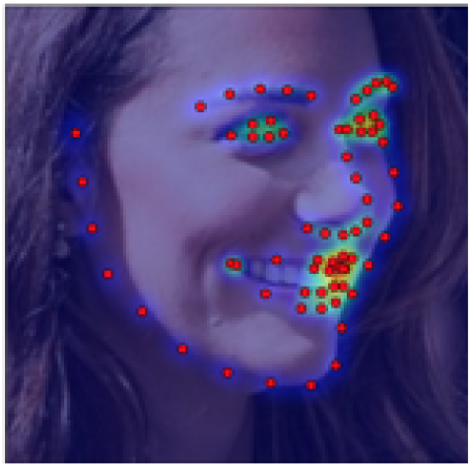
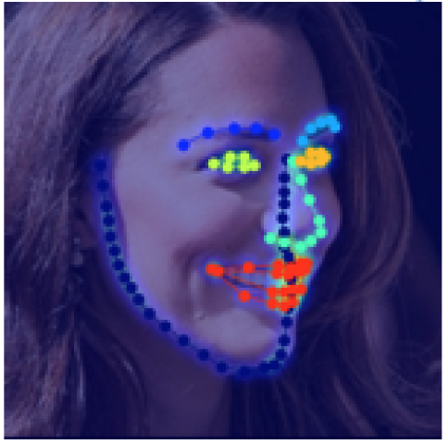
Goal: Semantic Consistent Facial Landmark Annotation
2D landmark annotation are not always semantically consistent and hardly preserve the 3D structure of the human face
3D landmark annotation preserves the correspondence between landmarks across poses
Input Image
2D annotation
Projected 3D annotation

Slide 3
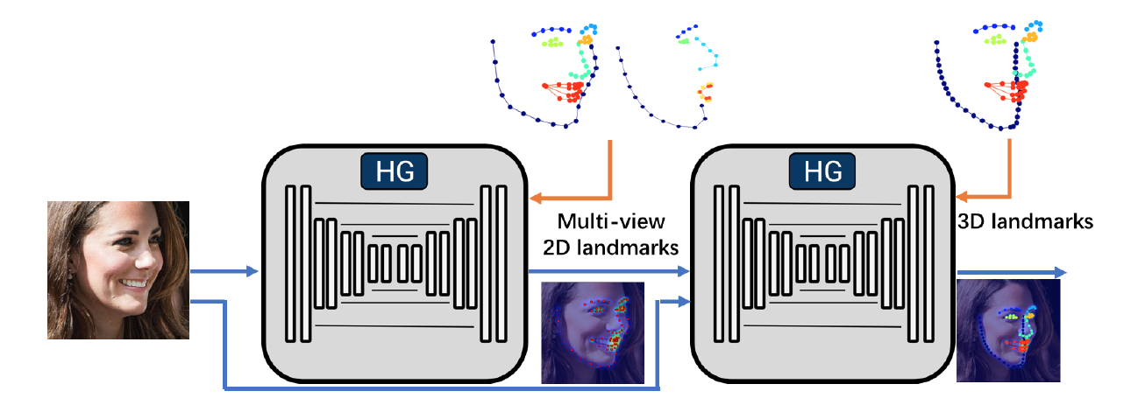
Cascade Multi-view Hourglass Model (CMHM)
Semifrontal (68 point)
Profile (39 point)
3D-projection (68/86 point)

Slide 4
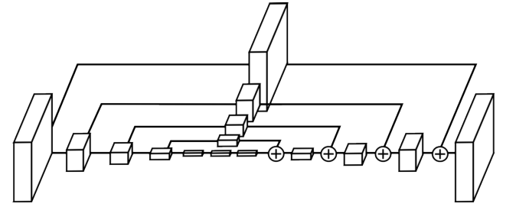

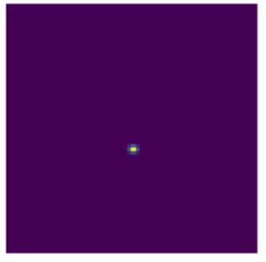
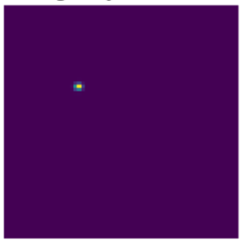
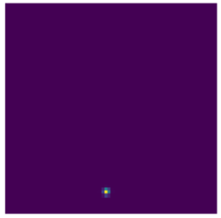
Hourglass Network
Combine local and global features – increase robustness when local observation is blurred.
Inception-Resnet block
Heatmap
Skiplayer
Residual Block
Downsampling
Upsampling
Alejandro Newell, Kaiyu Yang, and Jia Deng. Stacked hourglass networks for human pose estimation. In ECCV, pages 483-499. Springer, 2016.
Notes:
Inception Res-Net block -> improves capacity and compress computational capacity. (Parallel and multi-scale).

Slide 5
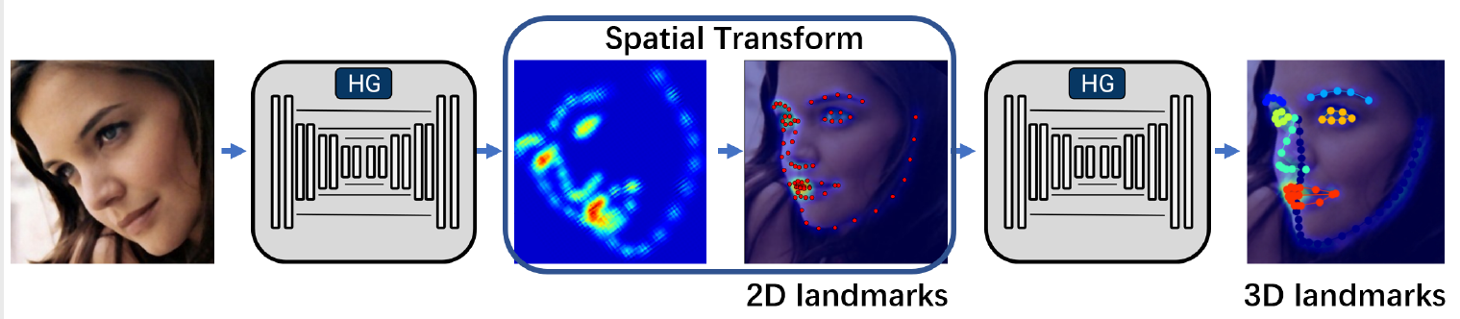
Cascade Multi-view Hourglass Model (CMHM)
Notes:
Rigid transformation
Apply two loss functions (2D and 3D) to avoid backpropagating through the rigid transformation.

Slide 6
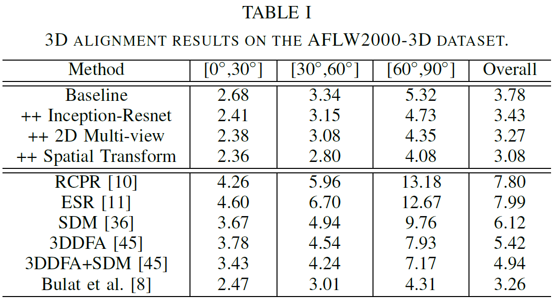
Results:
AFLW2000-3D dataset (68 landmarks)
Notes:
CONCLUSIONS:
Normalised mean error (NME) - Baseline: two stacked hourglasses (direct prediction of 3D landmarks with intermediate supervision, but not guided by 2D-landmarks).
Inception-Resnet: Improvement in architechture improves performance and prediction time
2D multi-view: The network benefits from having two separate networks. There is some information in the 2D-landmarks that makes it preform better.
Spatial transform: decrease the variance of the target

Slide 7
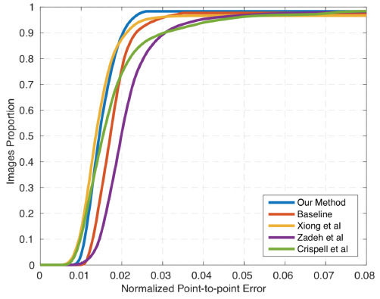
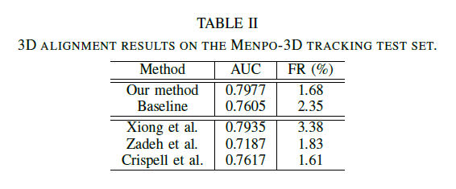
Results:
Menpo-3D video tracking
Notes:
CONCLUSIONS:
- It is believed that this method is better for large pose variations -> We train the first network jointly on profile and semi-frontal images. (Preserve the correpondence between the two views).

Slide 8
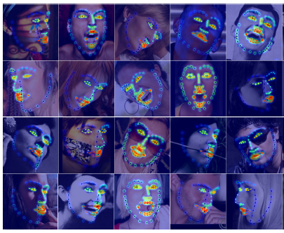
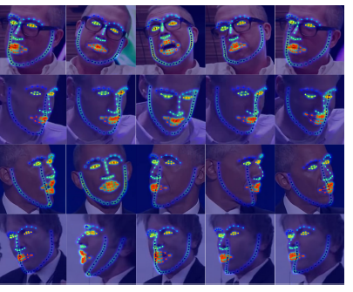
Results:

