Slide 1

IBM Employee Attrition Predictive Modelling
Koundinya Majeti
Kowtharapu Venkata Shashank

Slide 2

AIM
The main goal of our project is to predict the IBM Employee retention rate based on various parameters such as Attrition, Age, Job Satisfaction, Daily Rate etc.

Slide 3

ABOUT THE DATA
51000 Entries
Investigate the elements that contribute to employee turnover. Delve into key inquiries such as examining the correlation between the commute distance and job role with attrition or contrasting the average monthly earnings with education levels and attrition rates.

Slide 4

PREDICTIVE MODELLING
We have used 6 models to test and check the best suitable one for the data set selected.
The models we have used are –
Logistic Regression
Decision Tree
Random Forest
Ada Boost
Bagging
XGBC
Among these 6 models we have found that XGBC performs the best based on the ROC AUC as the scoring metric.

Slide 5
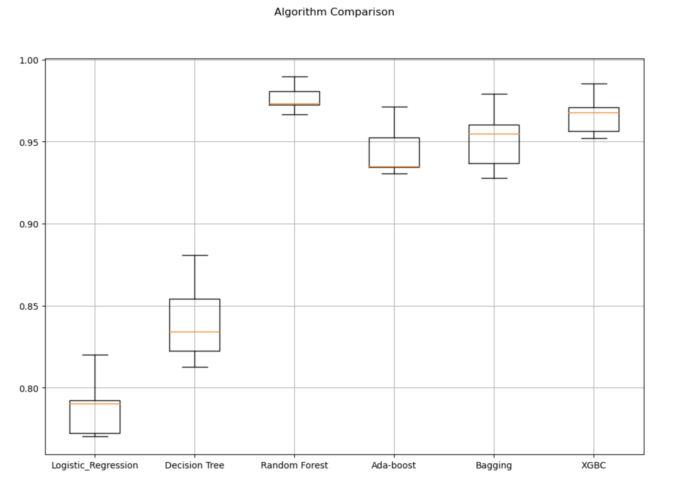
MODEL COMPARISION
https://github.com/coolprodad/Sem-3

Slide 6

BENEFITS
Reduces Human efforts and increases efficiency in data handling.
Helps to predict the retention rate of employees to help the HR make decisions.
Helps reduce the retention cost for the company due to detailed statistics available.

Slide 7

THANK YOU

