Slide 1
Getting Started with PowerShell for the DBAs

Slide 2
The Quick Version
We are dedicated to a harassment-free experience for everyone, regardless of who you are and what makes you you. We recognize the right of any individual to attend and participate. Anyone. This is included but not limited to gender identity and expression, sexual orientation, disability, physical appearance, body size, race, religion, or any other classification, affiliation, or label.
We do not tolerate harassment in any form. For the duration of your engagement with GroupBy and its programs, you are expected to act appropriately and to adhere to this Code of Conduct. This includes conduct in-person and online, at the conference itself, as well as any non-conference programs that may include participants: including talks, workshops, parties, on social media, and other online forums. GroupBy participants violating these rules may be sanctioned or expelled without a refund (if that applies) at the discretion of the conference organizers.
You can review the full policy at: GroupBy.org/Code-of-Conduct
Notes:
You do not need to read this full policy, just give people time to read this and explain they can review the full policy at the provided link.

Slide 3

HARRY CHANDRA
DBA, POWERSHELL ENTHUSIAST, TERRIBLE GOLFER
HARRYCHANDRA.COM
@HARRYCHANDRAPDX
Database Administrator for 12+ years
Co-leader of the Redmond SQL User group
I noodle in: SQL Server, PowerShell, VMWare, Storage & more

Slide 4
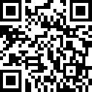
Pollev.com/harrychandra588

Slide 5
Agenda & Goals
The Basics
Module & cmdlet
Object, Method & Property
Tools
Using PowerShell to perform routine DBA tasks
Discover SQL instances
Check failed SQL Agent jobs
Check SQL Services status
Backup\restore
Goal
To get you started using PowerShell to manage SQL Server

Slide 6
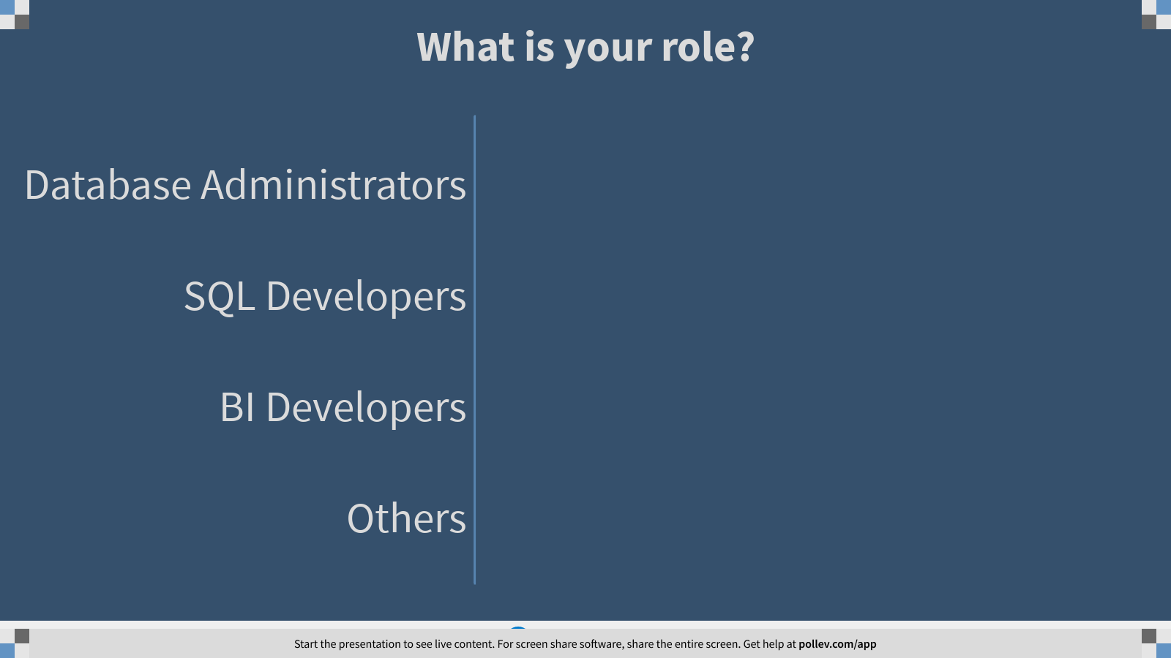
Notes:
Poll Title: What is your role? https://www.polleverywhere.com/multiple_choice_polls/hnieg24Dl7OKgDt9r0ANT?flow=Default&onscreen=persist

Slide 7
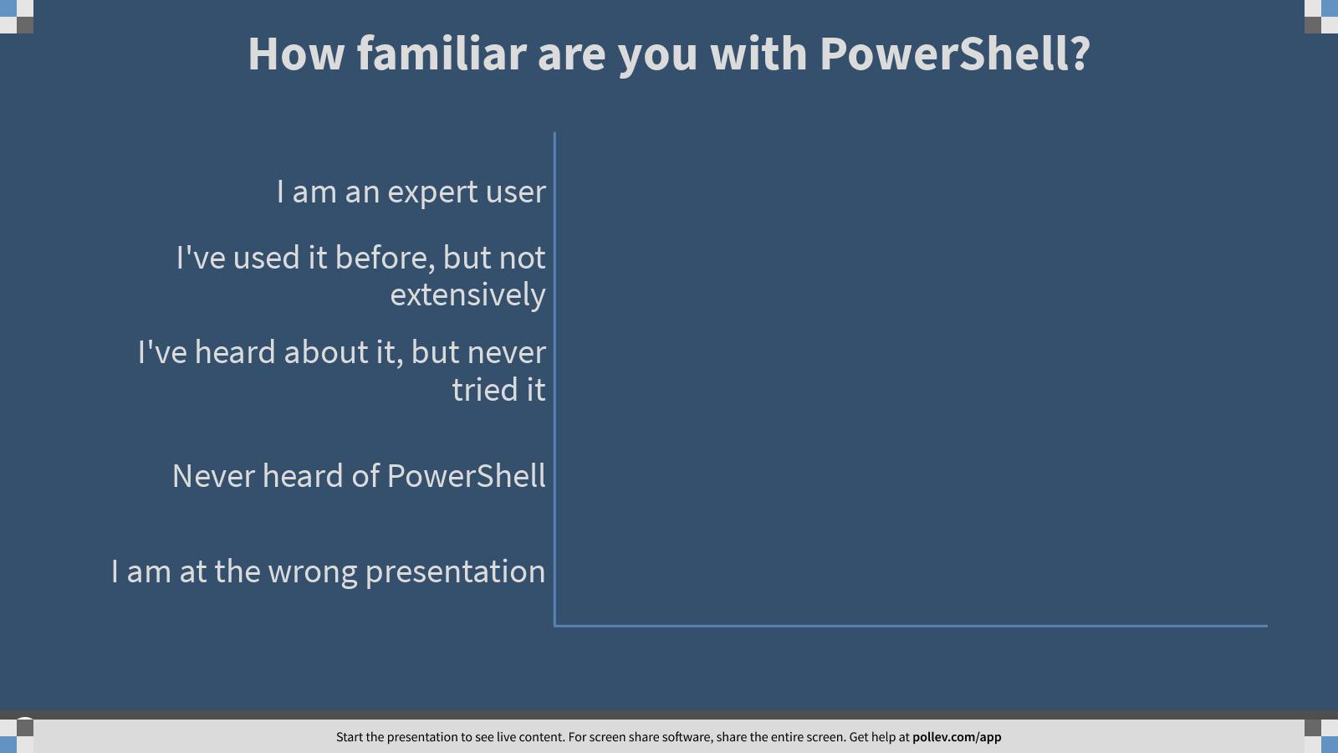
Notes:
Poll Title: How familiar are you with PowerShell? https://www.polleverywhere.com/multiple_choice_polls/t5ZEsPofK3MWxrGNipDk4?flow=Default&onscreen=persist

Slide 8
Why do DBA need to learn PowerShell…?

Slide 9
“if you have to do the same task more than once, automate it!!...”
-- Someone very wise or lazy…… probably

Slide 10
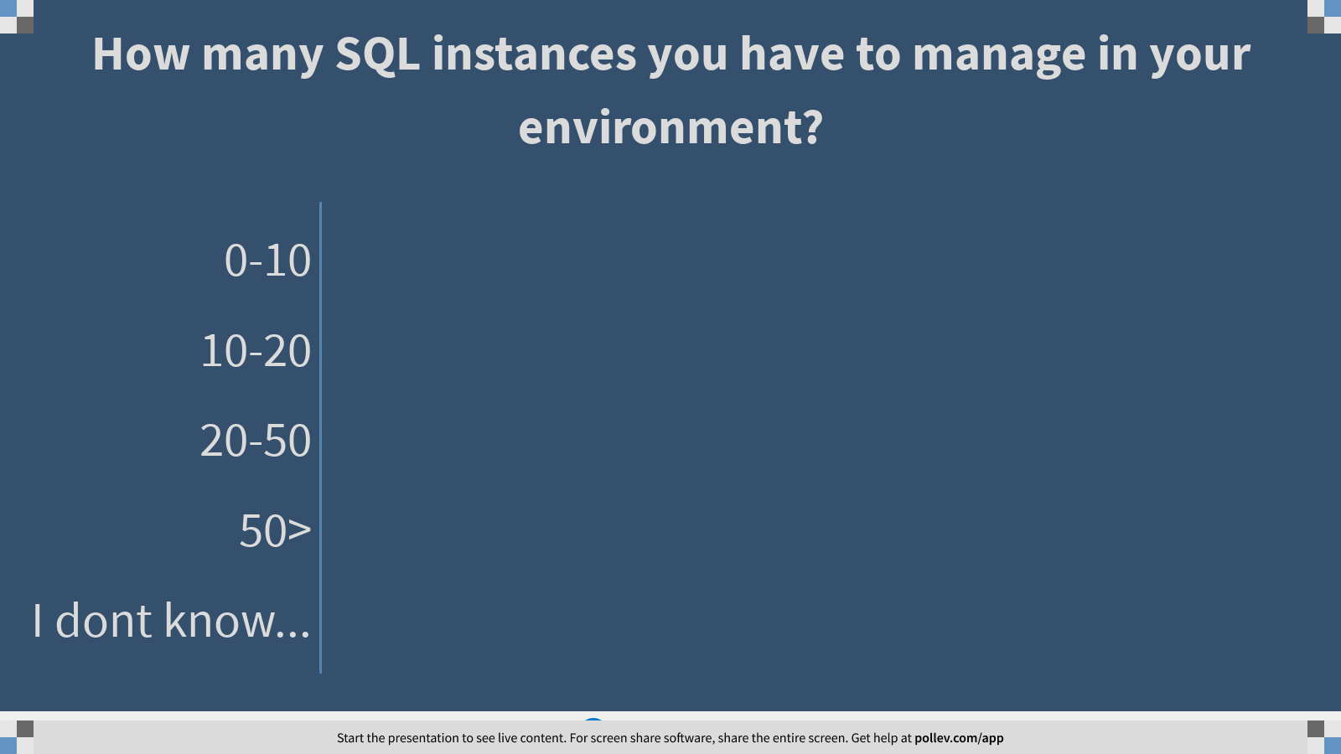
Notes:
Poll Title: How many SQL instances you have to manage in your environment? https://www.polleverywhere.com/multiple_choice_polls/z8amF5VhaTxveWfDuX3wT?flow=Default&onscreen=persist

Slide 11
What is PowerShell??

Slide 12
What is PowerShell?
Task-based command-line shell and scripting language built on .NET. PowerShell helps system administrators and power-users rapidly automate tasks that manage operating systems (Linux, macOS, and Windows) and processes.
Command line interface with Object-oriented output
Return object that can then be manipulated.
Pass object to another command, commonly called Piping by using “ | ” operator
PowerShell remoting use the same ports as WS-Man: 5985 & 5986
Standard Version:
v1(2008), v2(7, 2008 R2), v3(8, WS 2012), v4(8.1,2012R2), v5.0(10), v5.1(10 update, 2016)
Other Version:
PSCore 6.0, PS Core 6.1 (Support cross-platform OS and can run in Non-Windows OS)
PowerShell 7.0 (March 2020)

Slide 13
PowerShell – Modules and Cmdlets
Cmdlets (read: command-lets)
Cmdlet is a command use to invoke an action in PowerShell.
Examples: Get-service, Stop-computer, Write-Host
Modules
A collection of Cmdlets
Examples: SqlServer, DBATools, PoSHKeepass

Slide 14
PowerShell – Modules for SQL Server
SqlServer
contains updated versions of the cmdlets in SQLPS and includes new cmdlets to support the latest SQL features.
DBAtools
dbatools is PowerShell module that you may think of like a command-line SQL Server Management Studio. The project initially started out as just Start-SqlMigration.ps1 but has now grown into a collection of over 500 commands that help automate SQL Server tasks and encourage best practices.

Slide 15
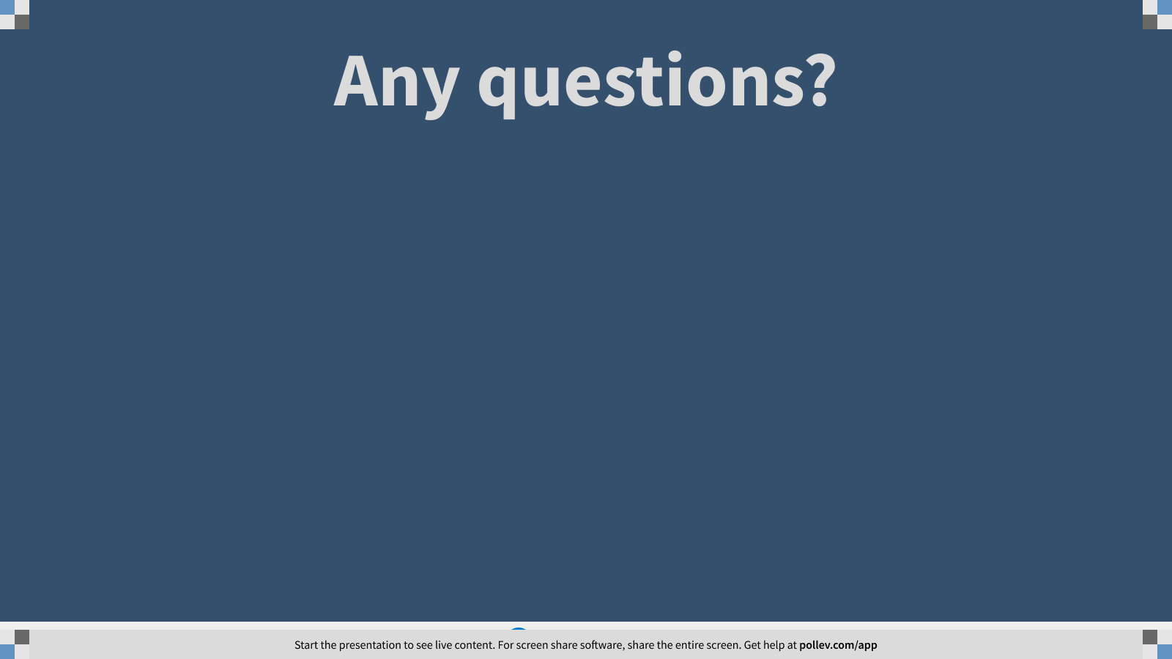
Notes:
Poll Title: Any questions? https://www.polleverywhere.com/free_text_polls/zoLaW6OePjqxIrkpVyo6M

Slide 16
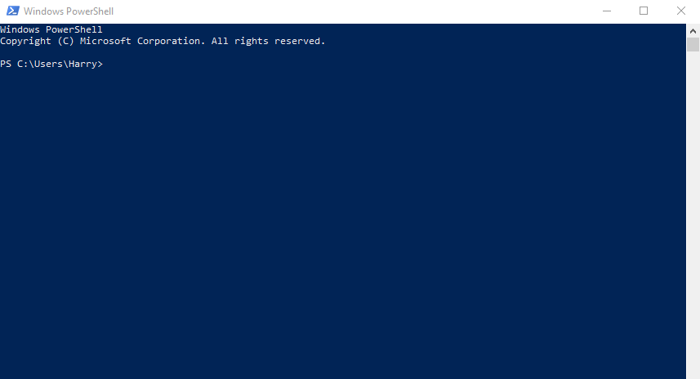
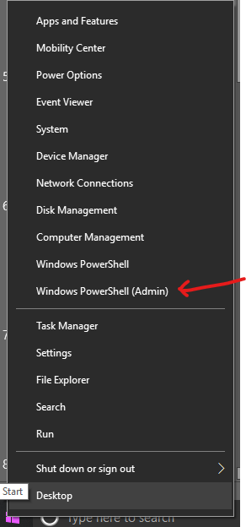
Tools - PowerShell Command Line
Command prompt equivalent for PowerShell
Standard shell as of Windows Server 2019

Slide 17
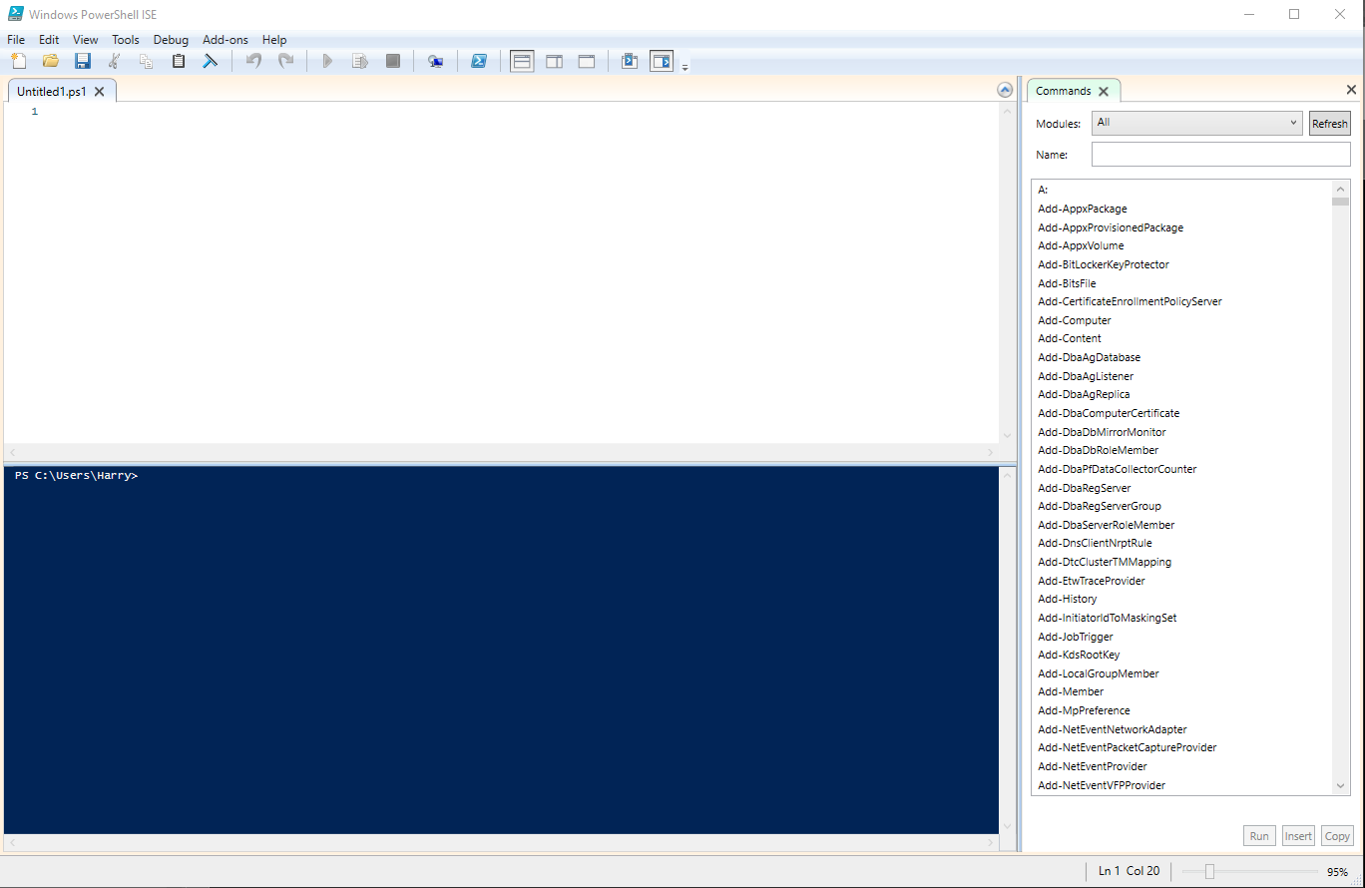
PowerShell Integrated Scripting Environment (ISE)
Part of OS installation with Windows Server 2012+, Windows 10+
Built-in PowerShell command line
Built-in Command browser
Simple UI

Slide 18
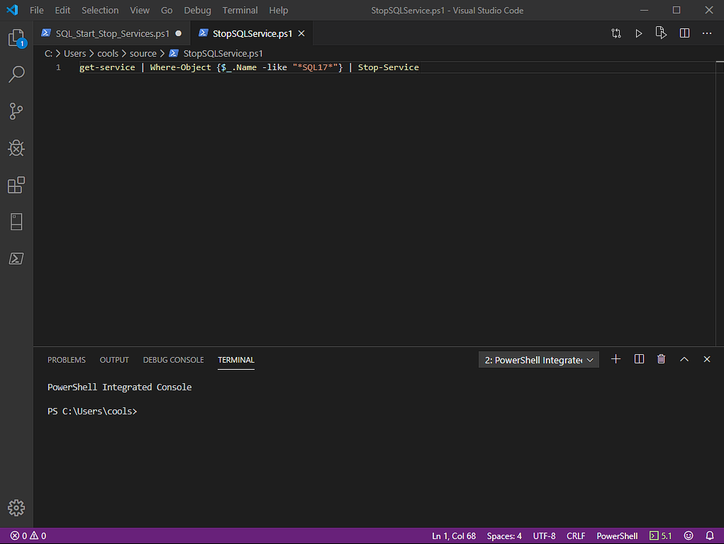
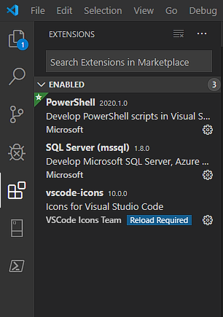
Tools - Visual Studio Code (with PowerShell extension)
Powerful scripting tool
Cross Platform (Windows, Linux, MacOS)
Extensible
Git Integration
Much much more…

Slide 19
Notes:
Poll Title: Any questions? https://www.polleverywhere.com/free_text_polls/zoLaW6OePjqxIrkpVyo6M

Slide 20
Demo
PowerShell 5.1, VS Code, PowerShell ISE

Slide 21
Notes:
Poll Title: Any questions? https://www.polleverywhere.com/free_text_polls/zoLaW6OePjqxIrkpVyo6M

Slide 22
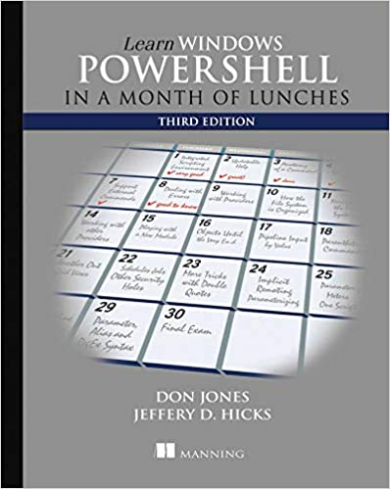
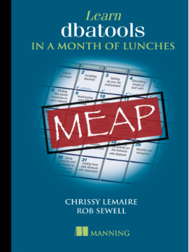
Recommended Books:

Slide 23
Resources
https://docs.microsoft.com/en-us/powershell/scripting/overview?view=powershell-7
https://devblogs.microsoft.com/scripting/ (The Scripting Guy)
https://sqldbawithabeard.com/ (Rob Sewell)
https://www.mssqltips.com/sqlservertip/2516/enable-powershell-remoting-on-sql-server-instances/
https://docs.microsoft.com/en-us/powershell/module/microsoft.powershell.core/about/about_execution_policies?view=powershell-7
https://docs.microsoft.com/en-us/powershell/module/sqlserver/?view=sqlserver-ps
https://docs.microsoft.com/en-us/archive/blogs/daviddasneves/powershell-security-at-enterprise-customers
https://dbatools.io/secure/
https://www.sqlservercentral.com/articles/basic-git-for-dbas-managing-powershell-scripts
https://devblogs.microsoft.com/scripting/get-started-with-powershell-development-in-visual-studio-code/

