Slide 1




Paper Seminar
Presentation #2
BitMoD: Bit-serial Mixture-of-Datatype LLM Acceleration, HPCA 2025
2022142255 SeokChan Jeong

Slide 2
Table of Content
Motivation and background
BitMoD Quantization Framework
BitMoD Hardware Accelerator
Evaluation
2

Slide 3
Motivation and Background
3

Slide 4
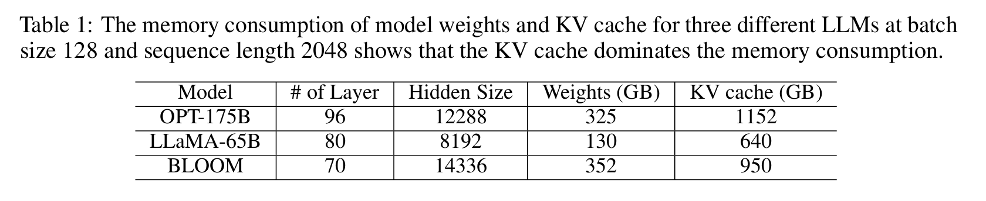
Why Weight Quantization for LLMs?
LLM inference stores two major tensors
Weight
Activation
• Model parameters • Huge memory footprint • Fetched repeatedly during inference
• Intermediate data • Depends on input and batch size • Reuse is limited at small batch
Zichang Liu et al., "Scissorhands: Exploiting the Persistence of Importance Hypothesis for LLM KV Cache Compression at Test Time", NeurIPS 2023.
Batch size = 1 or small batch
Large weight matrices
are repeatedly fetched
Matrix
Multiply
Output
Token
One request / one token step
Activation reuse
is limited
Weight Memory
4
Notes:
LLM 추론에서 weight는 모델 자체의 파라미터이기 때문에 크기가 매우 큽니다. Activation은 현재 입력에 따라 바뀌지만, batch size가 작으면 재사용 기회가 적습니다. 그래서 weight memory footprint와 weight memory traffic을 줄이는 것이 중요합니다.

Slide 5
FP16 → Low-bit Weight Quantization
Main operation: represent the same weight using fewer bits
FP16 Weight
16 bit
→
4 bit
16 bits / weight
≈ 1/4 storage
& memory traffic
Low-bit Weight
4 bits / weight
3 bits / weight
• FP16 → INT4 or FP4: 16-bit weight becomes 4-bit weight. • FP16 → FP3: even smaller memory, but accuracy becomes harder to preserve. • The challenge is to reduce memory while keeping model quality.
Examples
5
Notes:
FP16 weight는 16비트입니다. 이를 INT4나 FP4로 줄이면 weight 저장 용량과 memory traffic이 이론적으로 1/4로 줄어듭니다. 다만 precision이 낮아질수록 quantization error가 커지므로 정확도를 유지하는 것이 핵심입니다.

Slide 6
QAT vs PTQ: Two Quantization Paths
Quantization method determines whether we retrain the model or only convert a trained model.
QAT
Quantization-Aware Training
PTQ
Post-Training Quantization
• The model is trained while quantization error is simulated. • Can achieve higher accuracy because training adapts to quantization noise. • But retraining a large LLM is extremely expensive.
• The model is quantized after it has already been trained. • No full retraining is required, so it is practical for LLM deployment. • Accuracy can drop more than QAT, so better data types are needed.
Retraining: Required
Retraining: Not required
For LLMs
PTQ is generally preferred because retraining full LLMs is too costly.
6
Notes:
QAT는 양자화 오차를 학습 중에 고려하는 방식입니다. 정확도는 좋을 수 있지만 LLM 전체를 다시 학습해야 하므로 비용이 큽니다. PTQ는 이미 학습된 모델을 나중에 양자화하므로 LLM에서 훨씬 현실적입니다.

Slide 7
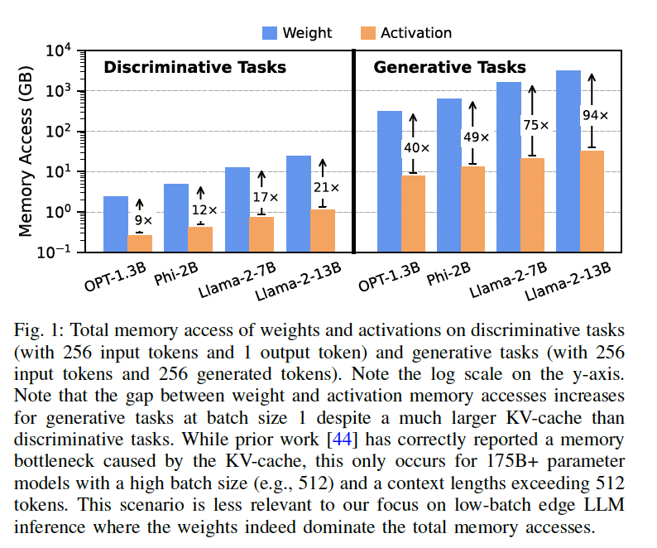
Why Weight-only PTQ is Widely Used
Most LLM quantization work focuses on weights, while keeping activations in FP16.
Operand
Treatment
Reason
Weight
Quantized to low precision
Large memory saving
Activation
Kept as FP16
Preserves accuracy and avoids activation quantization difficulty
Result
Low-precision Weight × FP16 Activation
Good memory-quality trade-off, but creates a compute mismatch
Low-bit
Weight
×
FP16
Activation
→
Memory saving is achieved, but hardware must still compute mixed precision efficiently.
7
Notes:
Weight-only PTQ는 가중치만 저정밀화하고 activation은 FP16으로 유지합니다. 이는 accuracy와 memory saving 사이의 균형이 좋기 때문에 많이 사용됩니다. 하지만 실제 계산은 low-precision weight와 FP16 activation의 mixed precision이 되므로 GPU에서 효율 문제가 생깁니다.

Slide 8
Limitation of Weight-only PTQ on GPUs
Problem: low-bit storage does not automatically mean low-bit compute
Low-Precision
Weight
(INT4 / FP4)
Dequantize
weight to FP16
FP16 Weight
×
FP16 Activation
✕
FP16
Activation
GPU Floating-Point Pipeline
• Weight-only PTQ saves memory, but GPUs often restore low-bit weights to FP16 before computation. • The advantage of low-precision weight is not fully translated into compute efficiency. • BitMoD targets this gap with hardware that directly handles low-precision weight × FP16 activation.
Therefore
8
Notes:
일반 GPU에는 integer 또는 low-precision weight와 FP16 activation을 직접 효율적으로 곱하는 전용 경로가 부족합니다. 그래서 weight-only PTQ는 메모리는 줄일 수 있지만, 실제 계산에서는 weight를 다시 FP16으로 역양자화하고 FP16 pipeline을 사용하는 경우가 많습니다. BitMoD는 이 간극을 해결하려는 논문입니다.

Slide 9
Existing Approaches Before BitMoD
After weight-only PTQ, prior work tried to avoid the “low-bit storage but FP16 compute” problem in different ways.
FIGNA
Microscaling
Integer Weight × Floating-point Activation Goal: compute quantized weights directly, instead of restoring all weights to FP16.
Low-precision group + shared exponent Goal: reduce exponent overhead by sharing scale-like information across several values.
ANT
OliVe
Adaptive Numeric Type Goal: choose a data type that better matches tensor distribution and reduces quantization error.
Outlier-aware value encoding Goal: protect very large outliers by sacrificing small “victim” values.
Common goal: keep the memory benefit of low-bit weights while making the hardware compute path efficient
9

Slide 10
Compare with BitMoD
Existing approaches solve part of the problem, but not all requirements at the same time.
Framework
Per-Group
Flexible Precision
3-bit Accuracy
HW Efficiency
Main Limitation
FIGNA
X
Limited
Low
High
Direct mixed compute, but limited data type / precision scope
ANT
X
Limited
Low
High
Data types are mainly per-channel oriented
OliVe
X
Limited
Mid
High
Outlier protection needs victim values and special handling
Microscaling
O
O
Low
Mid
Shared exponent / FP-like path increases energy cost
BitMoD
O
O
High
High
Target: satisfy all four goals together
Design target
Per-Group Quantization
+
Flexible Bit-width
+
Sub-4-bit Accuracy
+
Efficient Hardware
= BitMoD motivation
10

Slide 11
Quantization Basics
12
Notes:
이제 Quantization Basics입니다. 여기서는 integer quantization의 기본 원리와 symmetric/asymmetric의 차이를 예시 중심으로 설명합니다.

Slide 12

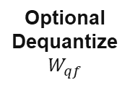
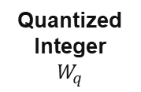
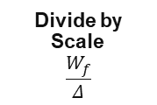
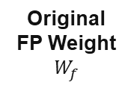
Quantization Basics: Scale + Round
Integer quantization converts continuous FP weights into a small set of low-bit integer levels.
$W_{q}=$Round($\frac{W_{f}}{Δ}$)
$$W_{qf}=W_{q}·Δ$$
Original
FP Weight
$$W_{f}$$
Divide by
Scale
$$\frac{W_{f}}{Δ}$$
Round(·)
Quantized
Integer
$$W_{q}$$
Optional
Dequantize
$$W_{qf}$$
Core trade-off: fewer representable values → smaller memory, but larger quantization error.
Two common integer modes differ in how the real-value range is mapped to integer levels.
Question for this section
When is each mapping good, and what error does it create?
Symmetric
quantization
0-centered grid
Asymmetric
quantization
scale + zero-point
13
Notes:
양자화 기본은 scale로 나누고 round해서 정수 값으로 바꾸는 과정입니다. 이 다음 두 슬라이드에서는 symmetric과 asymmetric이 range를 어떻게 다르게 잡는지 예시로 보겠습니다.

Slide 13




Symmetric Integer Quantization
Assumption: the minimum and maximum values have the same absolute range around 0.
Core equations
Interpretation
$$Δ=\frac{W_{f,max}}{2^{b−1}−1}$$
1. Choose the largest absolute weight value.
2. Divide it by the largest signed integer value.
3. Use that scale Δ to round every floating-point weight.
4. Optionally multiply back by Δ for dequantization.
$$W_{q}=Round\left(\frac{W_{f}}{Δ}\right)$$
4-bit signed range
$$\{−7,−6,…,0,…,+6,+7\}$$
$$W_{qf}=W_{q}⋅Δ$$
Real zero maps to integer zero, so no zero-point metadata is needed.
Limitation: if the weight distribution is skewed, many integer levels may be wasted.
14

Slide 14



Symmetric Quantization Example
Example: 4-bit signed integer, |W|max = 3.5, and one original weight Wf = 1.2.
Step 1. Scaling factor
Step 2. Quantize one weight
$$Δ=\frac{3.5}{2^{4−1}−1}=\frac{3.5}{7}=0.5$$
$$W_{q}=Round\left(\frac{1.2}{0.5}\right)=Round\left(2.4\right)=2$$
Step 3. Optional dequantization
$$W_{qf}=2×0.5=1.0$$
Original
1.2
Divide
1.2/0.5
Round
2.4→2
Wq
=2
Wqf
=1.0
Result: 1.2 is approximated as 1.0, so the quantization error is 0.2.
15

Slide 15




Asymmetric Integer Quantization
Asymmetric quantization does not force the range to be centered at zero. It adds a zero-point z.
Core equations
What does zero-point do?
$$Δ=\frac{Range\left(W_{f}\right)}{2^{b}−1}$$
z is the integer location that represents real 0.
This allows the integer grid to shift with the actual tensor range instead of forcing symmetry.
$$z=Round\left(\frac{−W_{f,min}}{Δ}\right)$$
$$W_{q}=Round\left(\frac{W_{f}}{Δ}\right)+z$$
Example mapping idea
min
0
max
$$W_{qf}=\left(W_{q}−z\right)⋅Δ$$
0
z
15
Better fit for skewed / asymmetric weight groups.
16

Slide 16



Asymmetric Quantization Example
Example: real range [-1.0, 3.0], 4-bit unsigned integers [0, 15], and Wf = 1.3.
Step 1. Compute scale
Step 2. Compute zero-point
$$Δ=\frac{3.0−\left(−1.0\right)}{2^{4}−1}=\frac{4.0}{15}≈0.2667$$
$$z=Round\left(\frac{1.0}{0.2667}\right)=4$$
Step 3. Quantize one weight
Meaning
$$W_{q}=Round\left(\frac{1.3}{0.2667}\right)+4$$
The +z term shifts the rounded value so that the integer grid aligns with the real range.
Therefore Wf = 1.3 becomes integer 9.
$$=Round\left(4.875\right)+4=5+4=9$$
Zero-point mapping
-1.0
0
1.3
3.0
0
4
9
15
17

Slide 17
Symmetric vs Asymmetric: Summary
The key difference is whether the integer grid is fixed around zero or shifted using a zero-point.
Aspect
Symmetric
Asymmetric
Integer range
Signed, centered at 0
Usually unsigned with zero-point
Metadata
Only scale Δ
Scale Δ + zero-point z
Best case
Balanced distribution
Skewed / shifted distribution
Trade-off
Simple, low metadata
Better fit, more metadata
Symmetric
Asymmetric
$$W_{q}=Round\left(\frac{W_{f}}{Δ}\right)$$
$$W_{q}=Round\left(\frac{W_{f}}{Δ}\right)+z$$
Connection to BitMoD: LLM weight groups are often locally asymmetric, so BitMoD later keeps the benefit of asymmetry using FP3/FP4 special values.
18

Slide 18

Quantization Granularity: What Shares One Scale?
Granularity decides how many weights share the same scaling factor Δ.
Weight tensor view
Three options
$$W_{f}∈ℝ^{K×D}$$
Granularity
What shares Δ?
Scope of outlier
K = number of output channels
D = number of weights in each channel
Per-Tensor
Whole tensor
Whole tensor
Per-Channel
One channel
Same channel
Ch. 1
w1
w2
w3
w4
w5
w6
w7
w8
K = 2
Per-Group
Small group
Only that group
Ch. 2
w1
w2
w3
w4
w5
w6
w7
w8
D = 8
Smaller sharing scope → less outlier impact
But: more scale metadata to store
19

Slide 19




Per-Tensor Quantization: One Outlier Affects Everything
Per-Tensor uses one scaling factor for the entire weight tensor.
MD example weight tensor
Effect on a small weight
Take a normal small weight from the tensor:
Ch. 1
0.2
-0.3
0.4
-0.1
0.1
-0.2
0.3
4.0
$$W_{f}=0.3$$
Ch. 2
0.5
-0.4
0.2
-0.1
0.6
-0.5
0.4
-0.3
$$W_{q}=Round\left(\frac{0.3}{0.5714}\right)=1$$
4.0 is the absolute maximum, so the whole tensor must use a large Δ.
$$W_{qf}=1×0.5714=0.5714$$
$$Δ=\frac{4.0}{2^{4−1}−1}=\frac{4.0}{7}≈0.5714$$
0.3 is approximated as 0.5714
Error ≈ 0.2714
20

Slide 20

Per-Channel Quantization: Better, But Still Coarse
Per-Channel assigns a separate scaling factor to each output channel.
Each channel has its own Δ
Remaining problem
Per-Channel prevents the outlier from affecting other channels.
But within Channel 1, every weight still uses:
Ch. 1
0.2
-0.3
0.4
-0.1
0.1
-0.2
0.3
4.0
→ Δ₁
Ch. 2
0.5
-0.4
0.2
-0.1
0.6
-0.5
0.4
-0.3
→ Δ₂
$$Δ_{1}=\frac{4.0}{7}≈0.5714$$
Therefore 0.2, −0.3, 0.4, −0.1 in the same channel are still affected by the 4.0 outlier.
Channel
Abs. max
Scale
Ch. 1
4.0
0.5714
Ch. 2
0.6
0.0857
Channel-level is better than tensor-level, but too coarse for large LLM hidden dimensions.
21

Slide 21

Per-Group Quantization: Limit the Outlier Impact
Per-Group splits each channel into smaller groups, and each group gets its own scaling factor.
General rule
MD example: Channel 1, G = 4
$$Groups/channel=\frac{D}{G}$$
G1
0.2
-0.3
0.4
-0.1
→ Δ₁ = 0.4/7 ≈ 0.0571
G = group size.
Recent LLM quantization frameworks often use G = 128 to balance accuracy and metadata overhead.
G2
0.1
-0.2
0.3
4.0
→ Δ₂ = 4.0/7 ≈ 0.5714
Group 1
Δ₁
Group 2
Δ₂
Group 1 can use a much smaller scale, because the 4.0 outlier is only in Group 2.
Outlier is contained in the group where it exists.
Key idea: Per-Group improves accuracy by reducing the maximum value/range inside each quantized block.
22

Slide 22






Same Weight, Different Granularity
Compare the same weight Wf = 0.3 when it belongs to Group 1.
Per-Tensor
Per-Channel
Per-Group
$$Δ=0.5714$$
$$Δ=0.5714$$
$$Δ=0.0571$$
$$W_{q}=Round\left(\frac{0.3}{0.5714}\right)=1$$
Channel 1 still contains the 4.0 outlier.
$$W_{q}=Round\left(\frac{0.3}{0.0571}\right)=5$$
$$W_{qf}=0.5714$$
$$W_{qf}=0.5714$$
$$W_{qf}=5×0.0571≈0.2855$$
Error ≈ 0.2714
Error ≈ 0.2714
Error ≈ 0.0145
Method
Scale Δ
Approx. value
Error
Per-Tensor
0.5714
0.5714
0.2714
Per-Channel
0.5714
0.5714
0.2714
Per-Group
0.0571
0.2855
0.0145
23

Slide 23


Why Smaller Scaling Factor Helps
The quantization error is proportional to the scaling factor Δ. Smaller Δ means denser representable values.
Error relation
Scale spacing intuition
$$Error\left(W_{qf}\right)={Error}_{Round}\left(\frac{W_{f}}{Δ}\right)⋅Δ$$
Large Δ = sparse grid
0
0.5
1
1.5
$$Quantization Error∝Δ$$
Small Δ = dense grid
Rounding error is unavoidable, but multiplying it by a large Δ makes the final dequantized error larger.
0
0.1
0.2
0.3
0.4
0.5
Therefore, reducing the local max/range is directly useful.
Trade-off: Per-Group needs more scale metadata, but group size 128 is used to balance accuracy and overhead.
24

Slide 24
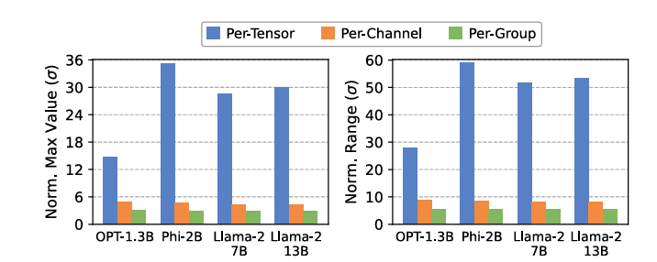
Motivation Takeaway: Why BitMoD Focuses on Per-Group
Granularity determines the accuracy–metadata trade-off before introducing BitMoD’s new data types.
Per-Tensor
Per-Channel
Per-Group
One Δ for whole tensor
One Δ per output channel
One Δ per small group
Outlier affects every weight
Outlier affects the same channel
Outlier is localized
Low metadata, low accuracy
Middle ground
Higher metadata, best accuracy
BitMoD direction: use Per-Group Quantization for accuracy, then design hardware to make per-group dequantization efficient.
25

Slide 25
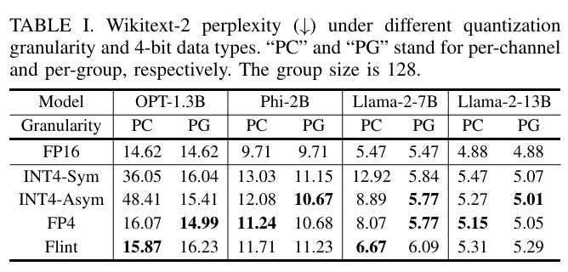
Quantization Data Type Matters: Same 4-bit, Different Error
Even with the same 4-bit precision, the data type changes quantization levels, error pattern, and perplexity.
INT4-Sym
INT4-Asym
FP4
Flint
Zero-centered integer range
Simple, but rigid
Integer + zero-point
Better for shifted range
Floating-point levels
Dense near zero
Power-of-two-like levels
Hardware-friendly
… -2 -1 0 +1 +2 …
zero-point z shifts range
0, ±0.5, ±1, ±2, ±4…
levels chosen for cheap compute
Result 1
Flint is strong in some PC cases, but not consistently best in PG.
Result 2
INT4-Asym and FP4 are strong in PG → FP + asymmetry are both useful.
26

Slide 26
Why FP and Asymmetry Help Per-Group Quantization
BitMoD combines two observations: LLM weights are Gaussian-like, and small groups can be asymmetric.
1. Floating Point
2. Asymmetry
Gaussian-like weight distribution
One-sided group outlier
density
density
Weight value
Weight value
Many weights are concentrated near zero.
FP levels can be denser around small magnitudes than uniform integers.
A small weight group can have a positive or negative outlier on only one side.
Symmetric levels waste range on the empty side.
Small values need finer resolution
Use range where the group needs it
27

Slide 27


BitMoD Insight: Reuse Redundant Zero as a Special Value
Low-precision floating point uses sign-magnitude, so +0 and −0 are two bit patterns for the same numerical zero.
Basic FP3 unique values
BitMoD replacement
Basic FP3
0, ±1, ±2, ±4
$$\{0,±1,±2,±4\}$$
3-bit gives 8 bit patterns, but +0 and −0 both represent numerical zero.
Replace redundant −0
with one Special Value
$$\frac{1}{8}=12.5\%$$
In FP3, one out of eight patterns is redundant zero.
This is too expensive to waste.
Example
0, ±1, ±2, ±4, +6
Special Value can improve resolution or extend one-sided range for each weight group.
28

Slide 28
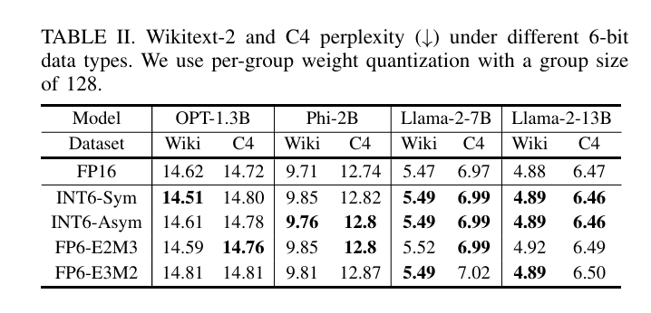
Quantization Bit-width Matters: 8/4-bit Is Not Enough
Different bit-widths provide different accuracy–efficiency trade-offs. 6-bit is important, and 3-bit needs better data types.
6-bit can be almost lossless
Precision choice should be flexible
High accuracy
6-bit
near FP16 quality
Compression
4-bit
balanced quality/cost
Minimum memory
3-bit
needs new data type
INT6-Sym average PPL loss is reported as < 0.05.
So 6-bit is a useful middle point between 8-bit and 4-bit.
Fixed 8/4-bit hardware cannot fully exploit this trade-off.
29

Slide 29
Bit-Serial Architecture: Flexible Precision by Term Count
A bit-serial design can use one PE structure while changing the number of processed terms by precision.
Bit-Parallel limitation
Bit-Serial idea
Hardware datapath is often specialized for fixed precision.
Data Type
Bit-serial Terms
INT8
4
INT8
INT4
?
INT6
3
FP4
2
6-bit and 3-bit are awkward to support efficiently.
FP3
2
Lower precision → fewer terms → fewer cycles.
The same PE can support multiple bit-widths by changing term count.
Good for common fixed widths, but less flexible.
This motivates BitMoD’s unified bit-serial representation.
30

Slide 30

But Existing Bit-Serial Accelerators Are Not Enough
Bit-serial flexibility alone does not solve LLM quantization. Two missing pieces remain.
Problem 1. Mostly integer data types
Problem 2. Per-Group dequantization cost
Each group has a different scaling factor:
Existing bit-serial accelerators are mainly designed around integer representation.
$$Δ_{1}, Δ_{2}, Δ_{3}, …$$
So every group partial sum must be dequantized separately.
At 3-bit, simple integer levels can cause large accuracy loss.
FP scale requires FP unit → area/energy overhead.
Need: FP/asymmetric data type suitable for local group distribution.
31

Slide 31
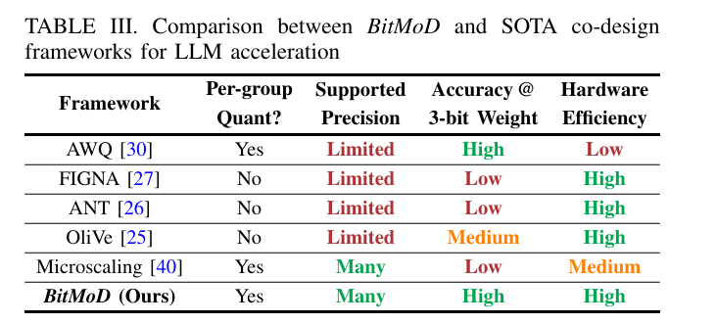
Motivation Summary: What BitMoD Must Satisfy
Existing frameworks satisfy only part of the requirement. BitMoD is motivated by satisfying all four together.
Core motivation
Design the quantization format and the accelerator together, so low-bit weights reduce both memory traffic and actual compute cost.
32

Slide 32
BitMoD Quantization Framework
33

Slide 33


A. Asymmetric FP3
Because sign-magnitude FP stores +0 and −0 as different bit patterns, one quantization level is duplicated.
3-bit sign-magnitude pattern view
Actual unique FP3 values
Example conceptual FP3 encoding
$$\{0,±1,±2,±4\}$$
S
E/M
Stored
Value
0
00
+0
0
two patterns
same value 0
$$2^{3}=8$$
Total bit patterns
1
00
−0
0
0
01
+1
+1
1
01
−1
−1
Unique numeric levels
7 levels
0
10
+2
+2
1
10
−2
−2
0
11
+4
+4
BitMoD turns the wasted −0 pattern into one useful Special Value.
1
11
−4
−4
34

Slide 34
From Redundant −0 to Special Value
BitMoD uses the redundant negative zero pattern as an extra quantization level selected for each weight group.
Before: Basic FP3
After: Extended FP3
+0 and −0 both map to 0
−0 encoding is reinterpreted as a Special Value
SV
−4
−1
+1
+4
−4
−1
+1
+3
−2
0
+2
−2
0
+2
+4
Only 7 unique values are available, even though there are 8 bit patterns.
The group now has 8 useful quantization levels.
Important: the Special Value is not chosen in this figure; it is defined here as a candidate and later selected per group by Algorithm 1.
35

Slide 35


FP3-ER: Extended Resolution
ER adds a Special Value inside the original FP3 range, making the value grid denser.
Basic FP3
FP3-ER
Range stays:
$$\left[−4,+4\right]$$
Special Value:
$$\text{SV}=±3$$
SV
SV
−4
−1
+1
+4
−4
−2
0
+2
+4
−2
0
+2
−3
−1
+1
+3
Notice the empty space between +2 and +4.
Purpose: improve quantization resolution
without changing the maximum range.
Useful for symmetric, Gaussian-like weight groups.
36

Slide 36

FP3-EA: Extended Asymmetry
EA adds a Special Value outside the original FP3 range, allowing one side to represent a larger value.
Basic FP3
FP3-EA (+6 example)
Special Value:
$$\text{SV}=±6$$
SV
−4
−1
+1
+4
−4
−1
+1
+4
−2
0
+2
−2
0
+2
+6
Negative Range → −4
Positive Range → +4
Negative Range → −4
Positive Range → +6
Purpose: represent one-sided outliers
or shifted weight groups.
37

Slide 37
ER vs EA: Different Special Values for Different Weight Groups
8
BitMoD prepares both resolution-oriented and asymmetry-oriented extensions.
Type
Special Value
Range Change
Best for
FP3-ER
±3
Range X
Dense / Gaussian-like group
FP3-EA
±6
Extend Range
Asymmetric outlier group
ER intuition
EA intuition
SV
SV
SV
SV
−4
−2
0
+2
+4
−4
−1
+1
+4
−3
−1
+1
+3
-6
−2
0
+2
+6
Adds missing levels inside the same range.
Extends the range toward the outlier side.
The same basic FP3 can become ER or EA depending on the selected Special Value.
38

Slide 38

FP4 Extension: Same Idea, More Levels
BitMoD applies the same redundant-zero reuse idea to FP4.
Basic FP4 values
BitMoD FP4 Special Values
$$\{0,±0.5,±1,±1.5,±2,±3,±4,±6\}$$
Extended Dtype
Special Value
Role
FP4-ER
−5 or +5
Resolution Extend
Basic FP4 already has more representable values than FP3, including fractional levels such as ±0.5 and ±1.5.
FP4-EA
−8 or +8
Asymmetry Extend
±5 fills the gap between ±4 and ±6.
−6
−1.5
.5
3
−4
−1
1
4
±8 extends the dynamic range beyond ±6.
−3
−.5
1.5
6
−2
0
2
39

Slide 39
Final Candidate Data Types Used by BitMoD
At this point, BitMoD has defined four Special Value candidates for each precision. The next section chooses one per group.
Basic Dtype
Extended Dtype
Special Value
Purpose
FP3
FP3-ER
−3 or +3
Resolution Extend
FP3
FP3-EA
−6 or +6
Asymmetry Extend
FP4
FP4-ER
−5 or +5
Resolution Extend
FP4
FP4-EA
−8 or +8
Asymmetry Extend
Important distinction
Next: Fine-grained Adaptation
This section defines candidate data types.
It does not yet decide which one a group uses.
Algorithm 1 tests these candidates per group and selects the one with the lowest MSE.
Core message: BitMoD combines FP’s Gaussian-like representation with asymmetric special values using a hardware-friendly encoding.
40

Slide 40
B. Fine-grained Data Type Adaptation: Motivation
Asymmetric FP3/FP4 defines candidate Special Values. Fine-grained adaptation decides which one each weight group should use.
Previous section: candidate values
Fine-grained adaptation
Same tensor, different local distributions
Precision
Basic Values
Special Values
Group A
balanced
SV ±3
FP3
{0, ±1, ±2, ±4}
{-3, +3, -6, +6}
Group B
positive outlier
SV +6
FP4
{0, ±0.5, ±1, ±1.5, ±2, ±3, ±4, ±6}
{-5, +5, -8, +8}
Group C
negative outlier
SV −6
However, one group does not use all four Special Values.
It selects only one.
Not only the scaling factor, but also the data type is adapted per group.
41

Slide 41


Algorithm 1: Search the Best Special Value
For each weight group, BitMoD tries every candidate Special Value and chooses the one with the smallest MSE.
Input
W, p
Get candidate
SVs
Quantize
with each SV
Compute
MSE
Choose
min MSE
Input / Output
Core objective
$$W,p→\left(W_{qout},v_{out}\right)$$
$$v_{out}=arg\min_{v∈𝒱_{SV}}MSE\left(W,W_{q}^{\left(v\right)}\right)$$
Output contains both quantized weights and the selected SV.
Choose the Special Value that minimizes quantization error.
Key idea: exhaustive candidate search is simple because there are only 4 Special Values per precision.
42

Slide 42


Non-linear Quantization and Error Measurement
Because FP3/FP4 levels are not equally spaced like integers, BitMoD uses non-linear quantization and evaluates MSE.
Non-linear levels
Error criterion
For each candidate, compare the original group W and the quantized group Wq.
FP3-EA(+6) example
SV
$$MSE\left(W,W_{q}\right)=\frac{1}{N}\sum_{i=1}^{N}{{\left(W_{i}−W_{q,i}\right)}^{2}}$$
0
+6
Spacing is uneven: −4, −2, −1, 0, +1, +2, +4, +6
Small MSE means the quantized levels fit the current group better.
$$W_{q}=NonLinearQuantize\left(W,𝒬_{v}\right)$$
Algorithm 1 chooses the SV with the smallest MSE.
43

Slide 43


Numerical Example: Selecting +6 for a Positive Outlier Group
This group has a large positive weight 5.7, so the +6 candidate fits best.
Weight group
$$W=\left[−0.8, 0.3, 1.1, 2.2, 3.8, 5.7\right]$$
MSE comparison
Decision
$$v_{out}=+6$$
Special Value
Data Type Meaning
MSE
−3
Negative resolution
0.42
Final quantization level set for this group:
+3
Positive resolution
0.31
$$\{0,±1,±2,±4,+6\}$$
−6
Negative range expansion
0.57
This is FP3-EA(+6), which expands the positive side to represent the outlier.
+6
Positive range expansion
0.08
If the outlier were negative, −6 could be selected instead; if the group were balanced, ±3 may be better.
44

Slide 44


C. Quantized weights need dequantization
Quantized weight values are integer / low-bit codes, not the final real-valued weights used in computation.
Quantized Weight
Scaling Factor
Dequantization
Recovered
Wq = 3
Δ = 0.2
Wq × Δ
0.6
General formula
Small numeric example
$$W_{qf}=W_{q}Δ$$
$$W_{q}=3, Δ=0.2 ⇒ W_{qf}=3×0.2=0.6$$
scale must be applied after quantization
same idea used for group partial sums
Core intuition
Quantization saves memory, but dequantization is still needed somewhere in the hardware datapath.
45

Slide 45



Per-channel dequantization is simple
In per-channel quantization, every weight in the same channel shares one scaling factor.
Example
Why this is hardware-friendly
$$W_{q}=\left[2,−1,3,1\right], A=\left[1.0,2.0,0.5,1.5\right], Δ=0.2$$
Wq · A
Sum
Scale
partial products
P = 3
× Δ
$$P=2\left(1.0\right)+\left(−1\right)\left(2.0\right)+3\left(0.5\right)+1\left(1.5\right)=3$$
Only one scaling factor exists for the entire channel, so the re-scaling can be delayed until after accumulation.
$$Y=PΔ=3×0.2=0.6$$
No per-group scale switching
No repeated floating-point re-scaling
Accumulator can work on one shared scale
Compute dot-product first → apply one scale once.
46

Slide 46





Per-group dequantization cannot be postponed
In per-group quantization, one channel is split into groups, and each group has a different scaling factor.
Group 1
Final output
$$W_{q}=\left[2,−1\right], Δ_{1}=0.1$$
$$Y=P_{1}Δ_{1}+P_{2}Δ_{2}=0+1.2=1.2$$
$$P_{1}=2\left(1.0\right)+\left(−1\right)\left(2.0\right)=0, P_{1}Δ_{1}=0$$
Different groups use different scales, so P1 and P2 must be scaled separately.
Cannot use one final scale after merging all groups
Group 2
$$W_{q}=\left[3,1\right], Δ_{2}=0.4$$
Scaling factor quantization
$$P_{2}=3\left(0.5\right)+1\left(1.5\right)=3, P_{2}Δ_{2}=1.2$$
47

Slide 47





Scaling factor quantization: detailed example
Step 1. Original group scales
Step 2. Build ΔSF
Step 3. Convert to INT8
$$\left[Δ_{1},Δ_{2},Δ_{3},Δ_{4}\right]=\left[0.10,0.21,0.32,0.40\right]$$
$$SF_{q,1}=Round\left(\frac{0.10}{0.00315}\right)≈32$$
$$Δ_{SF}=\frac{0.40}{127}≈0.00315$$
$$\left[SF_{q,1},SF_{q,2},SF_{q,3},SF_{q,4}\right]=\left[32,67,102,127\right]$$
The largest scale is 0.40.
127 is the positive maximum of signed INT8 symmetric quantization.
$$Δ_{g}≈SF_{q,g}Δ_{SF}$$
Example: 32 × 0.00315 ≈ 0.1008 ≈ 0.10
48

Slide 48

Rewriting dequantization for hardware
Once Δg is approximated as SFq,g × ΔSF, the common factor can be moved outside the group summation.
Mathematical transformation
Hardware view
$$Y=P_{1}Δ_{1}+P_{2}Δ_{2}+P_{3}Δ_{3}+P_{4}Δ_{4}$$
P1
SF1
×
FP partial
INT8
bit-serial
$$Δ_{g}≈SF_{q,g}Δ_{SF}$$
repeat for P2, P3, P4 ...
$$Y≈Δ_{SF}\left(P_{1}SF_{q,1}+P_{2}SF_{q,2}+P_{3}SF_{q,3}+P_{4}SF_{q,4}\right)$$
Sum and apply ΔSF once
common scale
Group-specific multiplication now uses INT8 SFq,g, not FP16 Δg.
This is why scaling factor quantization is connected to the BitMoD hardware design.
49

Slide 49
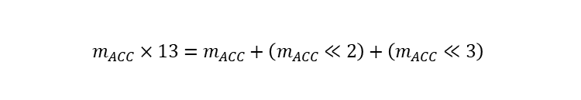

Why INT8 scales are bit-serial friendly
An INT8 scale can be consumed one bit per cycle and implemented with shift-and-add rather than a full FP multiplier.
Example: INT8 scale = 13
Shift-and-add form
$$13={00001101}_{2}=8+4+1$$
$$m_{ACC}×13=m_{ACC}+\left(m_{ACC}≪2\right)+\left(m_{ACC}≪3\right)$$
Active bits are 0, 2, and 3.
Cycle-wise interpretation
0
0
0
0
1
1
0
1
bit0 = 1 → use mACC
bit1 = 0 → skip
bit2 = 1 → use mACC << 2
bit3 = 1 → use mACC << 3
bit7 ... bit0
The example scale 13 is illustrative; the paper uses INT8 per-group scaling factors generally.
50

Slide 50
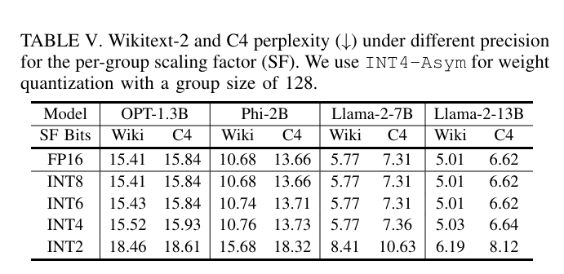
Why BitMoD chooses INT8 scaling factors
The paper sweeps scaling-factor precision under INT4-asymmetric per-group quantization with group size 128.
Observation 1
Observation 2
Observation 3
INT8 matches FP16 exactly in the table.
INT6 / INT4 are close, but not identical.
INT2 hurts perplexity significantly.
51

Slide 51




Channel size, group size, and metadata overhead
BitMoD stores one INT8 scaling factor and one 2-bit Special Value ID per group.
How many groups per channel?
Metadata per group
Overhead vs weight bits
$$\frac{D}{G}=\frac{4096}{128}=32 groups/channel$$
$$8 bits+2 bits=10 bits/group$$
$$\frac{10}{128×3}×100≈2.6\%$$
Example from the MD file
8-bit INT8 scale
+
2-bit SV ID
=
10 bits / group
$$\frac{10}{128×4}×100≈1.95\%$$
Channel size D = 4096
Group size G = 128
One channel has 32 groups.
Each group has its own INT8 scaling factor.
With G = 128, metadata overhead is small compared with the weight storage.
52

Slide 52
BitMoD Harware Accelerator
53

Slide 53
A. Unified Bit-serial Representation
BitMoD hardware should support multiple weight formats in a single accelerator without losing low-bit compute efficiency.
INT8
high accuracy
INT6
accuracy-cost tradeoff
FP4
compression
FP3
high efficiency
Problem 1: different representation
Problem 2: naïve solutions fail
BitMoD answer
INT8 / INT6
→ Integer Representation
Separate operators
INT / FP → common term
→ hardware area and complexity increase
Sign | Exp | Man | Bsig
FP4 / FP3
→ Floating-Point Representation
Convert all to INT8
Same PE, fewer terms for lower precision
→ FP3/FP4 lose low-bit compute benefit
54

Slide 54

Unified Bit-serial Term: the common language for all data types
Every supported weight is decomposed into one or more terms with the same four fields.
Field
Meaning
Role inside PE
Term value
Sign
value sign
positive / negative contribution
$$V_{term}={\left(−1\right)}^{sign}·2^{exp}·man·2^{bsig}$$
Exp
exponent
power-of-two scale inside the term
W = T1 + T2 + ⋯ + Tn
Man
mantissa
whether the term is active
Bsig
bit-significance
original bit position / shift amount
Core intuition
Lower bit-width → fewer bit-serial terms → fewer PE cycles
So quantization reduces not only memory footprint, but also the amount of computation.
INT8, 6
Unified Term
BitMoD PE
FP4, 3
same PE
55

Slide 55
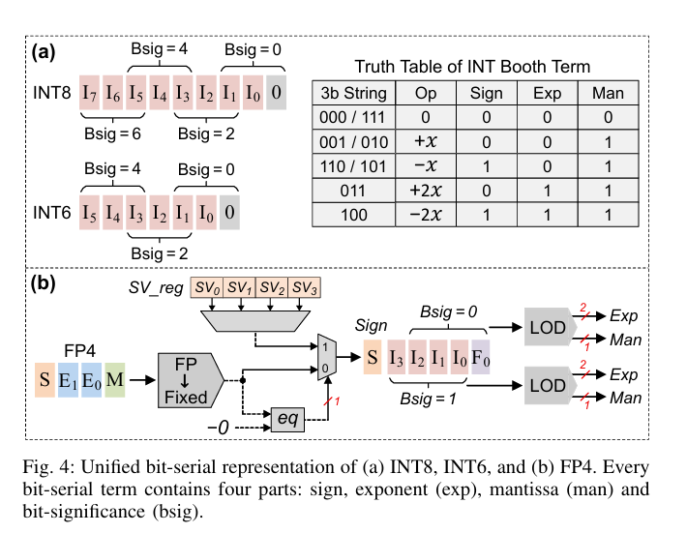
Figure 4 Overview: two decoders, one output format
INT formats and FP formats enter different front-end decoders, but both produce Sign / Exp / Man / Bsig terms.
Figure 4(a): INT8 / INT6
Booth Encoding decomposes integer binary strings into 3-bit Booth strings.
Figure 4(b): FP4 / FP3
FP → Fixed conversion + redundant −0 handling + LOD creates at most 2 terms.
Final output of both paths
Unified Bit-serial Terms: Sign | Exp | Man | Bsig
INT8
4 terms
INT6
3 terms
FP4
≤2 terms
FP3
≤2 terms
56

Slide 56
Case 1 — INT8: Booth Encoding creates 4 terms
INT8 has 8 binary bits, so radix-4 Booth encoding produces four 3-bit Booth strings with Bsig = 0, 2, 4, 6.
Example: INT8 weight 45
Result
45 → 00101101₂
0
0
1
0
1
1
0
1
45 = +64 −16 −4 +1
I7
I6
I5
I4
I3
I2
I1
I0
Each contribution becomes one unified bit-serial term.
Booth terms generated from LSB side
Term
Sign
Exp
Man
Bsig
+x·2⁶
0
0
1
6
Booth string
Op
Bsig
Contribution
−x·2⁴
1
0
1
4
010
+x
0
+1
−x·2²
1
0
1
2
110
−x
2
−4
+x·2⁰
0
0
1
0
101
−x
4
−16
INT8 → 4 cycles for 4 bit-serial terms
001
+x
6
+64
57

Slide 57
Case 2 — INT6: same Booth Encoding, fewer terms
INT6 uses the same Booth decoder as INT8, but the shorter bit-width reduces the number of terms from four to three.
Example: INT6 weight 21
Result
21 = +16 +4 +1
21 → 010101₂
0
1
0
1
0
1
I5
I4
I3
I2
I1
I0
Only three terms are required because INT6 has three radix-4 groups.
Booth terms
Data Type
Bsig values
Terms
INT8
6, 4, 2, 0
4
Booth string
Op
Bsig
Contribution
INT6
4, 2, 0
3
010
+x
0
+1
010
+x
2
+4
Takeaway: lower integer precision directly reduces bit-serial cycles.
010
+x
4
+16
58

Slide 58
Booth Truth Table: how INT bits become Sign / Exp / Man
A 3-bit Booth string is decoded into one of five simple operations: 0, +x, −x, +2x, −2x.
Example 1: 011
3-bit String
Operation
Sign
Exp
Man
011 → +2x
000 / 111
0
0
0
0
001 / 010
+x
0
0
1
Sign = 0, Exp = 1, Man = 1
110 / 101
−x
1
0
1
011
+2x
0
1
1
Example 2: 100
100
−2x
1
1
1
100 → −2x
Sign = 1, Exp = 1, Man = 1
Bsig is the second scale inside the term
$$V_{term}={\left(−1\right)}^{Sign}×2^{Exp}×Man×2^{Bsig}$$
Same +x has different contribution when Bsig changes: +x·2⁰, +x·2², +x·2⁴, ...
59

Slide 59
Case 3 — FP4: FP → Fixed, then LOD
FP4 cannot use the integer Booth path directly, so BitMoD first converts FP4 to a sign-magnitude fixed-point value.
FP4 input format
Why these bits?
I₃ is needed for FP4-EA special value ±8.
S
E₁
E₀
M
S
I₃
I₂
I₁
I₀
F₀
F₀ is needed for values such as ±0.5 and ±1.5.
8 4 2 1 0.5
Example: FP4 value 6
Example: FP4 value 1.5
6 = 4 + 2
0
0
1
1
0
0
1.5 = 1 + 0.5
0
0
0
0
1
1
S | I₃ I₂ I₁ I₀ | F₀
S | I₃ I₂ I₁ I₀ | F₀
60

Slide 60
Case 4 — FP4 Special Value: −0 triggers SV_reg
The redundant negative-zero encoding is not treated as zero; it becomes a group-specific Special Value selected by metadata.
Stored FP4
−0 pattern
eq
TRUE
Group metadata
2 bits
SV_reg
SV0..SV3
Selected
SV
Example mapping in FP4
Important distinction
Algorithm 1 already selected the best SV offline.
2-bit ID
Selected SV
00
−5
Figure 4 only uses the stored metadata to choose one value from SV_reg.
01
+5
10
−8
No MSE search happens inside this decoder.
11
+8
61

Slide 61
Case 5 — LOD converts FP4 fixed value into at most two terms
Extended FP4 values have at most two 1-bits after fixed-point conversion, so two LOD blocks are enough.
Example: +6
Example: +1.5
S
I₃
I₂
I₁
I₀
F₀
S
I₃
I₂
I₁
I₀
F₀
0 | 0 1 1 0 | 0
0 | 0 0 0 1 | 1
LOD finds I₂ and I₁ → Term 1 = 4, Term 2 = 2
LOD finds I₀ and F₀ → Term 1 = 1, Term 2 = 0.5
Why two LOD blocks?
LOD 1 checks {I₃, I₂, I₁, I₀}
LOD 2 checks {I₂, I₁, I₀, F₀}
Each detected 1-bit becomes a Sign / Exp / Man term sent to the PE.
62

Slide 62
Case 6 — FP3: reuse the FP4 decoder
Extended FP3 values are a subset of the values representable by the FP4 fixed-point decoder.
Basic FP3
FP3 Special Values
{0, ±1, ±2, ±4}
FP3-ER: ±3 FP3-EA: ±6
Example: +4 → fixed bits 0 | 0 1 0 0 | 0 → one active term
Example: +6 → same FP4 fixed path → 4 + 2
Hardware implication
No separate FP3 decoder is needed.
FP3 and FP4 share the same FP → Fixed + LOD hardware and both produce at most 2 terms.
63

Slide 63
Programmable Special Value: fixed hardware, flexible candidate values
SV_reg does not have to permanently store only one hard-coded set of values; it can be programmed for the target model.
Default candidates in the paper
Example: if SV = 7 is desired
Naïve decomposition
Precision
SV candidates
7 = 4 + 2 + 1 → 3 terms
FP3
−3, +3, −6, +6
FP4
−5, +5, −8, +8
Optimized decomposition
7 = 8 − 1 → 2 terms
These four choices are selected so only 2-bit metadata is needed per group.
The decoder can be slightly modified to keep the number of bit-serial terms small.
64

Slide 64
Unified Representation Summary
The purpose of Figure 4 is to make every supported data type look the same to the BitMoD PE.
Case
Input representation
Conversion method
Terms
INT8
8-bit integer
Booth Encoding
4
INT6
6-bit integer
Booth Encoding
3
FP4
S | E₁E₀ | M
FP→Fixed + −0/SV + LOD
≤2
FP3
subset of FP4
reuse FP4 decoder
≤2
Why this matters
Performance link
Next section
One PE can support all target data types.
Fewer terms mean fewer bit-serial cycles.
BitMoD PE computes these terms with FP16 activations.
Core message: low-bit data types become hardware-efficient only after they are converted into a common bit-serial form.
65

Slide 65
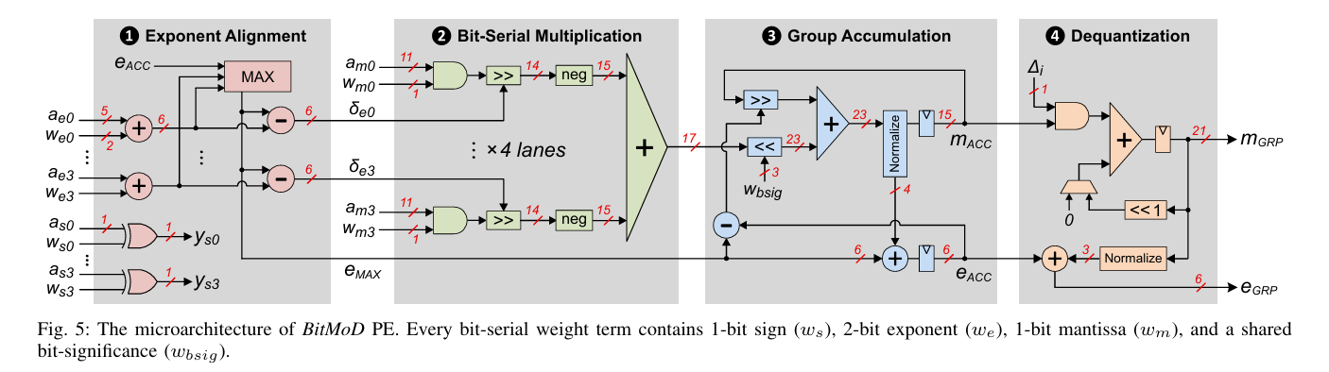


B. BitMoD Processing Element
BitMoD PE directly computes mixed-precision dot products between bit-serial low-precision weights and FP16 activations.
PE input format
Weight term from Figure 4
$w=$( $w_{s},w_{e},w_{m},w_{bsig}$)
FP16 activation already has FP fields
$a=$ ( $a_{s},a_{e},a_{m}$ )
• w_m is a 1-bit mantissa
• a_m is an 11-bit mantissa including hidden bit
• Every cycle: 4 weight terms × 4 activations
66

Slide 66


Weight Term and FP16 Activation Representation
A key point: BitMoD does not create a new exponent for activations. FP16 activations already contain sign, exponent, and mantissa fields.
Bit-serial weight term from Figure 4
FP16 activation fields
$$w=\left(w_{s},w_{e},w_{m},w_{bsig}\right)$$
$a$ = ( $a_{s},a_{e},a_{m}$)
Symbol | Meaning
w_s | sign of weight term
w_e | exponent of term
w_m | 1-bit mantissa
w_bsig | bit significance
Sign
1 bit
Exponent
5 bits
Fraction
10 bits
Mantissa used in PE = hidden bit + fraction = 11 bits
PE computes a_e + w_e because FP multiplication adds exponents
Generated by INT Booth or FP→Fixed + LOD decoder
67

Slide 67
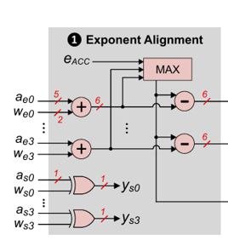
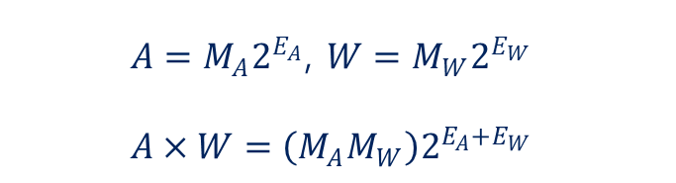
Step 1: Exponent Alignment
Step 1 computes the product exponent and sign, then aligns the four products before the dot product is accumulated.
What is computed?
Detailed example
$A=M_{A}2^{E_{A}}$, $W=M_{W}2^{E_{W}}$
$$A×W=\left(M_{A}M_{W}\right)2^{E_{A}+E_{W}}$$
Product exponents = [5, 3, 4, 5]
e_max = 5
$$e_{product}=a_{e}+w_{e}$$
$$δe_{i}=e_{max}−e_{i}$$
$$y_{s}=a_{s}⊕w_{s}$$
δe = [0, 2, 1, 0]
• Exponent addition follows FP multiplication
• Sign is computed by XOR
• The largest exponent becomes the alignment reference
P0 | P1 | P2 | P3
shift 0 | shift 2 | shift 1 | shift 0
δe controls the right shifter in Step 2.
68

Slide 68
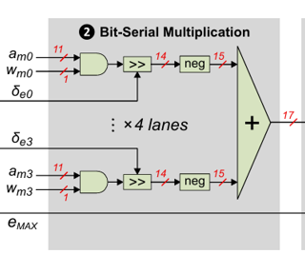
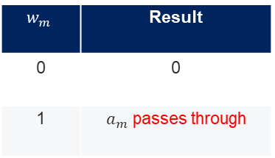
Step 2: Bit-serial Multiplication
The heavy multiplication is simplified because the weight mantissa in each bit-serial term is only one bit.
1-bit × 11-bit multiplication
Right shift by δe
Using δe = [0, 2, 1, 0] and mantissas [1.5, 1.25, 1.0, 1.5]
$$w_{m}×a_{m}$$
P0 | P1 | P2 | P3
1.5 | 1.25 | 1.0 | 1.5
>>0 | >>2 | >>1 | >>0
1.5 | 0.3125 | 0.5 | 1.5
$$w_{m}∈0,1$$
$$w_{m}$$ | Result
0 | 0
1 | $a_{m}$ passes through
After alignment, the four products are summed by an adder tree:
P = P₀ + P₁ + P₂ + P₃
This replaces a full multiplier with a lightweight bit-serial datapath.
3 extra bits are kept for round-to-nearest-even.
69

Slide 69
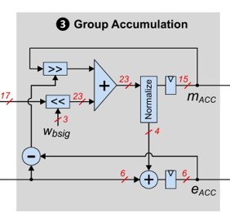

Step 3: Group Accumulation
After one bit-serial dot product is generated, BitMoD applies bit-significance and accumulates terms inside the weight group.
Why accumulation is needed
Detailed numeric example
FP4 value 6 = 4 + 2
Dot product result: P = 3
Current bit-significance: $w_{bsig}$= 2
Cycle 1: term 4
ACC stores result
Contribution = 3 × 2²(<<2) = 12
Cycle 2: term 2
Add to ACC
Previous accumulator: $m_{ACC}$= 20
$m_{ACC}$← 20 + 12 = 32
Multiple terms are accumulated to reconstruct the original weight contribution.
Then normalize $m_{ACC}$ and update $e_{ACC}$.
70

Slide 70
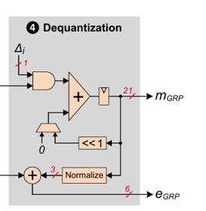


Step 4: Bit-serial Dequantization
Because BitMoD uses per-group quantization, each group partial sum must be dequantized with its own group scale.
Why INT8 scaling factor matters
Detailed example: SF = 13
• Previous section quantized scaling factors to INT8
• So dequantization no longer needs FP16 scale multiplication
• The PE can process scale bits one by one
13 = 00001101₂ = 8 + 4 + 1
Bit | Action
bit 0 = 1 | use m_ACC × 1
bit 1 = 0 | skip
bit 2 = 1 | use m_ACC << 2
bit 3 = 1 | use m_ACC << 3
Old: $P_{g}$ × FP16 $Δ_{g}$
New: $P_{g}$ × INT8 $SF_{q,g}$
m_ACC × 13 = m_ACC + (m_ACC << 2) + (m_ACC << 3)
This is shift-and-add instead of FP multiplication.
71

Slide 71
Why Dequantization Does Not Stall the PE Pipeline
Although INT8 scale dequantization takes 8 cycles, group dot-product computation takes much longer.
Cycle comparison
Term count becomes throughput advantage
Group size G = 128, PE processes 4 weights per cycle
Type | Terms | Cycles | Throughput
INT8 | 4 | 4 | 1×
INT6 | 3 | 3 | 1.33×
FP4 | 2 | 2 | 2×
FP3 | 2 | 2 | 2×
128 / 4 = 32
FP3 has 2 terms → 32 × 2 = 64 cycles
INT8 dequantization = 8 cycles
Lower weight precision → fewer bit-serial terms → fewer PE cycles
64 cycles >> 8 cycles, so no pipeline stall.
The paper also reports BitMoD PE uses about 24% less area than FP16 PE.
72

Slide 72
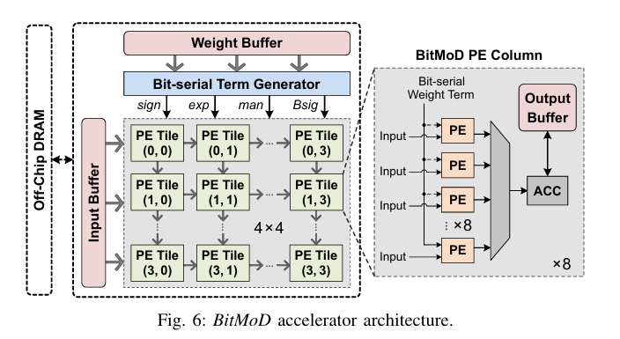
C. BitMoD Accelerator: Overall Architecture
Figure 6 shows how the bit-serial term generator and BitMoD PE are organized into a full accelerator.
Main components
• Banked input and weight buffers provide bandwidth for many PEs.
• Bit-serial Term Generator converts quantized weights into sign / exp / man / Bsig.
• Main PE Array contains 4×4 systolic PE tiles.
• Each PE column has a local output buffer and shared accumulator.
Core goal: exploit PE parallelism while reducing data movement.
Figure 6: banked buffers → term generator → 4×4 PE tiles → PE columns with output buffer + ACC
73

Slide 73
Weight-sharing and Input-sharing through Broadcast
BitMoD reuses both weights and inputs by broadcasting them in perpendicular directions across the PE tile.
Broadcast directions
Data reuse effect
W0
W1
W2
W3
• One weight term is fetched once and reused by all PEs in the same column.
• One input activation is fetched once and reused by all PEs in the same row.
• This reduces memory traffic while keeping many PEs active.
A0
PE
PE
PE
PE
A1
PE
PE
PE
PE
A2
PE
PE
PE
PE
A3
PE
PE
PE
PE
Reuse | Broadcast | Benefit
Weight-sharing | Column | less weight fetch
Input-sharing | Row | less input fetch
Weight term → column broadcast, Input → row broadcast
74

Slide 74
Hardware Summary: A → B → C
The hardware section connects data type conversion, PE computation, and accelerator-level data reuse into one pipeline.
A. Unified Bit-serial
Representation
B. BitMoD PE
C. BitMoD Accelerator
INT8 / INT6 / FP4 / FP3
↓
sign / exp / man / Bsig
bit-serial weight
×
FP16 activation
↓
group partial sum
4×4 PE tiles
+
row/column broadcast
+
shared ACC
Final message: BitMoD combines unified bit-serial data representation, mixed-precision PE design, and systolic data reuse to turn low-bit quantization into real accelerator speedup.
75

Slide 75
Evaluation
76

Slide 76
Evaluation Setup: What is measured?
BitMoD evaluation checks whether the proposed datatype and hardware actually preserve model quality and improve accelerator efficiency.
Model Accuracy
Speedup
Energy Efficiency
Compatibility
Low-precision quantization quality
4-bit and 3-bit behavior
End-to-end accelerator performance
FP16 / ANT / OliVe comparison
DRAM traffic reduction + compute energy
bit-serial PE advantage
Combination with AWQ, OmniQuant,
and SmoothQuant
Experimental methodology
Hardware methodology
Category | Details
LLMs | OPT-1.3B, Phi-2B, Yi-6B, Llama-2-7B, Llama-2-13B, Llama-3-8B
Discriminative | HellaSwag, WinoGrande, PIQA (zero-shot accuracy)
Generative | Wikitext-2 and C4 (perplexity, PPL)
Baselines | ANT, OliVe, Microscaling(MX), per-group asymmetric INT
• BitMoD accelerator is implemented in SystemVerilog RTL.
• Synthesis uses TSMC 28nm technology.
• End-to-end performance is evaluated with a cycle-level simulator.
• All accelerators are compared under the same compute-area budget.
Fair comparison: same compute area, different quantization and hardware designs
77

Slide 77
Model Accuracy: 4-bit is near-lossless, 3-bit is where BitMoD matters
The paper evaluates both discriminative accuracy and generative perplexity. BitMoD keeps quality especially well when precision gets very low.
< 0.5%
< 0.5
< 3
3-bit
Average accuracy loss
for 4-bit discriminative tasks
Average PPL increase
for 4-bit generative tasks
Average PPL loss
for 3-bit generative tasks
Benefit becomes larger
when quantization is harder
Conventional 3-bit quantization
BitMoD 3-bit quantization
Quantization error increases
↓
Model quality drops
↓
PPL grows significantly
Group-wise special value selection
↓
Range / resolution
↓
Lower quantization error
Takeaway: 4-bit BitMoD is almost FP16-quality; 3-bit BitMoD shows the strongest advantage over ANT, OliVe, MX, and INT3-Asym.
78

Slide 78
Accelerator Performance: speedup comes from memory and cycles
BitMoD improves speed by reducing weight memory traffic and reducing the number of bit-serial compute cycles.
Why performance improves
Reported speedup
• Low-precision weights reduce memory traffic.
• Bit-serial terms reduce PE compute cycles.
• Generative tasks are memory-bound, so they benefit strongly from weight traffic reduction.
1.99×
2.41×
FP16 baseline
Discriminative tasks
FP16 baseline
Generative tasks
Average speedup over existing accelerators
2.0×
1.69×
Low precision → smaller weights → fewer memory accesses
1.48×
Fewer bit-serial terms → fewer PE cycles
ANT
OliVe
BitMoD is faster than ANT and OliVe because it supports per-group low-bit quantization efficiently in hardware.
79

Slide 79
Energy and Hardware Efficiency
Energy saving mainly comes from fewer DRAM weight accesses and lower compute cost in the bit-serial PE.
2.31×
1.48×
1.31×
24%
Energy efficiency
over FP16 baseline
Energy efficiency
over ANT
Energy efficiency
over OliVe
BitMoD PE area reduction
vs regular FP16 PE
Where energy is saved
Why bit-serial is flexible
Low-precision Weight
↓
DRAM weight traffic decreases
Bit-serial PE
↓
Compute energy decreases
Type | Terms | Cycle effect
INT8 | 4 | baseline
INT6 | 3 | 1.33×
FP4 | 2 | 2×
FP3 | 2 | 2×
Same PE, different cycle count: no separate hardware path for every precision.
80

Slide 80
Evaluation Summary: What the results prove
The evaluation supports BitMoD as an algorithm-hardware co-design: accurate low-bit quantization plus efficient bit-serial execution.
Item | Reported result
4-bit accuracy | FP16 average accuracy loss < 0.5%
4-bit generative | Average PPL loss < 0.5
3-bit generative | Average PPL loss < 3
FP16 speedup | 1.99× discriminative / 2.41× generative
ANT / OliVe speedup | 1.69× over ANT / 1.48× over OliVe
Energy efficiency | 2.31× over FP16 / 1.48× over ANT / 1.31× over OliVe
Hardware area | BitMoD PE uses about 24% less area than FP16 PE
Compatibility | AWQ, OmniQuant, SmoothQuant can be combined with BitMoD
81

Slide 81
Q&A
82

