Slide 1




LeNet Accelerator
2022142255 SeokChan Jeong

Slide 2
Table of Content
Abstract
LeNet Baseline
V2 Accelerator
V3 Accelerator(Quantize+BitMoD)
Evaluation
2

Slide 3
Abstract
3

Slide 4
Abstract
LeNet FPGA accelerator across three generations
The accelerator is measured on the full PS → PL → PS path for 1,000 MNIST images
Baseline
Correctness-first
INT8 / Image8
V2
Parallel PL + DMA/cache
1,504 steady cycles
V3
Low-bit design @160MHz
962 steady cycles
Core Result
V3 preserves accuracy while sharply reducing steady-state PL latency and end-to-end execution time.
98.30%
V3 accuracy
983 / 1000
6.0125 μs
V3 steady PL latency
962 cycles @160MHz
2.001×
V2 → V3 PL latency
speedup
814.6×
E2E speedup
vs true baseline

Slide 5
Benchmark Summary
Accuracy is maintained around 98%, while PL cycles drop from 434,330 cycles/image in the baseline to 962 steady cycles in V3.
Version
Accuracy
PL Cycles
PL Latency
E2E Total
Main role
Baseline
98.40%
984 / 1000
434,330
cycles/image
8,686.60 μs
avg / image
@50MHz
8,760.471 ms
1000 images
Correctness-first
PS→PL→PS flow
V2
98.60%
986 / 1000
1,504
steady cycles
12.032 μs
@125MHz
22.589 ms
1000 images
Parallel PL +
DMA/cache timing
V3
98.30%
983 / 1000
962
steady cycles
6.0125 μs
@160MHz
10.754 ms
1000 images
Low-bit design +
clock improvement
99.78%
PL cycle reduction
vs Baseline
36.04%
V2 → V3 cycle
reduction
-0.10 pp
V3 accuracy change
vs Baseline
95.24%
Non-PL total
reduction vs Baseline
Abstract message: V3 achieves the best latency-efficiency point, delivering a 2× steady PL latency speedup over V2 while staying within 0.3 pp of V2 accuracy.

Slide 6
LeNet Baseline
33

Slide 7
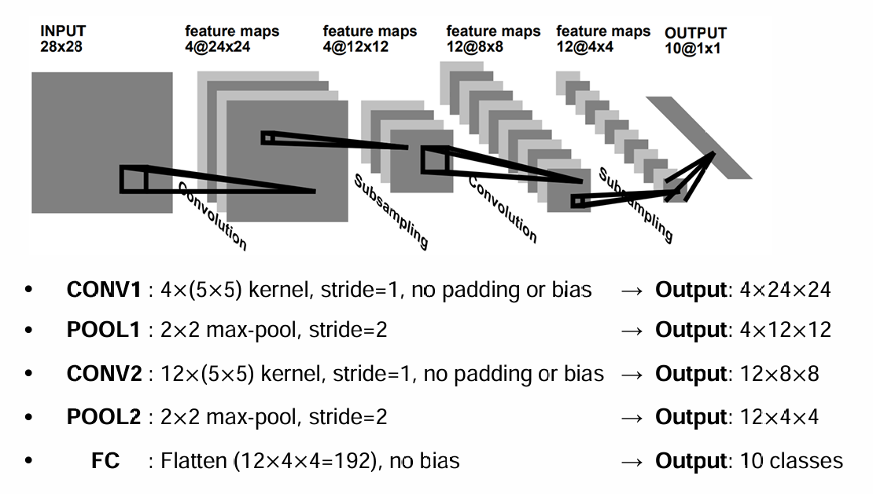
What is LeNet?
Stage
Operation
Parameters
Output Shape
Input
Image
uint8, 1 channel
1 × 28 × 28
Conv1
Valid conv + ReLU
4 filters, 5×5, stride 1, no bias
4 × 24 × 24
Pool1
MaxPool
2×2, stride 2
4 × 12 × 12
Conv2
Valid conv + ReLU
12 filters, 5×5, stride 1, no bias
12 × 8 × 8
Pool2
MaxPool
2×2, stride 2
12 × 4 × 4
FC
Fully connected + ReLU
192 → 10, no bias
10 logits
Output
Argmax
select max activated logit
digit 0–9

Slide 8
Input Data and Weight Setup
Header File
Parsed Type
Expected Size
Tensor Shape
conv1_arr.h
int8
4×1×5×5 = 100
4 × 1 × 5 × 5
conv2_arr.h
int8
12×4×5×5 = 1,200
12 × 4 × 5 × 5
fc1_arr.h
int8
10×192 = 1,920
10 × 192
test_images_arr.h
uint8
N×28×28
N × 28 × 28
test_labels_arr.h
uint8
N labels
N
Image
28×28
Conv1
ReLU
Pool1
Conv2
ReLU
Pool2
Flatten
192
FC
10
Argmax
0–9

Slide 9
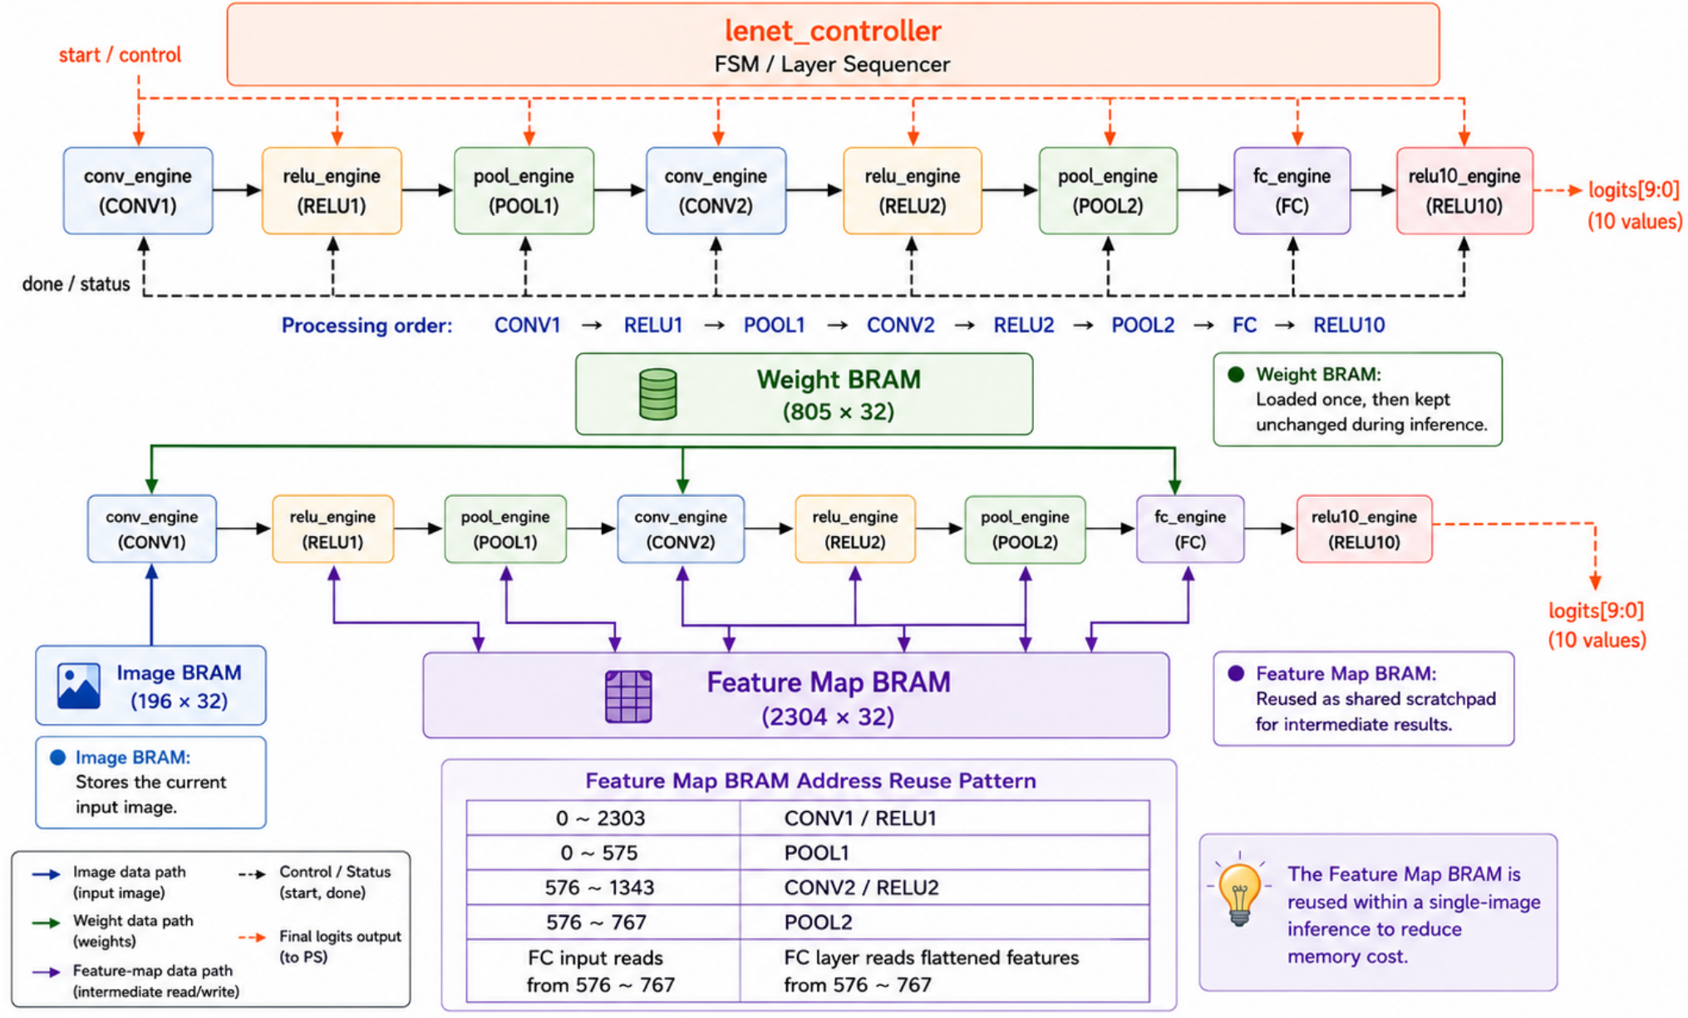
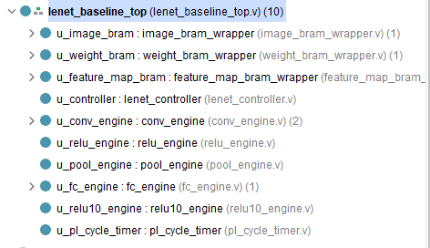
PL Architecture

Slide 10
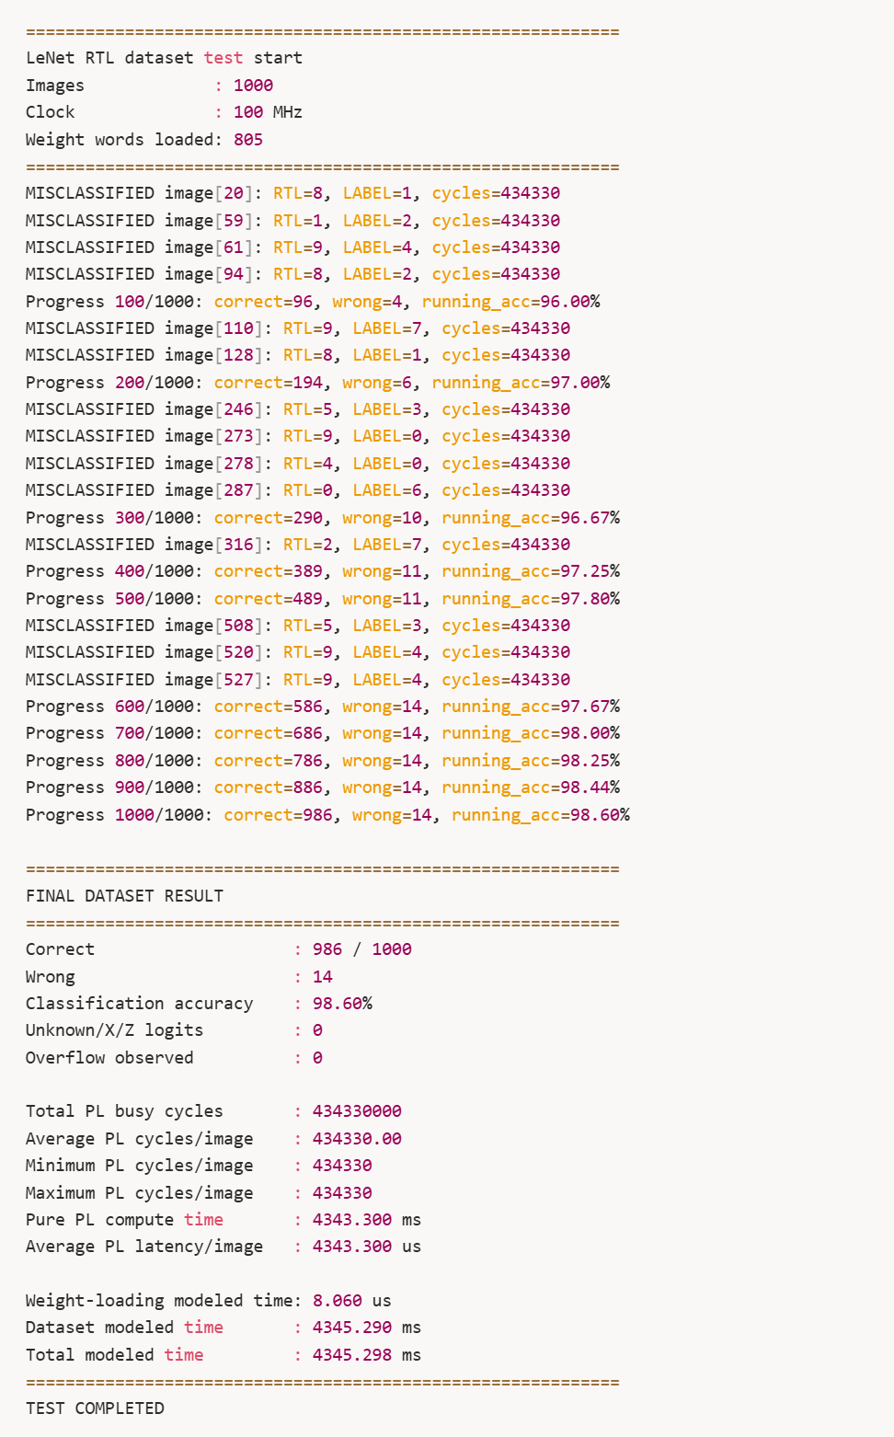
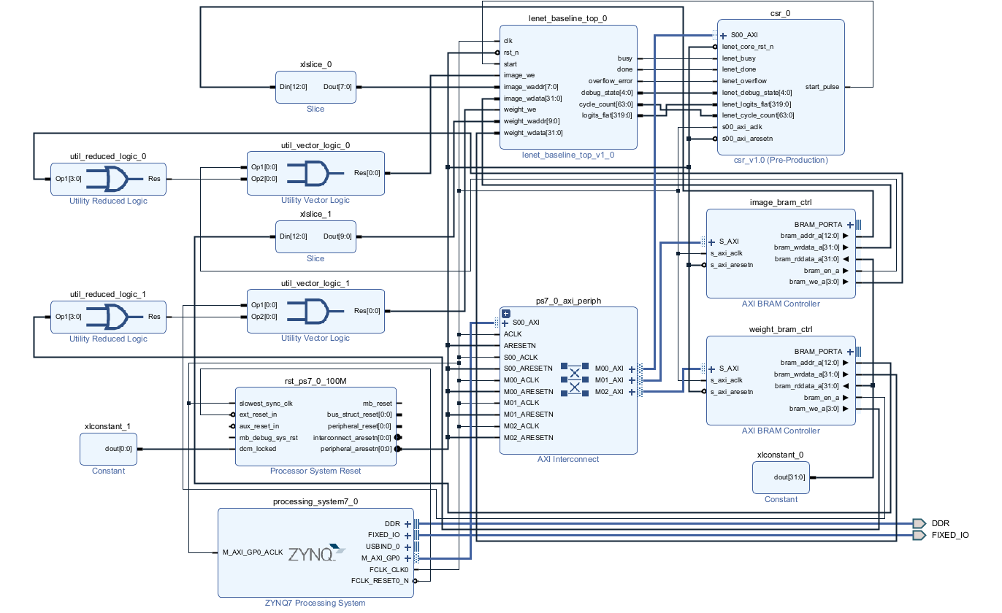
PL Result and Block Design

Slide 11
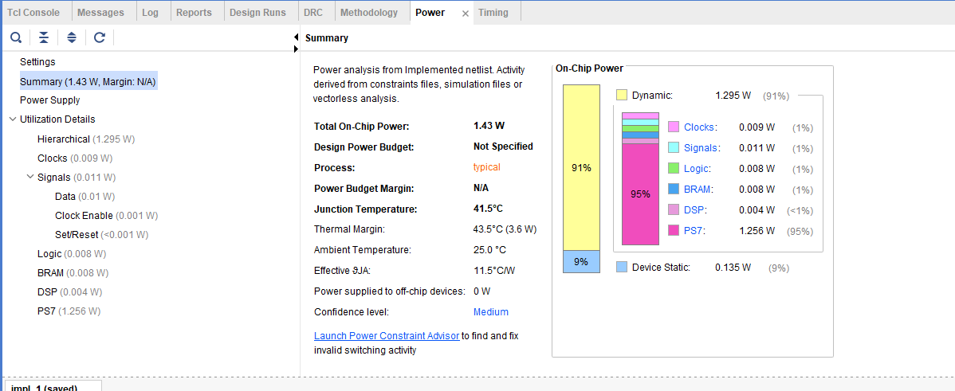
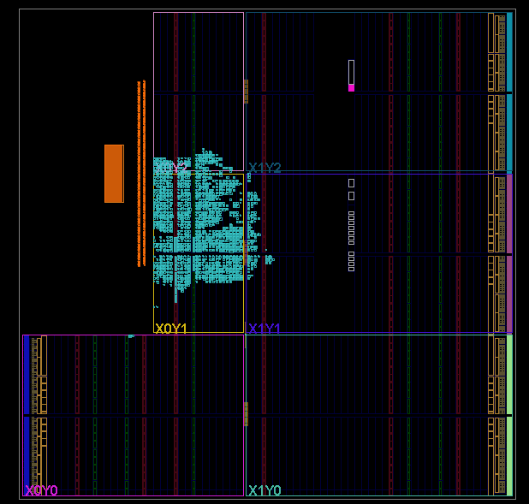
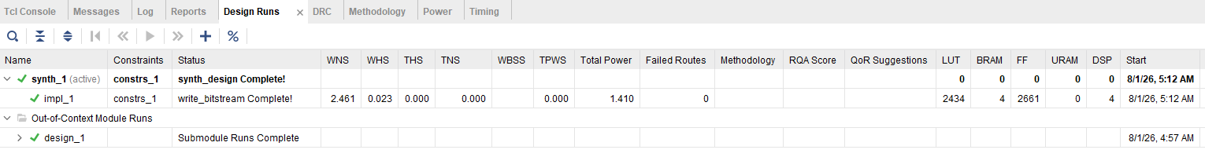
Block Design Analysis

Slide 12
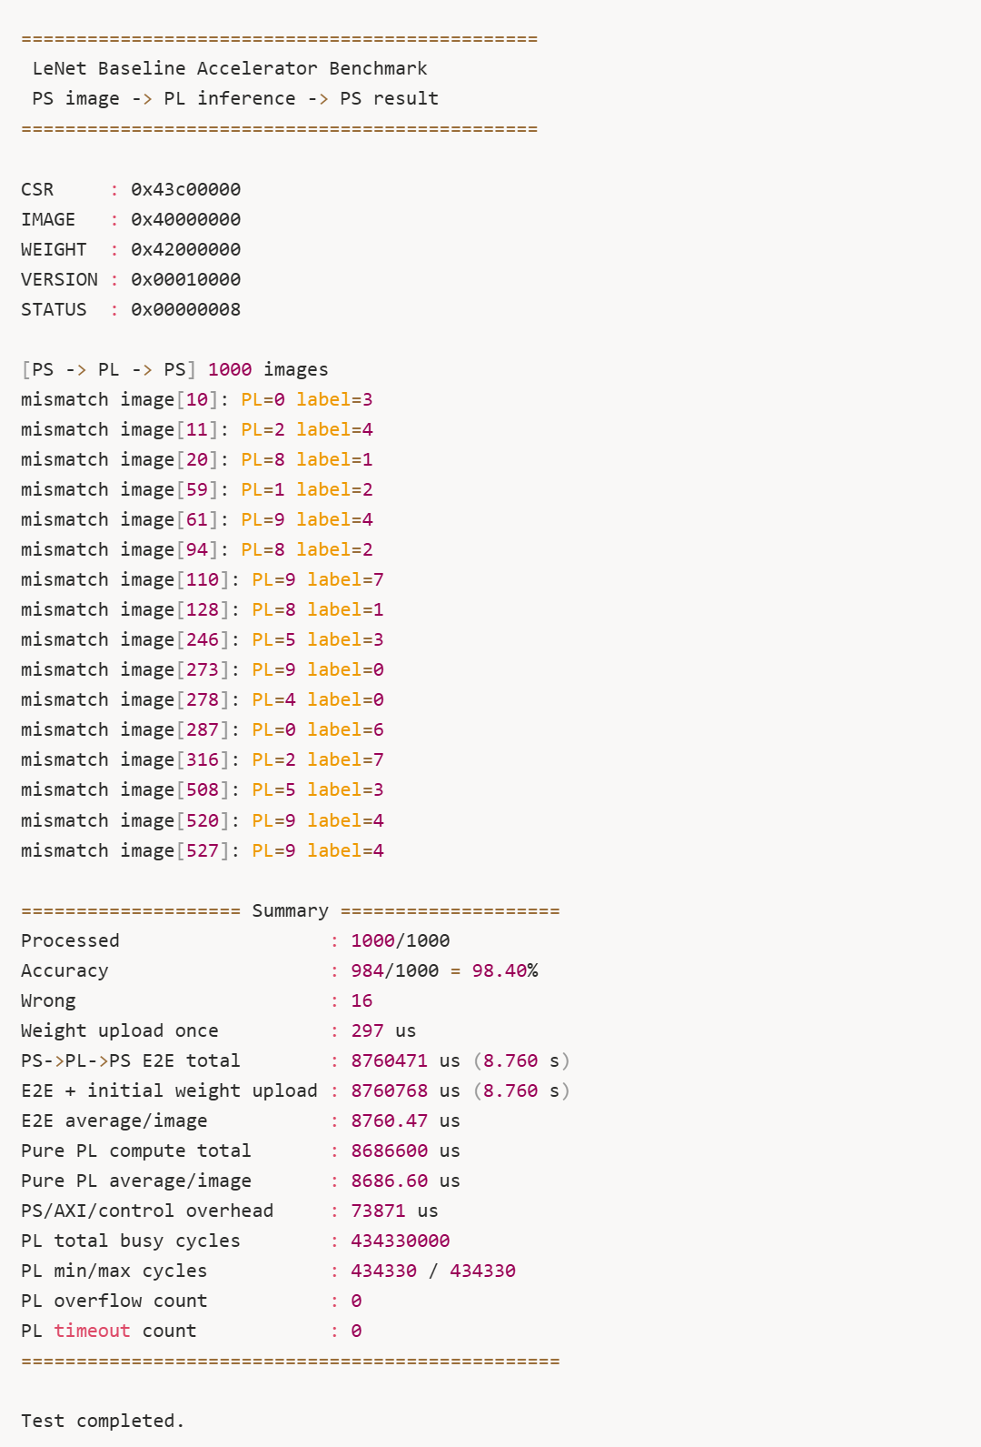
PS Result
Item
Arty Z7 Board
RTL Simulation
Test Images
1,000 images
1,000 images
Accuracy
98.40%
98.60%
Correct / Wrong
984 / 16
986 / 14
Operating Clock
50 MHz
100 MHz
PL Cycles / Image
434,330
434,330
Total PL Cycles
434,330,000
434,330,000
Pure PL Compute Time
8.6866 s
4.3433 s
Total Processing Time
8.760 s
4.345 s
Overflow
0
0
Timeout / X-Z
0
0
Total Processing Time
8.760 s
PS image → PL inference → PS result
Pure PL Compute Time
8.6866 s
FPGA computation only
PS / AXI / Control Overhead
0.0734 s
E2E - PL time
PL Cycles / Image
434,330
single-image latency
Time Breakdown
PL Computation
99.16%
0.84%

Slide 13
V2 Accelerator
53

Slide 14
Where the Baseline Loses Cycles
The baseline is functionally correct, but its datapath repeatedly waits on memory, reuses a small MAC path, and cannot overlap frames.
01
02
03
04
Shared Feature BRAM
Low MAC Throughput
Redundant Data Access
Memory Waiting Gaps
Problem
Problem
Problem
Problem
Conv, ReLU, and Pool repeatedly read/write the same feature-map BRAM.
A single MAC-style path serializes convolution and FC operations.
Adjacent 5×5 windows reread data that is already available.
Single image / Pool1 buffers force the next stage or frame to wait.
v2 direction
v2 direction
v2 direction
v2 direction
Fuse Conv + ReLU + Pool into one streaming module.
Allocate dedicated parallel engines using 160 DSPs.
Use line buffers and decouple window generation from MAC issue.
Use image / Pool1 ping-pong buffers and row-ready handshaking.
Core strategy: reduce PL cycles by increasing parallel compute, feeding MAC lanes continuously, and overlapping memory stages.
2

Slide 15
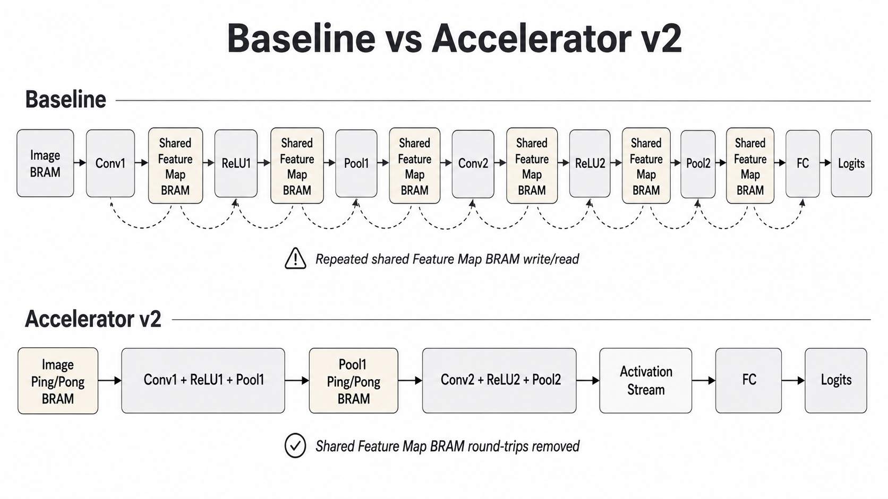
Bottleneck 1: Repeated Feature-Map BRAM Read / Write
B1
Baseline stores intermediate feature maps between Conv, ReLU, and Pool, causing repeated memory traffic.
Takeaway
The first bottleneck is not arithmetic itself. It is repeated movement of the same feature map through shared BRAM between small operators.
Upgrade rule
Keep data on-chip and streaming whenever possible.
3

Slide 16
Bottleneck 2: Low Arithmetic Throughput from a Reused MAC Engine
B2
The model requires many MAC operations per image. A sequential MAC path turns this into a large cycle count.
Layer
Output shape
Multiplications / output
Total multiplications
Main issue
Conv1
4 × 24 × 24
5 × 5 = 25
57,600
One image already requires 136,320 multiplications before address control, accumulation, and memory latency.
Conv2
12 × 8 × 8
4 × 5 × 5 = 100
76,800
FC
10 classes
192 inputs / class
1,920
Total
-
-
136,320
Sequential output-channel processing
The input window is reused, but the baseline consumes it through one compute path. Cycles grow with output channels and kernel taps.
Window 0
+ Filter 0
Window 0
+ Filter 1
Window 0
+ Filter 2
Window 0
+ Filter 3
4

Slide 17
v2 Response: Dedicated Parallel Engines
Accelerator v2 replaces the shared convolution path with dedicated Conv1, Conv2, and FC engines, using 160 DSPs in total.
Conv1 Engine
Conv2 Engine
FC Engine
Total
50 DSP
100 DSP
10 DSP
160 DSP
2 dot25 lanes × 25 multipliers
4 output lanes × 25 taps
10 class lanes in parallel
parallel datapath allocation
Conv1 issue schedule
Conv2 partial parallelization
25-tap
Window
Lane 0
OC0/OC2
2 issue cycles
for 4 channels
4 output lanes
× 25 taps
Input channels
processed serially
Lane 1
OC1/OC3
24×24 windows × 2 channel groups = 1,152 issue cycles
12 output channels = 3 groups; 4 input channels per group → 12 issue cycles per spatial position.
Parallel engines raise hardware utilization: each layer receives a datapath sized to its arithmetic demand instead of sharing one serial MAC path.
5

Slide 18
FC Engine: Broadcast One Activation to 10 Class Lanes
The fully connected layer is smaller than convolution, but class-parallel MAC lanes remove sequential class processing.
Baseline FC order
Key numbers
Class 0
192 MACs
Class 1
192 MACs
...
Class 9
192 MACs
192 input activations
× 10 output classes
= 1,920 multiplications
Accelerator v2 FC order
Class 0
Class 1
Class 2
Class 3
Class 4
One pooled
activation
10 accumulators
updated together
Class 5
Class 6
Class 7
Class 8
Class 9
The RTL uses 10 independent weight banks and broadcasts one pooled activation to all class MAC lanes.
6

Slide 19
Bottleneck 3: Redundant Data Access Between Adjacent Windows
B3
Adjacent convolution windows share most pixels, but independent BRAM reads request the same data again.
Two adjacent 5×5 windows
Naïve access
Reuse-aware access
a
b
c
d
e
b
c
d
e
A
Window 0: 25 reads
Window 1: 25 reads
Window 2: 25 reads
Next window needs only 5 new pixels; 20 pixels can be reused internally.
f
g
h
i
j
g
h
i
j
B
k
l
m
n
o
l
m
n
o
C
p
q
r
s
t
q
r
s
t
D
u
v
w
x
y
v
w
x
y
E
Upgrade direction: line buffer
20 / 25 pixels are reused
Previous Row 4
Previous Row 3
5×5 window
from internal rows
Previous Row 2
Previous Row 1
Current Row
Line buffers retain previous rows so the accelerator does not reread them from image or Pool1 BRAM.
7

Slide 20
Bottleneck 4: Image Memory Waits Between Frames
B4
A single image BRAM cannot safely receive the next image while Conv1 is reading the current one.
Single image BRAM
Image ping-pong buffer
Image Ping
Conv1 Read
Frame N
External
Write
Image BRAM
Conv1
Read
External Write
Frame N+1
Image Pong
Frame N load → Conv1 reads Frame N → Frame N+1 load
Control signals
Ping-pong buffering overlaps image transfer with computation, eliminating frame-load gaps before Conv1.
load_bank: bank for the next external image write
c1_active_bank: bank for the current Conv1 read
image_ready = 1 when the load bank is empty
9

Slide 21
Bottleneck 4 Continued: Pool1 Buffer Prevents Layer Overlap
Conv1 writes Pool1 results while Conv2 reads Pool1 as input. With one buffer, the two stages conflict.
Single Pool1 BRAM conflict
Pool1 ping-pong buffer
Conv2
Frame N
Read
Pool1 Ping
Conv1
Frame N+1
Write
Pool1
BRAM
Conv2
Frame N
Read
Conv1
Frame N+1
Write
Pool1 Pong
Even with dedicated Conv1 and Conv2 engines, one intermediate buffer serializes them.
Frame pipeline
Frame N
Conv1
Conv2 + FC
Frame N+1
Conv1
Conv2 + FC
Frame N+2
Conv1
Conv2 + FC
Pool1 ping-pong enables Conv1 of the next frame to run while Conv2 + FC process the current frame.
10

Slide 22
Pool1 Row-Ready: Start Conv2 Before the Whole Feature Map is Done
Pool1 ping-pong solves inter-frame conflict, but row-ready also reduces same-frame waiting between Conv1 and Conv2.
Without row-ready
RTL-level idea
Conv1 writes
all 12 Pool1 rows
Conv2 starts
after full map
Each Pool1 bank has a 12-bit row_ready status. When Conv1 finishes writing channel group 2–3 for the last column of a row, the corresponding ready bit is set.
Conv2 waits until the entire 12×12 Pool1 map is complete.
Conv2 checks whether the rows needed for its 5×5 window are ready before reading.
With row-ready bits
Conv2 starts when
required rows exist
0
1
2
3
4
5
6
7
8
9
10
11
row_ready[0..11]
Result: Conv2 does not wait for the full Pool1 feature map; it can begin as soon as enough rows are available.
11

Slide 23
Upgrade Summary: From Sequential Baseline to Pipelined v2
The v2 design attacks the dominant PL bottleneck through module fusion, parallel engines, data reuse, and overlapped buffering.
Bottleneck
Baseline limitation
v2 hardware direction
Expected effect
B1 Feature BRAM
Conv / ReLU / Pool repeatedly access shared feature-map BRAM
Fuse Conv + ReLU + Pool into one module
Lower intermediate memory traffic
B2 MAC throughput
One MAC path serializes 136,320 multiplications / image
Conv1 50 DSP, Conv2 100 DSP, FC 10 DSP
More MACs completed per cycle
B3 Data access
Adjacent 5×5 windows reread mostly identical pixels
Line buffer, BRAM banking, decoupled window generation
Keep DSP lanes supplied
B4 Waiting gaps
Single Image / Pool1 memories prevent frame and layer overlap
Image / Pool1 ping-pong + row-ready
Overlap load, Conv1, Conv2, and FC
Main message: the baseline is not inaccurate; it is underutilized. v2 improves latency by restructuring the PL datapath around parallel compute and memory overlap.
12

Slide 24
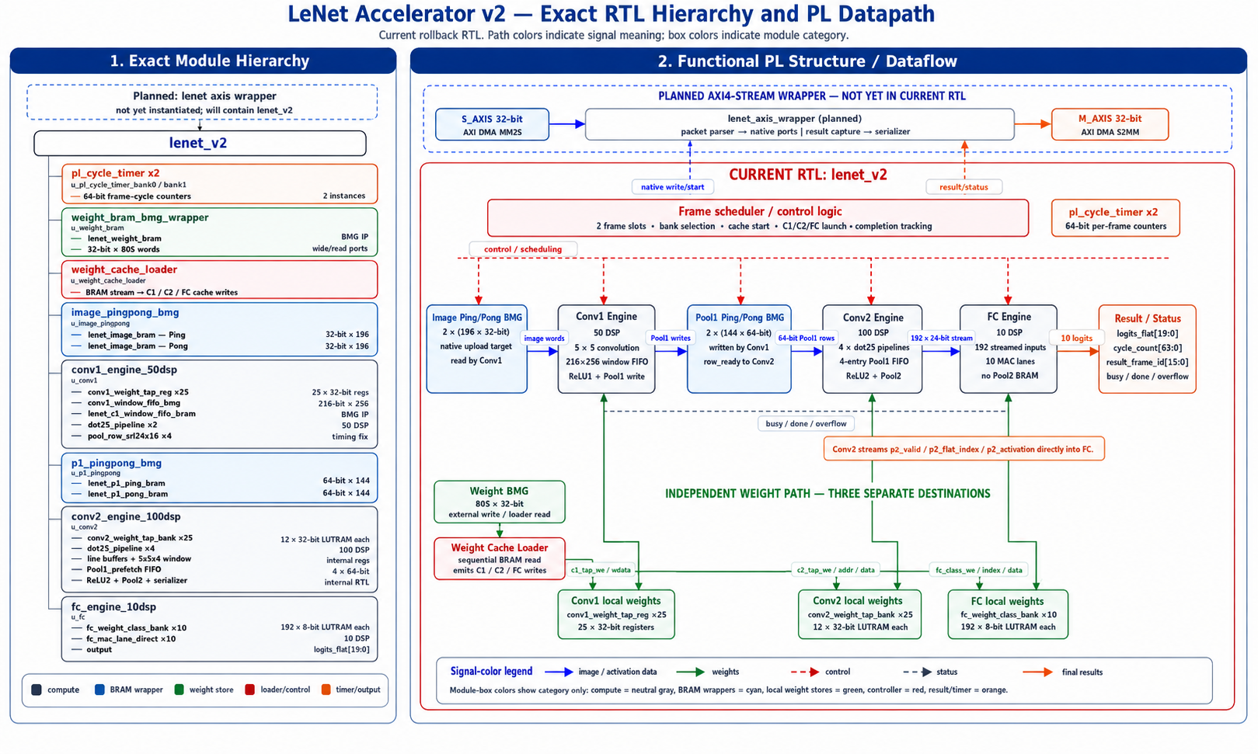
PL Architecture
12

Slide 25
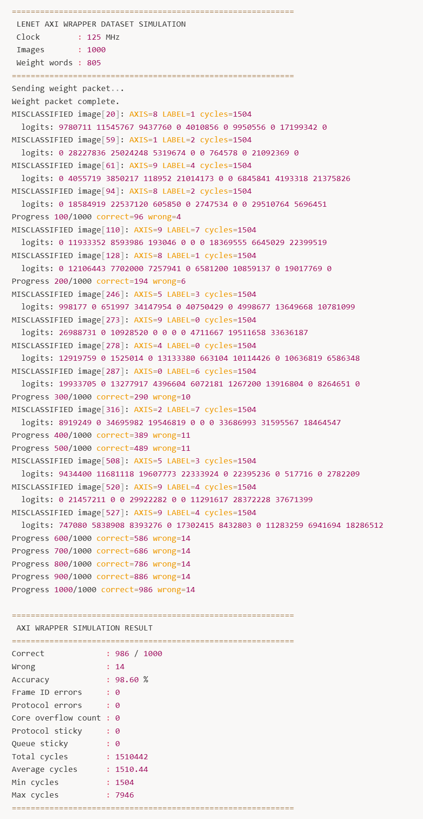
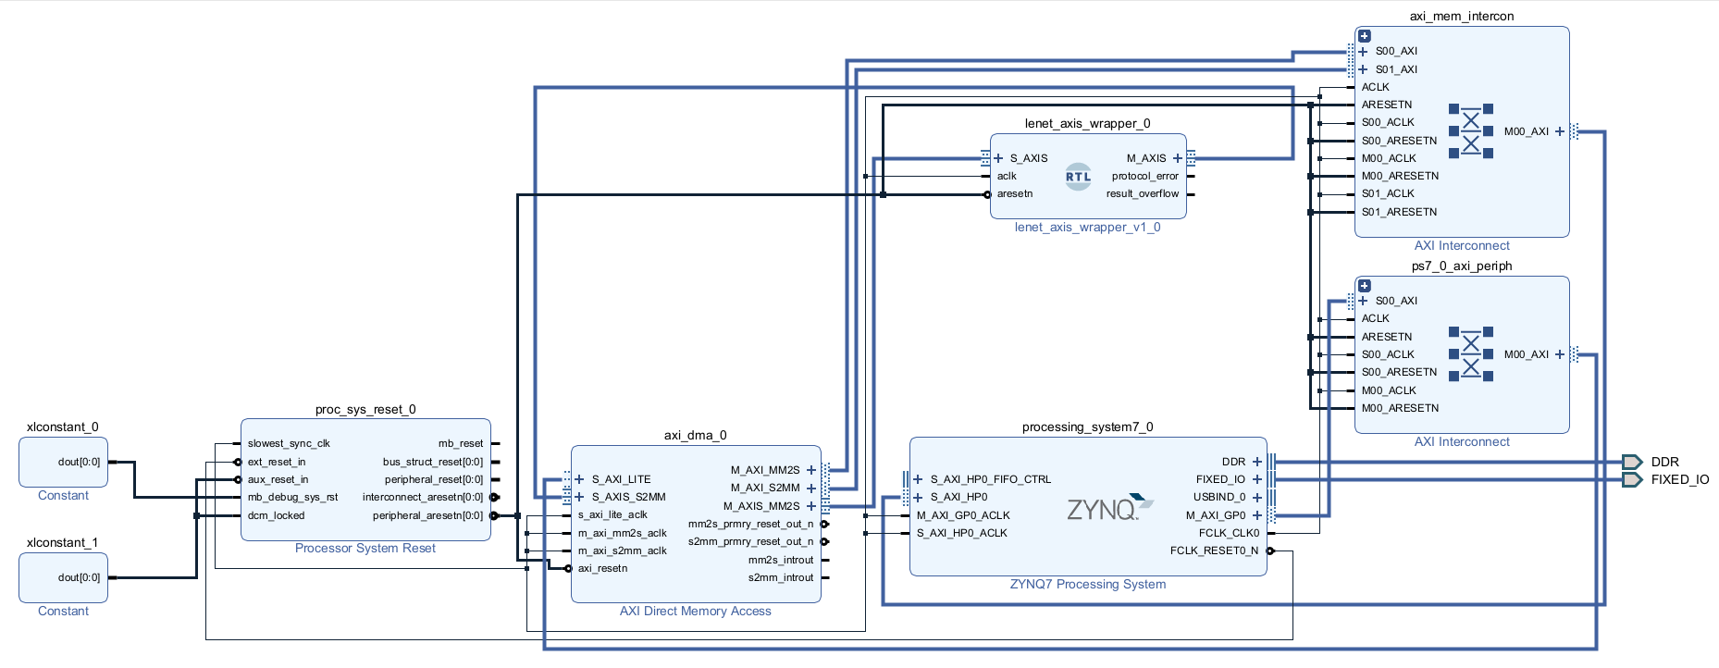
PL Result and Block Design

Slide 26
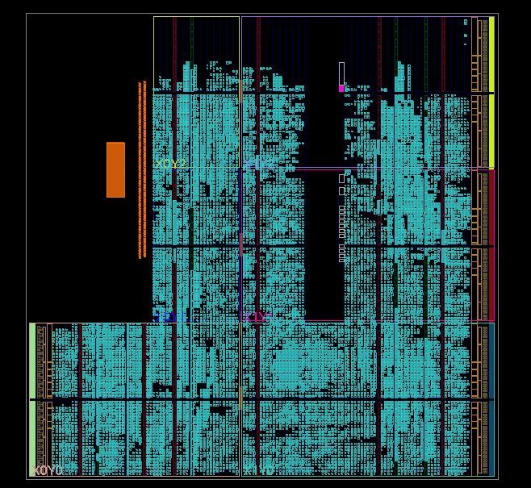
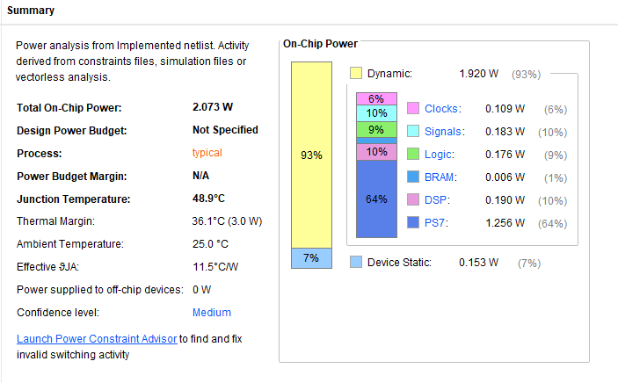
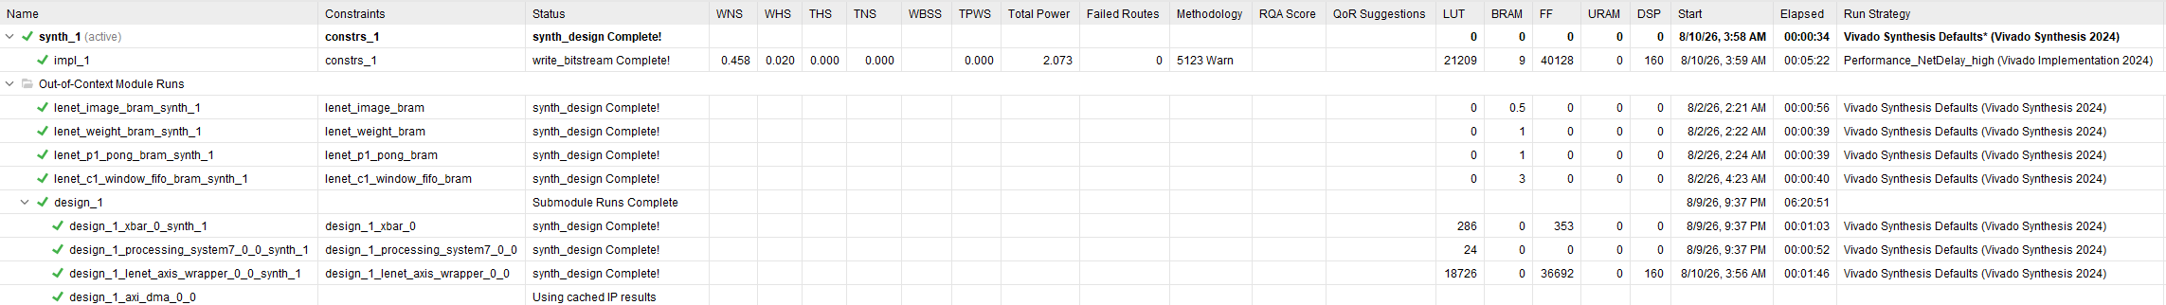
Block Design Analysis

Slide 27
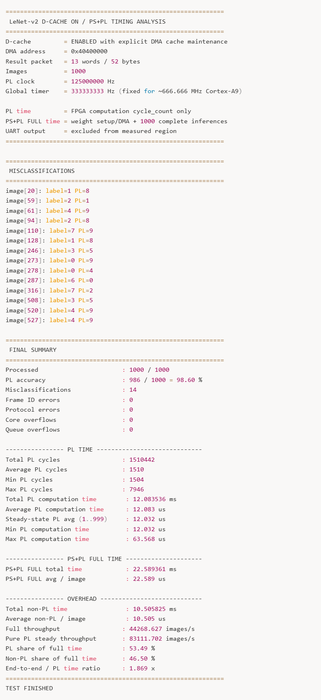
PS Result
Metric
Baseline
LeNet-v2
Change
Processed images
1000 / 1000
1000 / 1000
same
Correct predictions
984
986
+2
Wrong predictions
16
14
−2
Frame / protocol errors
N/A
0 / 0
clean protocol
Core / queue overflow
0
0 / 0
no overflow
PL cycles / image
PL latency / image
E2E average / image
434,330 cycles
1,504 cycles
8,686.60 us
12.032 us
8,760.47 us
22.589 us
288.8× fewer cycles · 99.65% reduction
722.0× faster PL latency
387.8× faster end-to-end
Architecture-normalized view: cycles / image
Baseline
434,330 cycles
v2 steady-state
1,504 cycles

Slide 28
V3 Accelerator(Quantize+BitMoD)
53

Slide 29
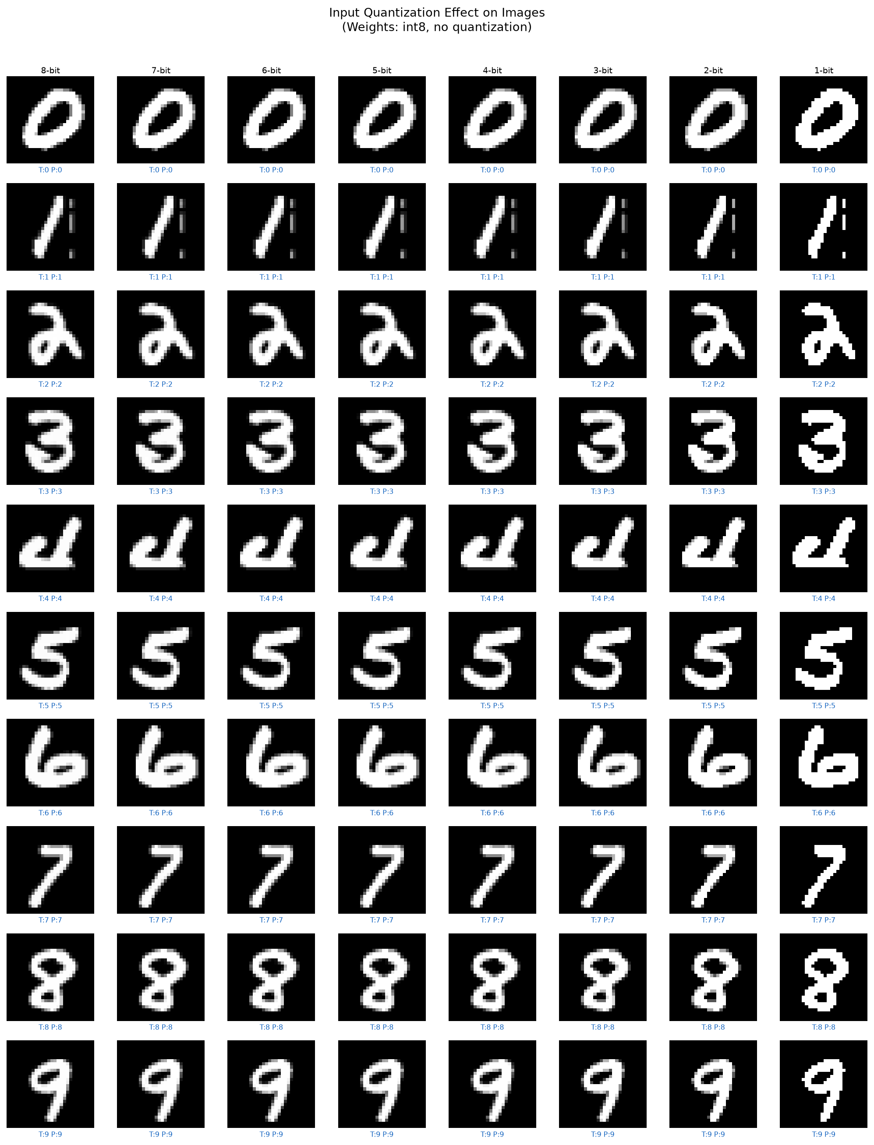
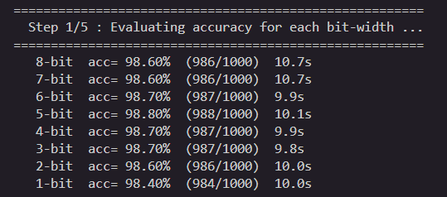
Why 1-bit Image Input?
Input-bit accuracy sweep
Image bits
8
6
4
3
2
1
Accuracy (%)
98.60
98.70
98.50
98.40
98.20
98.40
Imem compression
1.00×
1.33×
2.00×
2.65×
4.00×
7.84×
Imem compression by image precision
Input | Result
0 | 0
1 | passes through
Image8
1.00×
Image4
2.00×
Image1
7.84×
12

Slide 30
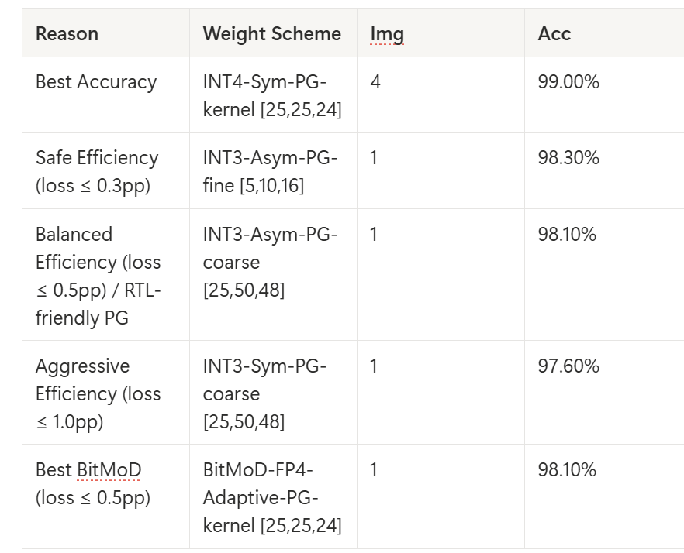
Why BitMoD FP4
FP3 gives stronger compression and compute proxy, but the accuracy drop is too large. FP4 keeps the model inside the target loss budget.
Scheme
Bits
PG preset
Img
Acc.
ΔAcc
Wmem
Imem
Comp
GrpOps
HWscore
BitMoD-FP3 coarse
3
coarse [25,50,48]
1-bit
96.40%
−2.20 pp
2.49×
7.84×
3.47×
3,880
3.322
BitMoD-FP3 kernel
3
kernel [25,25,24]
1-bit
96.20%
−2.40 pp
2.35×
7.84×
3.47×
5,456
3.028
BitMoD-FP4 coarse
4
coarse [25,50,48]
1-bit
98.00%
−0.60 pp
1.90×
7.84×
2.61×
3,880
2.758
BitMoD-FP4 kernel
4
kernel [25,25,24]
1-bit
98.10%
−0.50 pp
1.81×
7.84×
2.61×
5,456
2.525
BitMoD-FP4 fine
4
fine [5,10,16]
1-bit
98.50%
−0.10 pp
1.66×
7.84×
2.61×
19,320
1.518
Choice
Accuracy
ΔAcc
Wmem
Comp
GrpOps
Role
Accuracy at Image1
Group rescale pressure
FP3 coarse
96.4%
19,320
INT3-Asym coarse
98.10%
−0.50
2.28×
3.47×
3,880
Best balanced proxy
FP4 fine
19,320
FP4 coarse
98.0%
5,456
INT3-Sym coarse
97.60%
−1.00
2.40×
3.47×
3,880
Aggressive / lower accuracy
FP4 kernel
5,456
FP4 kernel
98.1%
FP4 coarse
3,880
BitMoD-FP4 kernel
98.10%
−0.50
1.81×
2.61×
5,456
v3 co-design target
FP4 fine
98.5%
3,880
Chosen rationale: FP4 gives acceptable accuracy at 1-bit input, while kernel/coarse grouping avoids the very high group-rescale pressure of fine-grained PG.
5

Slide 31
v2 → v3: Method-Level Changes
v3 changes the data representation and the system path around the accelerator, not only the layer schedule.
Area
LeNet-v2
LeNet-v3
Purpose
Input image
8-bit image input
1-bit quantized + packed image
Reduce PS→PL transfer and image memory
Weights
INT8 weights
BitMoD FP4 adaptive per-group weights
Reduce weight storage and operand workload
Datapath
Parallel INT8-style engines
Low-bit packed / BitMoD-aware compute path
Make quantization visible to hardware
Clock
125 MHz
160 MHz
Exploit shorter critical path after optimization
Transfer/control
DMA + cache maintenance
Prebuilt TX + bulk cache maintenance + direct MMIO
Lower non-PL overhead
Benchmark policy
D-cache ON timing analysis
Cold included + steady-state split
Separate cold start from steady throughput
Conceptual transition
v2
parallelism-first
v3
quantization + packing + clock
fewer cycles
+ shorter latency
The important presentation point is that v3 makes the low-bit representation an architectural feature, not just an offline model-compression result.
7

Slide 32
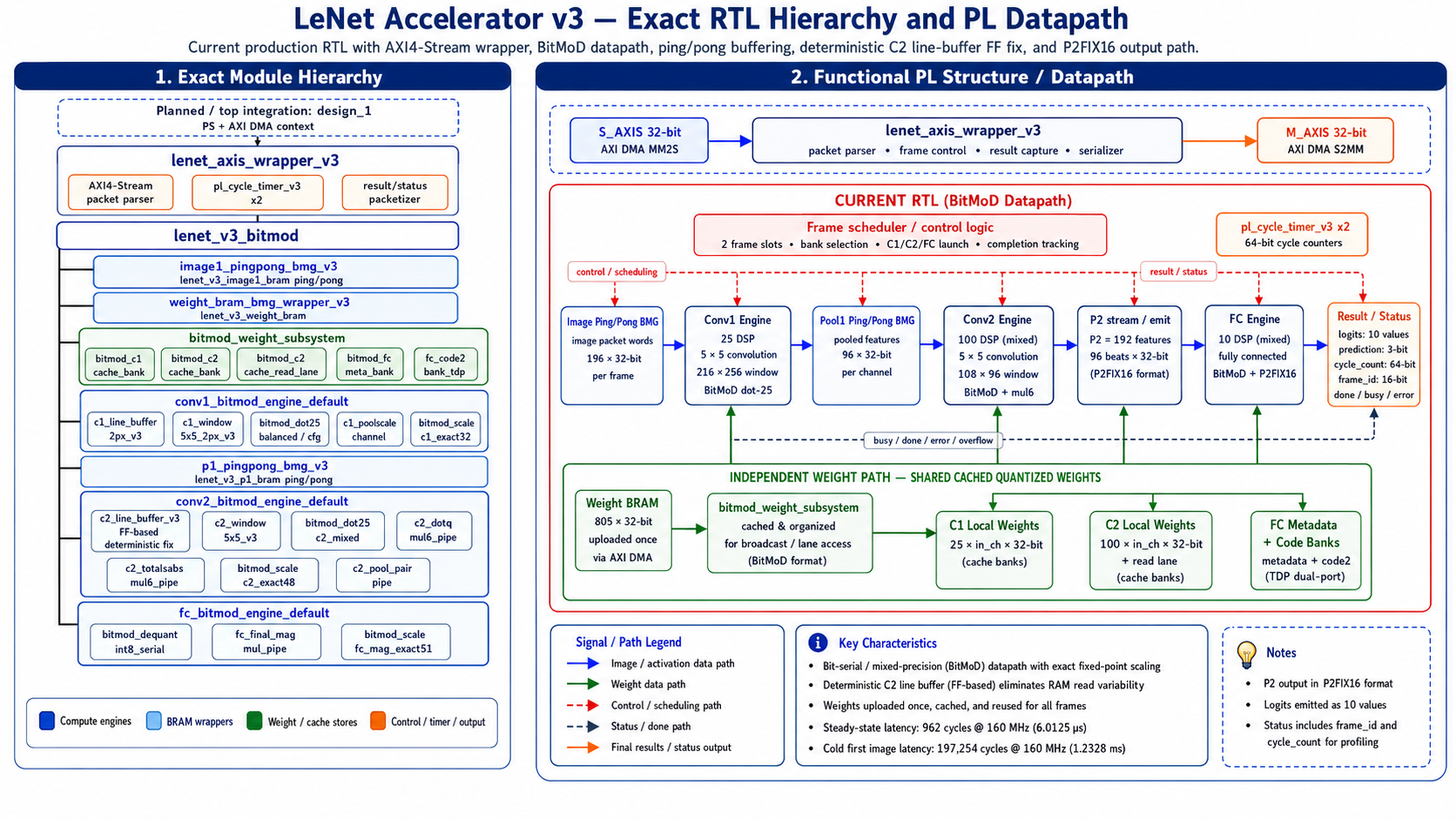
PL Architecture
12

Slide 33
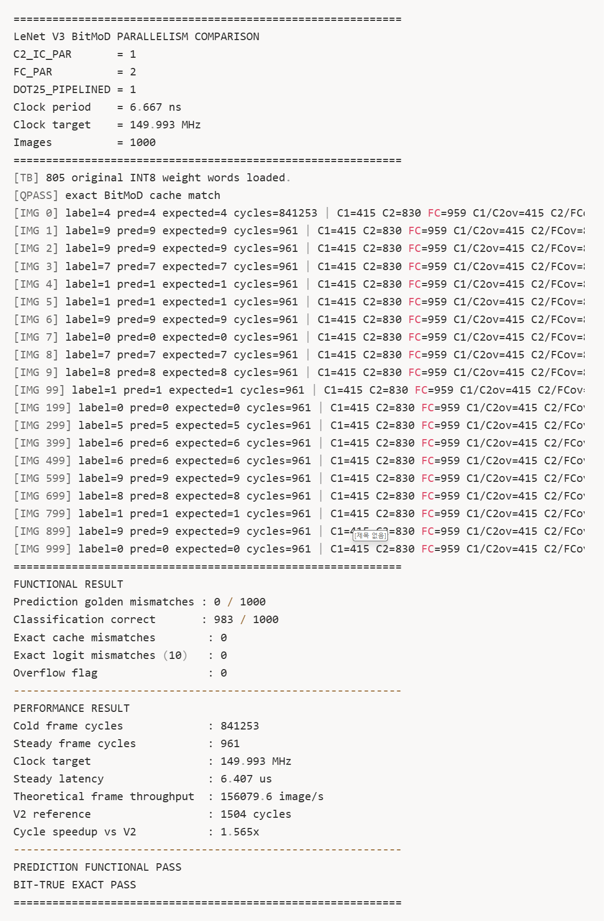
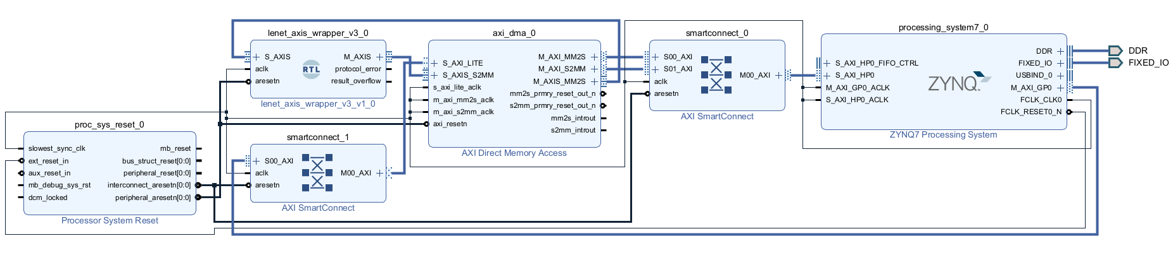
PL Result and Block Design

Slide 34
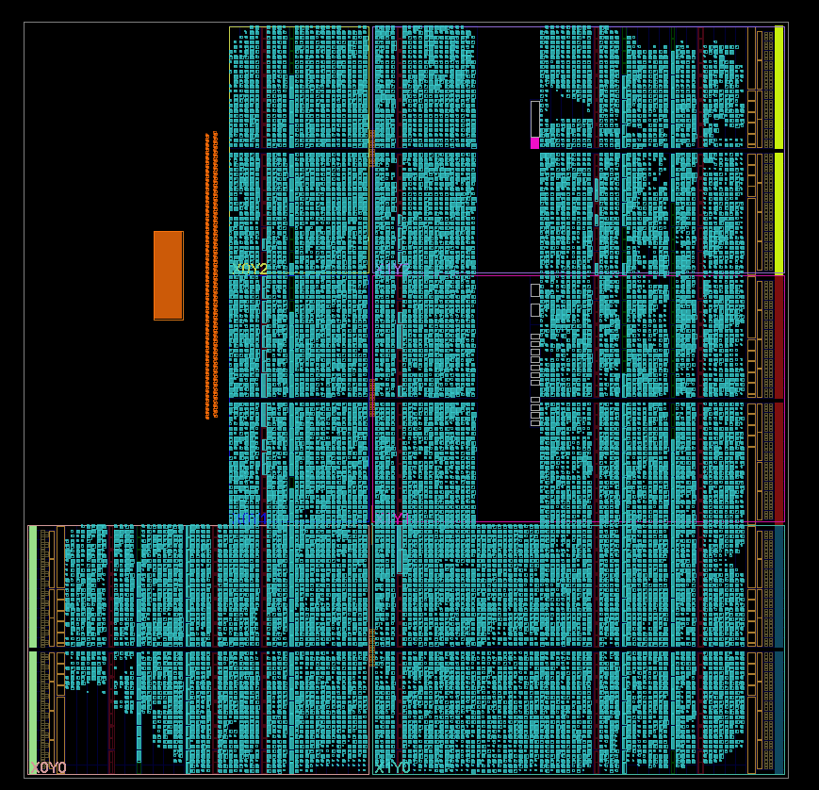
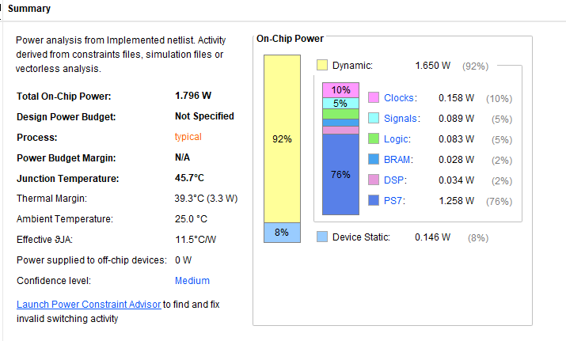
Block Design Analysis

Slide 35
Evaluation
76

Slide 36
Overall Benchmark Summary
All three accelerators were evaluated on 1,000 test images. The table separates model quality from PL computation and PS+PL system latency.
Metric
Baseline
LeNet-v2
LeNet-v3
Accuracy
98.40%
98.60%
98.30%
Correct / Wrong
984 / 16
986 / 14
983 / 17
PL steady cycles / image
434,330
1,504
962
PL latency / image
8,686.60 µs
12.032 µs
6.0125 µs
E2E latency / image
8,760.47 µs
22.589 µs
9.386 µs steady
Pure PL throughput
≈115 img/s
83,112 img/s
166,320 img/s
Key method
single sequential path
parallel engines + buffering
1-bit input + BitMoD FP4 + 160 MHz
PL cycle reduction
v2 → v3 PL
Accuracy cost
E2E throughput
99.78%
2.001×
−0.30 pp
106k img/s
Baseline → v3
steady latency speedup
v3 vs v2
v3 steady state
2

Slide 37
Accuracy–Performance Trade-off
v3 intentionally trades only a small accuracy difference for a large reduction in PL latency and cycle count.
Baseline
LeNet-v2
LeNet-v3
v3 penalty
98.40%
98.60%
98.30%
−0.30 pp
reference board run
best accuracy
low-bit final design
vs v2 accuracy
PL latency per image
PL throughput
Baseline
8.687 ms
Baseline
~115 img/s
v2
12.032 µs
v2
83k img/s
v3
6.013 µs
v3
166k img/s
Evaluation takeaway: v3 keeps the classifier within the same accuracy band while cutting the steady PL latency by 2.001× compared with v2.
3

Slide 38
If the Benchmark Runs on 10,000 Images
This is an extrapolation from the measured 1,000-image benchmark. It assumes the same accuracy rate and similar steady-state timing behavior.
Projected result
Baseline
LeNet-v2
LeNet-v3
Expected correct
9,840
9,860
9,830
Expected wrong
160
140
170
Projected E2E total
87.605 s
225.894 ms
95.086 ms
Projected PL total
86.866 s
≈120.320 ms
61.352 ms
Average E2E / image
8.760 ms
22.589 µs
9.509 µs
Main note
accuracy reference
high accuracy, higher overhead
fastest system-level projection
Speedup overview
v2 vs Baseline
~388× E2E
Projection method
v3 vs v2
~2.38× E2E @10k
v3 uses one cold-start image plus 9,999 steady-state images. That is why its 10k average improves compared with the 1,000-image cold-included average.
v3 vs Baseline
~921× E2E @10k
Log-scale bars are used only for visual comparison.
Projected 10k result: v3 would process 10,000 images in about 95 ms while still keeping an expected 98.30% accuracy.
4

Slide 39
Evaluation Conclusion
The three versions show a clear design evolution: correctness → parallelism → quantized hardware co-design.
Version
Main purpose
Strength
Remaining issue
Baseline
Verify the LeNet accelerator path
Stable PS → PL → PS behavior
Very large PL cycle count
LeNet-v2
Remove major computation bottlenecks
High accuracy and large PL speedup
PS+PL overhead still visible
LeNet-v3
Make low-bit representation visible to hardware
Fastest PL and E2E result with small accuracy loss
Needs larger-scale validation and power/resource study
One-sentence result
LeNet-v3 demonstrates that 1-bit input and BitMoD-style low-bit weights can preserve near-baseline accuracy while substantially reducing measured PL latency.
How to present it
Do not claim the 10k projection as measured data. Present it as an expected result if the same accuracy rate and steady-state timing hold.
6

Slide 40
Q&A
82

