Slide 1




Paper Seminar
Presentation #1
SpAtten: Efficient Sparse Attention Architecture with Cascade Token and Head Pruning, HPCA 2021
2022142255 SeokChan Jeong

Slide 2
Table of Content
Motivation and background
Background Knowledge
Software Algorithm
Hardware architecture
Evaluation
2

Slide 3
Motivation and Background
3

Slide 4
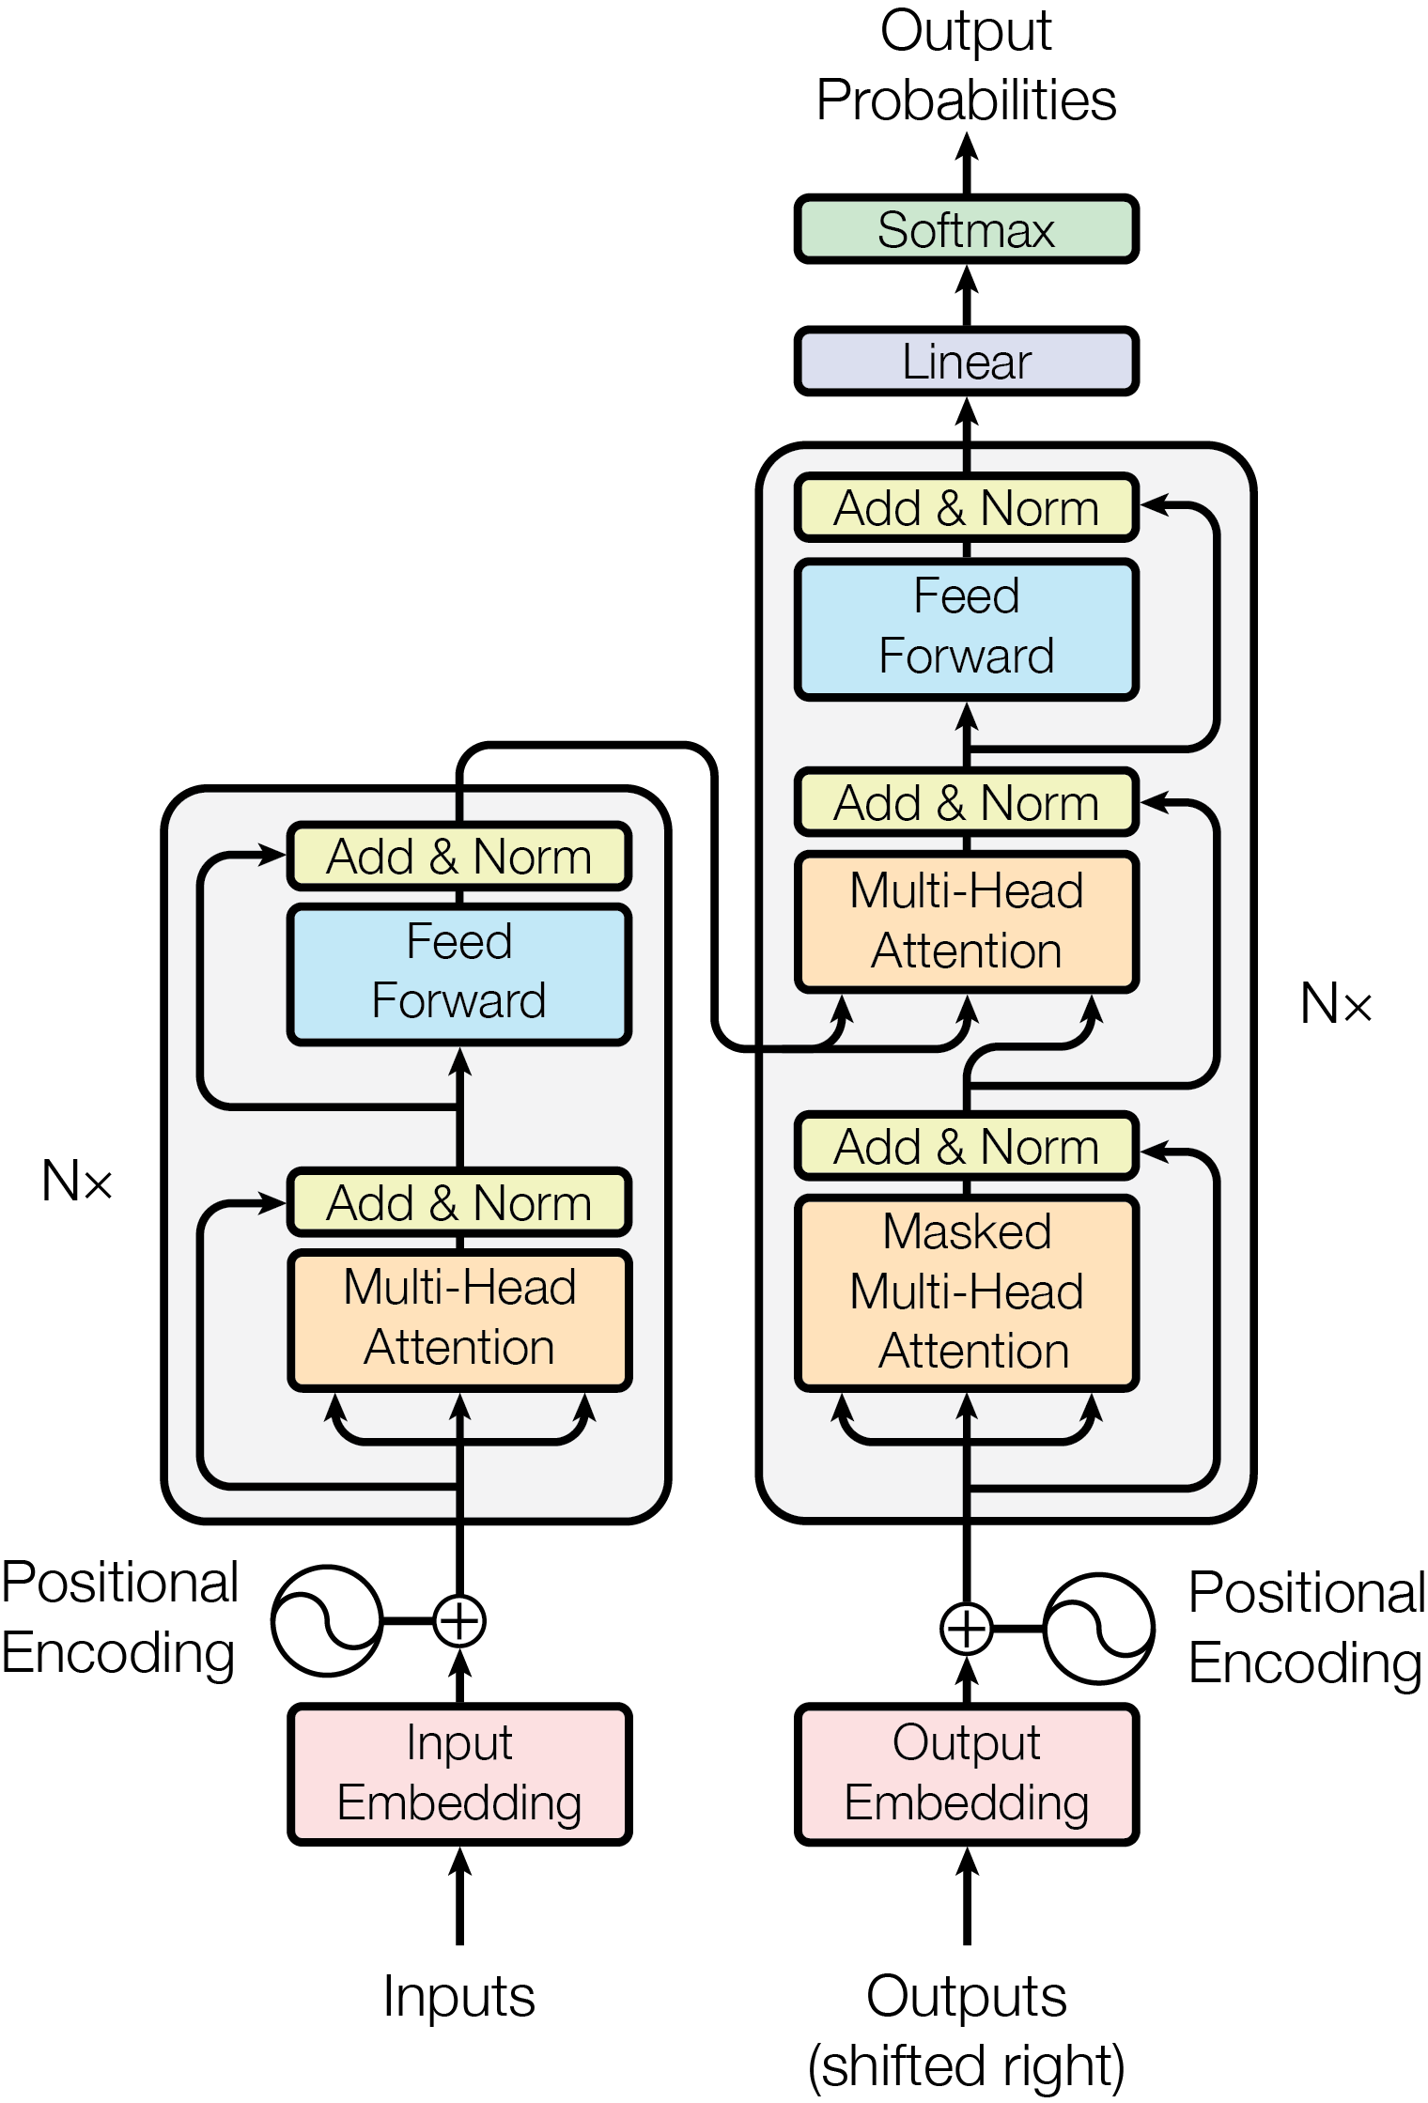
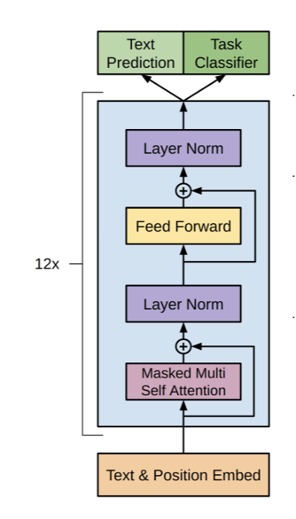
Attention is all you need(NIPS 2017)
Improving Language Understanding by Generative Pre-Training(GPT-1, 2018)
• Transformer
CNN -> Attention
• What became different with CNN&RNN?
Transformers calculate massive parallelism by GPU more effectively than CNN & RNN
Therefore
Transformer model become dominant
+ Require new acceleration method
4

Slide 5
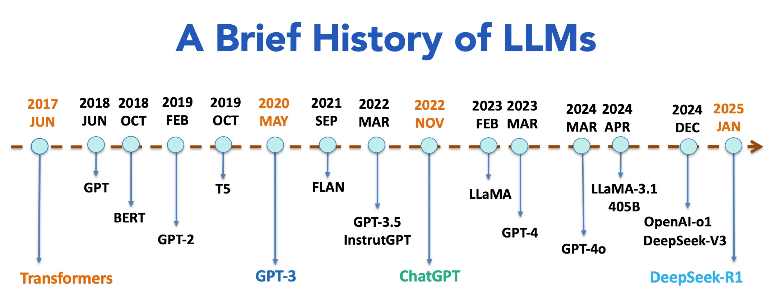
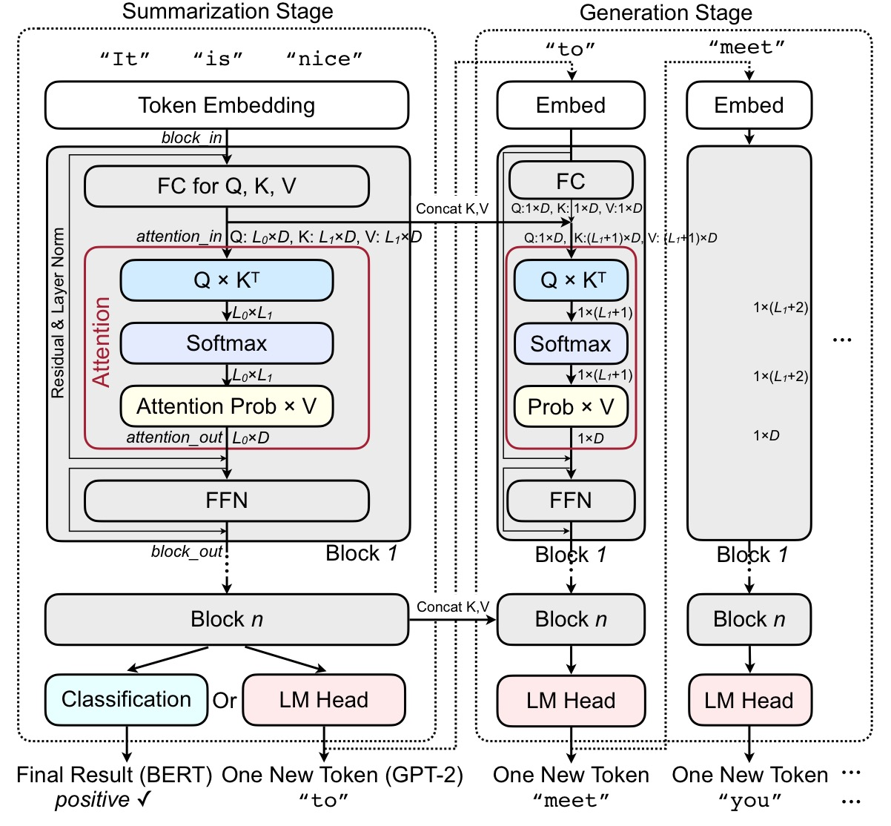
BERT & GPT-2
SpAtten
• GPT-1 vs BERT-Base
Encoder-only, 117M parameter, Bidirectional -> Understand language more, Computation-bound
• GPT-1 vs GPT-2
SpAtten
Decoder-only, 1.5B parameter, Scaling up, Memory-bound
5

Slide 6
Background Knowledge
6

Slide 7
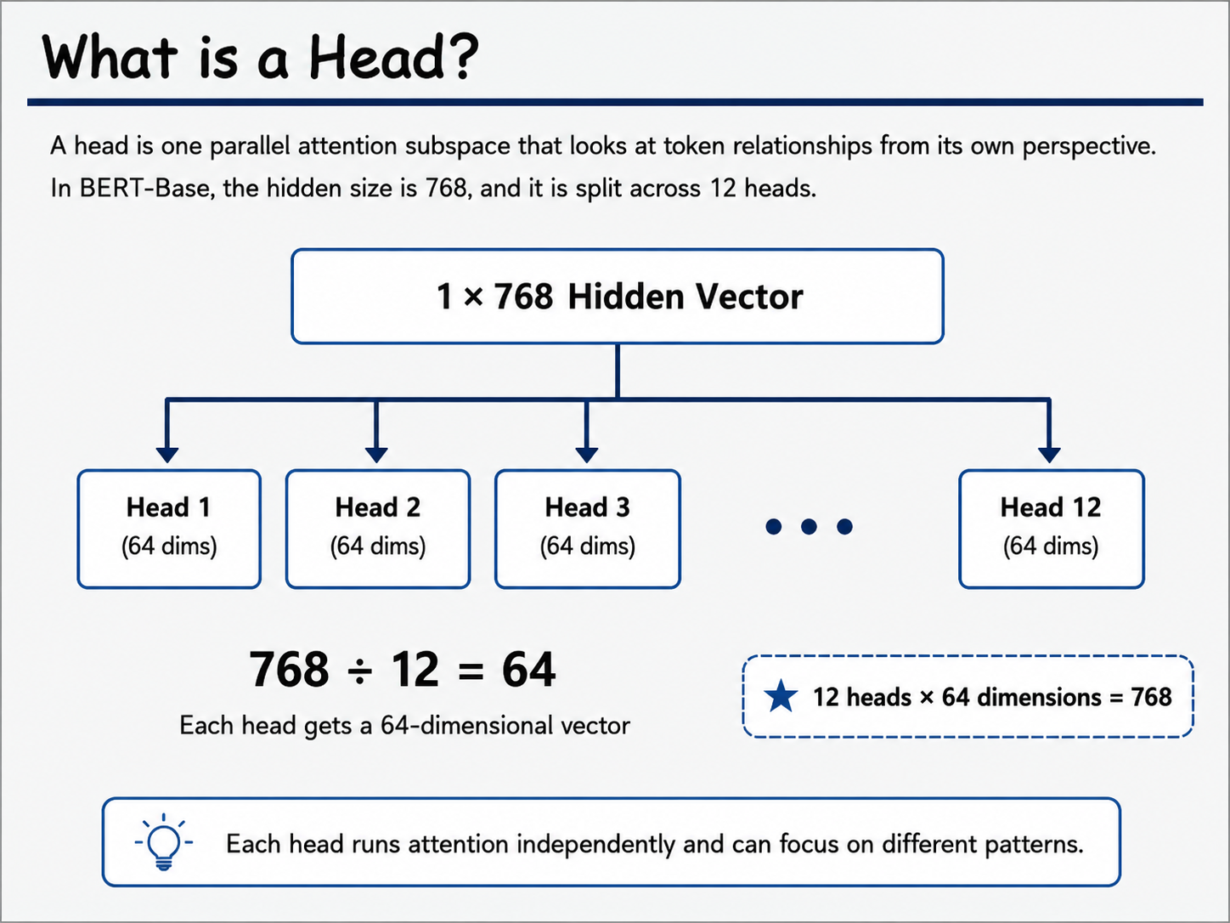
Token & Head (BERT-base)
As
a
visual
treat
,
the
film
is
almost
perfect
.
• Token
Fundamental unit of text that an AI model processes and understands
film
[0.12, -0.38, 0.57, ..., 0.21] → 1x768 Vector
Verb Adjective Noun → Features
• Head
One parallel attention subspace that looks at token relationships form its own perspective
7

Slide 8
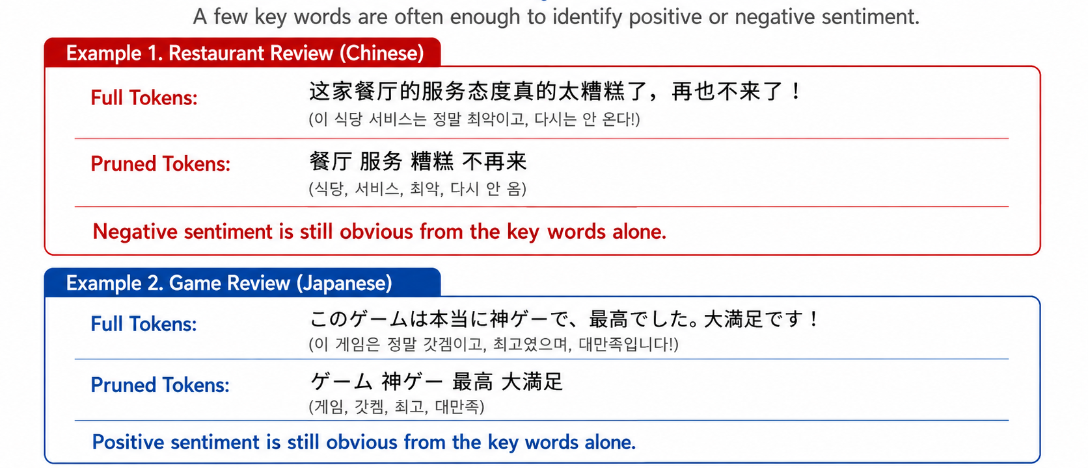
You don’t have to understand every word
8

Slide 9
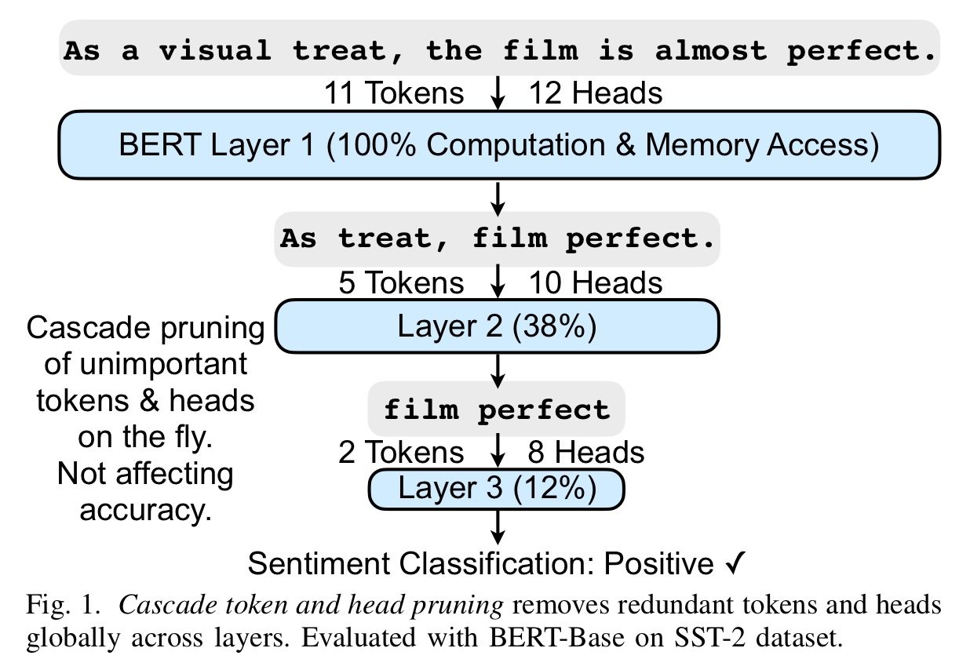
3 Optimization of SpAtten
• Cascade Token Pruning
• Cascade Head Pruning
• Progressive Quantization
⬍
Direct Quantization
9

Slide 10
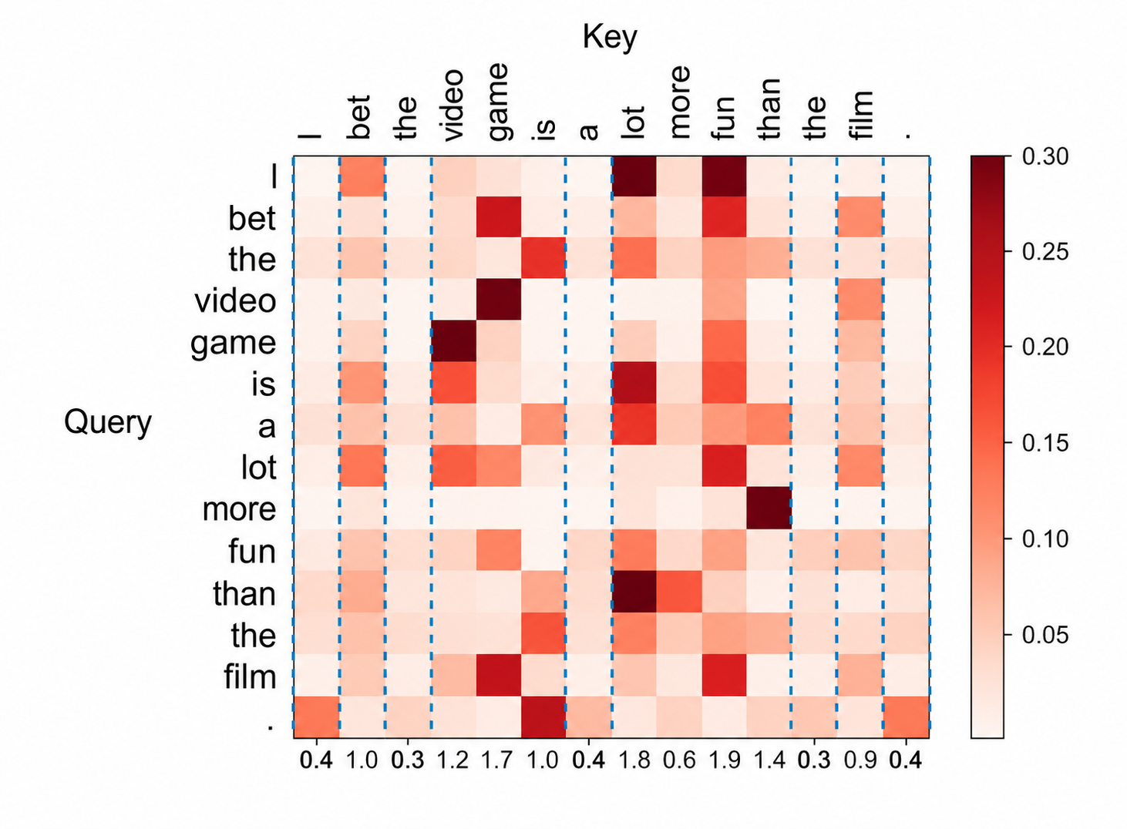
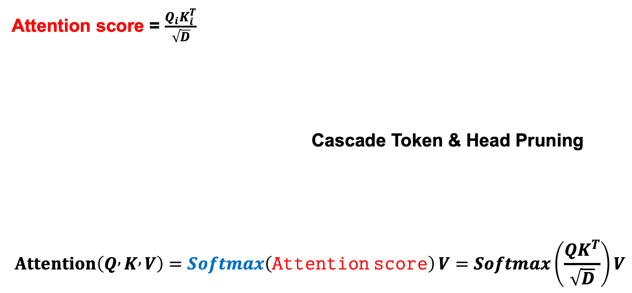
Attention Mechanism
Attention score = $\frac{Q_{i}K_{i}^{T}}{\sqrt{D}}$
Cascade Token & Head Pruning
$$Attention⁡\left(Q , K , V\right)=\operatorname{Softmax}\left(Attention score\right)V=\operatorname{Softmax}\left(\frac{QK^{T}}{\sqrt{D}}\right)V$$
Progressive Attention
10

Slide 11
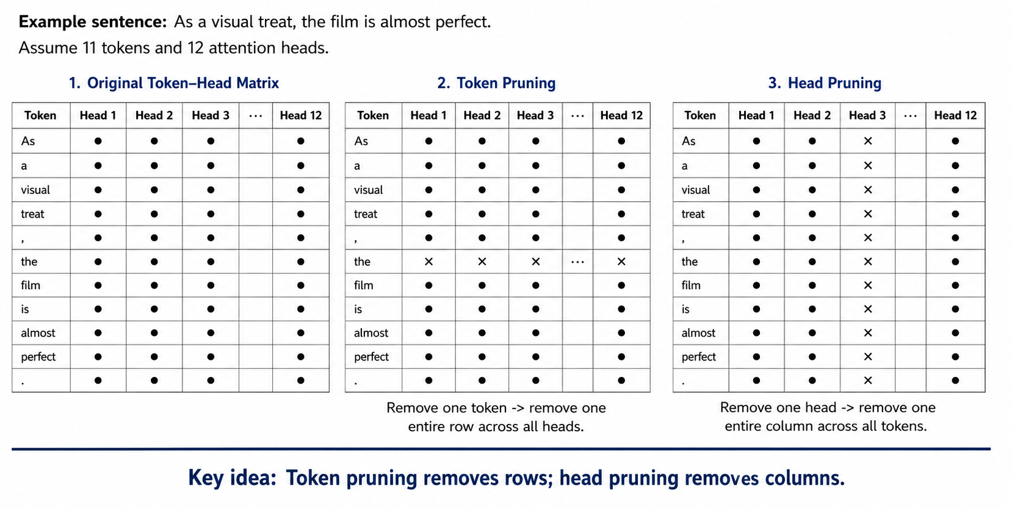
Cascade Token Pruning vs Head Pruning
11

Slide 12
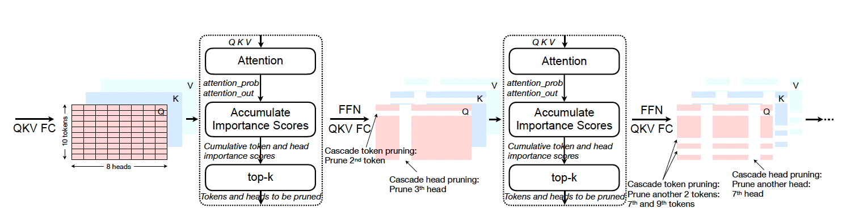
Cascade Pruning vs Value Pruning
1. Cascade Pruning
2. Local Value Pruning
Global & persistent pruning across later layers
Temporary pruning inside one query–head weighted sum
Query qᵢ
Softmax probs
top-k V IDs
Σ pᵢVᵢ
p = [0.05, 0.31, ...]
Current attention probability row
Only high-probability V vectors are fetched
What it removes
Effect
What it removes
Effect
• tokens before later QKV/FFN
• whole heads in later layers
Persistent: once removed, later computation is skipped.
• low-probability Value vectors
• only for this query/head
Local: tokens and heads still exist for other computations.
Aspect
Cascade Pruning
Local Value Pruning
Score source
Cumulative token/head importance scores
Current attention probabilities
Timing
Before later QKV/Attention/FFN computation
After Softmax, before probability × V
Scope
Global across later layers/heads
Local to one query and one head
Main saving
Computation + memory traffic
Value fetch + weighted-sum work
Key idea: Cascade pruning removes future work; local value pruning skips unnecessary V reads only for the current weighted sum.
12

Slide 13
Progressive Quantization vs Direct Quantization
1. Direct Quantization
2. Progressive Quantization
Fetch Full Bitwidth
(MSB + LSB)
Compute Attention
Probabilities
Fetch MSB ONLY
Compute attention probs
Need LSB?
Is distribution flat?
Fetch LSB
Concat MSB + LSB
Recompute probs
Start
Finish
Start
Finish
Same bitwidth for every input
Adaptive bitwidth by attention uncertainty
Fixed precision for all attention inputs
Starts with MSB-only low precision
No decision or recomputation step
Fetches LSB only when distribution is flat
Simple control, but higher memory traffic
Lower average memory access and bandwidth
Aspect
Direct Quantization
Progressive Quantization
Bitwidth strategy
Fixed
Adaptive
Memory access
Always full bitwidth
Lower on average
Key idea: Progressive quantization saves memory by loading extra bits only when the attention distribution is uncertain.
13

Slide 14
Software Algorithm
14

Slide 15
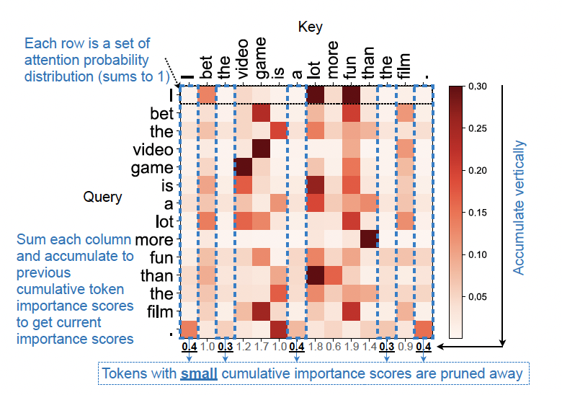
Cascade Pruning Algorithm
Input tensors
Attention probability map
P = attention_prob ∈ ℝ^{h×L₀×L₁}
E = reshape(attention_out) ∈ ℝ^{h×L₀×D}
s_{t}^{prev} ∈ ℝ^{L₁}, s_{h}^{prev} ∈ ℝ^{h}
Symbols
h: current number of heads
L₀: number of query tokens
L₁: number of key/value tokens
D: feature dimension of one head
How to read the map
• Each row is one query token
• Each column is one key token
• Column-wise accumulation gives token importance
• Low-score tokens can be removed in later layers
TopKIndex role
TopKIndex( s^{new}, k ): TopKIndex selects the indices of the $k$largest importance scores.
15

Slide 16
Cascade Pruning Algorithm
Token cumulative importance
Head cumulative importance
1) Accumulate by key-token columns
1) Accumulate by head output magnitude
s_{t}^{new}[j] = s_{t}^{prev}[j] + Σ_{m=1}^{h} Σ_{i=1}^{L₀} P_{m,i,j}, j = 1, …, L₁
s_{h}^{new}[m] = s_{h}^{prev}[m] + Σ_{i=1}^{L₀} Σ_{d=1}^{D} |E_{m,i,d}|, m = 1, …, h
Adds all probabilities that attend to key token j across heads and query tokens.
A head is important if its attention output has large magnitude across tokens and features.
2) Determine how many tokens remain
2) Determine how many heads remain
k_{t} = floor( L₁(1 − p_{t}) )
k_{h} = floor( h(1 − p_{h}) )
pₜ is the token pruning ratio; kₜ is the number of token IDs to keep.
pₕ is the head pruning ratio; kₕ is the number of head IDs to keep.
3) Select remaining tokens
3) Select remaining heads
T_{remain} = TopKIndex( s_{t}^{new}, k_{t} )
H_{remain} = TopKIndex( s_{h}^{new}, k_{h} )
TopKIndex returns the kₜ token IDs with the largest cumulative token scores.
TopKIndex returns the kₕ head IDs with the largest cumulative head scores.
Key difference: Token pruning removes rows across all heads; head pruning removes columns across all tokens.
15

Slide 17
Cascade Pruning Algorithm
Example with h = 2, L₀ = 2, L₁ = 4. The goal is to keep the two most important tokens.
Step 1. Start from attention probabilities P
Step 2. Accumulate token scores
Tokens: As the film perfect
Head 1, P[1,:,:]
q₁ 0.10 0.20 0.30 0.40
q₂ 0.05 0.10 0.35 0.50
Head 2, P[2,:,:]
q₁ 0.20 0.10 0.40 0.30
q₂ 0.10 0.05 0.50 0.35
As the film perfect
sₜ_prev 0.20 0.10 0.40 0.30
+ ΣₘΣᵢP 0.45 0.45 1.55 1.55
-----------------------------------------
sₜ_new 0.65 0.55 1.95 1.85
Column sums are accumulated vertically across all heads and query tokens.
Step 3. Decide how many tokens remain
Step 4. Apply TopKIndex
pₜ = 0.5
kₜ = floor(4 × (1 − 0.5)) = 2
TopKIndex([0.65, 0.55, 1.95, 1.85], 2)
= {film, perfect}
Result: film and perfect remain; lower-score tokens are pruned from later layers.
15

Slide 18
Cascade Pruning Algorithm
Use output magnitude to decide which attention heads remain active.
Step 1. Accumulate head scores from E
Step 2. Add previous head importance
Head 1 E: [0.40, −0.20], [0.10, 0.30]
abs sum = 0.40+0.20+0.10+0.30 = 1.00
Head 2 E: [0.05, 0.10], [−0.10, 0.05]
abs sum = 0.05+0.10+0.10+0.05 = 0.30
Head 1 Head 2
sₕ_prev 0.30 0.20
+ abs sum 1.00 0.30
----------------------------
sₕ_new 1.30 0.50
Step 3. Decide how many heads remain
Step 4. Apply TopKIndex
pₕ = 0.5
kₕ = floor(2 × (1 − 0.5)) = 1
TopKIndex([1.30, 0.50], 1)
= {Head 1}
Result: Head 1 remains; Head 2 is pruned across all tokens in later layers.
Key distinction: token pruning selects token IDs; head pruning selects head IDs.
15

Slide 19
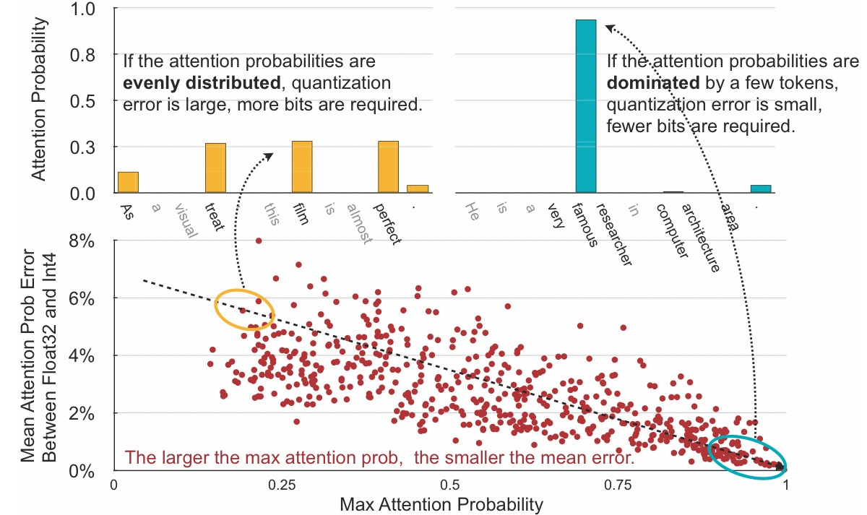
Progressive Quantization Algorithm
Quantization reduces memory traffic, but some attention patterns need more precision.
1. Score error from quantization
Quantizing Q and K slightly perturbs the attention score.
2. Softmax usually bounds the error
3. Error depends on the distribution
Flat distribution
higher error rate → fetch LSB
Peaked distribution
small error → MSB is enough
Key idea: Use MSB first. Add LSB only when attention probabilities are flat and quantization error becomes larger.
15

Slide 20

Progressive Quantization Algorithm
MSB-only estimate
Decision Flow
Pᴹˢᴮ = Softmax( Qᴹˢᴮ (Kᴹˢᴮ)ᵀ / √D )
Fetch MSB only
Compute Pᴹˢᴮ
pₘₐₓ < τ ?
YES
Fetch LSB
Recompute
Start
Finish
Confidence Test
NO: confident
MSB is enough
pₘₐₓ = maxⱼ Pⱼᴹˢᴮ
High pₘₐₓ means one token dominates.
Low pₘₐₓ means the distribution is flat.
Interpretation
Dominated distribution
max probability is high → use MSB only
Output Selection
Flat distribution
max probability is low → fetch LSB and recompute
$$P_{final}=\left\{\begin{matrix}P^{MSB}, & p_{max}≥τ \\ P^{MSB+LSB}, & p_{max}<τ\end{matrix}\right.$$
This is the algorithmic core of progressive quantization.
15

Slide 21
Progressive Quantization Algorithm
Decision rule: start with MSB only, then fetch LSBs only when the attention distribution is uncertain.
pmax = max(PMSB)
Pfinal = PMSB if pmax ≥ τ
Pfinal = PMSB+LSB if pmax < τ
Illustrative threshold: τ = 0.30
Case A. Peaked distribution
Case B. Flat distribution
High variance: one token dominates.
Low variance: probabilities are close.
MSB attention probabilities
[0.03, 0.02, 0.90, 0.05]
MSB attention probabilities
[0.27, 0.25, 0.24, 0.24]
1.0
1.0
0.5
0.5
0
p1
p2
p3
p4
0
p1
p2
p3
p4
pmax = 0.90
0.90 ≥ τ
pmax = 0.27
0.27 < τ
Use MSB result; no LSB fetch.
Fetch LSB, combine MSB+LSB, and recompute.
The dominant token remains clear even with low-bit quantization.
Small quantization errors can change the ordering between tokens.
Key idea: flat attention distributions are more sensitive to quantization error, so SpAtten refines precision only for those cases.
15

Slide 22
Hardware Architecture
14

Slide 23
Zero Eliminator
Problem: filtering creates holes
Output: dense stream
0
1
2
3
4
5
6
7
0
1
2
3
4
5
6
7
a
0
b
0
c
d
0
e
Zero Eliminator
a
b
c
d
e
0
0
0
Sparse vector after comparison
Valid elements keep the original relative order
Core operation
For each valid element, count how many zeros are before it, then shift it left by that count.
new_index(xᵢ) = i − zᵢ
•
Used after top-k filtering to remove zeros before pushing values into FIFO.
•
Does not sort values; it only compacts valid items.
•
Scores and their token/value/head IDs move together.
Zero Eliminator = order-preserving compression of nonzero elements
15

Slide 24









Zero Eliminator
For each position, compute the prefix count of zeros that appeared earlier in the vector.
Input vector
$$X_{0}$$
$$X_{1}$$
$$X_{2}$$
$$X_{3}$$
$$X_{4}$$
$$X_{5}$$
$$X_{6}$$
$$X_{7}$$
zᵢ = Σⱼ₌₀ⁱ⁻¹ 1(xⱼ = 0)
a
0
b
0
c
d
0
e
Prefix zero count
$$1\left(x_{j}=0\right) \text{=} \left\{\begin{aligned}1,&x_{j}=0, \\ 0,&x_{j}≠0.\end{aligned}\right.$$
0
0
1
1
2
2
2
3
zero_cnt
Element
Original index
Zeros before
Shift amount
a
0
0
0
Example reading
At position 4, the value is c. Before c, there are two zeros, so z₄ = 2.
At position 7, the value is e. Before e, there are three zeros, so z₇ = 3.
b
2
1
1
c
4
2
2
d
5
2
2
e
7
3
3
zᵢ tells how far each valid element must move left
15

Slide 25
Zero Eliminator
A valid element moves left by the number of zeros before it.
new_index(xᵢ) = i − zᵢ
Mapping from original position to compacted position
Before
Element
i
zᵢ
new index = i − zᵢ
Result
0
1
2
3
4
5
6
7
a
0
b
0
c
d
0
e
a
0
0
0 − 0 = 0
y₀ = a
b
2
1
2 − 1 = 1
y₁ = b
c
4
2
4 − 2 = 2
y₂ = c
After
d
5
2
5 − 2 = 3
y₃ = d
0
1
2
3
4
5
6
7
e
7
3
7 − 3 = 4
y₄ = e
a
b
c
d
e
0
0
0
15

Slide 26
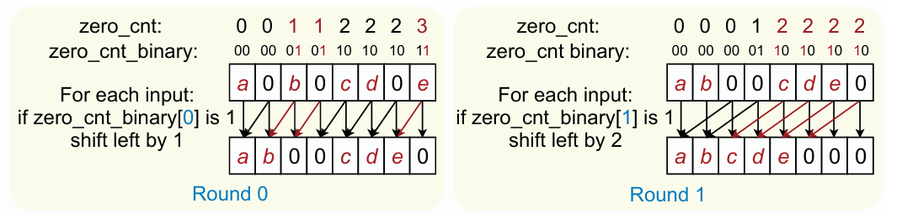
Zero Eliminator
Hardware does not need a large arbitrary shifter; it performs staged shifts of 1, 2, 4, ... positions.
Shift amount as binary
0
0
1
1
2
2
2
3
zᵢ = Σᵣ bᵢ,ᵣ 2ʳ
zero_cnt
00
00
01
01
10
10
10
11
binary
Each bit controls one shift stage.
15

Slide 27
Zero Eliminator
The stage distances double each round, so n elements only require ⌈log₂ n⌉ shift stages.
N_stage = ⌈log₂ n⌉
n = 8 → ⌈log₂ 8⌉ = 3 stages
Stage distances
Round 0
Round 1
Round 2
bit 0
bit 1
bit 2
Shift left by 1 position
Shift left by 2 positions
Shift left by 4 positions
In the example, the maximum shift is 3, so only the 1-position and 2-position stages are actually used.
•
A full 8-element design still includes a possible 4-position stage for the worst case.
•
The hardware scales efficiently because stages grow as 1, 2, 4, 8, ... rather than one stage per possible shift distance.
Zero Eliminator uses staged parallel shifts, not serial movement
15

Slide 28
Quick select
Goal: select the top-k important tokens, heads, or values without fully sorting the whole array.
Core idea
Importance
scores
Choose
a pivot
Partition
<, =, >
Keep only
needed side
Find k-th
threshold
Why this matters in SpAtten
Instead of sorting everything
•
Token pruning keeps only important token IDs.
•
Quick Select finds the boundary value: the k-th largest score.
•
Head pruning keeps only important attention head IDs.
•
The original order can be preserved when filtering.
•
Local value pruning keeps only high-probability value IDs.
•
Hardware can process many comparisons in parallel.
Key message: Quick Select is a threshold finder for Top-k selection, not a full sorter.
15

Slide 29
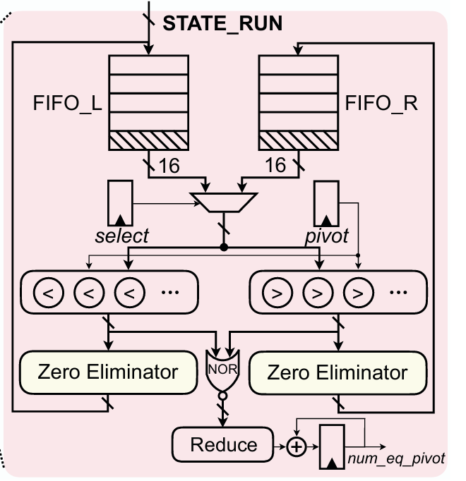
Quick select
1
Select active FIFO
FIFO_L or FIFO_R is chosen depending on where the k-th value can still exist.
2
Choose a pivot
A random item from the selected FIFO becomes the current pivot.
3
Compare in parallel
16 values are compared at once: item < pivot and item > pivot.
4
Compact outputs
Zero Eliminators remove empty slots and pack valid values.
5
Count equal values
NOR + Reduce counts items equal to pivot as num_eq_pivot.
STATE_RUN performs only one partition. START decides whether to repeat or stop.
15

Slide 30
Quick select
After one partition, only one side needs to be searched again.
G = { x | x > p } E = { x | x = p } L = { x | x < p }
Let p be the pivot, g = |G|, e = |E|, and r be the target rank.
Output of Quick Select
Final filtering
A threshold θ = k-th largest value, not a fully sorted list.
Keep values > θ and only the needed number of values = θ.
The algorithm narrows the candidate set instead of ordering all scores.
15

Slide 31
Quick select
Selected FIFO: FIFO_L Candidate set = [0.6, 0.1, 0.5, 1.2, 0.6]
Pivot p = 0.1
Target r = 4
FIFO_L = [ ]
FIFO_R = [0.6, 0.5, 1.2, 0.6]
Value x | Relation | Output
0.6 | x > p | FIFO_R
0.1 | x = p | Equal
0.5 | x > p | FIFO_R
1.2 | x > p | FIFO_R
0.6 | x > p | FIFO_R
num_eq = 1
|FIFO_R| = 4 and r = 4
Decision: r ≤ |FIFO_R|, so the pivot is too small and the next search moves to FIFO_R.
15

Slide 32
Quick select
Selected FIFO: FIFO_R Candidate set = [0.6, 0.5, 1.2, 0.6]
Pivot p = 0.6
Target r = 4
Value x | Relation | Output
0.6 | x = p | Equal
0.5 | x < p | FIFO_L
1.2 | x > p | FIFO_R
0.6 | x = p | Equal
FIFO_L = [0.5]
FIFO_R = [1.2]
num_eq = 2
|FIFO_R| + num_eq = 1 + 2 = 3 < r = 4
Decision: the pivot is too large. One value in FIFO_R and two equal values are already fixed, so update the target to r = 4 - 3 =1 and search FIFO_L next.
15

Slide 33
Quick select
Selected FIFO: FIFO_L Candidate set = [0.5]
Pivot p = 0.5
Updated target r = 1
FIFO_L = [ ]
FIFO_R = [ ]
num_eq = 1
Value x | Relation | Output
0.5 | x = p | Equal
Termination condition: |FIFO_R| < r ≤ |FIFO_R| + num_eq → 0 < 1 ≤ 1
Therefore the threshold is θ = 0.5.
15

Slide 34
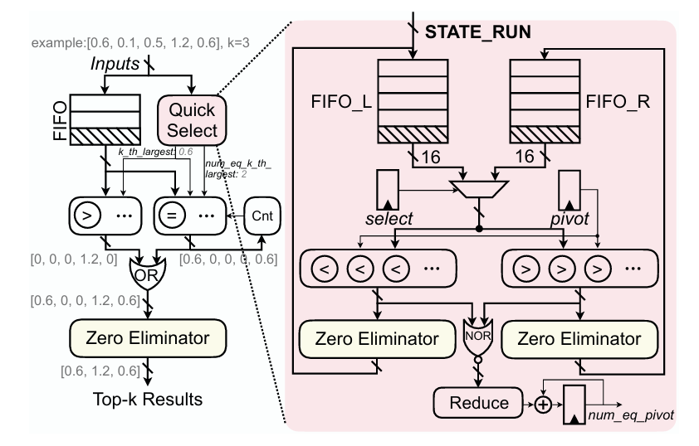
Top-k Engine
FIFO: [0.6, 0.1, 0.5, 1.2, 0.6], k = 3
FIFO_L: [0.6, 0.1, 0.5, 1.2, 0.6], k = 3
If, pivot = 0.6
FIFO_L: [0.1, 0.5], k = 3
| FIFO_R: [1.2] | + num_eq = 2 == k = 3
k_the_largest = 0.6
[0.6>0.6, 0.1>0.6, 0.5>0.6, 1.2>0.6, 0.6> 0.6]
= [0, 0, 0, 1.2, 0]
[0.6=0.6, 0.1=0.6, 0.5=0.6, 1.2=0.6, 0.6= 0.6]
= [0.6, 0, 0, 0, 0.6]
[0.6, 0, 0, 1.2, 0.6]
[0.6, 1.2, 0.6]
15

Slide 35
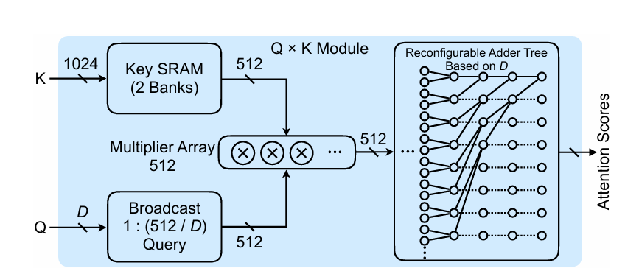
Query-Key Multiplication Module
Purpose
S = QKᵀ produces attention scores
sᵢ = Σⱼ KᵢⱼQⱼ
Key SRAM supplies 512 key elements per cycle.
The query vector is broadcast to multiple multiplier groups.
512 multipliers compute element-wise products in parallel.
A reconfigurable adder tree reduces products into attention scores.
If head dimension is D, scores per cycle = 512 / D
Nscore = 512 / D
15

Slide 36
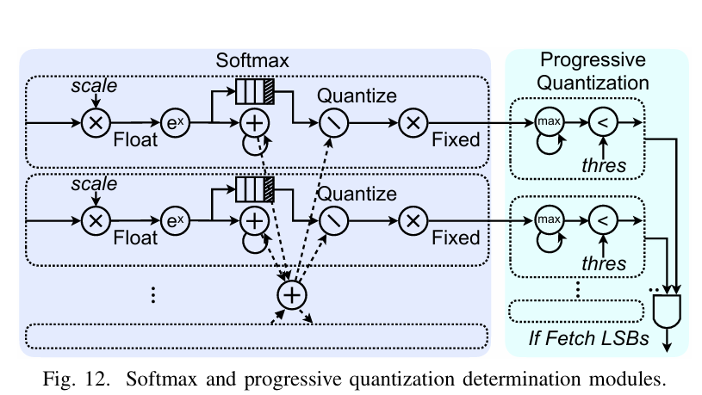
Softmax and Progressive Quantization
Converts fixed-point scores into probabilities and decides whether low bits are needed.
1. Dequantize + Normalize
ŝᵢ = α · sᵢint / √D
Peaked distribution: MSB is enough.
Flat distribution: fetch LSBs and recompute.
This reduces average memory traffic for GPT-style generation.
2. Softmax
pᵢ = exp(ŝᵢ) / Σⱼ exp(ŝⱼ)
3. Precision Decision
pmax = maxᵢ pᵢ
Decision rule: fetch LSBs only when pmax is below threshold τ
15

Slide 37
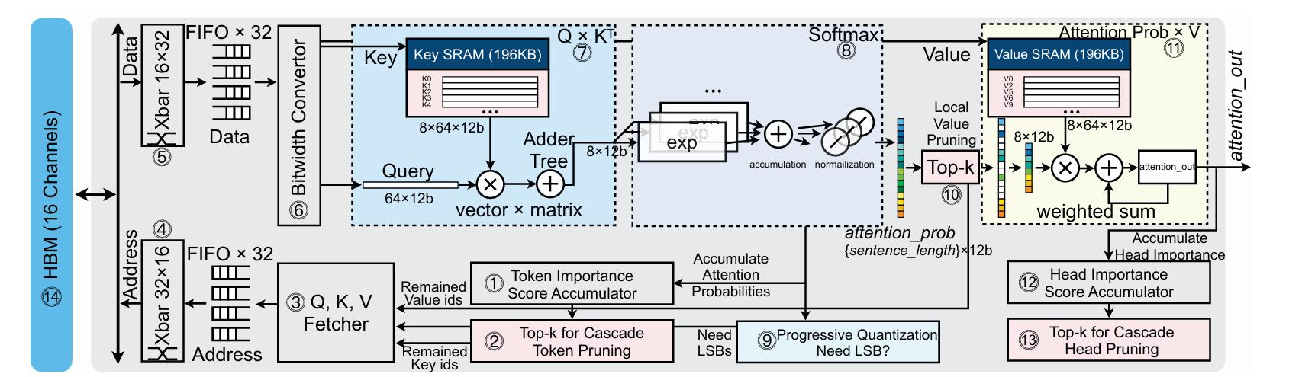
How One Query Flows Through SpAtten
Example Query current token = "more"
Goal compute attention_out for this Query
Main benefit fetch and compute only important K/V data
15

Slide 38
How One Query Flows Through SpAtten
Input Query
Current Query token "more"
Query vector for one head Q_more = [1.0, 2.0]
Token | Prev. importance
I | 0.4
bet | 1.0
the | 0.3
video | 1.2
game | 1.7
is | 1.0
a | 0.4
lot | 1.8
more | 0.6
fun | 1.9
than | 1.4
the | 0.3
film | 0.9
. | 0.4
SpAtten keeps cumulative token importance from previous queries, heads, and layers.
Before fetching all Keys, it first selects high-importance Key IDs.
This reduces unnecessary HBM traffic.
For this example, choose Top-6 Key IDs from the previous importance scores.
15

Slide 39
How One Query Flows Through SpAtten
Modules 1–2
Top-k input Cumulative token scores
Top-k output Key IDs to fetch
Rank | Selected Key | Score
1 | fun | 1.9
2 | lot | 1.8
3 | game | 1.7
4 | than | 1.4
5 | video | 1.2
6 | is | 1.0
Important: this step selects Key IDs, not the Key vectors themselves.
15

Slide 40
How One Query Flows Through SpAtten
Modules 3–6
Selected Key IDs fun, lot, game, than, video, is
Address mapping Key ID → HBM address
HBM Fetch selected K only
Key | HBM channel | Action
fun | Ch. 5 | Fetch
lot | Ch. 9 | Fetch
game | Ch. 11 | Fetch
than | Ch. 2 | Fetch
video | Ch. 2 | Fetch
is | Ch. 7 | Fetch
low-score tokens | - | Skip
MSB first Fetch high bits only
Bitwidth Converter internal 12-bit format
Crossbars distribute irregular memory requests across 16 HBM channels and restore the returned data order.
15

Slide 41
How One Query Flows Through SpAtten
Module 7
Formula: S_j = (Q · K_j) / √D with D = 2
Key | K_j | Dot product | Score
fun | [1.5, 1.2] | 3.90 | 2.76
than | [1.2, 1.1] | 3.50 | 2.47
lot | [1.0, 0.75] | 2.50 | 1.77
game | [0.8, 0.6] | 2.00 | 1.41
video | [0.5, 0.25] | 1.00 | 0.71
is | [0.3, 0.1] | 0.50 | 0.35
Score vector = [2.76, 2.47, 1.77, 1.41, 0.71, 0.35]
15

Slide 42
How One Query Flows Through SpAtten
Module 1
Update rule: s_t[j] ← s_t[j] + P_j
Token | Previous | Current P_j | New score
fun | 1.90 | 0.384 | 2.284
than | 1.40 | 0.289 | 1.689
lot | 1.80 | 0.143 | 1.943
game | 1.70 | 0.100 | 1.800
video | 1.20 | 0.049 | 1.249
is | 1.00 | 0.035 | 1.035
These updated scores are used by future Query/head/layer pruning decisions, not by the current Q × K calculation.
15

Slide 43
How One Query Flows Through SpAtten
Modules 8–9
Softmax(score) = [0.38, 0.29, 0.14, 0.10, 0.05, 0.03]
Key | Probability
fun | 0.384
than | 0.289
lot | 0.143
game | 0.100
video | 0.049
is | 0.035
p_max = 0.385
threshold τ = 0.30
Decision: p_max ≥ τ No LSB fetch
If the distribution were flat, SpAtten would fetch LSBs, concatenate MSB+LSB, and recompute Q × Kᵀ and Softmax.
15

Slide 44
How One Query Flows Through SpAtten
Module 10
Input to Local Value Top-k: current attention probabilities
Rank | Selected Value | Probability
1 | V_fun | 0.385
2 | V_than | 0.288
3 | V_lot | 0.143
Skipped Values V_game, V_video, V_is
Fetch only V_fun, V_than, V_lot
Local Value Pruning is per Query/head. It reduces V memory traffic and weighted-sum computation.
15

Slide 45
How One Query Flows Through SpAtten
Module 11
Formula: E_more = Σ P_j V_j over selected Value IDs
E_more = 0.385·V_fun + 0.288·V_than + 0.143·V_lot V_fun=[1.0,0.8], V_than=[0.5,1.2], V_lot=[0.9,0.4]
attention_out for Query "more" = [0.66, 0.71]
This output is the final attention result for one Query in one head.
The same pipeline repeats for the next Query.
15

Slide 46
How One Query Flows Through SpAtten
Modules 12–13
Head importance update: s_h[m] ← s_h[m] + Σ_d |E_{m,Q,d}|
For this Query/head Σ|attention_out| = 1.37
Accumulated over all Queries then used for Head Pruning
Layer-level decision After all Queries are processed, Top-k for Cascade Head Pruning keeps high-importance heads and prunes low-importance heads.
Token pruning is updated during attention. Head pruning is decided after accumulating head importance across the layer.
15

Slide 47
Evaluation
14

Slide 48
Evaluation
SpinalHDL RTL design
Verilator cycle count
Ramulator HBM2 model
Cadence Genus area & power
→
→
→
Benchmarks BERT-Base / BERT-Large GLUE + SQuAD GPT-2 Small / Medium WikiText, PTB, One Billion Word
Baselines TITAN Xp GPU Jetson Nano GPU Xeon CPU Raspberry Pi ARM CPU A³ and MNNFast
Accuracy control Pruning ratios and quantization bitwidths are tuned per task. Fine-tuning is applied after pruning.
15

Slide 49
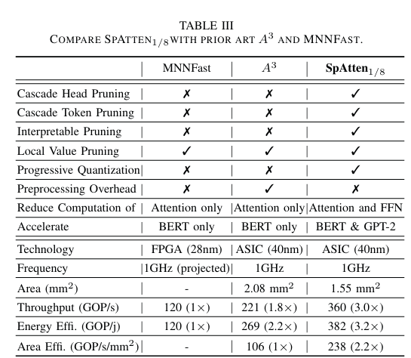
Evaluation
What Table III shows
Only SpAtten supports cascade token pruning and cascade head pruning.
Only SpAtten combines interpretable pruning with progressive quantization.
SpAtten1/8 reaches 360 GOP/s throughput and 382 GOP/J energy efficiency.
SpAtten accelerates both BERT and GPT-2, while prior designs target BERT only.
Key idea SpAtten wins through algorithm–hardware co-design, not only more compute units.
15

Slide 50
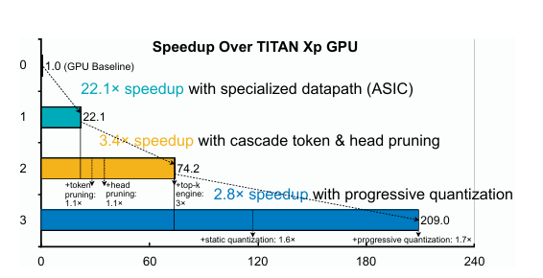
Evaluation
Breakdown interpretation
Dedicated attention datapath gives the first large jump: 22.1×.
Cascade pruning reduces work, but Top-k itself can become the bottleneck.
A high-throughput Top-k engine removes that bottleneck and adds a 3× jump.
Progressive quantization further reduces average input bitwidth and DRAM traffic.
Final message Specialized datapath + fast Top-k + adaptive precision are all necessary.
Pruning alone is not enough: without fast Top-k selection, pruning decisions can become the new bottleneck.
15

Slide 51
Evaluation
Computation 2.1× average reduction Token/head pruning removes unnecessary attention work.
DRAM Access 10× average reduction Pruning and quantization avoid unnecessary Q/K/V fetches.
BERT Throughput 1.61 TFLOPS BERT is closer to computation-bound execution.
GPT-2 Throughput 0.43 TFLOPS GPT-2 generation is memory-bound, so reducing K/V traffic matters.
Evaluation takeaway: SpAtten is effective because it reduces both arithmetic and off-chip memory movement.
15

Slide 52
Q&A
14

