Slide 1
Programming the FPGA Configuration Flash

Slide 2
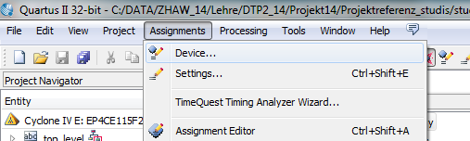
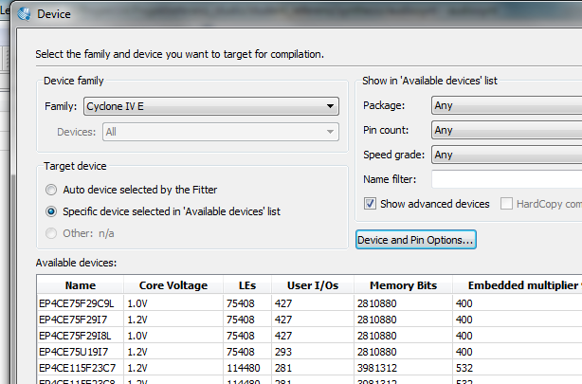
Setting Quartus to generate *.pof
Quartus must be configured to generate a Programmers Object File (pof)
Which is suited to be programmed into the External Flash (Configuration Device)

Slide 3
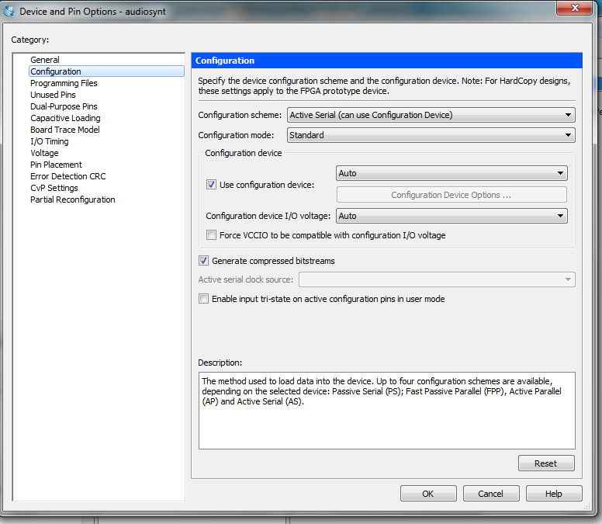
Setting Device Options
After saving the menues, recompile the device and check whether the *.pof file is generated lokated in the synthesis or output directory

Slide 4
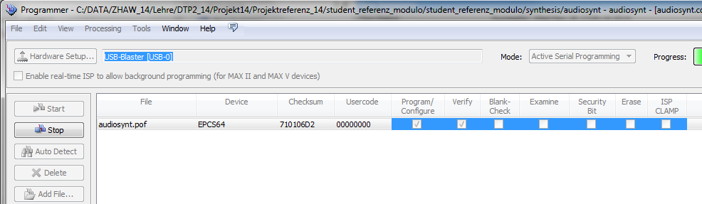
Programming
Set the RUN-PRG Switch on the DE115 board to PRG
Open the Programmer and set it to Active Serial Programming
Remove the .sof and add the .pof file
4. Programm and Verify the device
5. Set the Switch back to RUN.
6. Turn on and off the power of the board to load the configuration

