Slide 1
Employment Restructuring and Industrial Relations in Russia: Lessons for Other Transitional Economies
Simon Clarke
Department of Sociology
University of Warwick

Slide 2
Orthodox model of transition
First stage
  Archaic state enterprises liquidated
  Transitional unemployment
  High levels of social tension
Second stage
  Job creation by new private enterprises
  Absorption of unemployment
  Social stabilisation

Slide 3
What really happened?
Very few bankruptcies

Slide 4
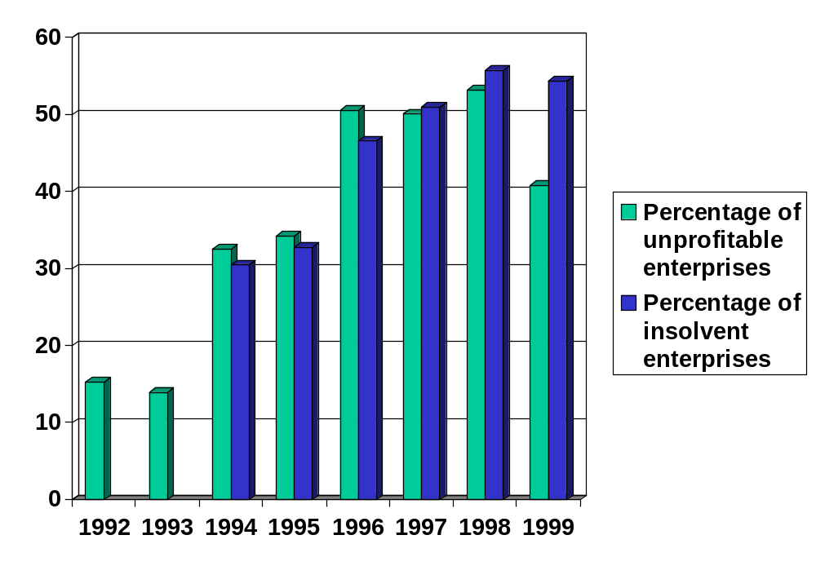

Slide 5
What really happened?
Very few bankruptcies
Very few compulsory redundancies

Slide 6
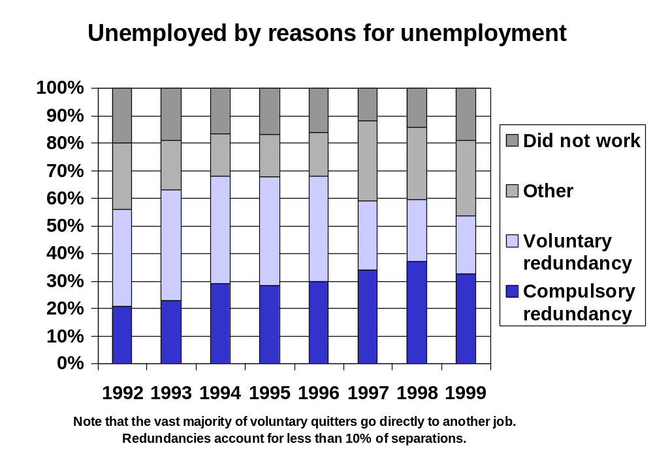

Slide 7
What really happened?
Very few bankruptcies
Very few compulsory redundancies
Low levels of unemployment

Slide 8
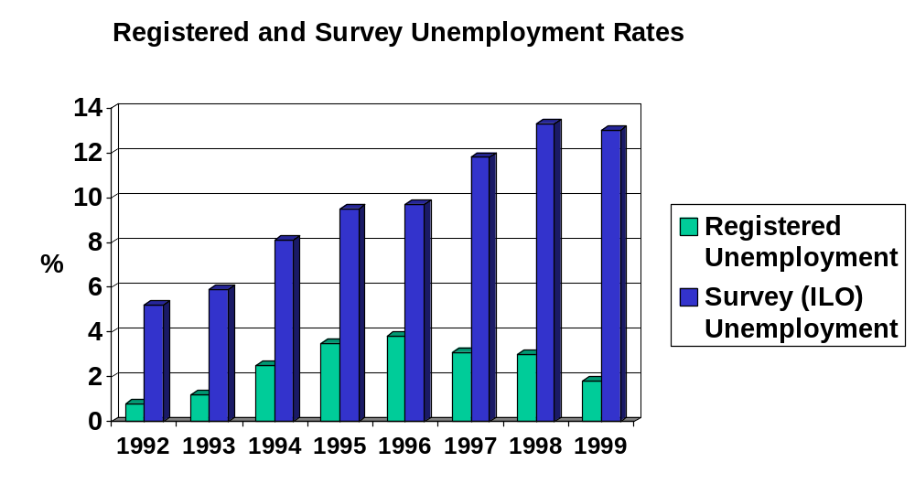
Low levels of unemployment

Slide 9
Economic difficulties led to
wages lagged behind prices
non-payment of wages
huge increase in wage inequality

Slide 10
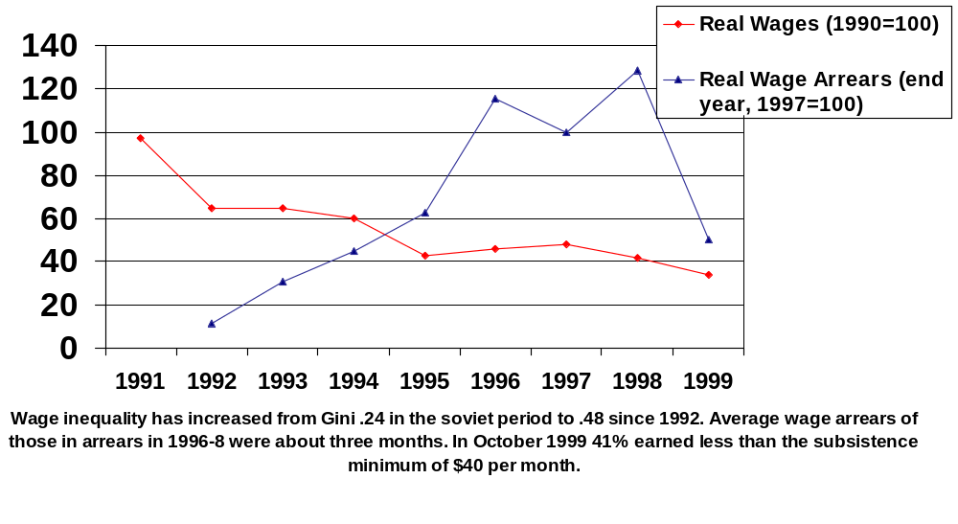
Falling and unpaid wages

Slide 11
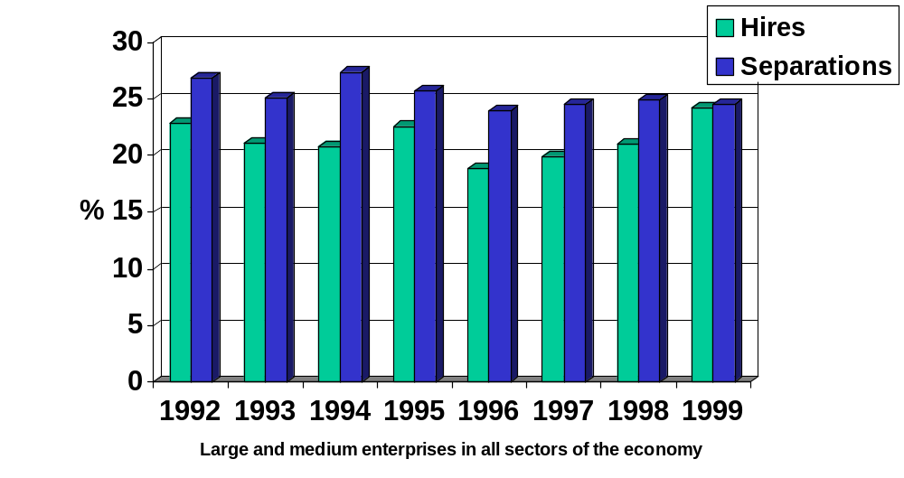
Stimulated ‘exit’

Slide 12
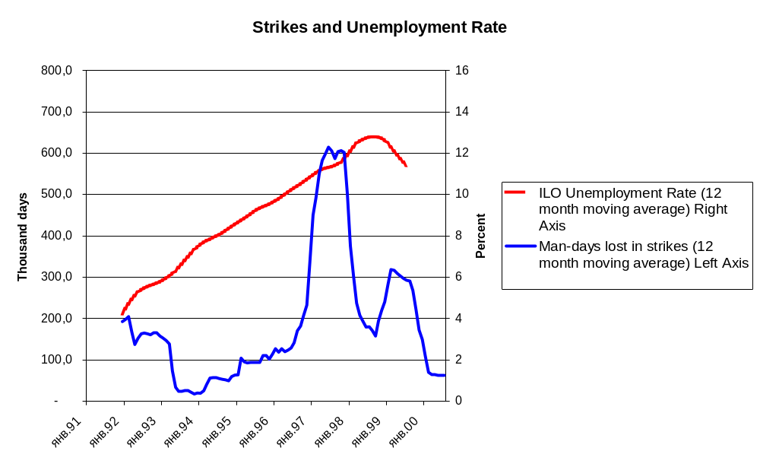
Rather than ‘voice’

Slide 13
Why has this happened?
Labour hoarding
  workers trade employment stability for low wages
    but workers have no power
    workers vote with their feet, so that
    wages inversely correlated with labour turnover
Not hoarding but hiring
    technical constraints
    economic instability
    social and political pressures

Slide 14
Management employment strategy
‘Preserve the (nucleus of the) labour collective’
  ensure wages and work for core workers
  lay-offs and short-time rather than redundancy
  high wages condition for tight labour discipline
  wage increases restricted by ability to pay
  non-payment of wages rather than wage cuts
  multi-tasking and intensification of labour to maintain production

Slide 15
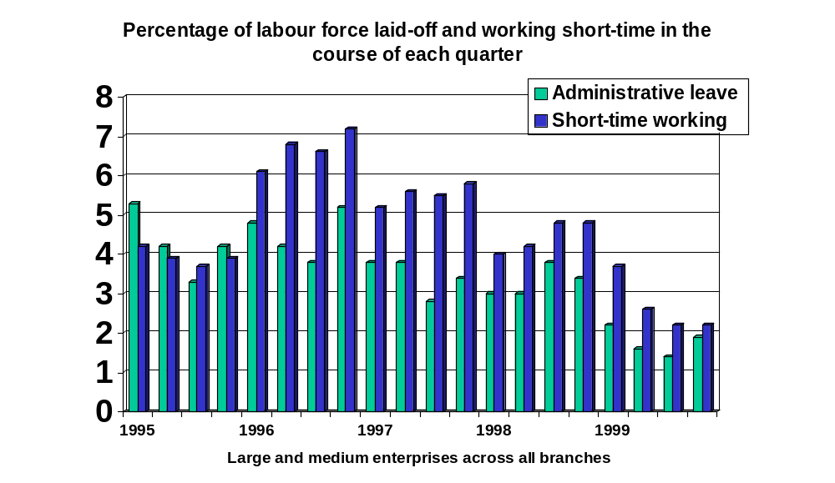
Lay-offs and short-time work

Slide 16
Employment & Labour Relations
Prosperous enterprises
  Relatively high wages
  Tight labour discipline
  Low labour turnover
Declining enterprises
  Low wages, lay-offs, short-time, non-payment
  Loose labour discipline: drinking, theft
  High labour turnover

Slide 17
Labour Market
High job-to-job transitions
  very high differentials between workplaces
Unemployment
  Current Rate 12%
  Long-term unemployment 6%
  Average duration 10 months
Labour force participation has fallen 12%
  mostly young and old
  no gender differences

Slide 18
Industrial Relations
Fear of job loss
Authoritarian management
Very low levels of industrial conflict
Loyal trade unions
Individualised responses
Individualised labour relations
  bureaucratic and legal disputes procedures

Slide 19
Lessons
Unregulated (flexible) labour market
  allows enormous employment restructuring
  avoids mass unemployment
  at the cost of workers’ living standards and working conditions
  with Latin American levels of inequality
Low wages/no wages
  allow inefficient employers to survive
  undercut incentives to investment/innovation

