Slide 1


“Capstone Project”
“EMPLOYEE MANAGEMENT SYSTEM”
Submitted by: Tushar Bhosale
Submission type : Individual
Batch : Batch 1
LMS Id : tushbhosale8@gmail.com
Program : API development program
Date: 10/05/2023

Slide 2

Table of contents
Introduction
Project Overview
Architecture Design
Back-end Development
Testing
Deployment
Conclusion
Future Work
References
Appendices

Slide 3
Introduction
The Project simply demands for Employee details like Employee Name, Date of birth and Employee ID When we provide the employee ID to the application .The project also make sure that the date of birth is displayed in Encrypted format and only Client can access the date . The application also make sure of request security by secure protocol

Slide 4
Project Overview
Problem statement: Web-based employee management system needed for efficient HR personnel management.
Objectives: User-friendly interface, data security, scalability and flexibility.
Scope: System to allow viewing and searching of employee information based on criteria.
Target audience: HR departments in organizations of all sizes.
Benefits: Increased efficiency, improved accuracy, and reduced workload for HR personnel.

Slide 5
Architecture Design
High-level architecture: Overview of components, layers, and modules. class diagrams.
Technologies used: System built using Spring Boot, Java.
Data storage: Application uses MySql.
Security: Authentication and authorization mechanisms, data encryption methods.
Integration: System integrated with client systems using REST API.

Slide 6
Architecture Design
Fig. Architectural Block Diagram
EmployeeController
EmployeeService
EmployeeRepository
GET /employee/{employeeID}
getByEmployeeId(int employeeId)
JpaRepository<Employee, Integer>
GlobalExceptionHandler
EmployeeDTO
handleEmployeeIDException(EmployeeIDException ex)
employeeId: int
employeeName: String
dateOfBirth: String
exceptionHandler(EmployeeIDException exp)

Slide 7
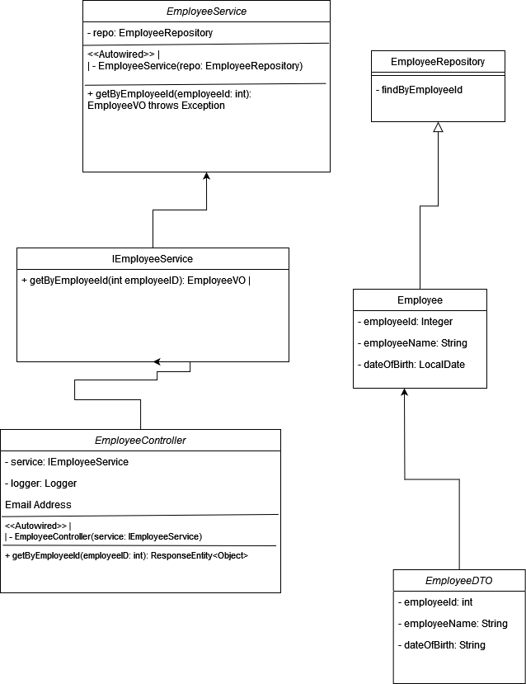
Architecture Design
Fig. Class Diagram

Slide 8
Architecture Design
EmployeeService: Implements IEmployeeService, depends on EmployeeRepository for retrieving Employee entities.
IEmployeeService: Defines the contract for EmployeeService.
EmployeeRepository: Extends JpaRepository for Employee entity, provides methods for manipulating Employee entities in the database.
Employee: Entity class representing an employee.
EmployeeController: Controller class handling HTTP requests for /employee endpoint, depends on IEmployeeService to retrieve Employee entities.
EmployeeDTO: DTO class representing an employee, with one-to-one mapping with Employee entity.

Slide 9
Back-end Development
Database Schema
CREATE TABLE Employee ( employeeId INT PRIMARY KEY, employeeName VARCHAR(255), dateOfBirth );
This table has three columns: employeeId, employeeName, and dateOfBirth. The employeeId column is the primary key of the table.

Slide 10
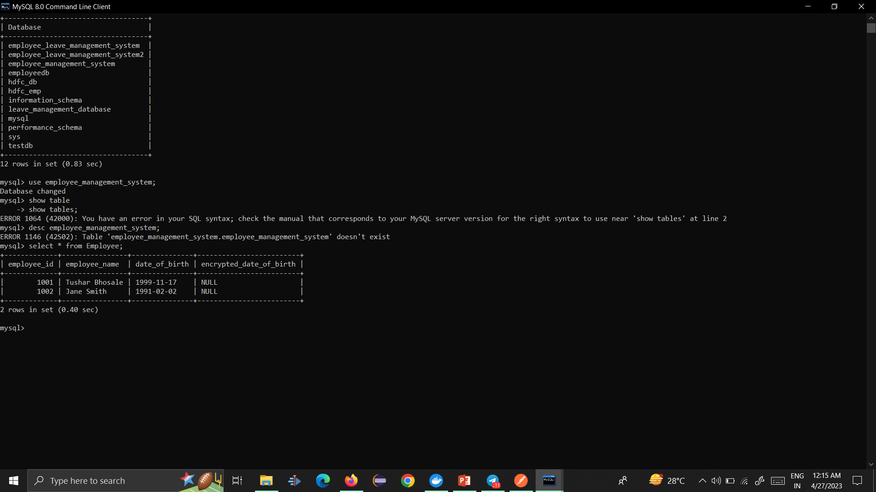
Back-end Development
Fig. My SQL Database

Slide 11
Back-end Development
Programming languages and frameworks: the system is built using Java and Spring Boot.
Database design: SQL queries..
API development: including the REST API endpoints, request and response structures .
Testing: unit testing, integration testing. the testing frameworks and tools used, such as JUnit .
Challenges and solutions: mentioning issues related to performance, security, and deployment.

Slide 12
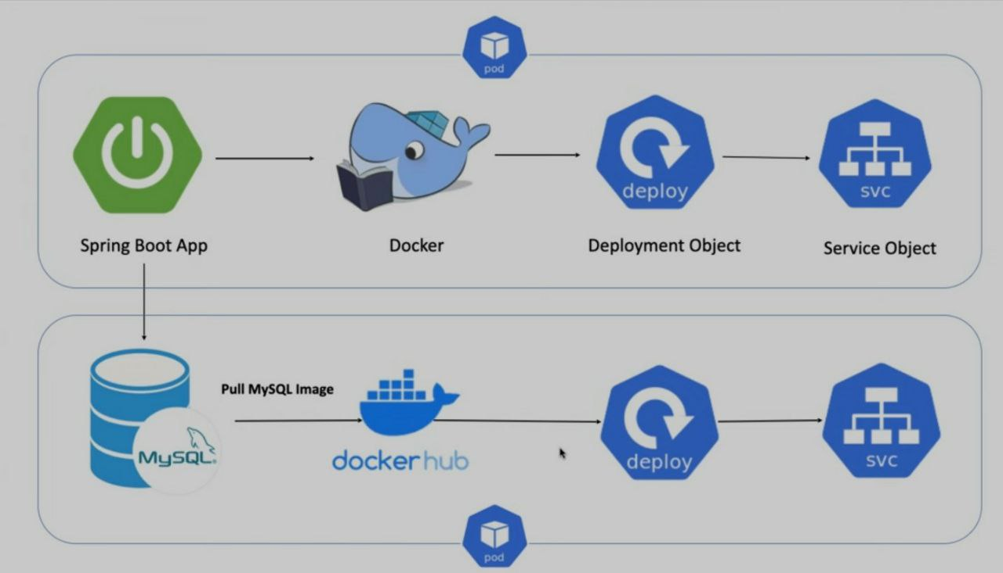
Integration and Testing
Fig. Deployment Cycle Diagram

Slide 13
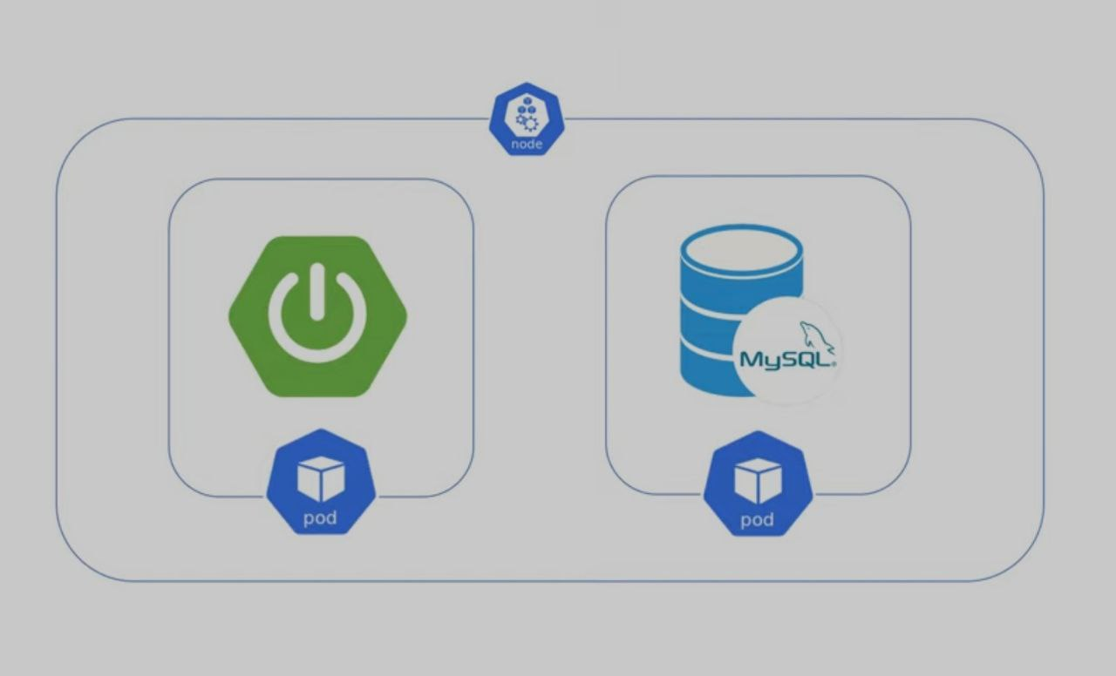
Integration and Testing
Fig. Images Pods Diagram

Slide 14
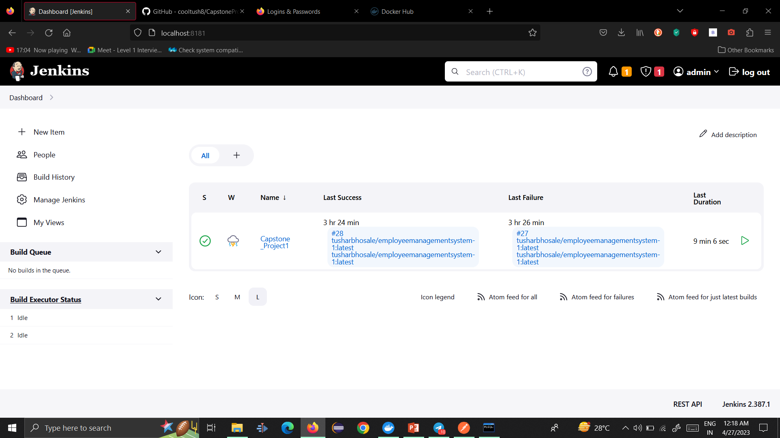
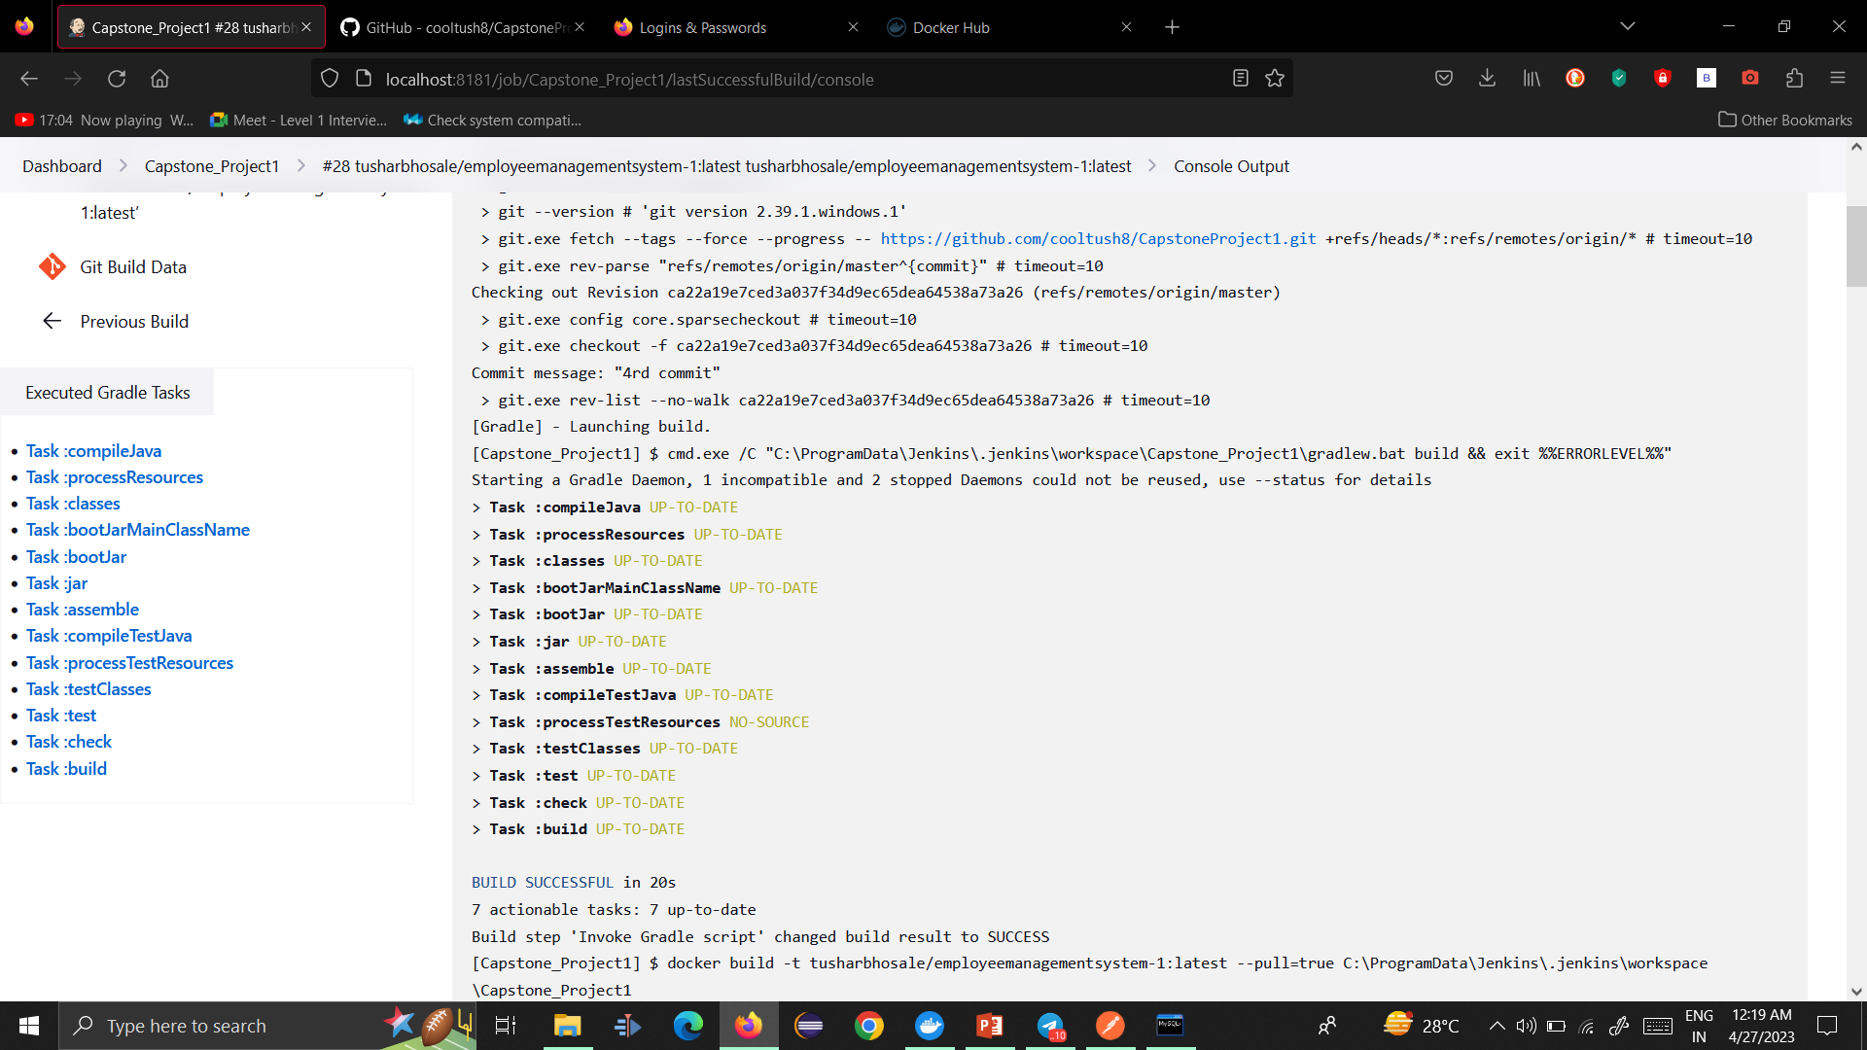
Integration and Testing
Junit Jenkins dashboard, console,

Slide 15
Integration and Testing
Created two micro services: Employee Management System and Employee Management System- Client
Used Spring Boot framework and MySQL database
Encrypted and decrypted DateOfBirth between micro services
Employed HTTPS for secure communication and Jenkins for continuous integration
Deployed Employee micro services with Kubernetes and Docker
Conducted Unit Testing, Integration Testing, and Performance Testing

Slide 16
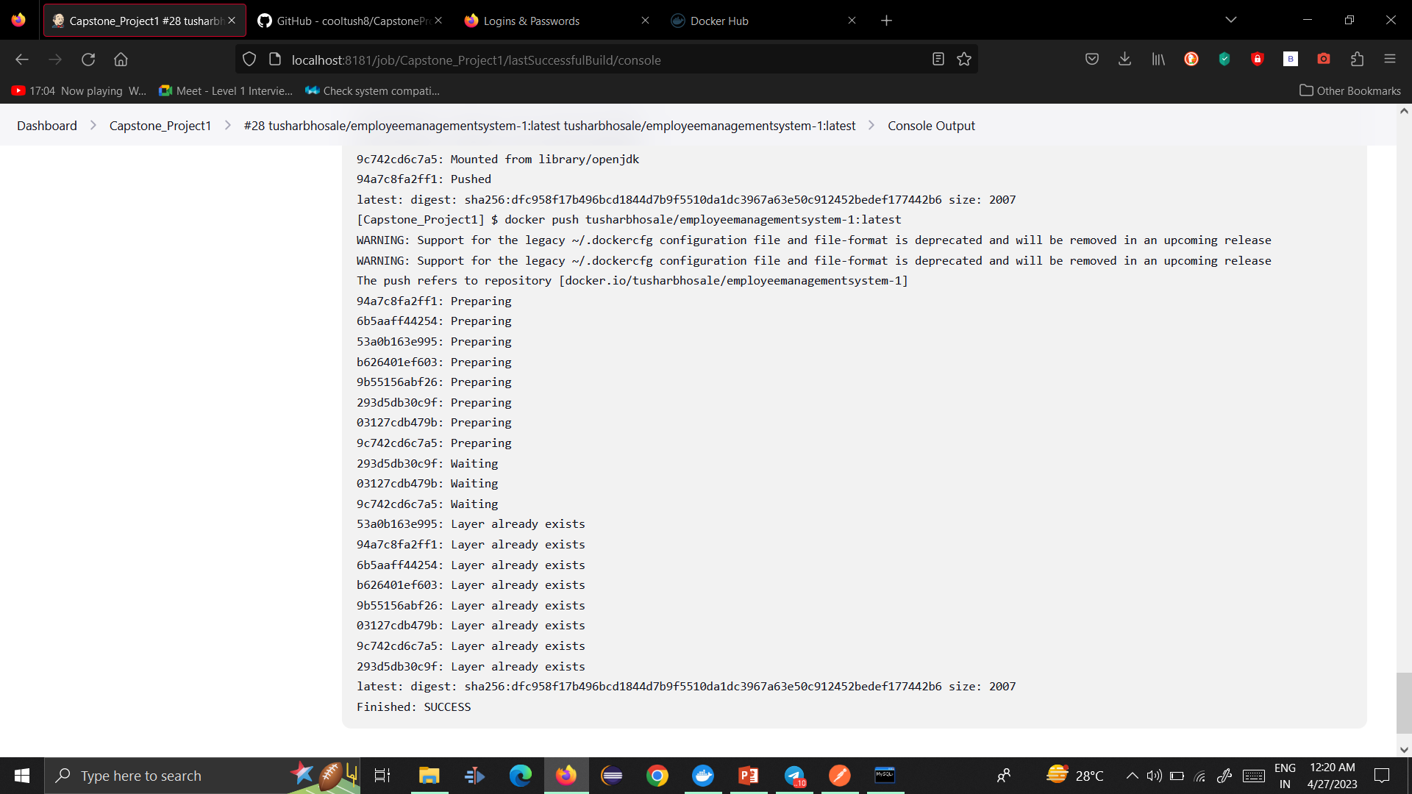
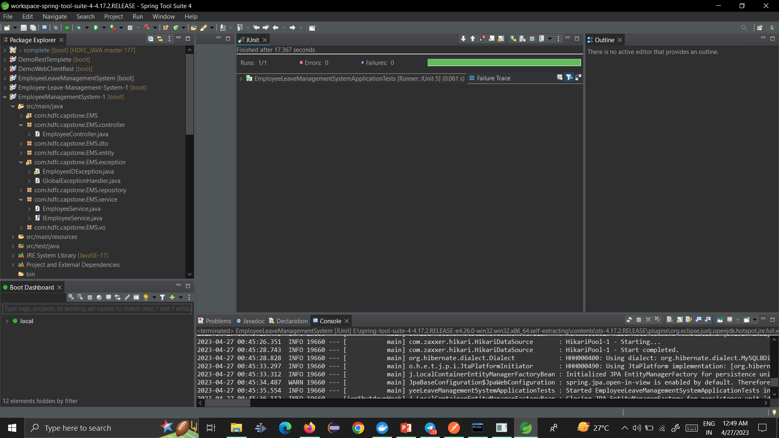
Integration and Testing

Slide 17
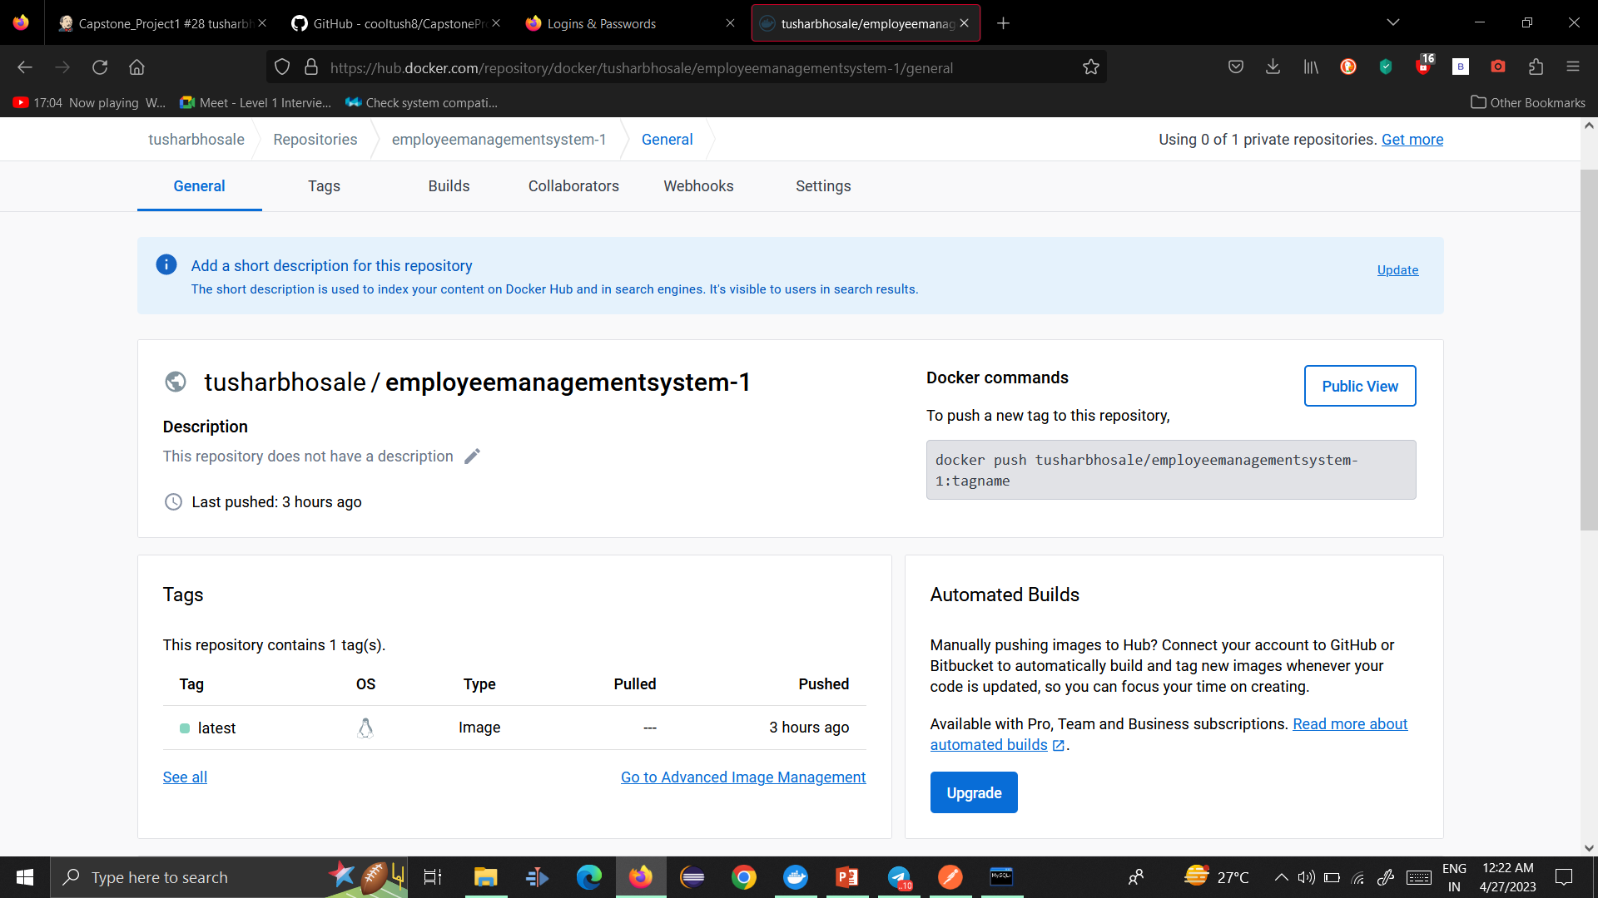
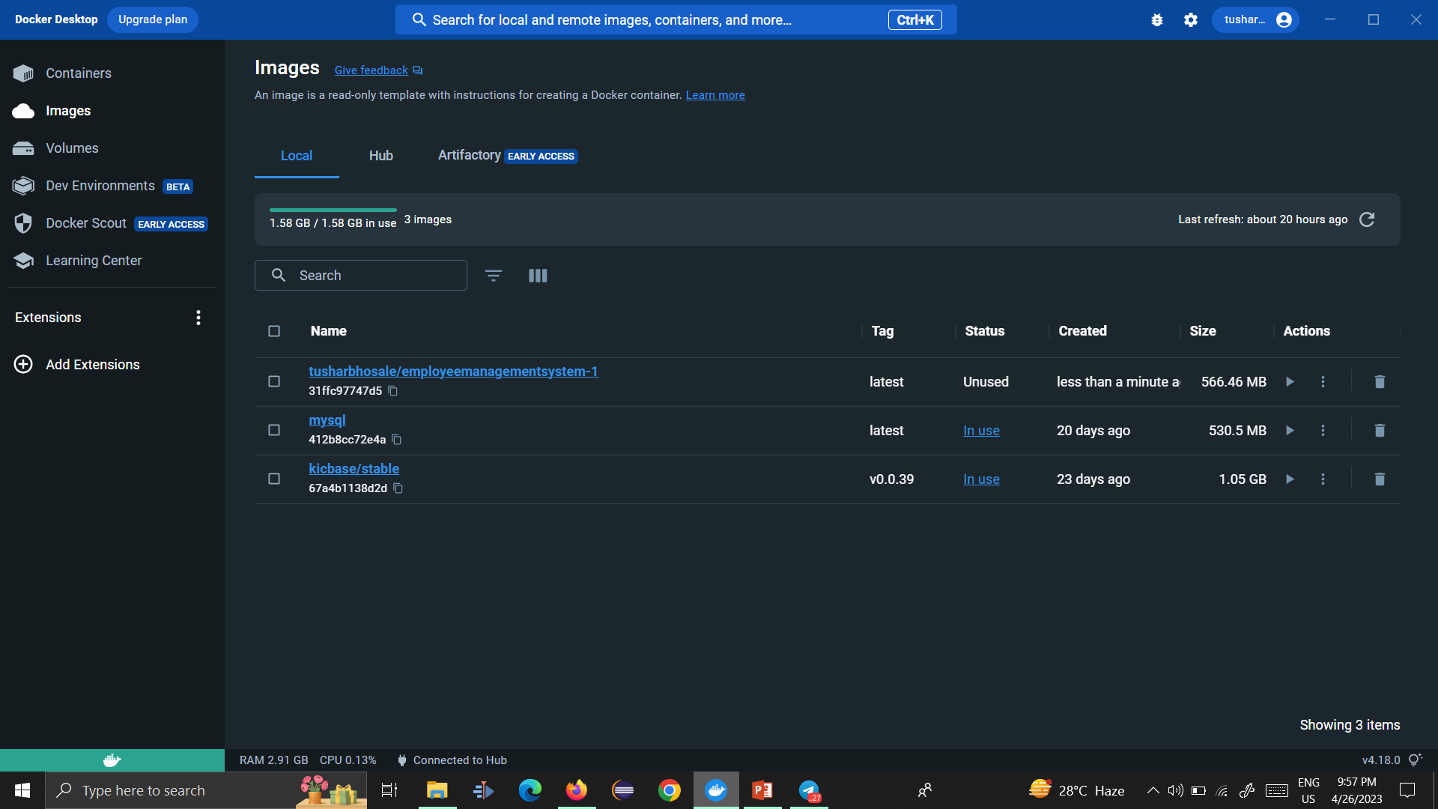
Deployment

Slide 18
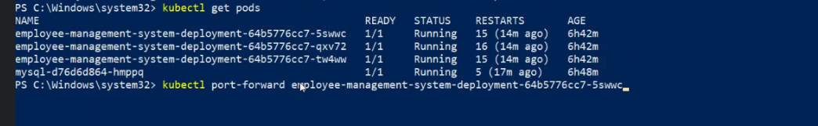
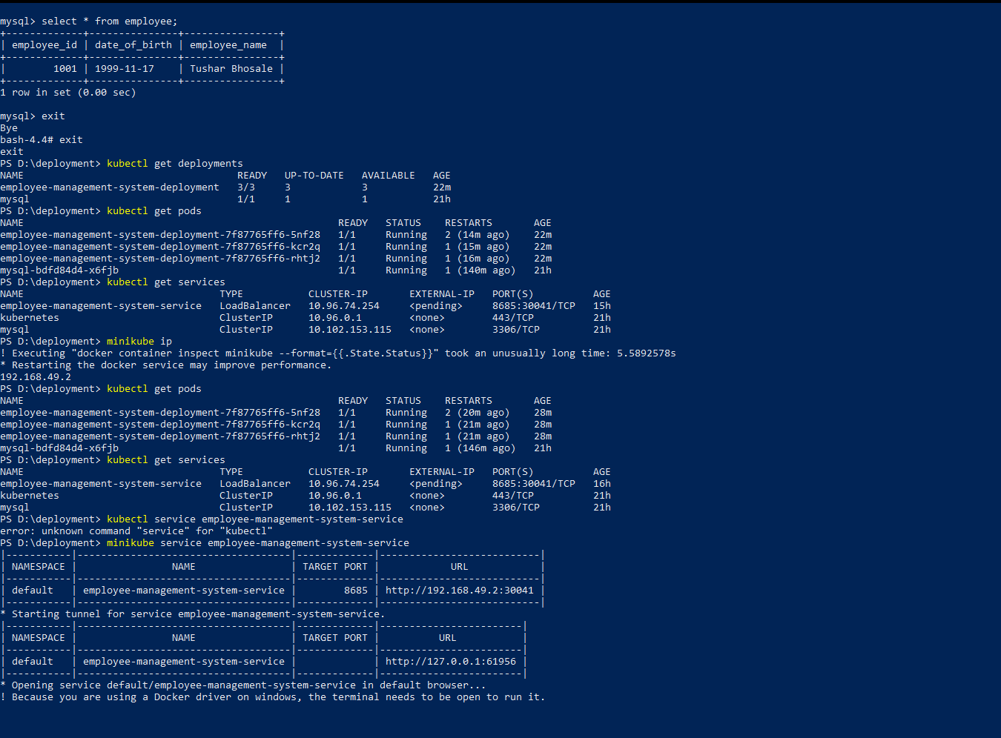
Deployment

Slide 19
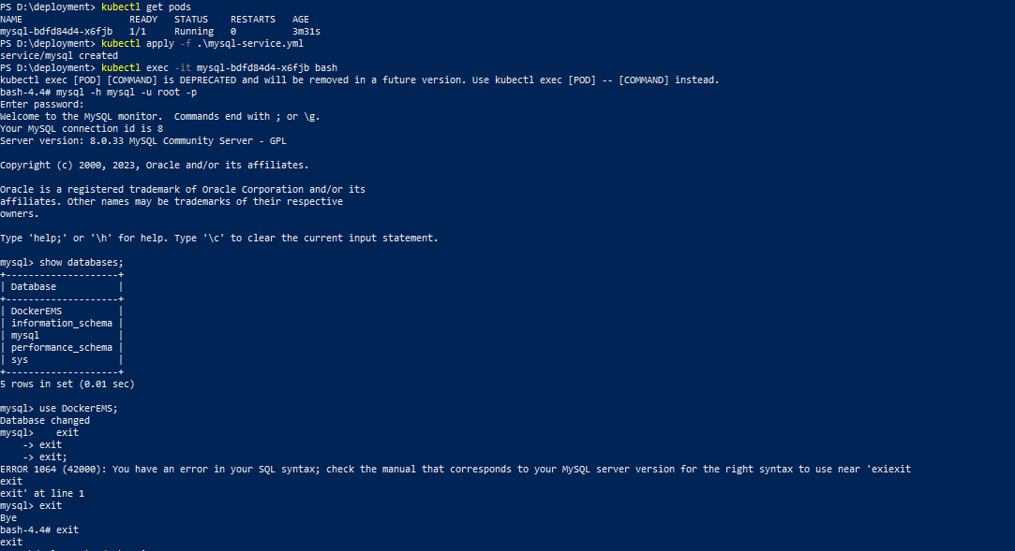
Deployment

Slide 20
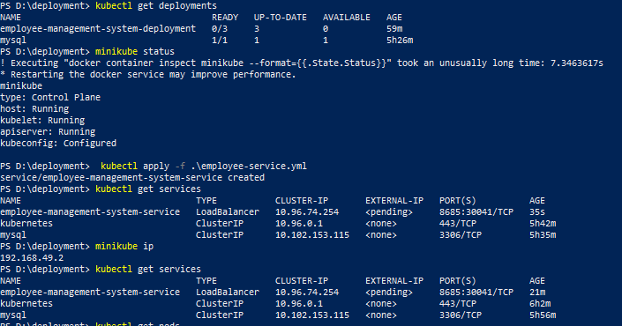
Deployment

Slide 21
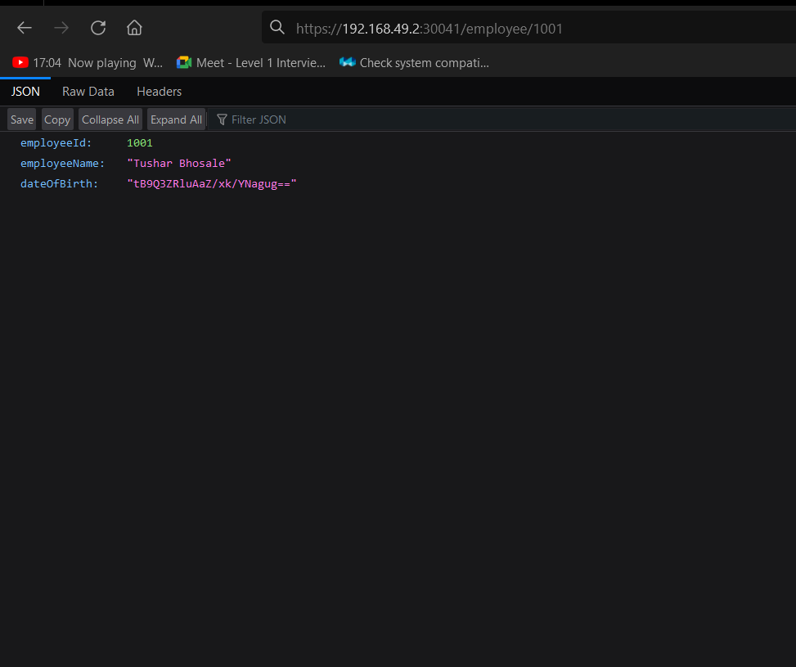
Deployment

Slide 22
Conclusion
Objectives of Employee Management System project achieved within scope
Back-end system developed using Spring Boot and Java
Integrated with a MySQL database and encrypted sensitive data
Implemented RESTful API architecture for secure communication over HTTPS
Integrated with Kubernetes for deployment and scaling
Challenges related to performance and security addressed using caching, query optimization, and latest security standards
Lessons learned include using design patterns and best practices, monitoring and optimizing system performance and security
Future plans include adding support for multiple languages, enhanced reporting, and user management
Focus on improving system performance and scalability for increasing user loads
Employee Management System provides secure and scalable solution for managing employee data
Project a great success with potential for future work and improvement.

Slide 23
Future Work
Potential areas for future work to enhance Employee Management System functionality, performance, and security
Additional features: support for multiple languages, enhanced reporting, user management
Performance and scalability: load balancing mechanisms, caching mechanisms, upgrading hardware resources
Security enhancements: multi-factor authentication, security audits, advanced encryption methods
Integration with other systems: HR management systems, payroll systems, attendance tracking systems
User feedback: gather feedback to identify areas for improvement and ensure the system meets their needs
Technology upgrades: upgrading to newer versions of Spring Boot, using a different database, exploring new programming languages and frameworks
Testing and quality assurance: implementing automated testing, conducting more comprehensive testing to identify and resolve issues quickly.

Slide 24
Referance
Spring Boot documentation: https://spring.io/projects/spring-boot
Java Cryptography Architecture (JCA) documentation: https://docs.oracle.com/en/java/javase/16/security/java-cryptography-architecture-jca-reference-guide.html
Kubernetes documentation: https://kubernetes.io/docs/home/
Docker documentation: https://docs.docker.com/
Jenkins documentation: https://www.jenkins.io/doc/
JUnit documentation: https://junit.org/junit5/docs/current/user-guide/
Oracle Java SE documentation: https://docs.oracle.com/en/java/javase/index.html

Slide 25
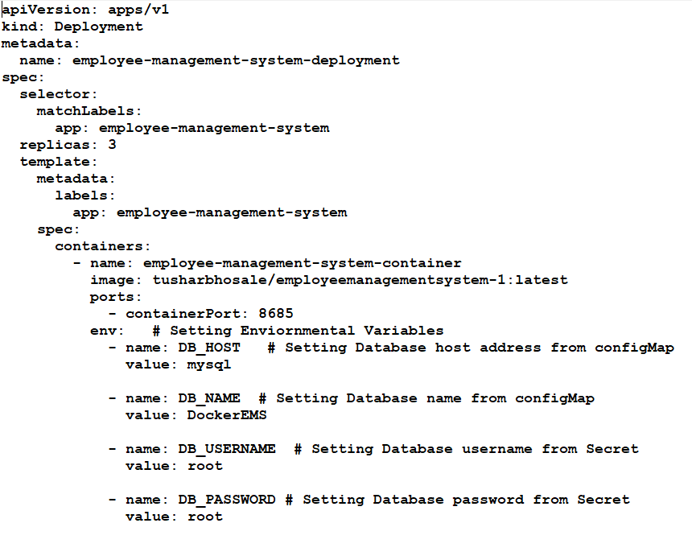
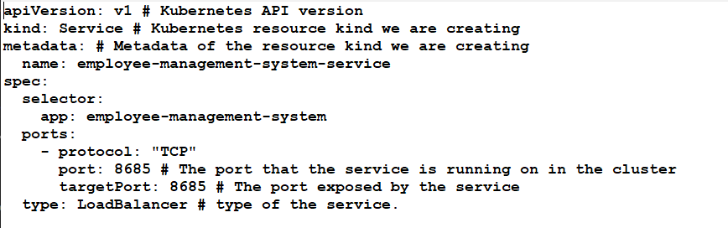
Appendices
Fig. Deployment .Yml File
Fig. Service .Yml File

Slide 26
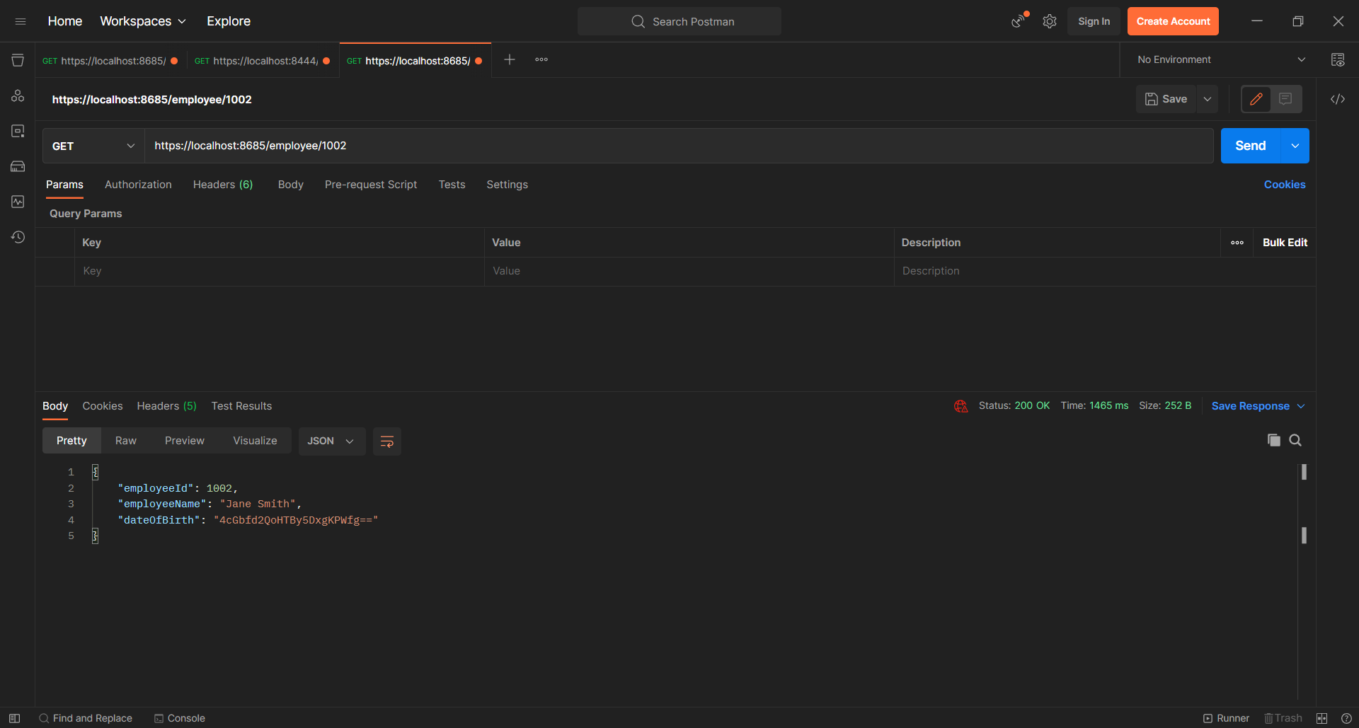
Appendices

Slide 27
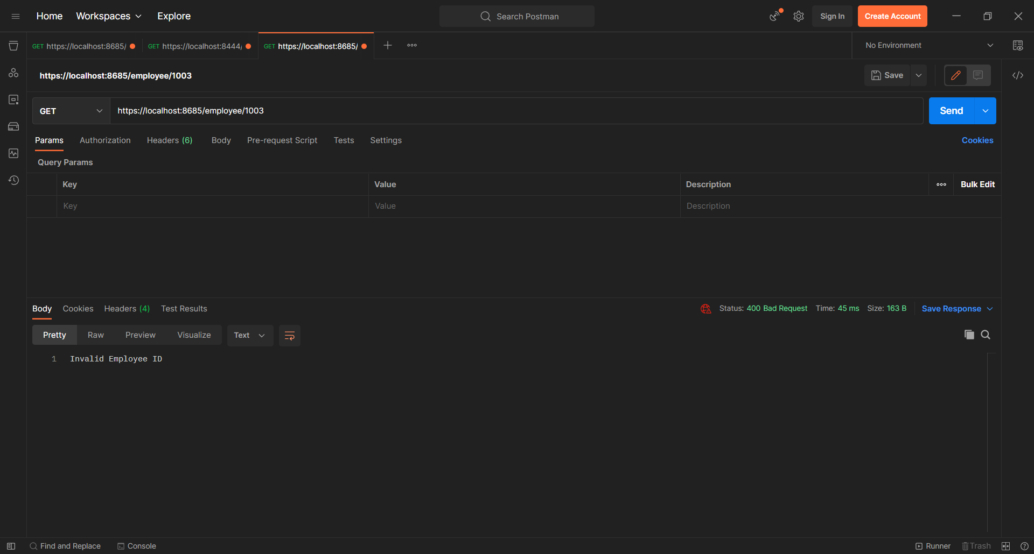
Appendices

Slide 28
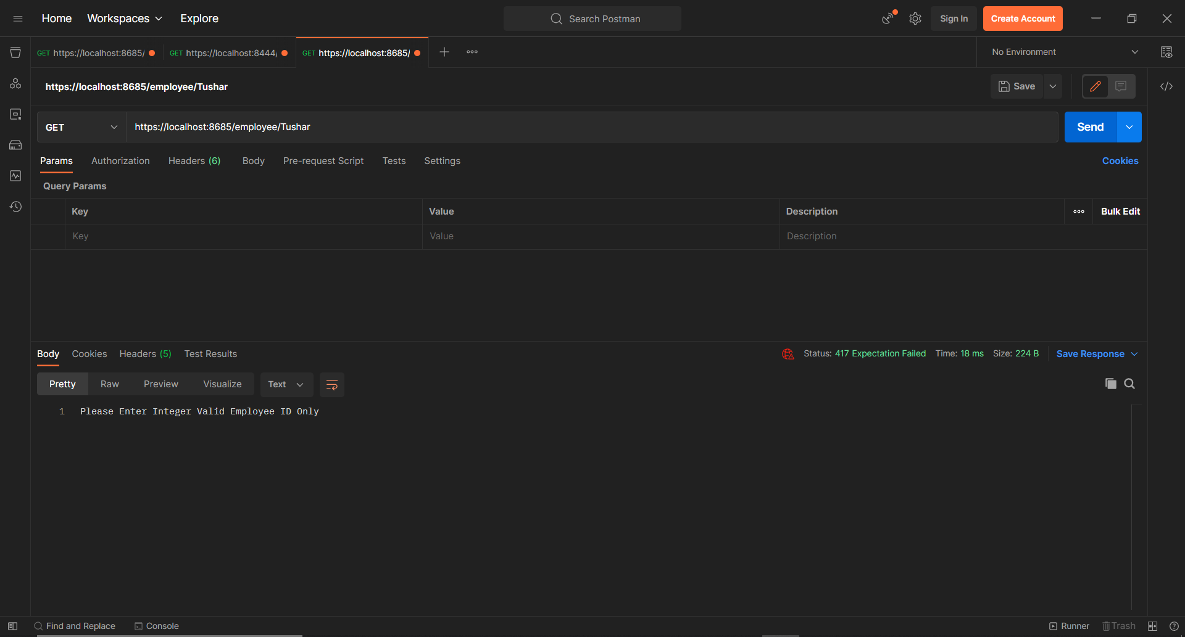
Appendices

Slide 29
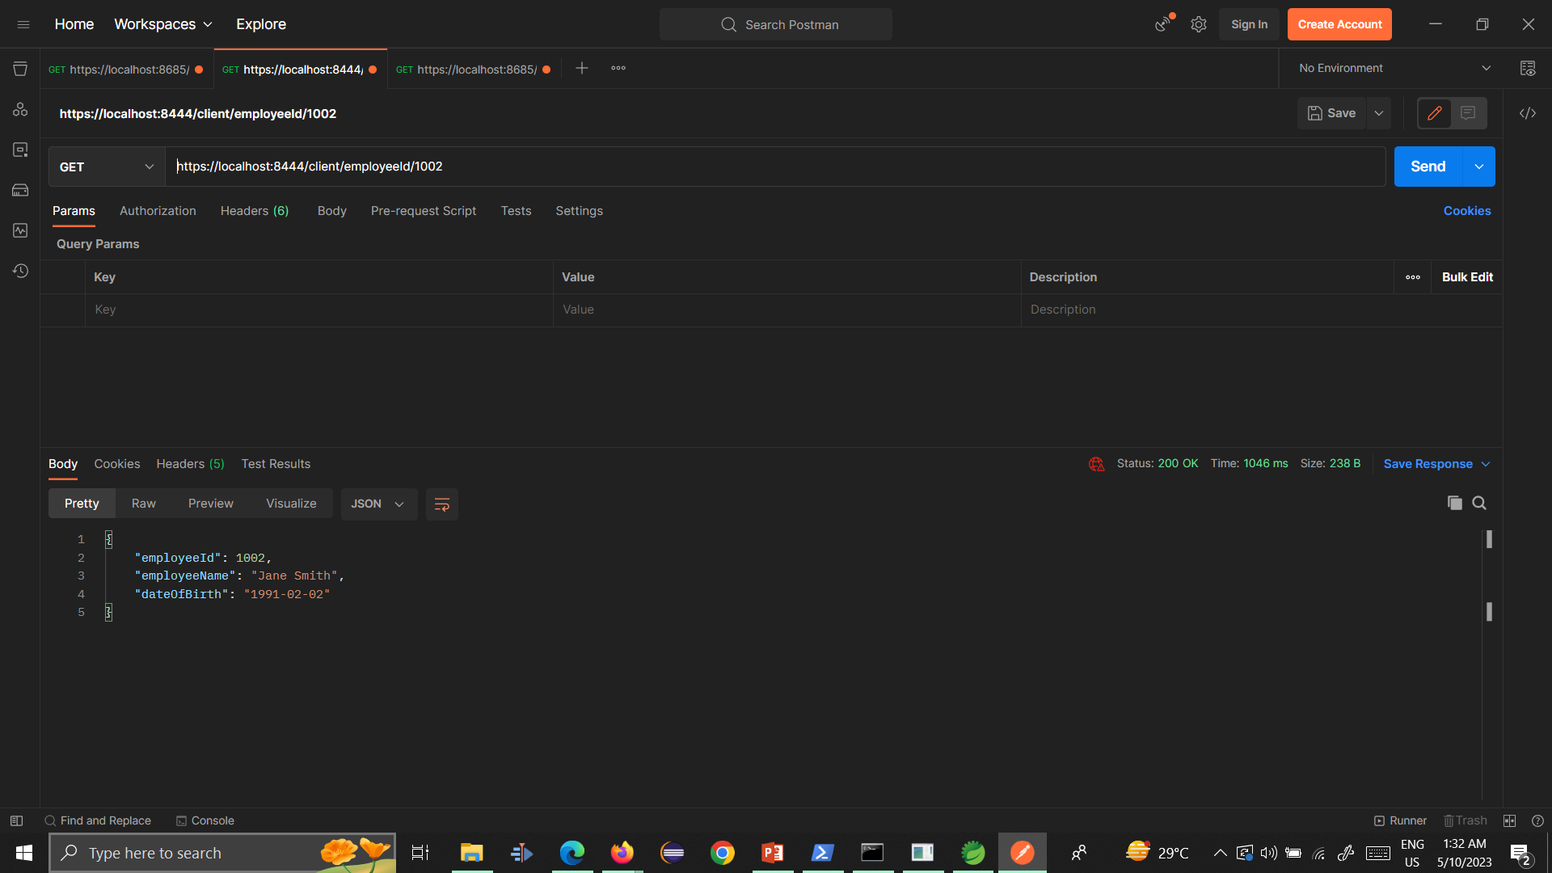
Appendices

Slide 30
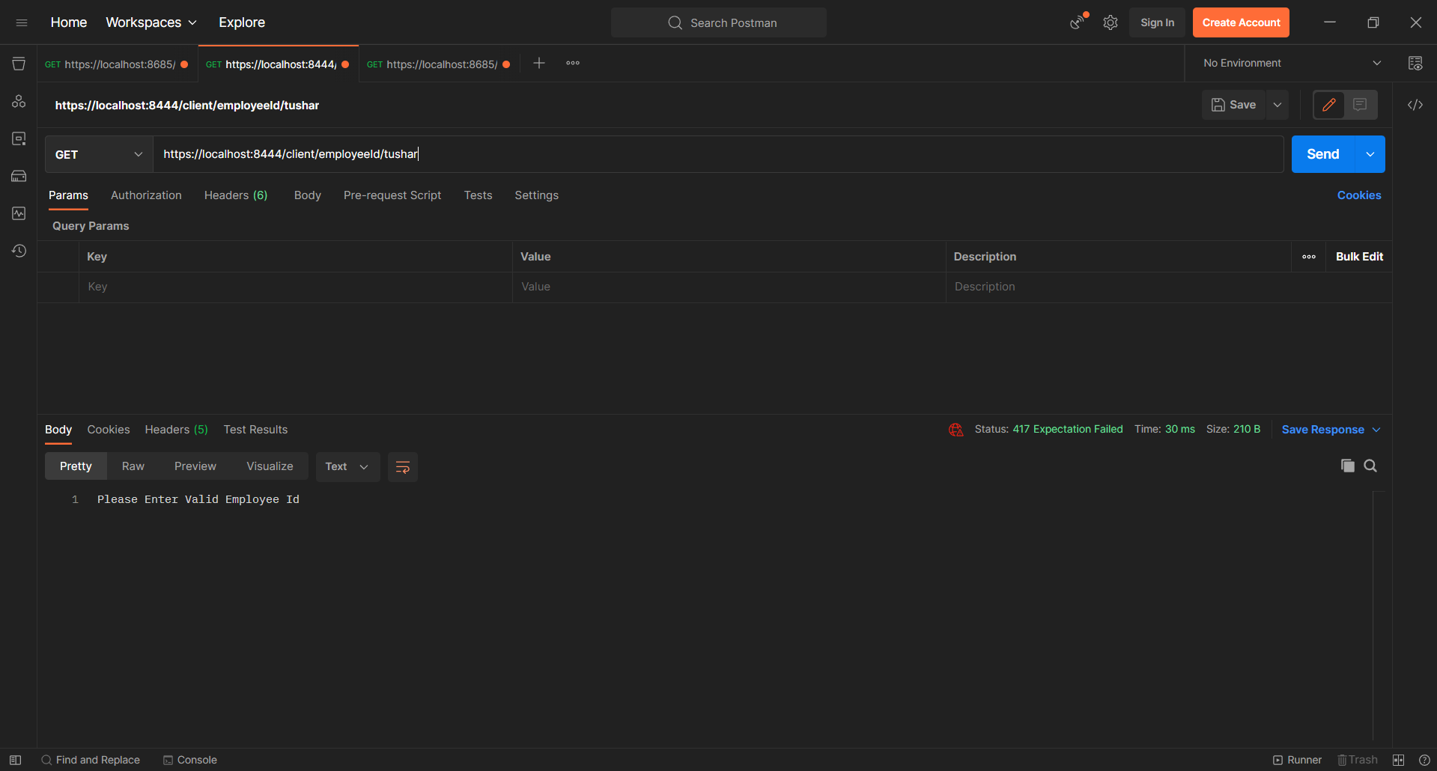
Appendices

