Slide 1

INTERNSHIP SUMMARY
4 WEEK (28 June – 23 July)

Slide 2
Team Members
Upendra Gupta (Team leader)
Aneesha Sengupta
Madhuri
Earavelly Sriharshitha
Prateek Singh
Vasvi Agarwal
Nikita Verma

Slide 3
MY PROJECT
Software training is one of the requirements to be fulfilled in order to obtain the Bachelor’s degree in technology. Each student needs to do software training in a recognized company of their respective domain. The students are required to do training for a duration of 1 months which is intended for their exposure to the software industry in the field of Artificial Intelligence. A well planned, properly executed and evaluated software training helps a lot in developing a professional attitude. It develops an awareness of software approach to problem solving, based on a broad understanding of processes. Besides, software training builds self confidence among students and lets students know technical knowledge and professionalism.
Various efforts and processes involved in designing a component under the field of AI were studied and understood during the internshiP.
It helped me in improving my technical, interpersonal and communication skills, both oral and written. Overall, it has been a great experience to have industrial training in such a reputed firm and we believe that it will help me in building a successful career.

Slide 4

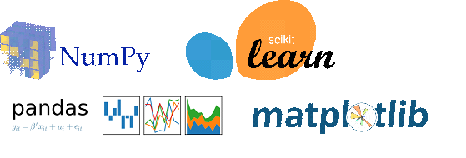

WEEK 1 TASK
For the first week, I asked my team to go through the basics of all the tools and libraries required for ML.
Assigned tasks:
Install Python, Matplotlib, Pandas, Numpy, Scikit-Learn, Jupyter Notebook.
Write some small python codes on jupyter notebook, try to use Numpy and plot some graph using matplotlib.

Slide 5
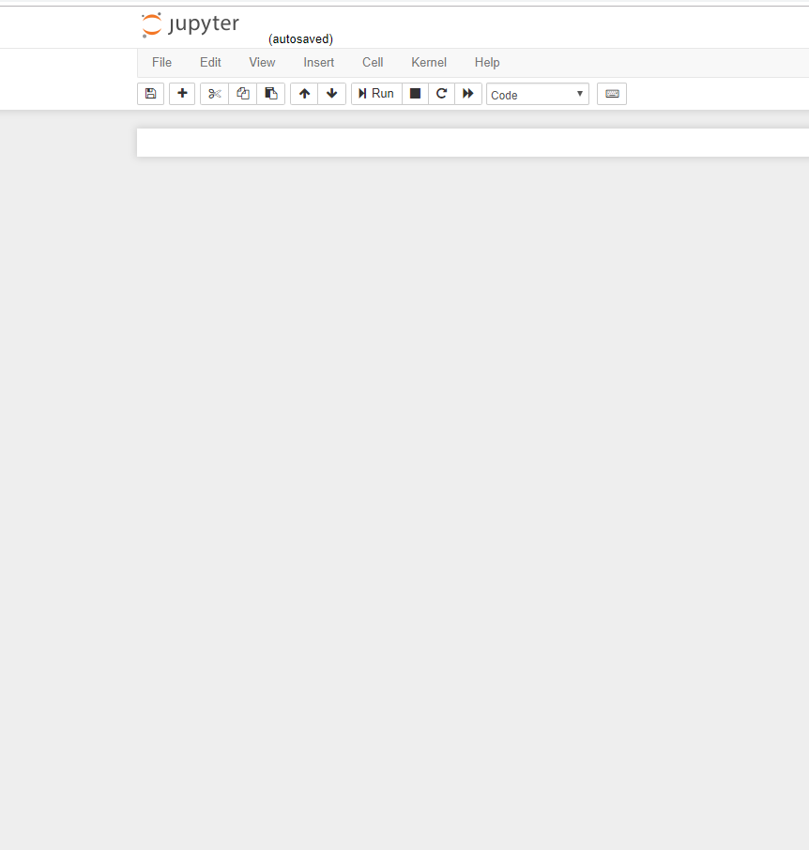
TAKEAWAYS FROM WEEK 1 TASK
Python is high-level language that facilitates data analysis and visualisation among other things like machine learning and application development.
Matplotlib is a plotting library and NumPy is especially for numerical mathematics.
Pandas is a library that helps in data manipulation and analysis.
Scikit-learn is a very useful tool that features many tools for machine learning and statistical modelling – for eg. Regression, clustering, etc.

Slide 6
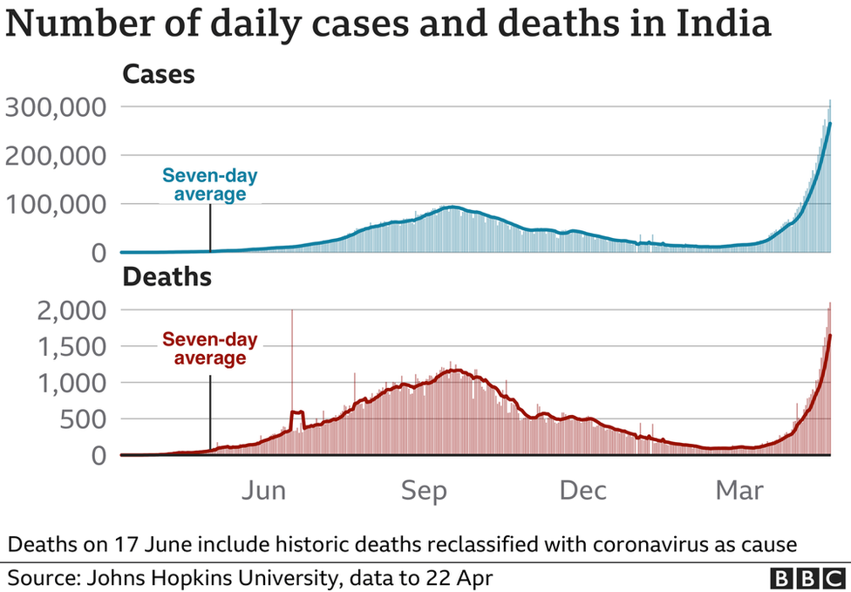
WEEK 2 TASK -1
For second week, I asked my team to complete two tasks.
Go through the Dataset Namely “Covid Report”. This dataset was originally from www.kaggle.com.
Download the data from the zip file.
Convert CSV to Excel.
Adjust Column Width.
Freeze Panes.
Sort Data – Oldest to Newest.
Remove Duplicates.
Count Blank.
Find Extreme Values.
Tools & Libraries may need: Excel.

Slide 7
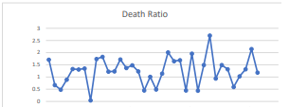
TAKEAWAYS FROM WEEK 2 TASK -1
Excel is an important tool that can be used to perform data cleaning and visualisation.
Dadra and Nagar Haveli and Daman and Diu is seen to have the least death ratio due to covid where as Punjab has the highest death ratio. (according to the data set)
It is recommended to remove outliers in a dataset before performing further operations.

Slide 8
WEEK 2 TASK -2
Go through the Dataset Namely “IRIS dataset”. This dataset is originally from www.kaggle.com. Can also access the iris dataset from scikit-learn datasets module.
Perform basic pipelining tasks such as cleaning and formatting.
Split data into test and train.
Use the K Nearest Neighbors algorithm to make a prediction on the 'quality' column of the dataset.
Measure Performance and Validation.
Test your model with the test data.
Tools & Libraries You may need:
Python, Matplotlib, pandas, Scikit-Learn, Jupyter Notebook.

Slide 9
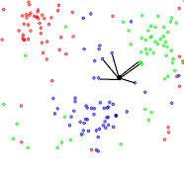
TAKEAWAYS FROM WEEK 2 TASK 2
The dataset can be taken from Kaggle.com or scikit-learn directly.
train_test_split from sklearn.model_selection can be used to split data into test and train.
K-NN algorithm assumes the similarity between the new case/data and available cases and put the new case into the category that is most similar to the available categories.
KNeighboursClassifier can be used from sklearn.neighbours for the same.
This model gives a score of 0.966

Slide 10
WEEK 3 TASK
For third week, I asked my team to go through the Dataset Namely “Housing data Report”.
Download the data from the zip file.
Perform basic pipelining tasks such as cleaning and formatting.
Convert CSV to Excel, Adjust Column Width, Freeze Panes, Sort Data – Oldest to Newest, Remove Duplicates, Count Blank, Find Extreme Values & Split data into test and train.
Split data into test and train.
Use the various algorithm to make a prediction on price of house.
Measure Performance and Validation.
Test your model with the test data.
Tools & Libraries You may need: Python, Excel, Matplotlib, pandas, Scikit-Learn, Jupyter Notebook.

Slide 11
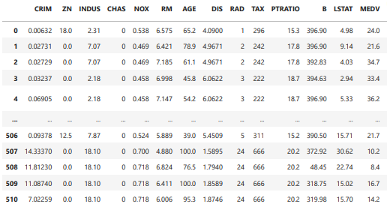
TAKEAWAYS FROM WEEK 3 TASK
Without proper data visualisation, a set of data often is useless. The first step is always to find relations between the parameters involved.
train_test_split from sklearn.model_selection can be used to split data into test and train.
In this dataset, 13 parameters are features and 1 is the label.
Different models can be used to predict the price.

Slide 12
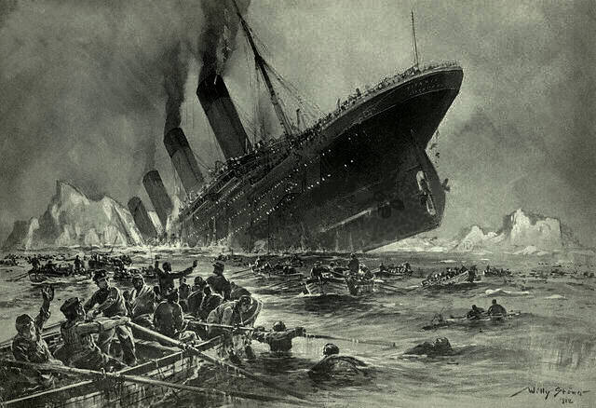
WEEK 4 TASK
For fourth week, I asked my team to go through the Dataset Namely “Titanic - Machine Learning from Disaster”.
Download the dataset.
The data has been split into two groups: training set (train.csv) & test set (test.csv).
Perform basic pipelining tasks such as cleaning and formatting.
Use the various algorithm to make a prediction of survival on the Titanic.
Measure Performance and Validation.
Test your model with the test data.
Tools & Libraries You may need:
Python, Excel, Matplotlib, pandas, Scikit-Learn, Jupyter Notebook.

Slide 13
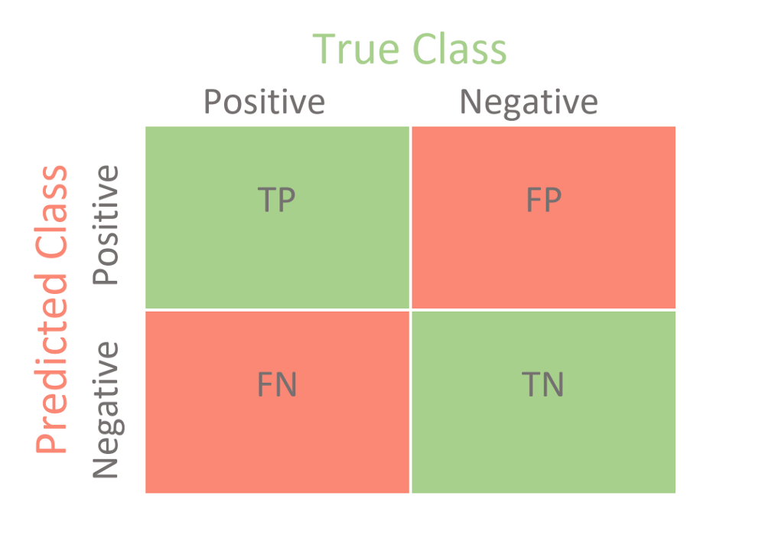
TAKEAWAYS FROM WEEK 4 TASK
The dataset is already divided into test and train. So, they need to be called separately at the right time in the code.
After cleaning and proper visualization, the important features can be selected.
Models like LogisticRegression, KNeighboursClassifier and DecisionTreeClassifier can be used from sklearn for the same.
Confusion matrix can be generated by using confusion_matrix from sklearn.metrics to get a good idea on the performance of the models.
From the confusion matrix, testing accuracy can be derived using the formula (TP + TN) / (TP + TN + FN + FP)

Slide 14
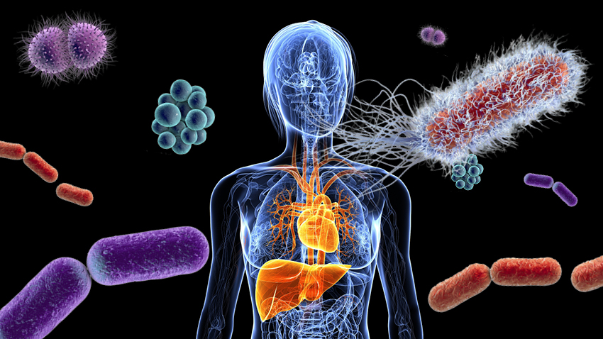
DISEASE PREDICTION BASED ON SYMPTOMS–
A MACHINE LEARNING PROJECT
-Presented by UPENDRA GUPTA and TEAM

Slide 15
INTRODUCTION
In today's scenario, the whole world is suffering from a pandemic. It’s not safe for anyone to go to hospital. We want to provide a platform where when a person enters his/her name and the 5 symptoms a person is observing in his/herself example like a person enters symptoms like losing weight , doziness, extra urination , thirsty, blurry vision then the person may be suffering from Diabetes. Further whole will be saved in the database whenever a person visits again the database can help to predict the disease.
The objective of this project is to build a platform for users where they can analyze themselves just by mentioning utmost five symptoms they are observing without going to any hospital or without reaching any doctor.
SCOPE

Slide 16
METHODOLOGY USED
Using the method based approach, the project's core problem modules were divided into four distinct sections for identifying/ monitoring the appropriate input values to determine the end result of our project as a whole. These functions were separate testing models that we trained and tuned to determine the best result to determine and work on our new input data for real world problems. The core objective of using this kind of methodology is to deprecate any kind of complexity and keep the workflow as simplistic as possible. This way each model can stand on its own without any influence from others
These four methods/models are →
● NaiveBayes()
● KNN()
● randomforest()
● DecisionTree()

Slide 17
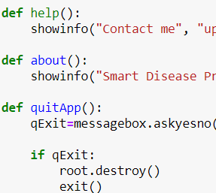
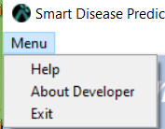
Apart from the the four major model functions and number of util functions are added as a means to increase code reusability, robustness, and overall efficiency of the project as a whole. These methods help in various visualizations and work as simple util functionalities like dialog confirmations or error message display boxes.
These methods are →
● scatter plot(disea)
● plotScatterMatrix(df1, plotSize, textSize)
● plotPerColumnDistribution(df1, nGraphShown, nGraphPerRow)
● Reset()
● help()
● about()
● quitApp()

Slide 18
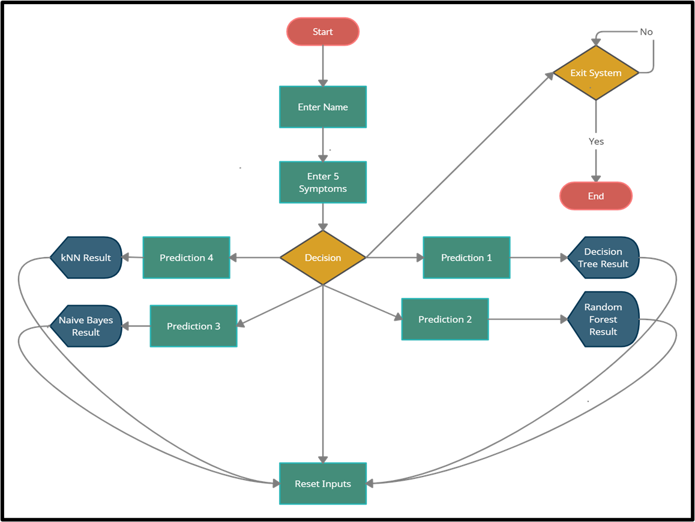
PROJECT DESIGN
Block diagram:
This block diagram gives us a quick
reference of our program that is how it
Actually works.
First the user will start the application
and will enter his/her name . Once he/she
enter his/her name, will need to select 5
symptoms that he she is facing , then after
when he/she went to check prediction the
very first prediction that is the prediction 1
will show the predicted result of disease based
on the algorithm applied on first prediction
box i.e., Decision Tree in our case. So,
prediction 1 will predict the result based on
Decision Tree algorithm similarly prediction
2,3 ,4 will predict the values based on Random Forest,
Naïve Bayes, KNN respectively. After the user get satisfied
can exit the application through exit command.

Slide 19
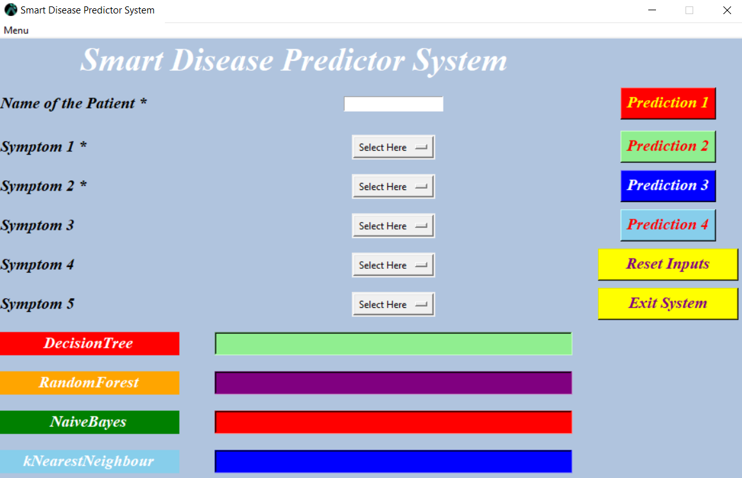
FINAL PROJECT GUI

Slide 20
THANK YOU

