Slide 1

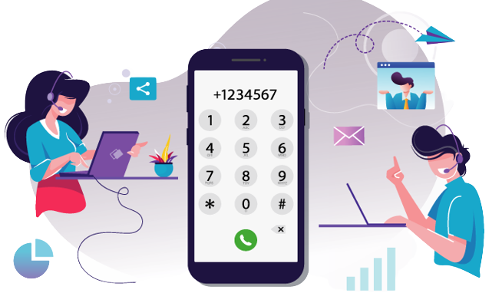
REMOTE PHONE BOOK FOR CLIENT
CAPGEMINI SPRINT -2 GROUP 3

Slide 2

THE PROJECT IDEA
This project idea aims to create the development of a Remote Phone Book for client Assignments application , it’s a simple implementation of a file transfer program. It includes custom client and server programs that provide functionality to authenticate a user, list remote files, and retrieve remote files.

Slide 3
Our solution
It is a phonebook application that contains names and contact numbers of each person who are stored in data structure.
The server will support a virtual user with a name to add contact to a public group only without any password. It will also support the concurrent client connection.
An administrator can access any contact in addition to adding, removing groups to the phone directory.
The client program will start with an authentication.
To Quit from the phonebook the user or client use “bye” to end the connection.

Slide 4
Functional requirements
Client server connection
User authentication
Authenticated user access
Authenticated admin access
Server side firewall protection
Anonymous user access
Client side contact add, deletion
Client side group add, remove
Client side quit

Slide 5
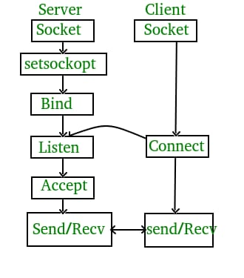
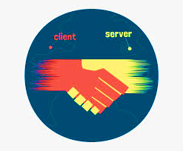
Connection Establishment
We establish the connection between client and server.
We do it with the help of port no. 8028.

Slide 6
The entire process can be broken down into following steps:
TCP Server :
Using create() : It creates TCP socket.
Using bind(): Bind the socket to server address.
Using listen(): It puts the server socket in a passive mode where it waits for the client to approach the server to make a connection.
Using accept(): At this point the connection is established between client and server, they are ready to transfer the data.

Slide 7
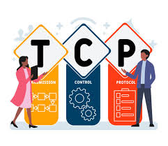
TCP Client
Create TCP socket.
Connect newly created client socket to server.

Slide 8
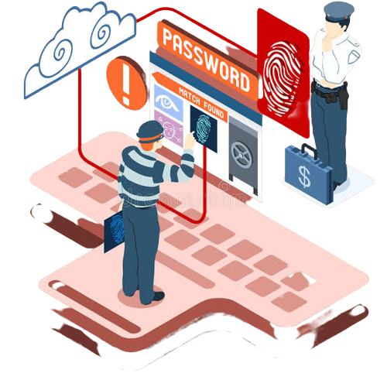
User authentication
User authentication verifies the identity of a user attempting to gain access to a network or computer resource by authorizing a human-to-machine transfer of credentials during interaction on a network to confirm a user’s authenticity.
User authentication consists of three tasks:
Identification
Authentication
Authorization

Slide 9
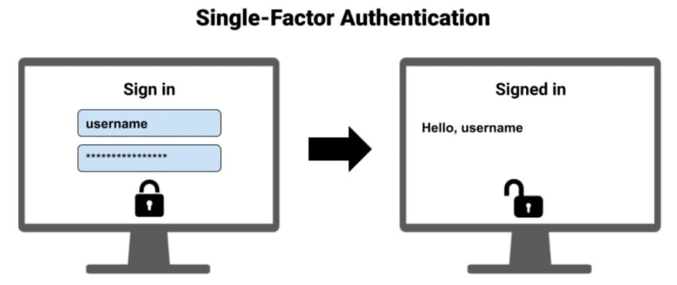
Single factor authentication
On this authentication system the user has to enter the username and the password to confirm whether the user is logging in or not.
If the user name or password is wrong , then the user will not be allowed to access the phonebook

Slide 10
Type of client
Admin
Authenticated User
Anonymous User

Slide 11

Authenticated Admin
An administrator can access any contact in addition to add, remove group to phone directory.
This user is responsible for changing the passwords, include and exclude from the phone directory.
They can access any contact in the phone book.

Slide 12
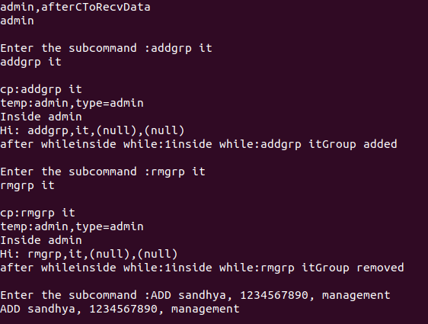

Slide 13

Authenticated user
Authenticate User can add in public group as default .
They can change their respective group by using chgrp sub command.
Then they can access to Add, Delete, and Search the Contacts.

Slide 14
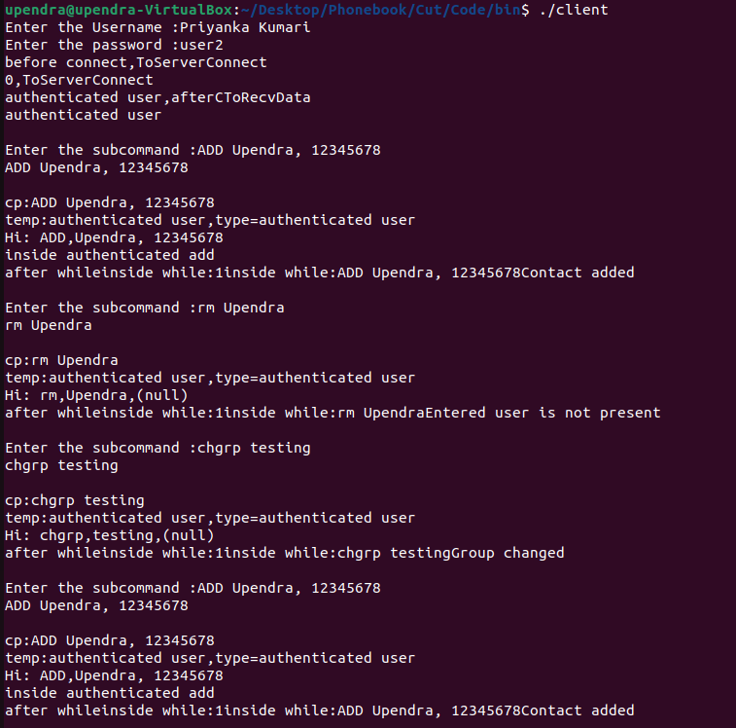

Slide 15

Anonymous user
Anonymous User doesn't require User name or Password.
Default they are at public group and they are permit only to add the contacts in that group.
Server should support an virtual user with name anonymous to add contact to public group only without any password.

Slide 16
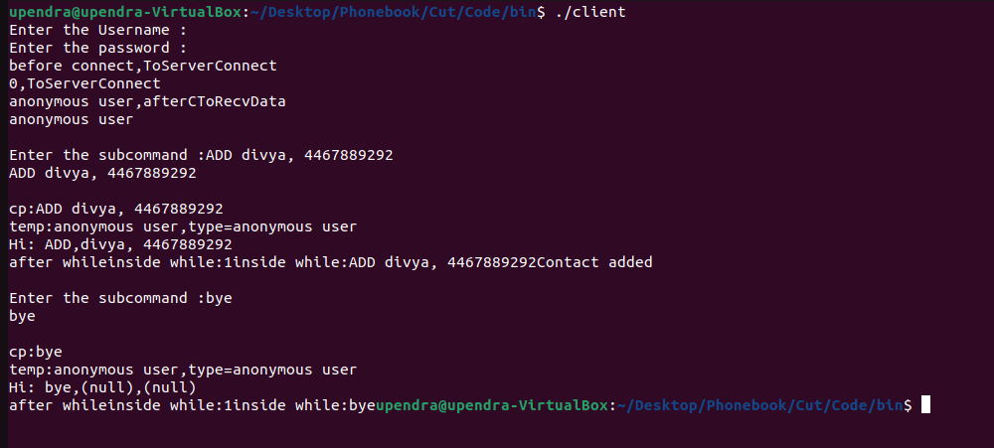

Slide 17

TEAM CAPG-84 GROUP 3
BHANU PRAKASH KORLEPARA
SANDHYA G
SUBHRANSU SAHU
SWETHA GANGA
UPENDRA GUPTA
VENKATA SATYA LAKSHMI DIVYA VARUPULA

Slide 18



