Slide 1

SCREEN-1
SCREEN-2
SCREEN-3
SHOPKEEPER
CUSTOMER
SIGN IN
SIGN UP
SPLASH
LANDING

Slide 2


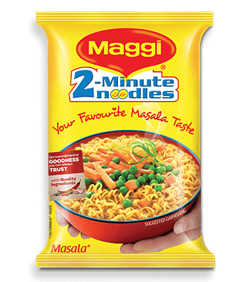




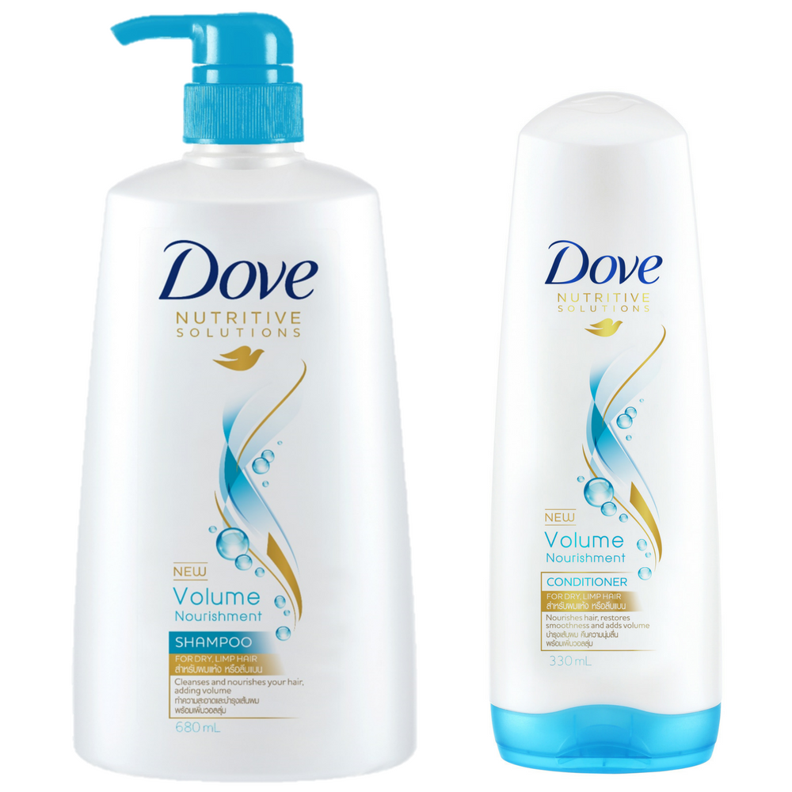
SCREEN-4
SCREEN-5
SCREEN-6
Home
Home
Home
STOCK
ORDERS
INBOX
STOCK
ORDERS
INBOX
STOCK
ORDERS
INBOX
Edeals daily
Category 1
Category 2
Category 3
Category 4
Category 5
Category 6
Category 7
Category 8
Product 1
Product 2
Product 3
Product 4
Product 6
Product 5
MRP 180 ₹
Quantity 4
Discount
NO / 10 %
Fragrances, Beauty & Health
MRP 180 ₹
Quantity 4
Discount
NO / 10 %
List view
Grid view
On click of category

Slide 3



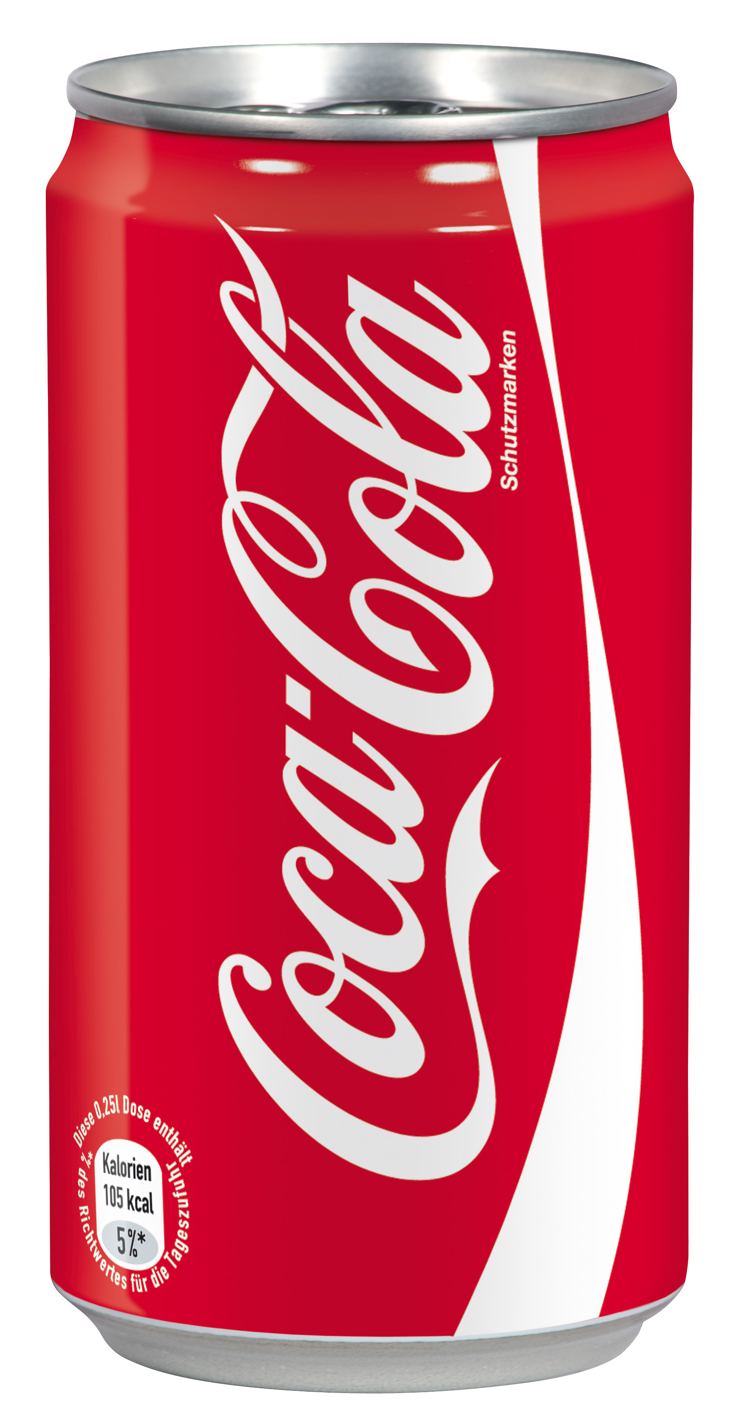



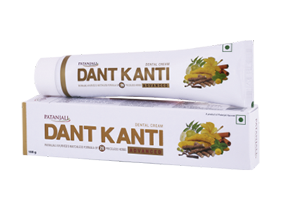
SCREEN-7
SCREEN-8
SCREEN-9
Home
Home
Home
STOCK
ORDERS
INBOX
STOCK
ORDERS
INBOX
STOCK
ORDERS
INBOX
Maggie noodles
Customer
25 Jan 2018
Total Price:
20 ₹ x 4 = 80 ₹
Received
Himanshu sharma
60 ₹
Quantity 4
Know more
Maggie is going out of stock
Quantity remaining - 3
Coca-Cola cold drink
Total Price:
30 ₹ x 2 = 60 ₹
New product in trend near you
Name – Himalaya facewash
Quantity 2
Know more
Dove shampoo
Shivank sharma needs 3 Cans of Pepsi, see your orders for More details
Total Price:
120 ₹ x 4 = 120 ₹
Quantity 1
Know more
Order delivered to mohit kumar
Order number – C78FT443
Patanjali dant-kanti
Total Price:
60 ₹ x 4 = 120 ₹
Dove soap is going out of stock
Quantity remaining - 3
Quantity 1
Know more
Orders
null
null

Slide 4





SCREEN-10.1
SCREEN-10.2
Settings
Settings
General
Privacy and more
Himanshu sharma
Change phone number
8008877665
8008877665
Change password
Shop Specific
**********
Epic General Store
Visibility range to your customers
Shop Logo
500 meters
K-99 Sector 45 sardar bazar Noida
281022
Help, Support and Feedback
Payment acceptance
Terms and Conditions
cash only
Display
Delete account
Theme
edeals light
Language
english
Notification sound
phone default
Alert me when products reaches
out of stock
Alert me when I got new order
Profile
Profile

Slide 5
SCREEN-
NULL
null

Slide 6
Colors
#FF1DB41C – green
#747879 – gray

