Slide 1
LGE Internal Use Only
ODDoc
2018.03.05
박종민

Slide 2
목차
ODDoc
Struct
Enum
Function

Slide 3
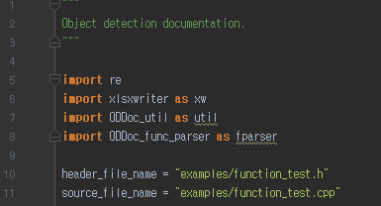
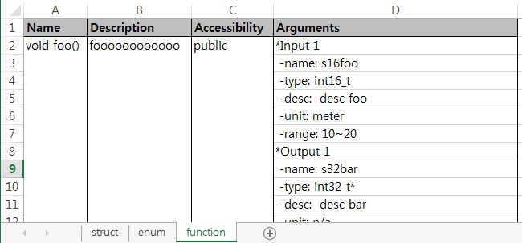
1. ODDoc
실행 환경: Python 2.7, PyCharm Community Edition 2016.3.2
실행 방법
ODDoc.py 에서 module의 header file과 source file 이름 지정.
ODDoc.py 실행.
module 이름.xlsx 파일이 생성됨.
sheet마다 struct, enum, function에 대한 정의 table이 생성됨.

Slide 4
2. Struct
Struct 구현 및 주석
생성 결과.
/** Structure description */ typedef struct OD_Struct_t { int16_t s16bar; /**< variable description. unit:meter range:10~20*/ float32_t f32foo; /**< foo description. unit:radian range:-2pi~+20pi */ int32_t s32test; /**< test description. */ } OD_Struct_t; /** test struct */ typedef struct OD_Test_t { int32_t s32foo; /**< foo unit:ea */ int32_t s32bar; /**< bar range:0~120*/ } OD_Test_t;
Name | Type | Description | Unit | Range
OD_Struct_t | struct | Structure description
s16bar | int16_t | variable description. | meter | 10~20
f32foo | float32_t | foo description. | radian | -2pi~+20pi
s32test | int32_t | test description. | n/a | n/a
OD_Test_t | struct | test struct
s32foo | int32_t | foo | ea | n/a
s32bar | int32_t | bar | n/a | 0~120
unit 이나 range를 입력하지 않으면 n/a로 입력됨.

Slide 5
3. Enum
Enum 구현 및 주석
생성 결과.
/** * ROI enummeration. */ enum OD_ROI_e { eOD_ROI_RECT_QUARTER = 0 /**< Rectified Quarter Image. */, eOD_ROI_RECT_HALF /**< Rectified Half Image. */, eOD_ROI_RECT_FULL /**< Rectified Full Image. */, eOD_ROI_NUM_ROI }; /** Debug list enumeration. */ enum DEBUG_LIST_e { eDEBUG_VOD = 0, /**< vod debug. 123 345*/ eDEBUG_POD, /**< pod debug. */ eDEBUG_LVOD, /**< lat. vod debug. */ };
Name | Description
OD_ROI_e | ROI enummeration.
eOD_ROI_RECT_QUARTER | Rectified Quarter Image.
eOD_ROI_RECT_HALF | Rectified Half Image.
eOD_ROI_RECT_FULL | Rectified Full Image.
DEBUG_LIST_e | Debug list enumeration.
eDEBUG_VOD | vod debug. 123 345
eDEBUG_POD | pod debug.
eDEBUG_LVOD | lat. vod debug.

Slide 6
4. Function
Function 구현 및 주석
header
source
class test { public: void foo(int16_t s16foo, int32_t* s32bar); private: float32_t bar(int16_t s16foo, int32_t s32bar); };
/** @fn void foo( int16_t s16foo, int32_t* s32bar) @brief foooooooooooo @param s16foo : [in] desc foo unit:meter range:10~20 @param s32bar : [out] desc bar */ void test::foo(int16_t s16foo, int32_t s32bar) { } /** @fn void bar(int16_t s16foo, int32_t s32bar) @brief barrrrrrrrrrrrrr @param s16foo : [in] desc foo @param s32bar : [in] desc bar range:0~20 @return This function returns barrrrrrrrrrr unit:meter range:10~(OD_IMAGE_WIDTH-1). */ float32_t test::bar(int16_t s16foo, int32_t s32bar) { }

Slide 7
4. Function
생성 결과.
Name | Description | Accessibility | Arguments
void foo() | foooooooooooo | public | *Input 1
 |  |  | -name: s16foo
 |  |  | -type: int16_t
 |  |  | -desc: desc foo
 |  |  | -unit: meter
 |  |  | -range: 10~20
 |  |  | *Output 1
 |  |  | -name: s32bar
 |  |  | -type: int32_t*
 |  |  | -desc: desc bar
 |  |  | -unit: n/a
 |  |  | -range: n/a
void bar() | barrrrrrrrrrrrrr | private | *Input 1
 |  |  | -name: s16foo
 |  |  | -type: int16_t
 |  |  | -desc: desc foo
 |  |  | -unit: n/a
 |  |  | -range: n/a
 |  |  | *Input 2
 |  |  | -name: s32bar
 |  |  | -type: int32_t
 |  |  | -desc: desc bar
 |  |  | -unit: n/a
 |  |  | -range: 0~20
 |  |  | *Output 1
 |  |  | -return value
 |  |  | -type: void
 |  |  | -desc: This function returns barrrrrrrrrrr
 |  |  | -unit: meter
 |  |  | -range: 10~(OD_IMAGE_WIDTH-1).

