Slide 1
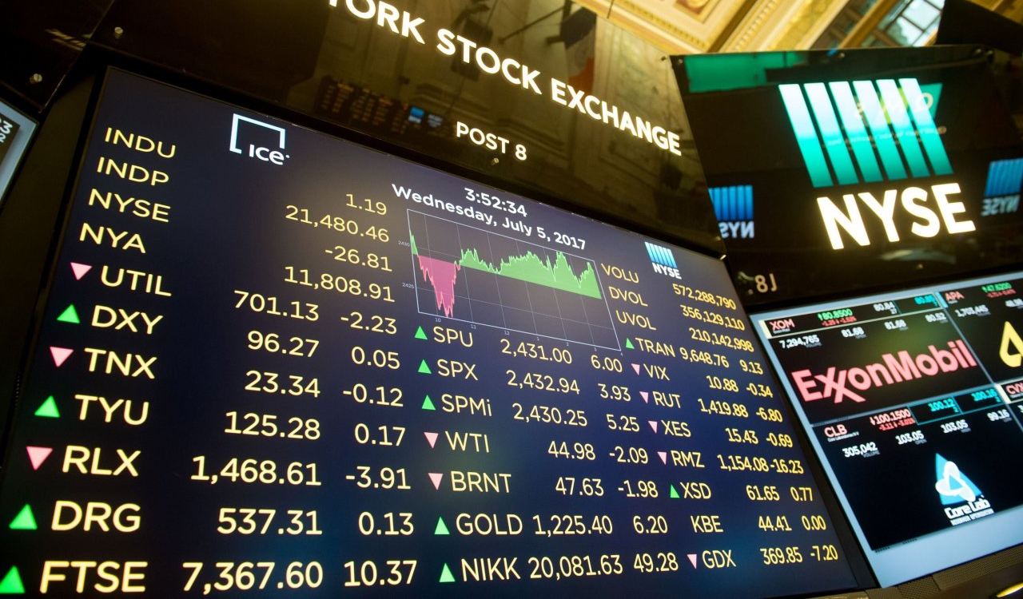
Chasing the Whale Portfolio Optimization Analysis using Whalewisdom Index
Team Members:
Connor Gross
Julas Hollie
Marcus Kim
Aaron Packard

Slide 2
Introduction
Overview: Analyze 13F filings over the past several years, we will build a model based on fund performance and sector weightings to outperform the S&P 500.
Part 1:
Exploring the 13F filings data to find the best-performing funds over the given time period.
Using XXX method to determine the most optimized quarterly weightings for each sector.
Part 2:
Using the optimized weights from Part 1, create a portfolio with 11 index ETFs representing each sector
Compare the results of three portfolios [Portfolio without rebalancing, Portfolio with rebalancing and S&P500]
Build and compare a various machine learning model that forecast the best about our portfolio.
Goals: Based on the analysis, we can build our model portfolio that beats the market return by allocating only 11 index ETFs with the optimized weights
Methodologies: Historical weightings of portfolio by sector from top performing hedge funds were used to find the
optimized weighting of our portfolio.
Conclusion:

Slide 3
About Whale wisdom Index

Slide 4
Part I: Finding the optimized weightings
Notes:
Percentage (cumulative) chart by city – line chart
Top 5
Bottom 5

Slide 5
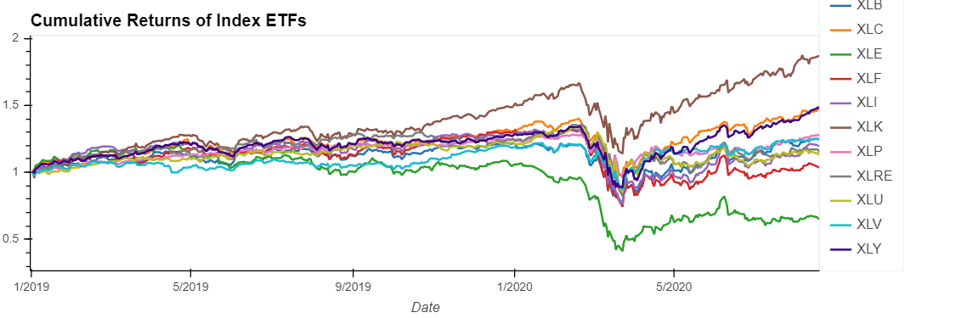
Part 2: Create a portfolio with index ETFs

Slide 6
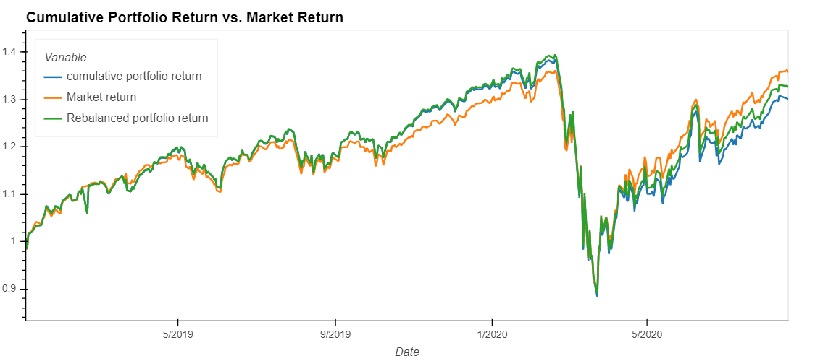
Part 2: Compare the results – Berkshire
Notes:
Line chart by property type + interest rates

Slide 7
Part 2: Compare the results - Optimized
Notes:
Line chart by property type + interest rates

Slide 8
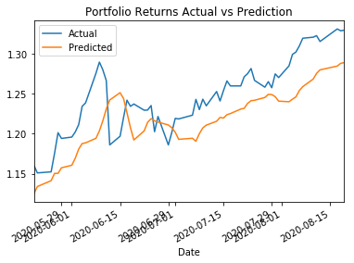
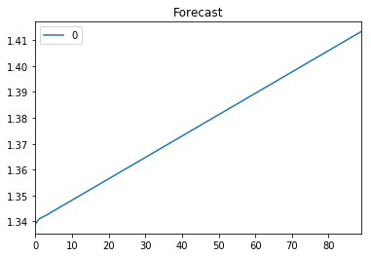
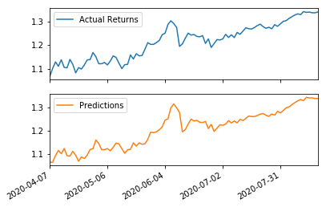
Part 2: Finding the best learning model
8/22/2020
8
Notes:
Property Feature
Affordable, luxury, etc.
Bubble chart real time walkthrough (switch to jupyter)

Slide 9
Summary
Hypothesis
Conclusion
Identify top performing funds
Identify investment sector weightings for top performing funds
Create model to predict sector weightings for maximum annual return
Using sector ETFs combined using suggested sector weightings, compare quarterly and annual returns versus S&P 500
Optimal investment can be made through replicating the sector weightings
Notes:
Property Feature
Affordable, luxury, etc.
Bubble chart real time walkthrough (switch to jupyter)

Slide 10
Appendix
Notes:
Property Feature
Affordable, luxury, etc.
Bubble chart real time walkthrough (switch to jupyter)

Slide 11
Data Preprocessing
Notes:
Property Feature
Affordable, luxury, etc.
Bubble chart real time walkthrough (switch to jupyter)

Slide 12
Questions
Notes:
Property Feature
Affordable, luxury, etc.
Bubble chart real time walkthrough (switch to jupyter)

