Slide 1
Project 3 - NLP Analysis and Stock Data
Alex Waters
Joe Swiderski
Marcus Kim
Mark Foxworth
Zach Cone

Slide 2
Motivation & Summary
The goal of the project was determine if there is any correlation between the text sentiment of a given stock and the stock’s price movement.
The project utilized various text sources such as comment threads from Yahoo Finance and Reddit, Twitter posts, and news articles to examine sentiment utilizing machine learning models.
This sentiment analysis was compared to stock price movements over time, including daily stock price movements and intertrade day movements, to review any possible correlation in the data.
The project focused on information related to Tesla with the intent to apply the same methodology to other stocks assuming any correlation was found.

Slide 3
Questions of the Data
Is there a correlation between stock price movements and sentiment related to comments on yahoo finance, twitter, reddit, and news sources?
Does Elon Musk Twitter comments drive the stock price more than social media?
Can various comments and news articles be used to predict the movements of a stock price?

Slide 4
Python Packages
· Sklearn
· BeautifulSoup
· Selenium
· News API
· NLTK
· Pandas
· Reddit API
· Numpy
· Plotly
· PRAW
· Yahoo Finance (Python)
· TextBlob
· TensorFlow

Slide 5
Analysis Methods
· Visualizations using plots
· Train/Test methods
· Data frames
· Text tokenization
· Loops
· Sentiment Analysis

Slide 6
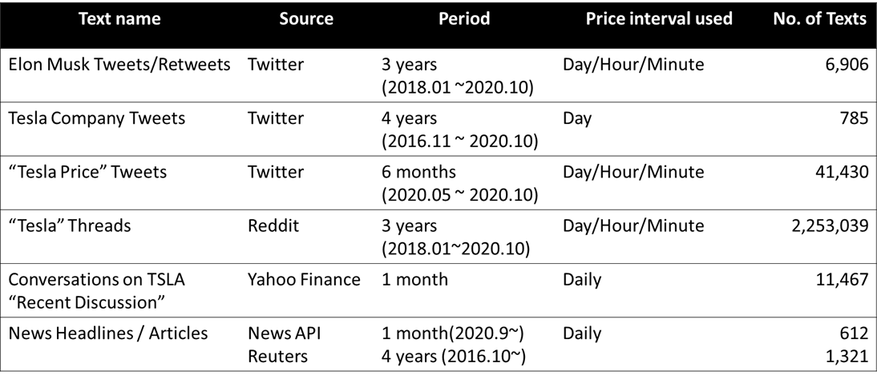
Analysis Methodology - Resources

Slide 7
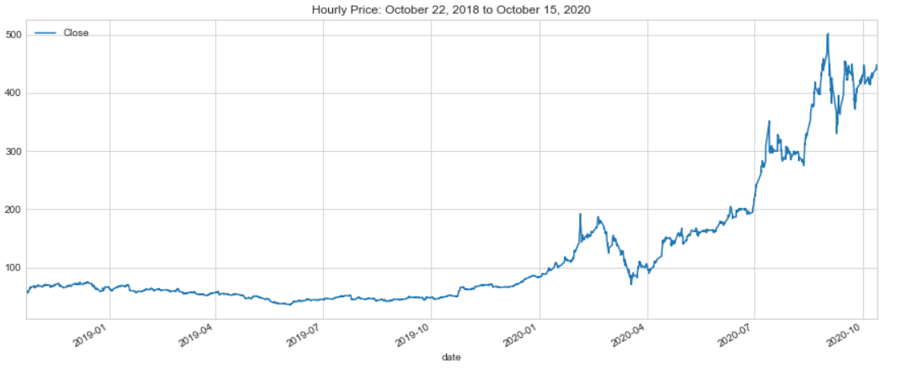
Tesla Trade History: Hourly (2 years)

Slide 8
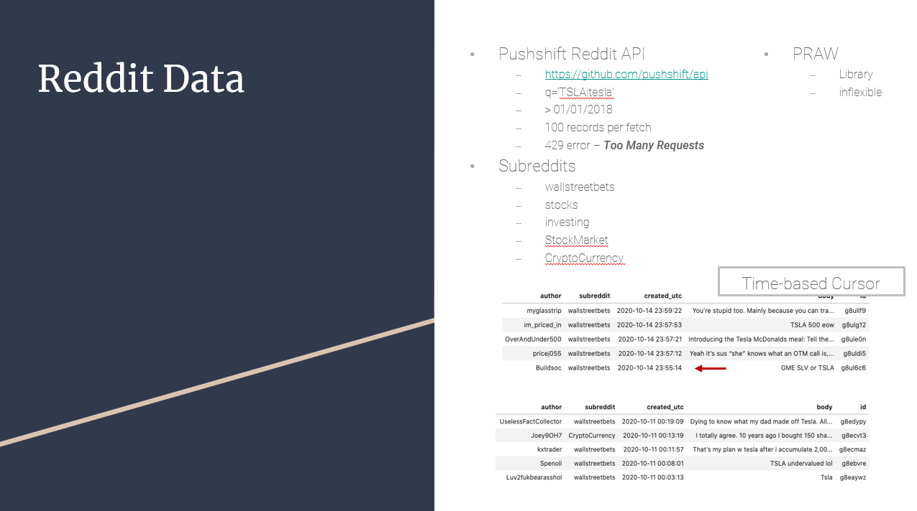
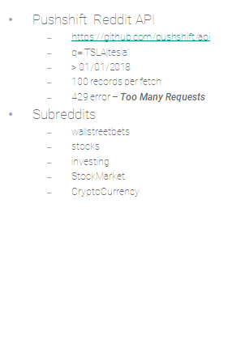



Reddit Data
Pushshift Reddit API
https://github.com/pushshift/api
q=‘TSLA|tesla’
> 01/01/2018
100 records per fetch
429 error – Too Many Requests
Subreddits
wallstreetbets
stocks
⎼investing
⎼StockMarket
⎼CryptoCurrency
PRAW
⎼Library
⎼inflexible

Slide 9
Analysis Method - finding out any correlations
Decide which TSLA Price we use
Daily / Hourly / 15 minutes
Preparing for various Sentiment Score
Subjectivity and Polarity scores from TextBlob
Going straight with Polarity score only
Or tweaking and combining with Subjectivity score by filtering or weighting
Simply taking more objective texts only (i.e. dropping out texts w/ Subjectivity > 0.4)
Creating adj. Polarity score by weighting on subjectivity
If 0 <= Subjectivity score <= 0.2 ⇒ 140% * Polarity score
0.2< Subjectivity score <= 0.4 ⇒ 120% * Polarity score and so on.
Grouping scores by daily/hourly/15 mins by taking mean, sum, count, first and last
Comparing the analysis by market hours
Analyze all texts regardless of on and off market hours or
Analyze only texts posted within market hours

Slide 10
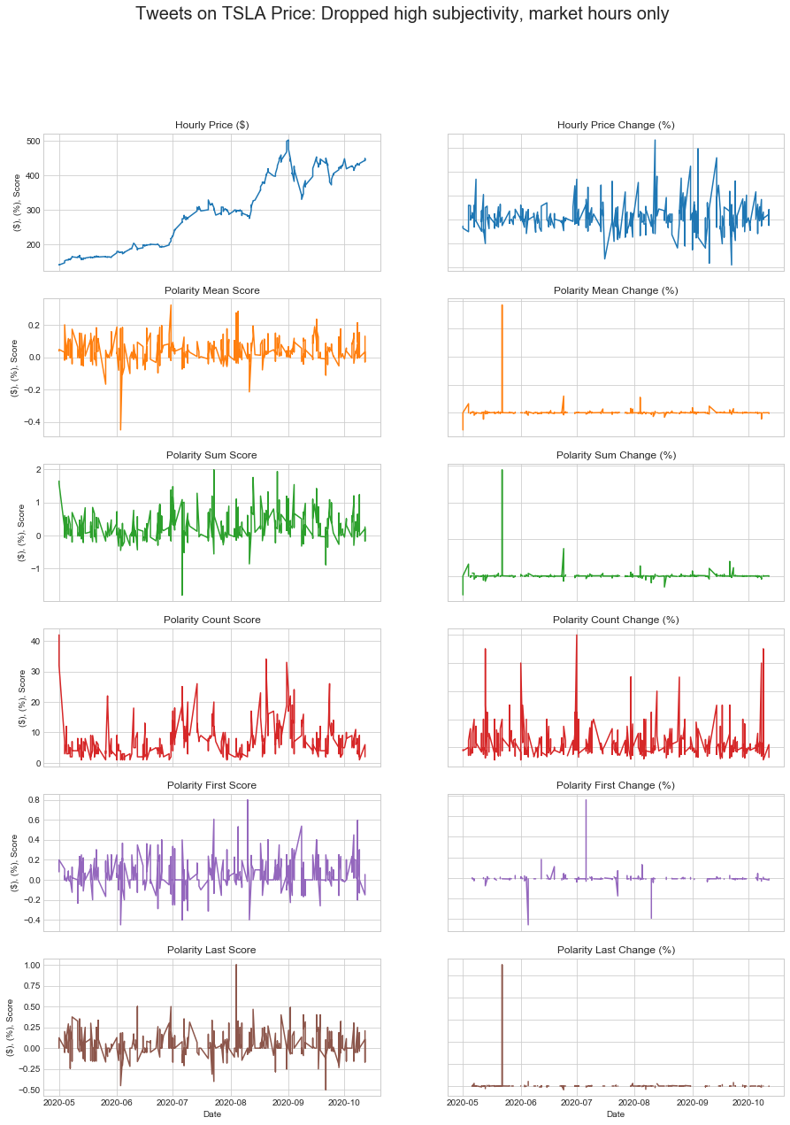
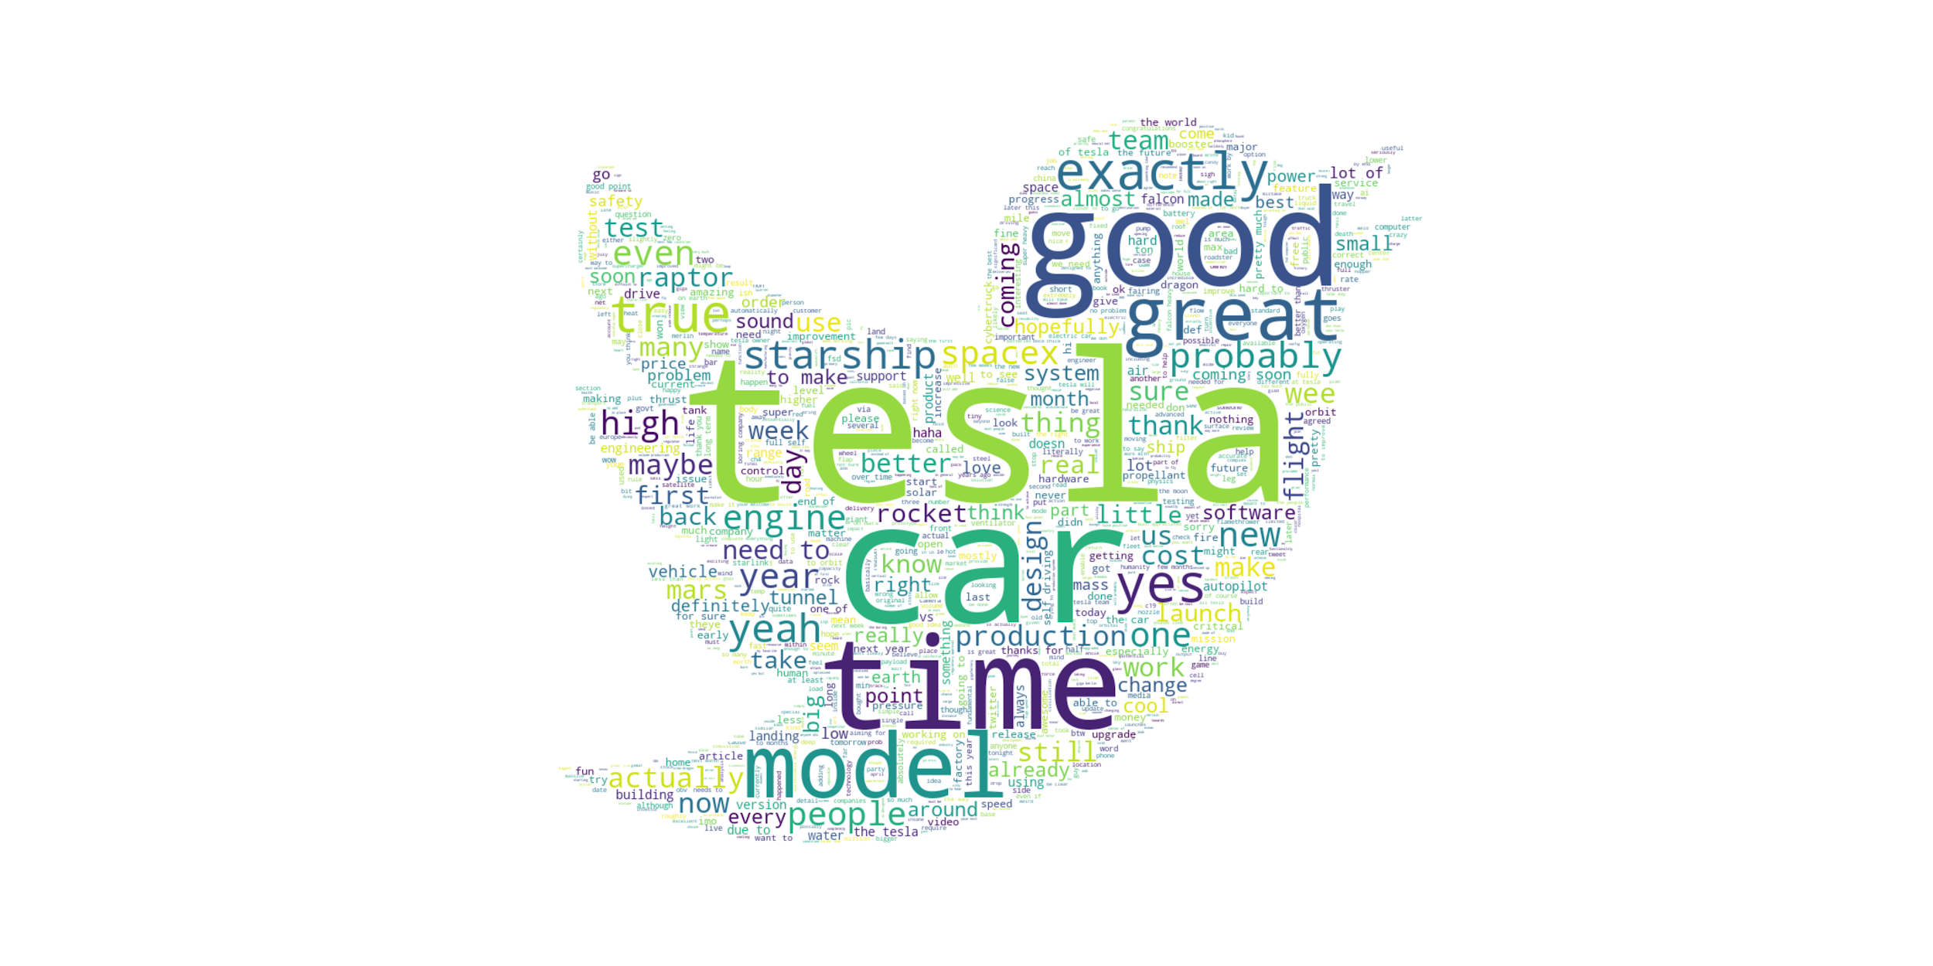
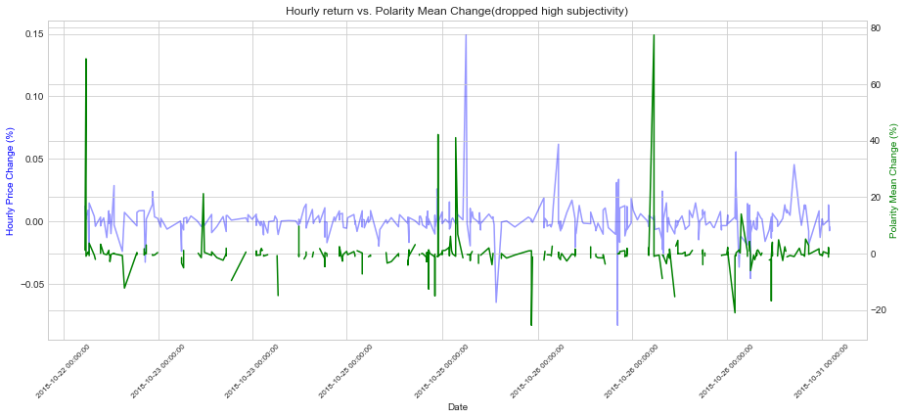
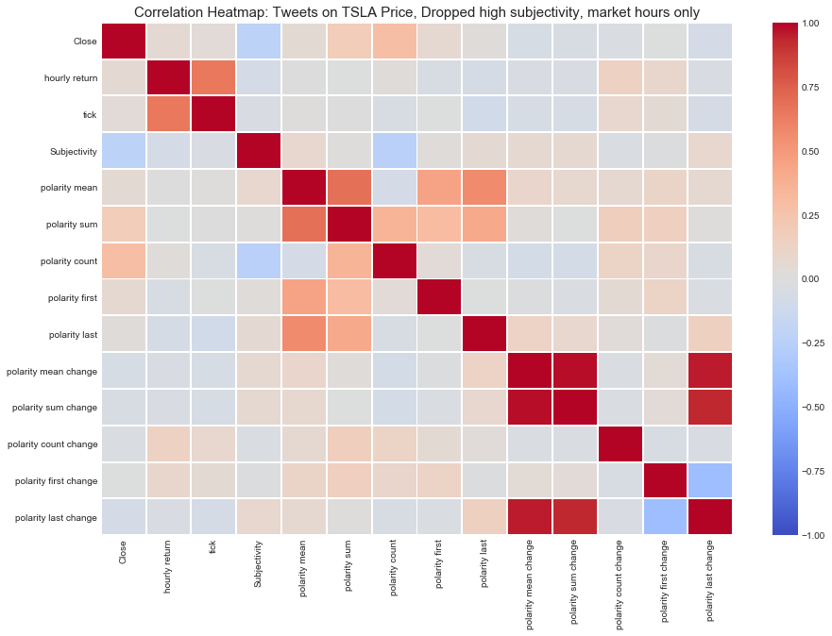
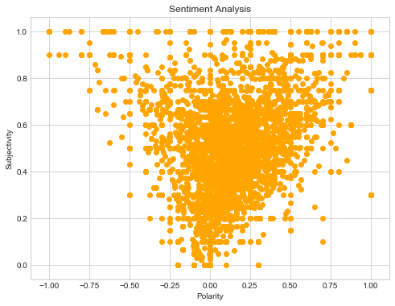
Analysis Method - Cont’d
And we ended up with having these..

Slide 11
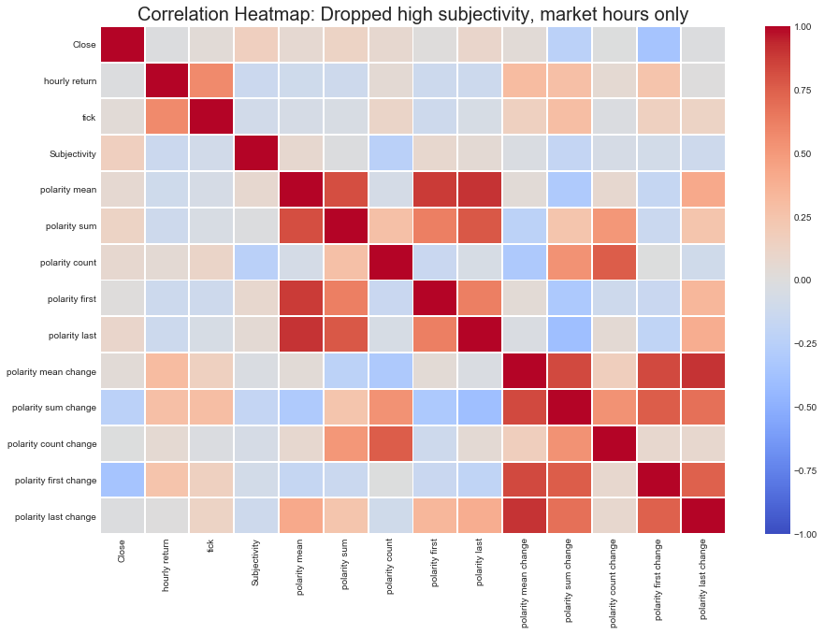
Elon Musk Tweets: Hourly (2 years)
Strongest correlation is between the hourly price return and polarity mean change (corr=0.31).
The assumption is that positive tweets from Elon Musk (CEO) with objective tones (based on more factual information) have the strongest impact on changes in Tesla’s stock price.
Notes:
Elon Musk positive tweets have an impact on the stock price (more polarity based on facts)

Slide 12
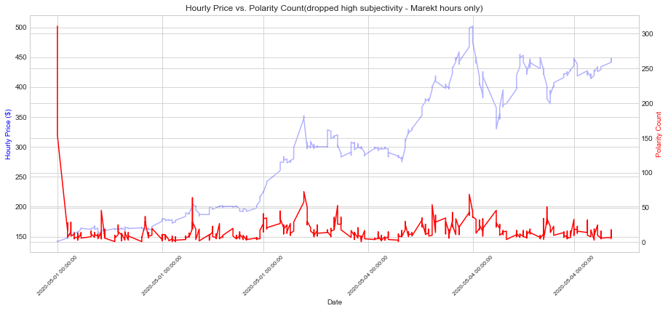
Mass Tweets on Tesla Price: Hourly (6 months)
There was a relatively strong correlation between hourly price change and the number of comments (corr=0.30) for mass tweets on the tesla price.
Comparing this to the Elon Musk tweets, we found that the number of texts counts on TSLA’s hourly price had the strongest correlation.
Notes:
Correlation in the mass tweets is really geared toward the number or count of the total comments.

Slide 13
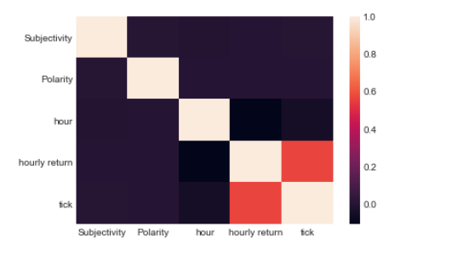
Reddit Analysis
Filtered Reddit data by wallstreetbets subreddit
Added the hourly Tesla stock price infor for the last two years to the dataframe.
Dropped null values and additional columns not needed.
371K rows of data (test and stock movement)
Findings:
No correlation between Polarity, Subjectivity, and hourly returns found in the filtered data frame.

Slide 14
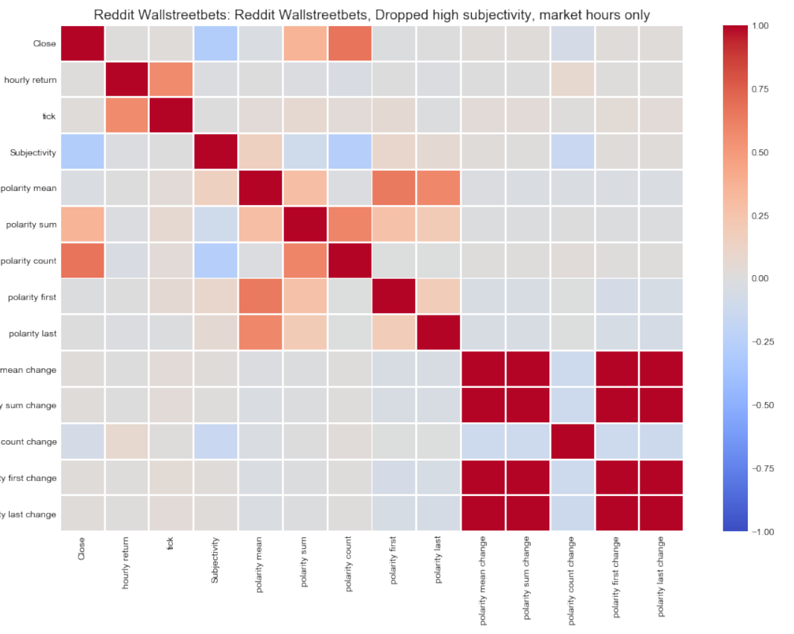
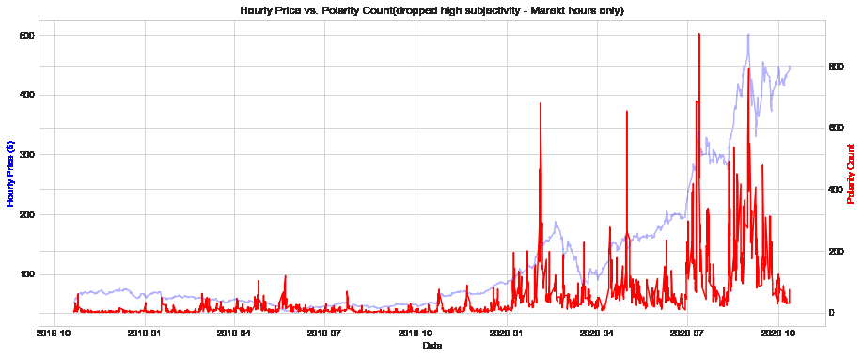

Reddit Analysis (2 years)

Slide 15
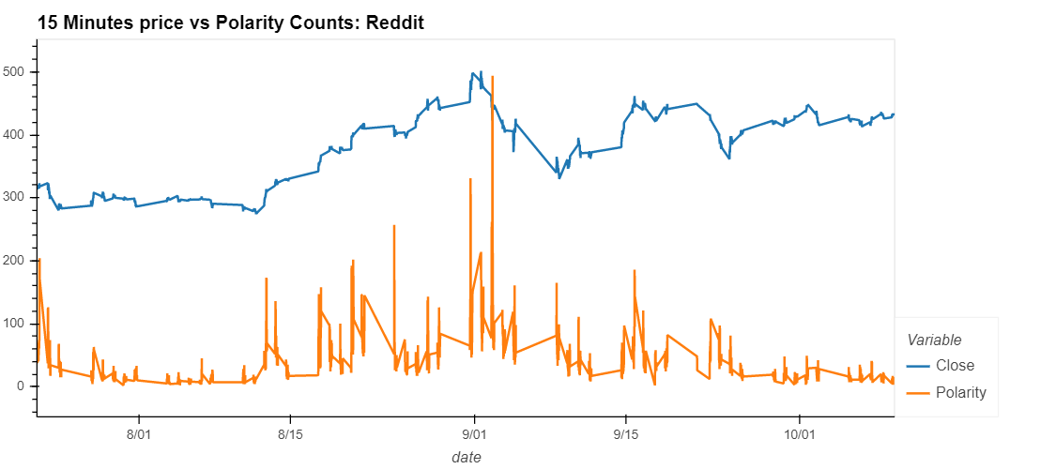
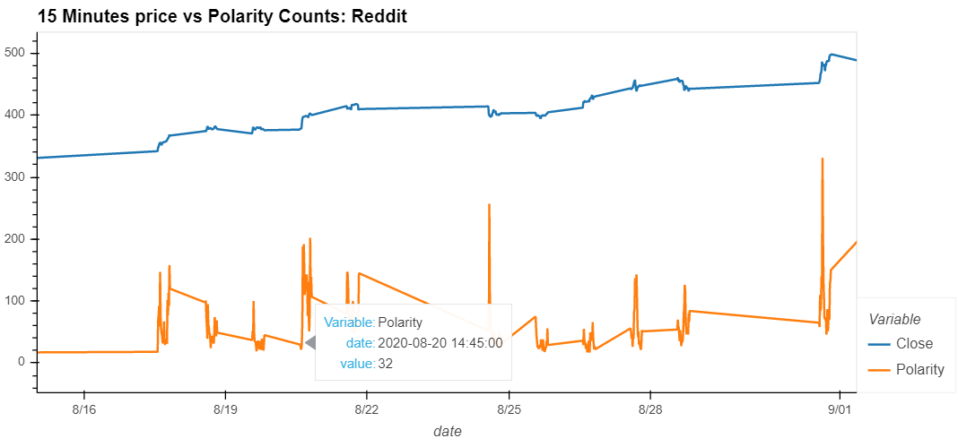
Reddit Analysis (3 Months – by 15 minutes)
Which one comes first?
We need to determine if the stock price is moving twitter/reddit or the other way around

Slide 16

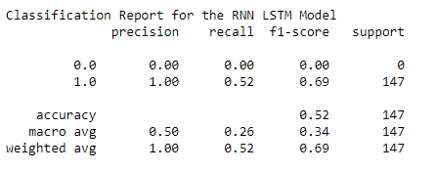
Twitter RNN_LSTM
Conclusion
Took Twitter text data and combined it with the movement, either up or down.
Ran this through an LSTM model to see how accurate it could be at predicting stock movement based on Tweets from Twitter.
Conclusion is the model was only accurate 52% of the time.

Slide 17
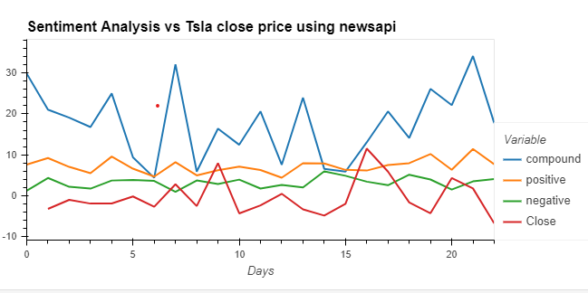
Short Term newsapi vadar
One month of pulled articles from API
Grouped by day and took mean
Dropped neutral scores
Plot against close for trading days
Conclusion: low correlation

Slide 18
Conclusion
TextBlob can be a good tool in terms of having subjectivity scores, comparing to Vader which only gives polarity-oriented ones.
Less subjective texts tend to give more distinguishable results than those not.
Likewise, texts generated around market hours are more distinguishable in finding out correlations than those not.
Positive Elon Musk(CEO) tweets in more objective tones have some impact on price (return).
For mass texts from Twitter or Reddit, show a meaningful correlation with stock price in terms of the number of texts. The more texts, the more price movement observed.
We couldn't find any meaningful correlation from tweets by Tesla Company with stock price. The small number of data might have made it difficult to observe (Tesla company does not tweet often, especially for the last six months)
We might be able to use the sentiment analysis as one of indicators in building an algorithmic trading.

Slide 19
Wrap up issues &
Outstanding questions
Review and testing of the “aftermarket” text data may provide additional lead indicators for next days opening.
More time needed to clean the reddit data. Reddit contained many posts that were noise and junk.
Possible opportunity to examine how long the stock price holds vs time.

